Slide 1


Welcome

Slide 2
Scripture Reading
Matthew 18:15-35
Peter Learns Forgiveness

Slide 3
Peter Learns Forgiveness
Matthew 18:21-35
(21) Peter’s straightforward question - How often?
(15-17) Path of repentance & forgiveness.
(18) Permanence of forgiveness described.
(19,20) God’s presence when seeking reconciliation.
(21) Peter’s concerns about granting forgiveness.
(22) Jesus’ shocking answer - Don’t keep track!
(23-35) Lengthy illustration - Here are the options.

Slide 4
(23) Jesus describes Kingdom versus revenge “accounting”.
Sin creates moral and relational debt.
(you “owe” me an apology, you’ll “pay” for this, etc.)
Forgiveness releases or cancels that debt.
Kingdom forgiveness shows compassion (27,33).
Revenge accounting shows anger (28) & hypocrisy (29).
Depending on which we practice, we will experience either pity (33) or punishment (34).
Nothing truly changes until the heart changes (35).

Slide 5
Kingdom forgiveness means …
- though I was personally wronged, I choose to release my offender from the relational “debt” he/she “owes” me, and to no longer hold that debt against him/her.
- without denying the past, I choose (with God’s help) to expect and practice a different and better future.
- I chooses not to maliciously bring up forgiven debts …
in your face; behind your back; over & over in my mind.
- I choose to do for others what God has done for me.
(like Jesus being crucified; like Stephen being stoned)

Slide 6
Eph 4:31,32 Let all bitterness, wrath, anger, clamor, and evil speaking be put away from you, with all malice. And be kind to one another, tenderhearted, forgiving one another, even as God in Christ forgave you.

Slide 7
(30,31) Unforgiveness ruins our reputation.
(32,33) Unforgiveness blinds us to our blessings.
(34) Unforgiveness results in torture.
Tortured Mind — endless rehearsing, anxiety.
Tortured Spirit — hardened heart, root of bitterness, hatred, vengeance.
Tortured Relationships —mistrust, conflict, gossip, division, distance.
Tortured Body — stress, physical decline.

Slide 8
Torture Example Experiences
Mental Cain Resentment, anger, identity shaped by offense.
Spiritual King Saul Hardened heart, consumed with jealousy & revenge.
Relational Absalom Bitterness that destroys friendships and family ties.
Physical Judas Refusal to seek forgiveness becomes destructive.
Eternal? Lord’s Prayer

Slide 9
Matt 6:9 Our Father in heaven …
12 Forgive us our debts, as we forgive our debtors.
14 For if you forgive men their trespasses, your heavenly Father will also forgive you.
15 But if you do not forgive men their trespasses, neither will your Father forgive your trespasses.

Slide 10
Matt 18:23-35 - A description of our salvation
- Master’s accounting = God’s conviction.
- Servant’s position = My unpayable debt.
- Servant’s calculation = I can pay this off myself.
- Master’s grace = God’s willingness to absorb the debt.
- Servant’s response = my graceless, unforgiving life.
- Master’s reaction = labels such as wicked; loveless; hypocritical; choosing a life of tortures now, and if there is no heart change, for eternity.

Slide 11
Peter Learns Forgiveness
Matthew 18
(21) Peter’s straightforward question - How often?
(22) Jesus’ shocking answer - Don’t keep track!
(23-35) Lengthy illustration - Refusing to forgive doesn’t end well.

Slide 12
Are you an unforgiving person?
Have days, weeks, months, even years passed, and you’re still making someone “pay”?
Could an unwillingness to forgive say more about the condition of your heart than about the person you refuse to forgive?
Do you need to repent and ask God to help you grow in the grace of forgiveness?

Slide 13
Eph 4:31,32 Let all bitterness, wrath, anger, clamor, and evil speaking be put away from you, with all malice. And be kind to one another, tenderhearted, forgiving one another, even as God in Christ forgave you.

Slide 14
God graciously removes our sin & guilt from …
Reach - as far as East is from West (Ps 103:12)
Sight - behind His back (Isa 38:17)
Recovery - cast in the deepest sea (Micah 7:19)
Memory - He remembers it no more (Jer 31:34)
Existence - blotted out (Isaiah 44:22)
Further Judgement - nailed to the cross (Col 2:14)

Slide 15
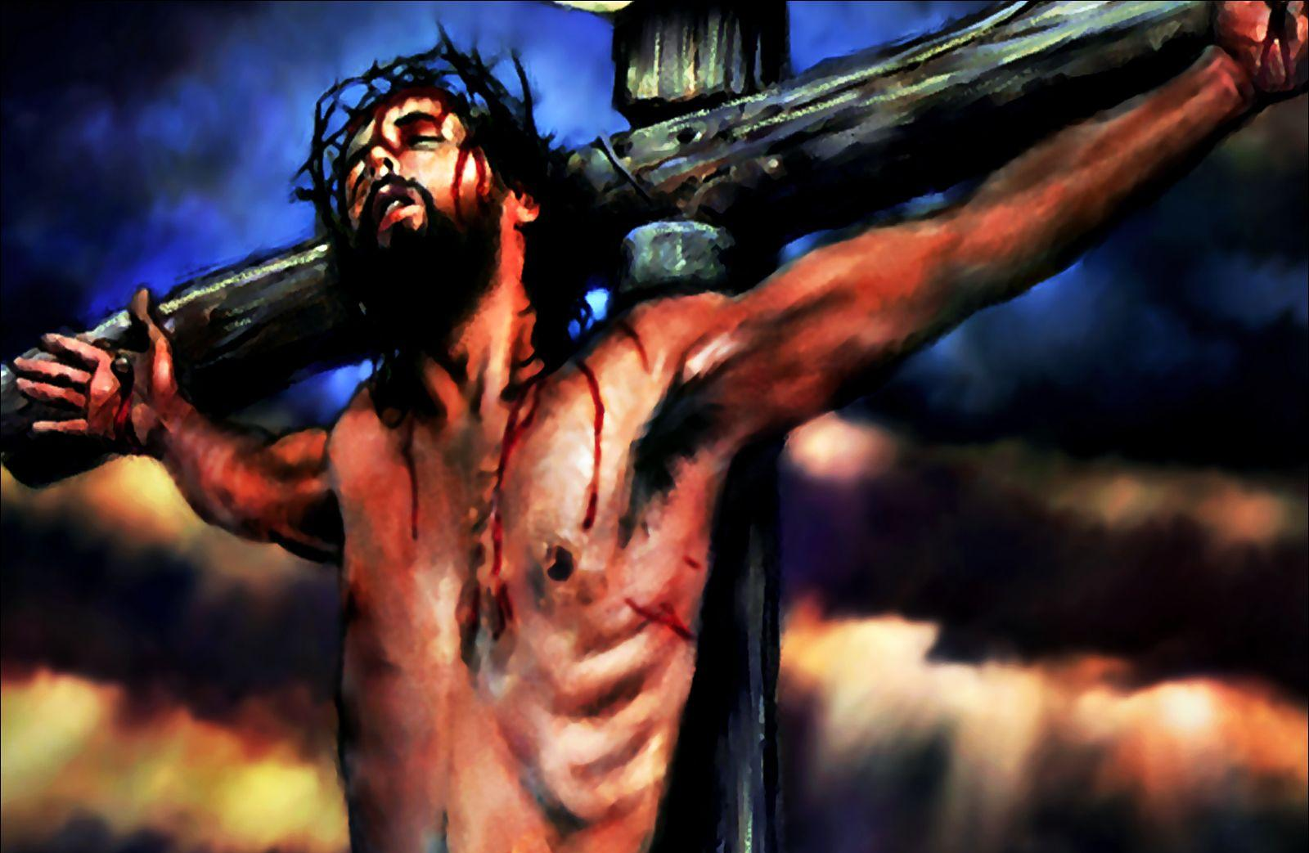
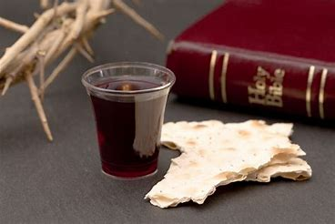

My sin, oh the bliss of this glorious thought,
my sin, not in part but the whole,
was nailed to the cross, and I bear it no more!
Praise the Lord, praise the Lord O my soul!!

Slide 16
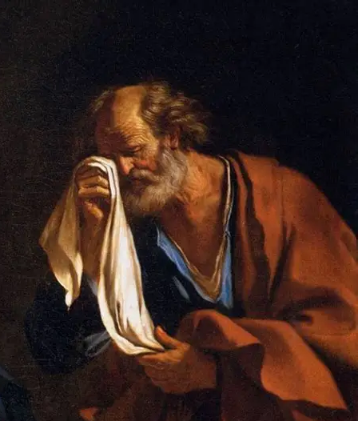
Peter - His Life and Letters
Matthew 18
Peter
LEARNS
Forgiveness
John 18,21
Peter
LIVES
Forgiveness

