Slide 1
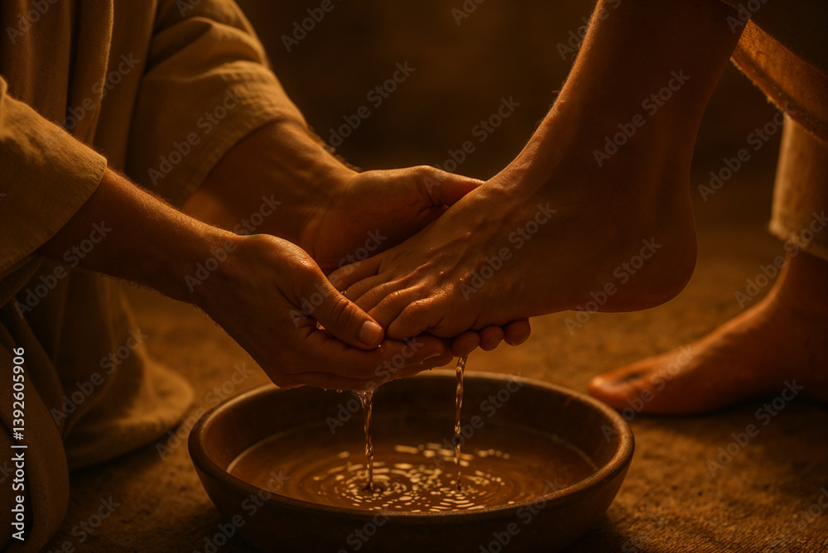

Welcome
Love one another John 13:34

Slide 2
Scripture Reading
John 13:1-20
Peter Learns About Serving

Slide 3
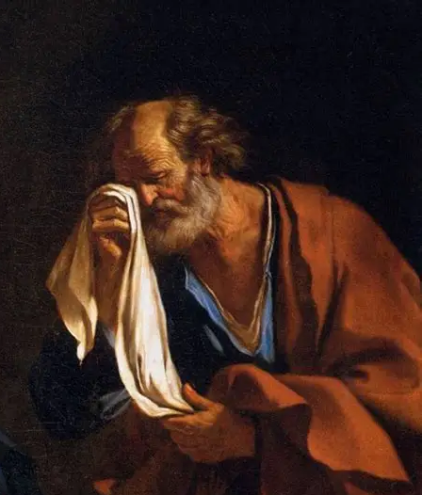
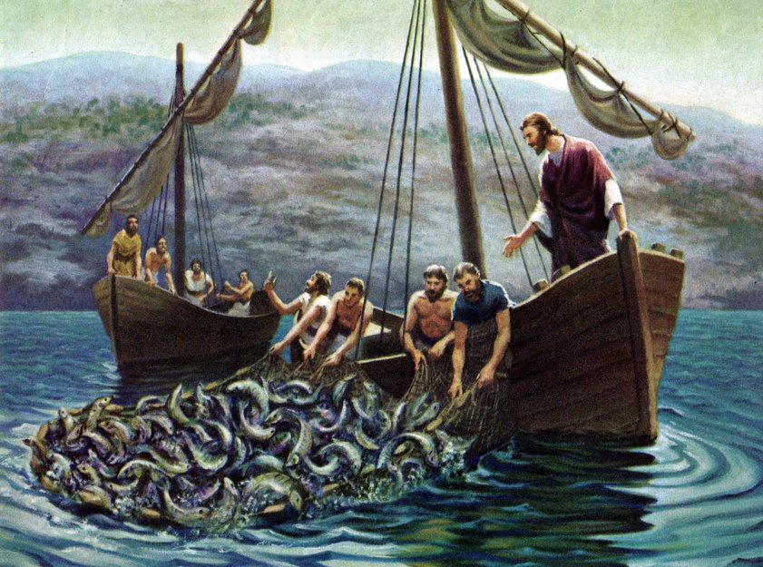
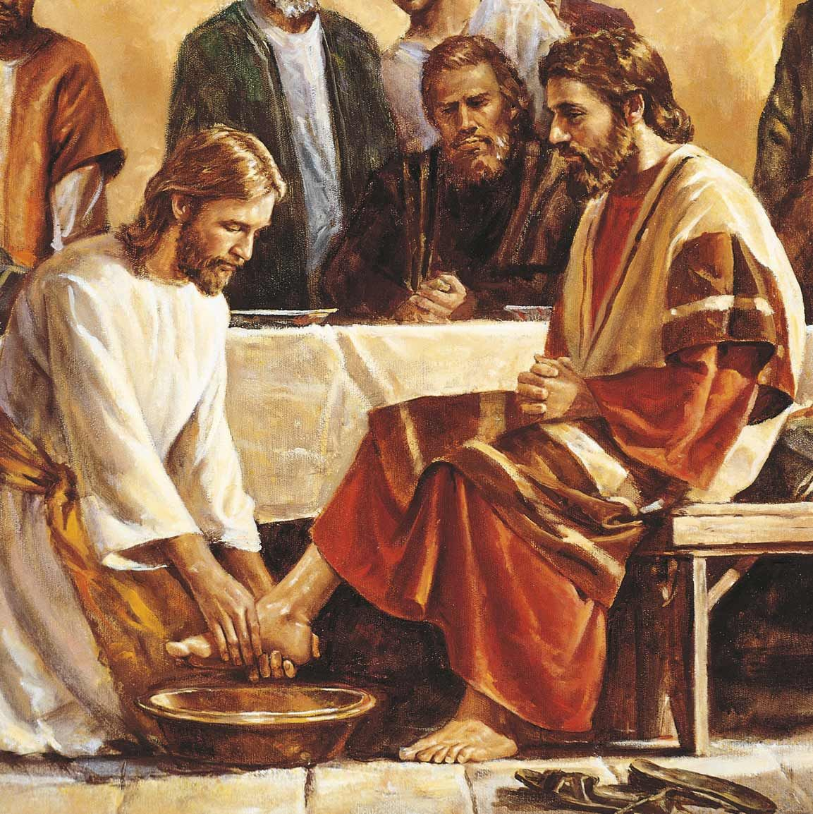
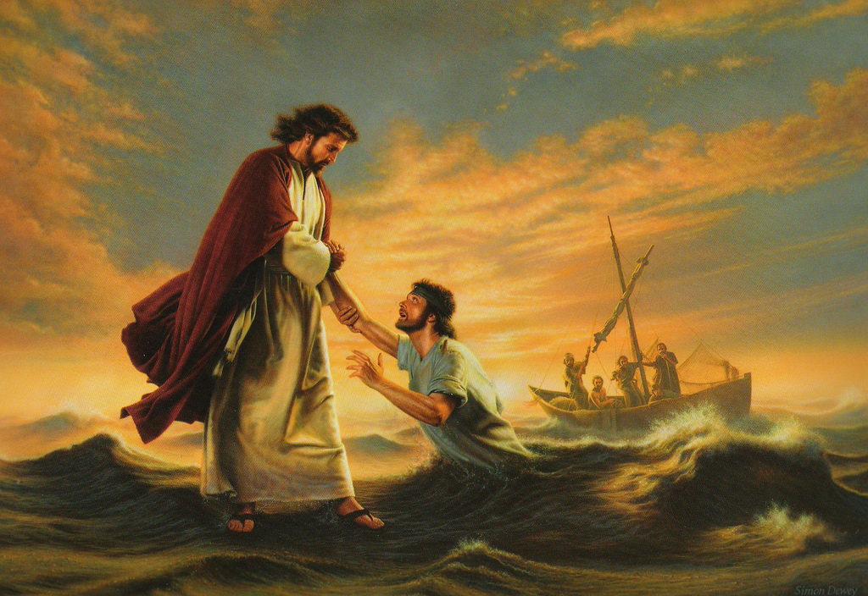
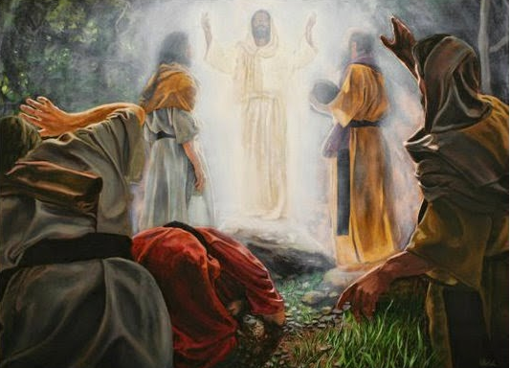
Peter - His Life and Letters
John 13
Learning
about Serving

Slide 4
John 13:1 Now before the Feast of the Passover, when Jesus knew that His hour had come …
Sunday (Palm) - Triumphal Entry into Jerusalem
Monday - Temple Cleansing
Tuesday - Teaching in the Temple & on Mt of Olives
Wednesday - Quiet Day, Judas arranges betrayal
Thursday - Last Supper & Gethsemane
Friday (Good) - Trials, Crucifixion & Burial
Saturday - Tomb Sealed & Guarded
Sunday (Easter) - Resurrection
(John 13)

Slide 5
Jesus models Loving SERVICE
Greatest love (John 15:12,13) - crucifixion
Daily love (John 13:1) - washing feet
needed (dirty/damp roads; smelly/sandaled feet).
lowly (usually performed by servants).
undeserved (disciples arguing Lk 22:24; betraying).
calculated (3-5)
example (stooping & washing)
  = sign of what Jesus came to do
  and the heart behind it all.
  ≠ to baptism & communion.

Slide 6
Peter wrestles with Jesus’ Loving SERVICE
(6) Peter - Master, are you going to wash my feet?
(7) Jesus - Yes. You don’t understand now, but you will.
(8) P - Never! This task is inappropriate for you!
Luke 5:8 Depart from me; I’m a sinful man.
Luke 9:33 Let us make three tents.
Matt 16:22 This will never happen to You.
John 13:8 You will never wash my feet.
John 13:37 I will die before I deny You.
John 18:10 I won’t let them arrest You.

Slide 7
Peter wrestles with Jesus’ Loving SERVICE
(6) Peter - Master, are you going to wash my feet?
(7) Jesus - Yes. You don’t understand now, but you will.
(8) P - Never! This task is inappropriate for you!
(8) J - But only people who accept my cleansing work belong with me.
(9) P - Then Master, bathe all of me. I want to belong!
(10) J - You do belong, Peter. You are already bathed and pure, though your feet still need washing as you go through this world.
But not everyone in this room is pure.

Slide 8
Jesus explains His Loving SERVICE
(12-14) If I, your master and teacher, have stooped to serve you, then follow My example.
(15) This foot washing, and everything it represents, is the example I want you to imitate.
(16,17) Servants are not greater than masters, or messengers than senders. You will be blessed if you know and do what I’ve shown you.
(18,19) Be forewarned by scripture and by Me of one among you who opposes Me. Later this will help you trust that I am who I claim to be.

Slide 9
Judas betrays and rejects Jesus
(Jn 6:70,71) Judas is a devil (false accuser).
(Jn 12:6) Judas is a thief.
(Jn 13:2) Judas’ heart is infiltrated by the devil.
(10,11) Judas has never been “cleaned”.
(17,18) But Judas has been chosen (as an apostle).
(21,22) Judas has deceived the other 11 disciples.
(23-25) Peter initiates a discovery plan.
(26-30) Judas chooses to betray Jesus & obey Satan.
Light vs darkness; Life vs death; Heaven vs hell
(Jn 17:12) Judas is the son of perdition (destruction).

Slide 10
Lessons from this Upper Room
1 - Satan is at work in even the best circles.
(John 13:2,27) Influence in & over Judas.
(36-38) Influence on Peter.
2 - Jesus knows what is really happening.
(1) His time on earth is short.
(3) He has been “handed” everything He needs.
(11) He is about to be betrayed.
(17,18) Even Judas is part of His chosen plan.
(27,28) He will soon be bruised, but Satan crushed.

Slide 11
Lessons from this Upper Room
3 - Judas …
wasted 3 years of watching and hearing Jesus.
could not escape the sinful grip of greed.
embodies the results of deception & betrayal.
was loved by Jesus to the end (Mt 26:50 friend).
4 - Peter learns ...
godly authority is used for serving (Jn 13:3,4).
sin intends ruin; God turns it for redemption (18-20).
love is the badge of true discipleship (34,35).

Slide 12
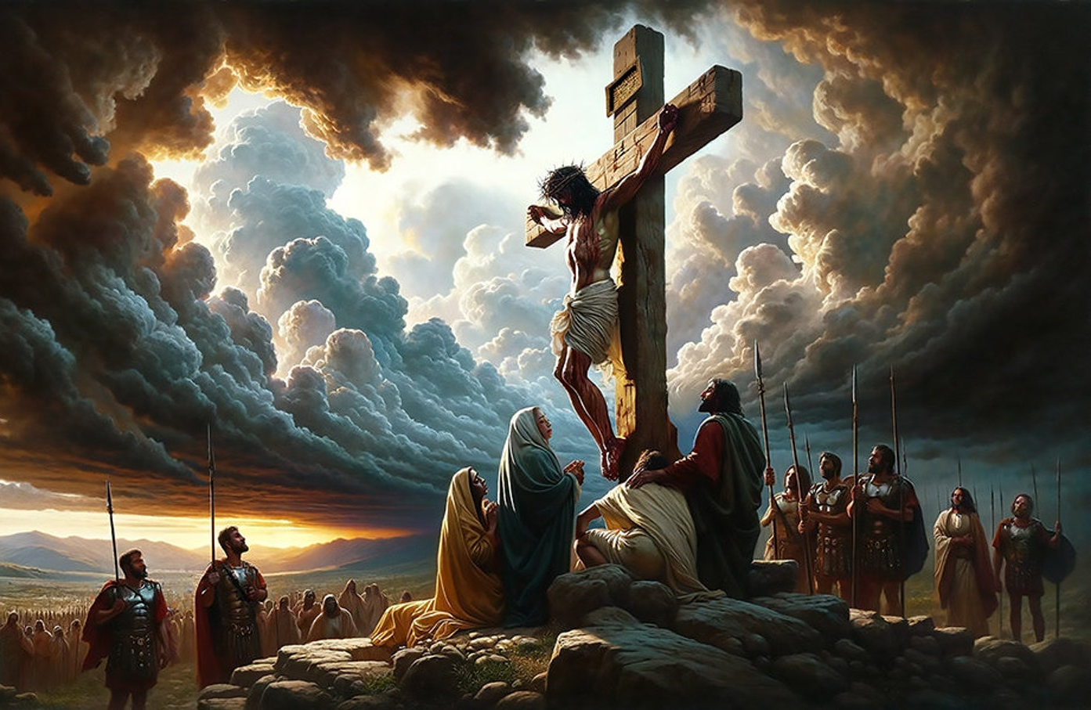
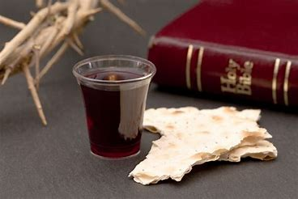
John 13:34,35 A new commandment I give to you, that you love one another; as I have loved you, that you also love one another. By this all will know that you are My disciples, if you have love for one another.

Slide 13
How beautiful the hands that served
the wine and the bread
and the sons of the earth.
How beautiful the feet that walked
the long dusty roads
and the hill to the cross.
How beautiful is the body of Christ.

Slide 14
How beautiful the heart that bled,
that took all my sin
and bore it instead.
How beautiful the tender eyes
that choose to forgive
and never despise.
How beautiful is the body of Christ.

Slide 15
And as He laid down His life,
we offer this sacrifice;
That we will live just as he died,
willing to pay the price
willing to pay the price.

Slide 16
How beautiful the radiant bride
who waits for her Groom
with His light in her eyes.
How beautiful when humble hearts give,
the fruit of pure lives
so that others may live.
How beautiful is the body of Christ.

