Slide 1
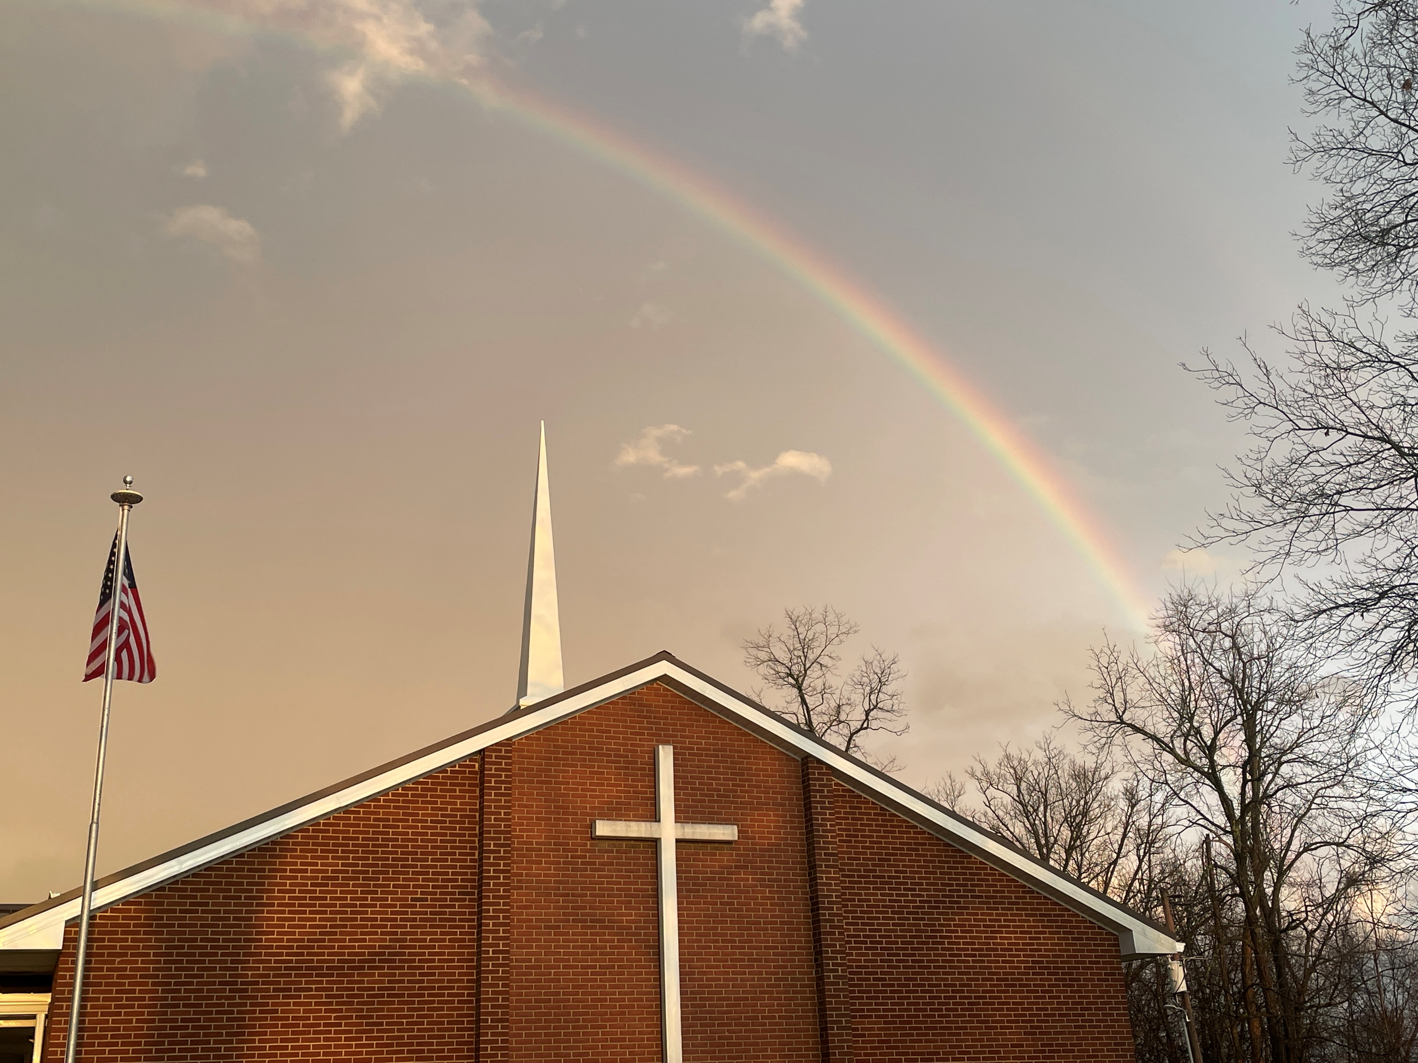

Welcome
In God we trust

Slide 2
Scripture Reading
Mark 10:17-31
Peter Learns About Sacrifice

Slide 3
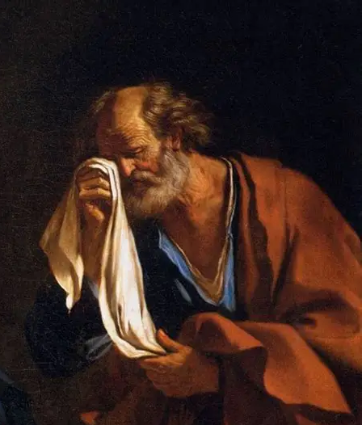
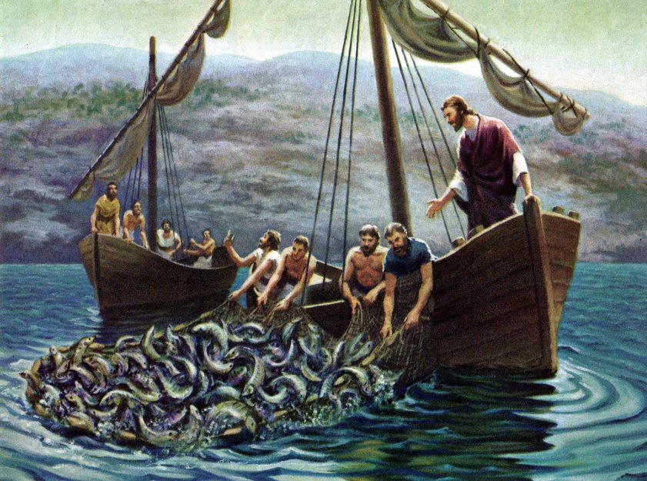
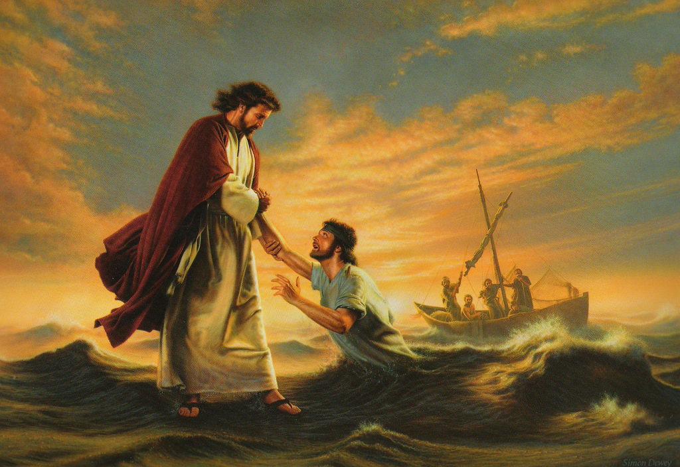
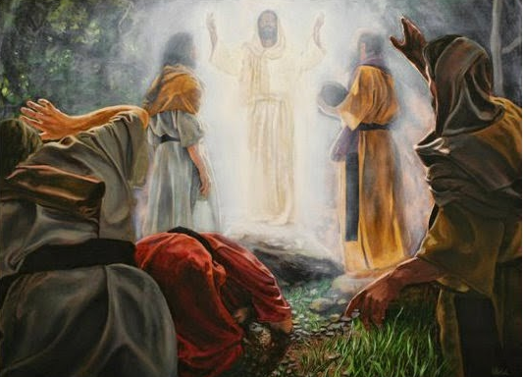
Peter - His Life and Letters
Mark 10
Learning
about Sacrifice

Slide 4
Jesus’ Repeated Message About Himself
Matt 16:21 Jesus began to show to His disciples that He must go to Jerusalem, suffer many things from the elders and chief priests and scribes, be killed, and be raised the third day.
Luke 9:30,31 Behold, two men talked with Jesus, who were Moses and Elijah, who appeared in glory and spoke of His decease which He was about to accomplish at Jerusalem.

Slide 5
Jesus’ Repeated Message About His Followers
Matt 10:38 He who does not take his cross and follow after Me is not worthy of Me.
Matt 16:24 Jesus said to His disciples, "If anyone desires to come after Me, let him deny himself, and take up his cross, and follow Me.
Mark 10:17 As Jesus was going out on the road, one came running, knelt before Him, and asked Him, "Good Teacher, what shall I do that I may inherit eternal life?"

Slide 6
Mark 10:17-31
(17) Account of a real person, not a parable.
- urgent, respectful, rich (22), young (Matt), ruler (Luke).
- knows he is missing something - eternal life.
(18,19) Given the “Goodness” test.
- The Gospel isn’t really good news until we wrestle with the bad news - none good but God.
- If the Law doesn’t drive us to Christ, it will drive us to hell because of our own spiritual pride.

Slide 7
(20) Man’s error - Faith in his own long-term goodness.
- adultery exists in the heart as lust (Matt 5:27,28).
- murder exists in the heart as anger (Matt 5:21,22).
(21) Jesus’ compassion, evaluation, and invitation.
(22) Man’s choice - Pride & possessions over God & eternal life.
(Mark 8:34-37).
(23-25) Jesus’ astonishing statements …
- having/trusting riches makes entering God’s Kingdom hard.
- What seems physically impossible is easier.

Slide 8
Why is it hard for rich people to be saved?
- They have a false sense of security (I Tim 6:17).
- They are strongly attached to this world (Mt 6:21).
- They enjoy God’s gifts, but miss/neglect Him (Lk 12:19-21).
(26) Disciple’s astonished question - Is there any hope?
(27) Jesus’ unlimited assurance - God does the impossible!
Rom 8:3 - Men can’t keep the Law, but Jesus did.
Heb 10:4 - Animal sacrifices can’t remove sin, but Jesus did.
Mk 10:22 - Men won’t leave riches, but Jesus did.

Slide 9
Mark 10:28 Peter began to say to Him, "See, we have left all (taken up our cross) and followed You."
Left economic security (jobs, tools, income).
Left domestic stability (home, meals, routines).
Left family expectations (obligations, honor).
Left geographic roots (village life).
Left social standing (community networks).
Left religious rhythms (synagogue life).
Left personal freedoms (control of their future).

Slide 10
Mark 10:29 So Jesus answered, "Assuredly, there is no one who has left house or brothers or sisters or father or mother or wife or children or lands, for My sake and the gospel's,
30 who shall not receive a hundredfold now in this time—houses and brothers and sisters and mothers and children and lands, with persecutions—and in the age to come, eternal life.

Slide 11
Peter’s Mark 10 Life appears in Peter’s 2 Letters
2 Pet 2:1-3,14; 3:10 - Earthly treasures can blind & bind.
2 Pet 3:13; 1 Pet 1:3,4 - Eternal expectations are real.
I Pet 5:1-4 - God addresses questions/doubts lovingly.
1:22; 2:9,17 - God provides new deep relationships.
1:6-8 - God sees & rewards sacrifices.
grievous trials tempered by great rejoicing.
perishing gold exchanged for genuine confidence.
fiery tests giving way to praise, honor, and glory.

Slide 12
Why me? Why my Cross?
When the Good Shepherd moves His flock, He often “grabs” one sheep, and then others follow.
- In your flesh, you don’t volunteer for this path, but by God’s sovereignty you are chosen, and by God’s grace, you will be sustained (Ps 23:3).
- A lonely road doesn’t mean you are alone (Ps 23:4).
- You may not be able to explain the sacrificial path until later (Rom 8:28,29; II Cor 1:3-5).

Slide 13
Mark 10:31 Many who are first (rich, young, rulers) will be last, and the last (Peter & sacrificing disciples) first.
32 Now they were on the road, going to Jerusalem, and Jesus was going before them; and they were amazed. And as they followed, they were afraid. Then He took the twelve aside again (third time) and began to tell them the things that would happen to Him:

Slide 14
Mark 10:33 "Behold, we are going up to (where) Jerusalem, and the Son of Man will be betrayed to (who) the chief priests and scribes; and they will (what) condemn Him to death and deliver Him to the Gentiles;
34 and (how) they will mock Him, and scourge Him, and spit on Him, and kill Him. And (when) the third day He will (what) rise again (WOW!!)."
21 Jesus loved him and said, “You will have treasure in heaven. Come, take up the cross, follow Me."

