Slide 1
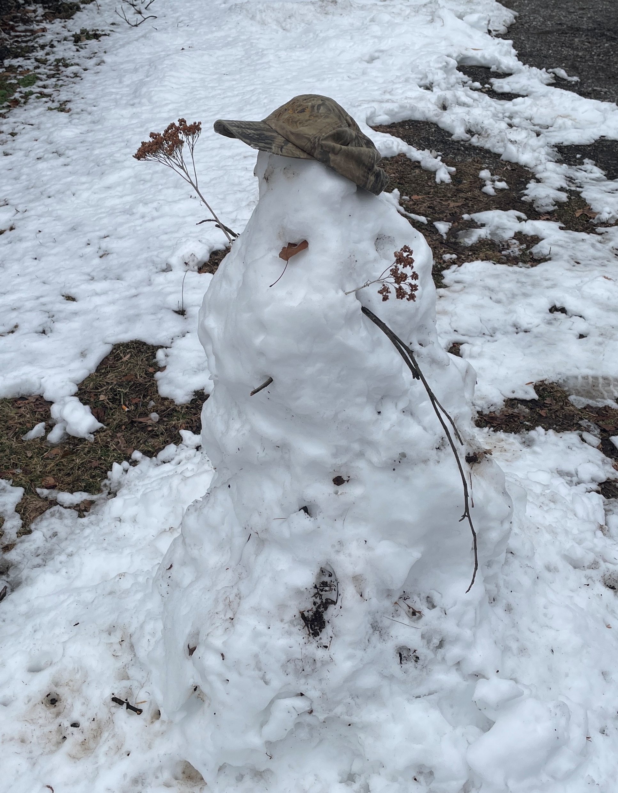

W
e
l
c
o
m
e
Fearfully and
wonderfully made.
Psalm 139:14

Slide 2
Scripture Reading
Matthew 18:1-14
Jesus and Children

Slide 3
Exploring the HEART of GBC
Grace - God’s Favor - Undeserved & Unearned
Bible - God’s Word - Inspired, Inerrant, Sufficient
Chapel - God’s People - Redeemed, Gathered
Gospel - God’s Salvation - Provided, Powerful, Proclaimed
Romans 1:15,16 I am ready to preach the gospel. I am not ashamed of the gospel of Christ, for it is the power of God to salvation for everyone who believes, for the Jew first and also for the Greek.

Slide 4
Romans 10:13 For whoever calls on the name of the Lord will be saved.
14 But how will they call on Him in whom they have not believed? And how will they believe in Him of whom they have not heard? And how will they hear without a preacher?
15 And how will they preach unless they are sent? As it is written: “How beautiful are the feet of those who preach the gospel of peace, who bring glad tidings of good things!"

Slide 5
Missions and Prayer ~ Missions and Giving
Missions and CHILDREN
Satan’s schemes involve children.
Eph 6:11 Put on the whole armor of God, that you may be able to stand against the wiles (schemes, methods) of the devil.
Cain & Able - Genesis 4:6-8
Moses - Exodus 1:15,16
Jesus - Matthew 2:16
Son - Mark 9:20-22

Slide 6
Missions and CHILDREN
➢ Satan’s schemes.
Society’s attitudes about children.
bothersome - Mark 10:13,14
despised - I Timothy 4:12
expendable, non-existent - II Timothy 3:1-3

Slide 7
Missions and CHILDREN
➢ Satan’s schemes.
➢ Society’s attitudes.
Savior’s heart for children.
Matthew 18:1-14
Humility as a little child = greatness (4).
Causing a young believer to sin = deadly (6).
Children have heaven’s care & full attention (10).
The Great Shepherd joyfully rescues even one (13).

Slide 8
Missions and CHILDREN
➢ Satan’s schemes.
➢ Society’s attitudes.
Savior’s heart for children.
Matthew 18:1-14
II Timothy 3:15 From a child you (Timothy) have known the holy scriptures, which are able to make you wise unto salvation through faith which is in Christ Jesus.
(Wordless Book; A-B-C-D; Bridge; NKJV/NLT)

Slide 9
Missions and CHILDREN
➢ Satan’s schemes.
➢ Society’s attitudes.
➢ Savior’s heart.
GBC treasures children.
Prayers & Budget - CAPC; CEF; ACCA; GO;
Property & People (10+)
CLO; Children/Youth SS; Youth Group; VBS

Slide 10
Matt 18:10 Take heed that you do not despise one of these little ones, for in heaven their angels always see the face of My Father who is in heaven.
11 For the Son of Man has come to save that which was lost.
14 Even so it is not the will of your Father who is in heaven that one of these little ones should perish.

