Slide 1
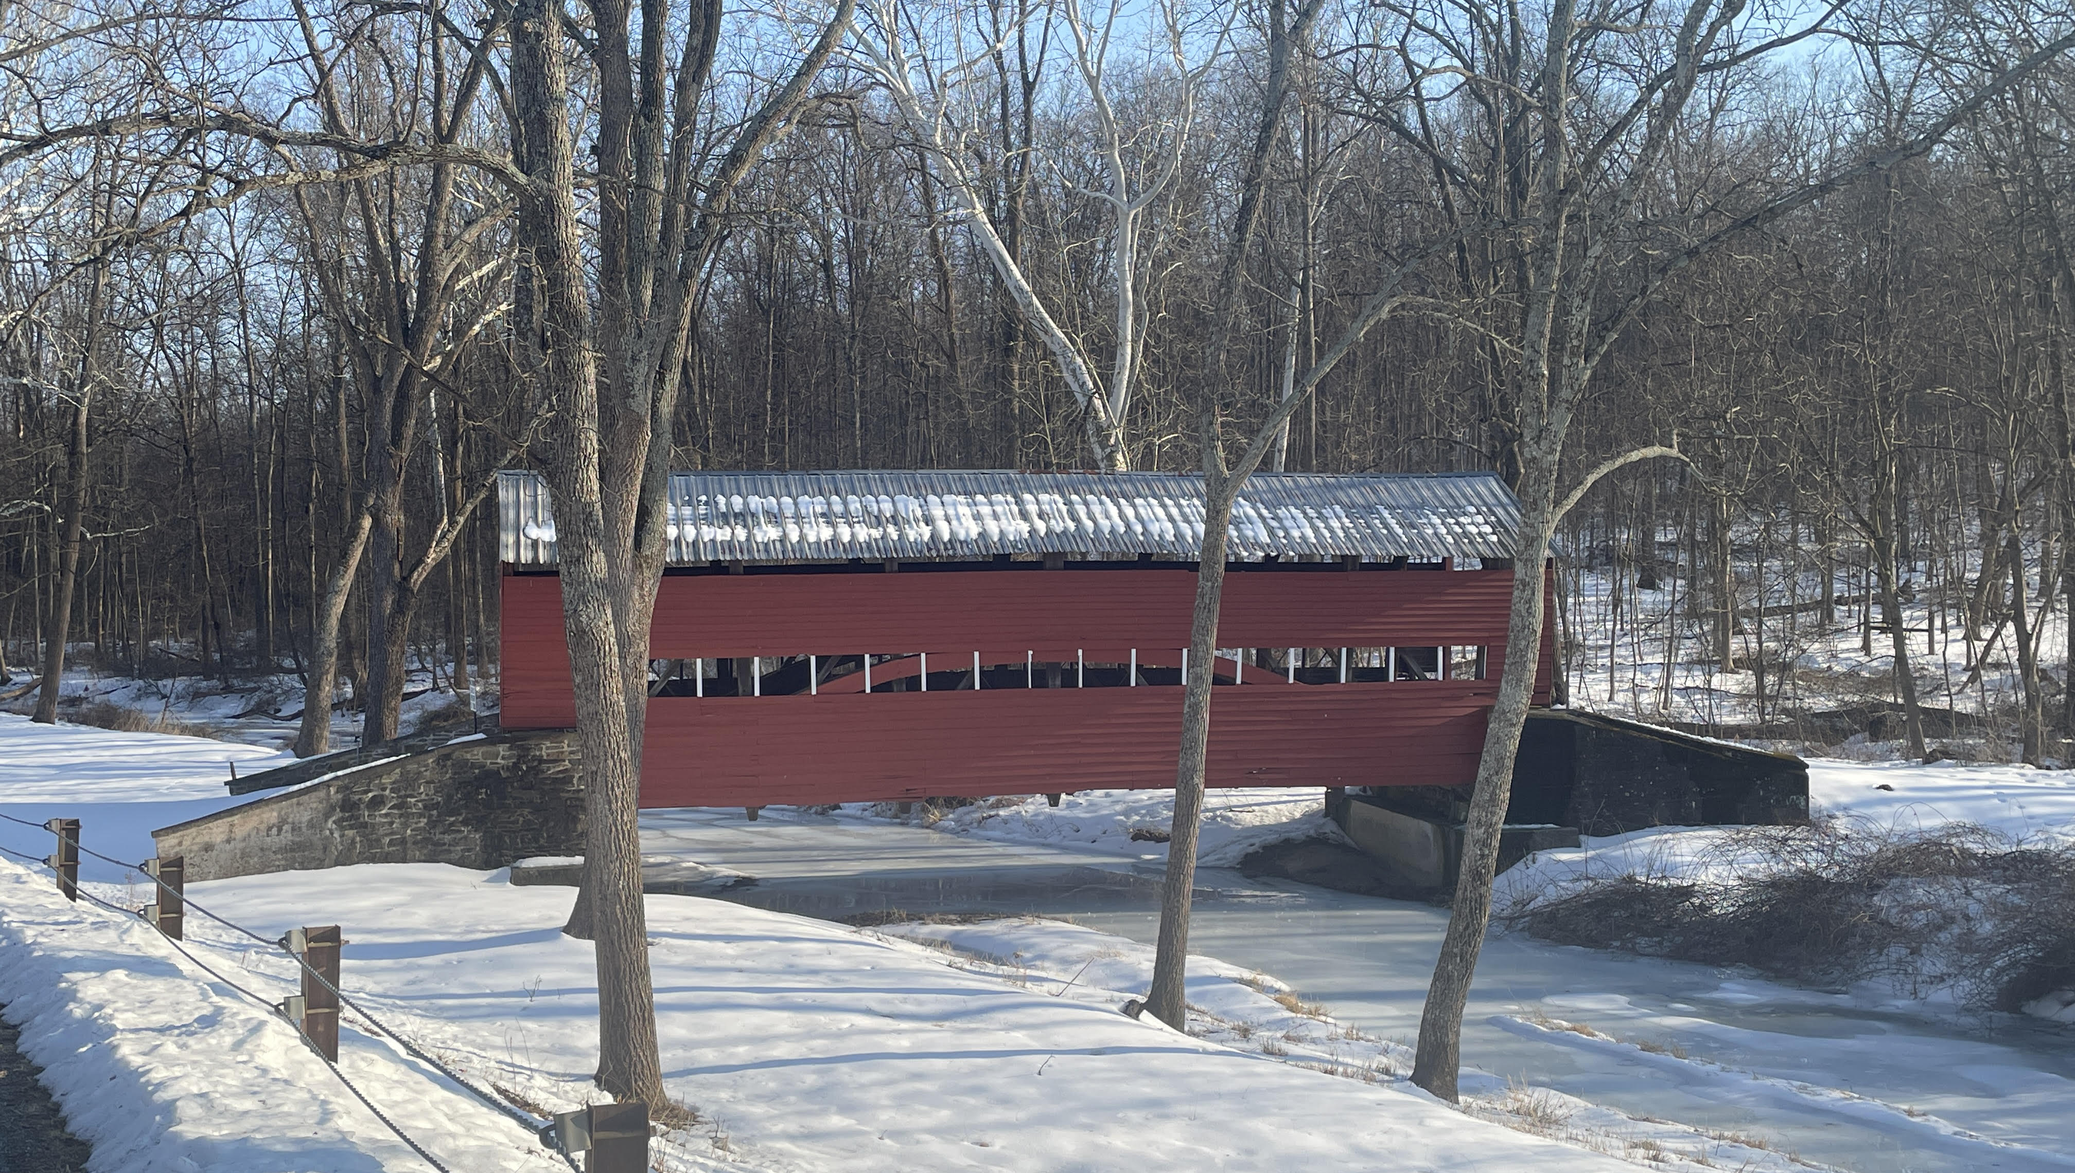

Welcome
A shelter
in the time
of storm.

Slide 2
Scripture Reading
Matthew 16:24 -17:8
Jesus in His Glory

Slide 3
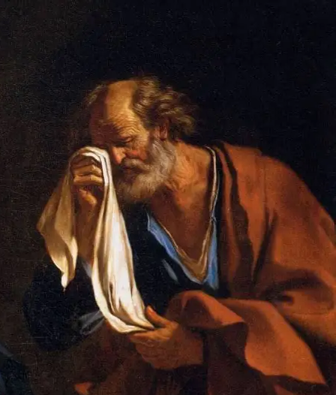
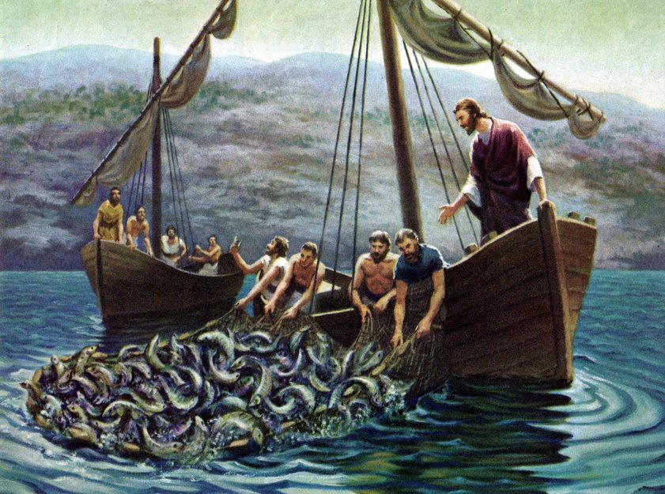
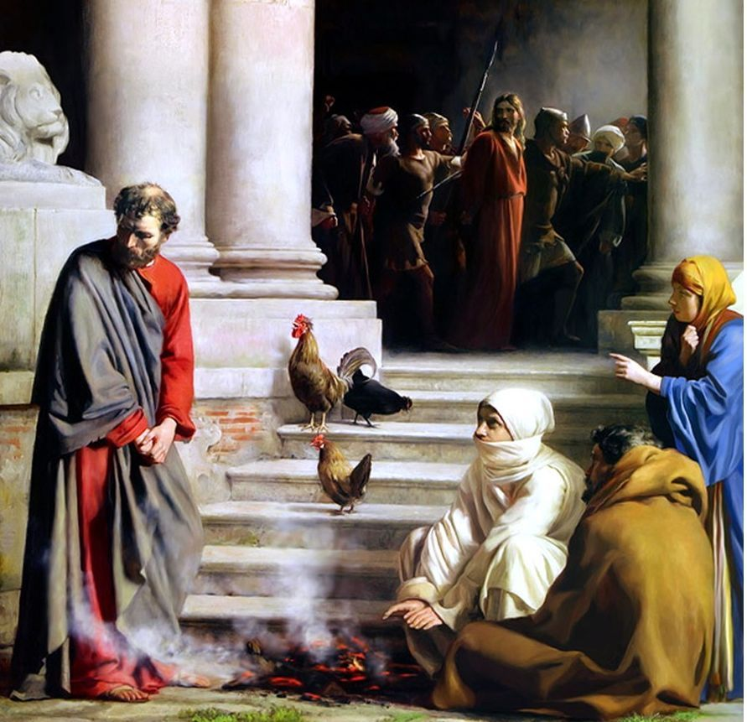
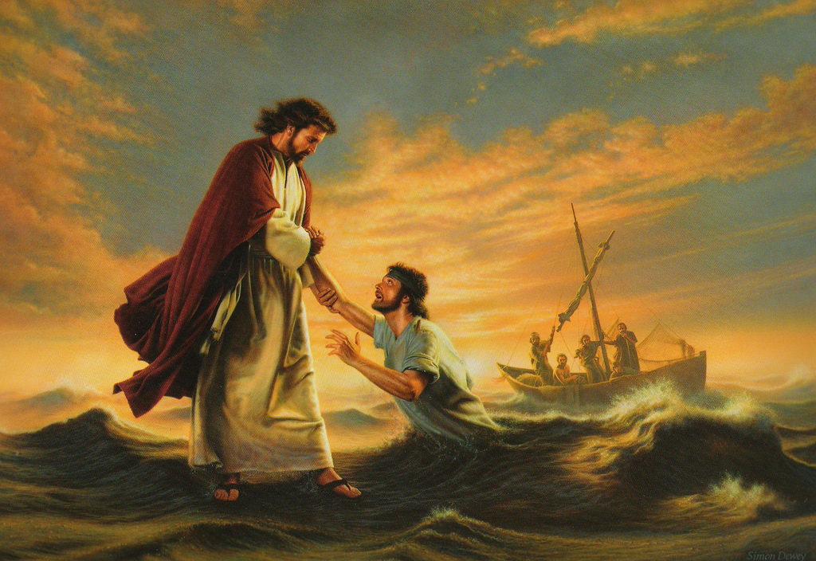
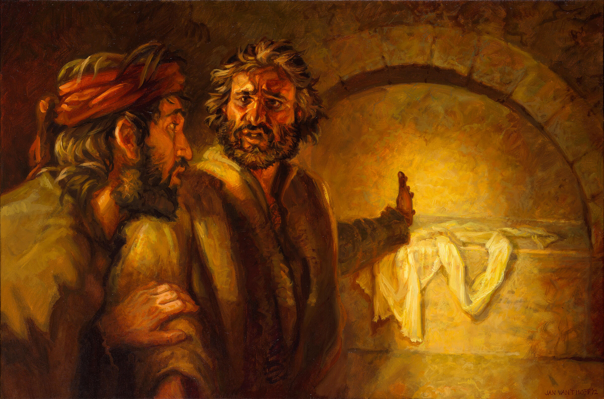
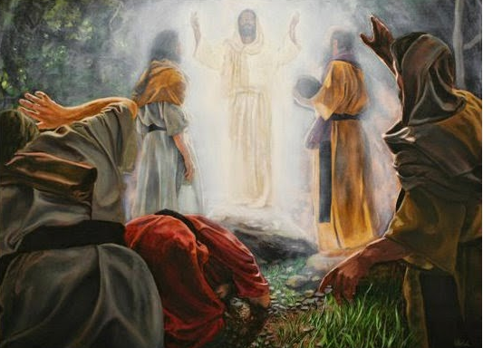
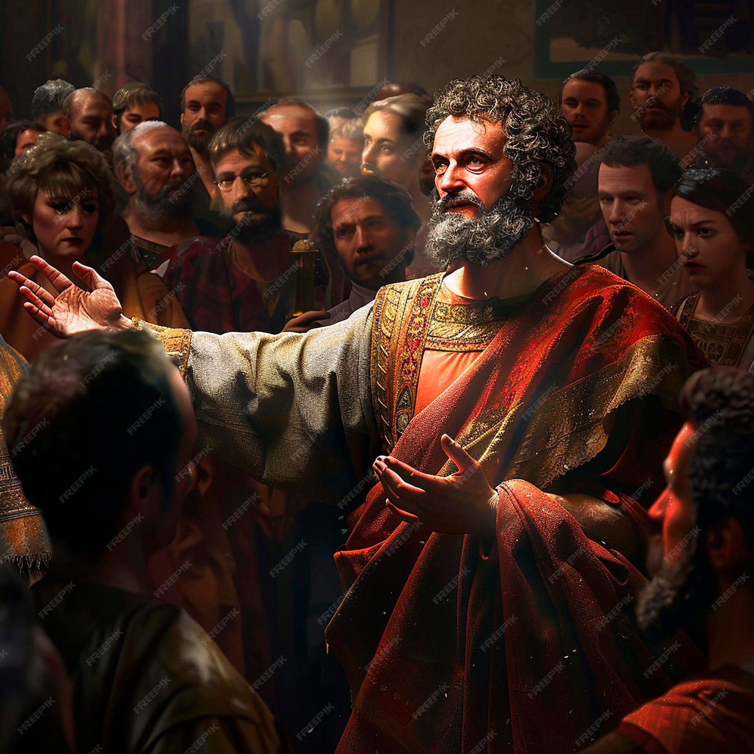
Peter - His Life and Letters

Slide 4
Peter meets Jesus the Lamb
- he gets a new name - John 1
Peter meets Jesus the Lord
- he gets a new calling - Luke 5
Peter meets Jesus on the Lake
- he gets a new reason to worship - Matt 14
Peter meets Jesus the Rock
- he gets a new revelation - Matt 16

Slide 5
Matt 16:15 Who do you (disciples) say that I am?
16 Simon Peter answered and said, "You are the Christ (Messiah), Son of the living God."
17 Jesus answered and said to him, "Blessed are you, Simon Bar-Jonah, for flesh and blood has not revealed this to you, but My Father who is in heaven”.

Slide 6
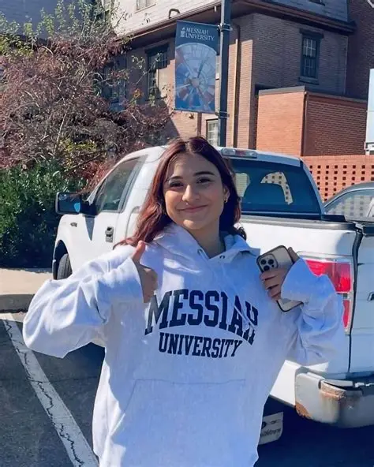
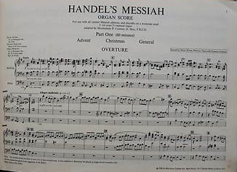
What does “Messiah” bring to your mind?

Slide 7
Peter meets Jesus in His Glory
Matt 16:28 Assuredly, I say to you, there are some standing here who shall not taste death till they see the Son of Man coming in His kingdom.
Matt 17:1 Now after six days Jesus took Peter, James, and John his brother, led them up on a high mountain by themselves;

Slide 8
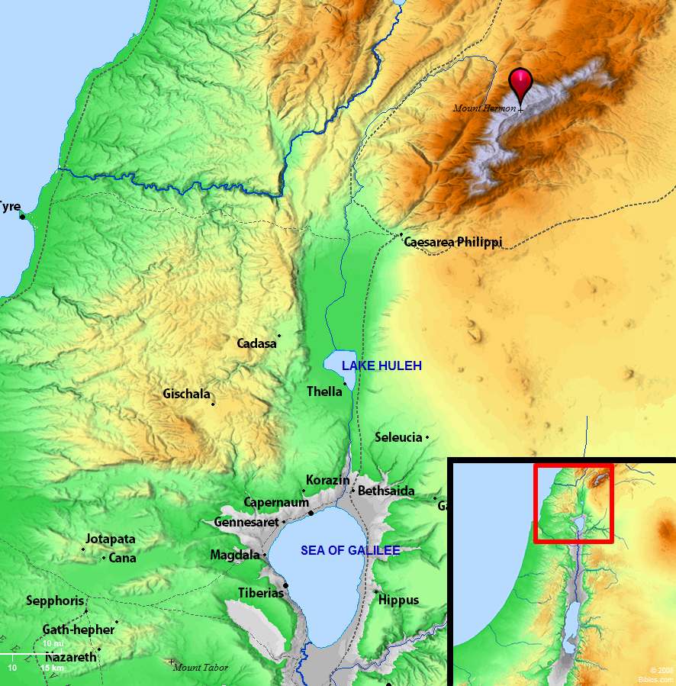
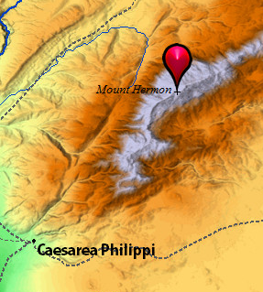
9,232 feet

Slide 9

Matt 16:2 Jesus was transfigured (metamorphoō) before them. His face shone like the sun, and His clothes became as white as the light.

Slide 10
Going up the mountain, Jesus looks “normal”.
Suddenly His face is glowing like the Sun!
His robe takes on a supernatural brightness!
2 Cor 3:13 Moses put a veil over his face so that the children of Israel could not look steadily at the end of what was passing away.
18 But we all, with unveiled face, beholding as in a mirror the glory of the Lord, are being transformed into the same image from glory to glory.

Slide 11
Phil 2:6 Though Jesus Christ was in the form of God, He did not count equality with God a thing to be grasped,
7 but emptied himself, by taking the form of a servant, being born in the likeness of men.
“Emptied Himself” of what?
Not of His Deity. Still truly God & truly man.
Set aside “the independent use of His Divine attributes” (omniscience, omnipotence, omnipresence).
I always do the will of Him who sent me (Jn 4:34).

Slide 12
3 And behold, Moses and Elijah appeared to them, talking with Jesus.
Not random visitors. They represent: The Law (Moses) & The Prophets (Elijah).
Disciples seeing a miniature of the future Kingdom.
Glorified Christ (yet to die) will be there.
Resurrected dead (like Moses who has died) there.
Transformed living (like Elijah who didn’t die) will be there.

Slide 13
How did the disciples know it was Moses & Elijah?
Recognition not from memory, but by revelation. (Lk 24:31 - their eyes were opened and they knew Him)
Talking with Jesus about His “exodus” (Lk 9:31).
Not from Egypt (like Moses)
Not by a chariot of fire (like Elijah)
But by crucifixion.

Slide 14
4 Then Peter answered and said to Jesus, "Lord, it is good for us to be here; if You wish, let us make here three tabernacles (booths) one for You, one for Moses, and one for Elijah."
Peter is overwhelmed (Luke 9:33) & impulsive.
He seems to have missed the “exodus” conversation.
Motives may be good, but his theology is bad.
Three = proposing equal status, equal honor.
Booths = represent celebration, permanence (stay here).

Slide 15
5 While Peter was still speaking, behold, a bright cloud overshadowed them; and suddenly a voice came out of the cloud, saying, "This is My beloved Son, in whom I am well pleased. Hear Him!"
2nd voice from above (1st at Jesus’ baptism).
2nd interruption (1st “get behind me, Satan”).
Matt 16:23 You are an offense to Me, for you are not mindful of the things of God, but the things of men.

Slide 16
6 When the disciples heard it (the transfiguration was dazzling, but the voice was devastating), they fell on their faces and were greatly afraid.
Rev 1:12 I (John) turned to see the voice that spoke with me. And having turned I saw …
13 One like the Son of Man, clothed with a garment down to the feet and girded about the chest with a golden band.
14 His head and hair were white like wool, as white as snow, and His eyes like a flame of fire;

Slide 17
Rev 1:15 His feet were like fine brass, as if refined in a furnace, and His voice as the sound of many waters;
16 He had in His right hand seven stars, out of His mouth went a sharp two-edged sword, and His face was like the sun shining in its strength.
17 And when I saw Him, I fell at His feet as dead.

Slide 18
7 But Jesus came and touched them and said, "Arise, and do not be afraid."
8 When they had lifted up their eyes, they saw no one but Jesus only.
Jesus is more than meets the eye!
Glorious beyond imagination.
Greater than any OT hero.
Honored by God the Father.
Patient and gentle with terrified followers.

Slide 19
Matt 17:9 As they came down from the mountain, Jesus commanded them, "Tell the vision to no one until the Son of Man is risen from the dead."
You are rightly amazed by my transfiguration, but something even greater is coming.
My “exodus” (death) will be followed by my resurrection.
So, you can tell people about this later.

Slide 20
John 1:1 In the beginning was the Word, and the Word was with God, and the Word was God (truly God).
14 And the Word became flesh (truly man) and dwelt (tabernacled) among us, and we beheld His glory, the glory as of the only begotten of the Father, full of grace and truth.
17 For the law was given through Moses, but grace and truth came through Jesus Christ.
➢ You can trust & follow the LIVING Word - Jesus!

Slide 21
2 Peter 1:16 We (disciples) did not follow cunningly devised fables when we made known to you the power and coming of our Lord Jesus Christ, but were eyewitnesses of His majesty.
17 For He received honor and glory from God the Father when such a voice came to Him from the Excellent Glory: "This is My beloved Son, in whom I am well pleased."
18 We heard this voice which came from heaven when we were with Him on the holy mountain.

Slide 22
19 And so we have the words of the prophets confirmed, which you do well to heed as a light that shines in a dark place, until the day dawns and the morning star rises in your hearts;
20 knowing this first, that no prophecy of Scripture comes from a man’s own explanation,
21 for prophecy never came by the will of man, but holy men of God spoke as they were moved by the Holy Spirit.
➢ You can trust the WRITTEN Word - It’s about Jesus!

Slide 23
What are people like in heaven?
Eric Clapton - “Tears in Heaven”
Would you know my name, if I saw you in heaven?
Would it be the same, if I saw you in heaven?
Would you hold my hand, if I saw you in heaven?
Would you help me stand, if I saw you in heaven?

Slide 24
What are people like in heaven?
Embodied (2 Cor 5:1–4) - real, permanent, resurrection body.
Recognizable (Matt 17:3) - Identity preserved & perfected.
Glorious (Mt 17:2; 1 Jn 3:2) - Radiant, transformed, Christlike.
Sinless (1 John 3:2–3) - Pure, whole, morally renewed.
Immortal (2 Cor 5:1) - No decay, no death.
Fully alive (2 Cor 5:4) - “Swallowed up by life”.
Fellowshipping endlessly in restored surroundings (Gen 3:8).
Busy (Gen 1:28) - Fruitfully, perfectly, joyfully multiplying God’s dominion through all creation.

Slide 25
Will you be in heaven?
John 1:10 Jesus was in the world, and the world was made by Him, and the world did not know Him.
11 He came to His own, and His own did not receive Him.
12 But as many as received Him, to them He gave the right to become children of God, to those who believe in His name.

