Slide 1
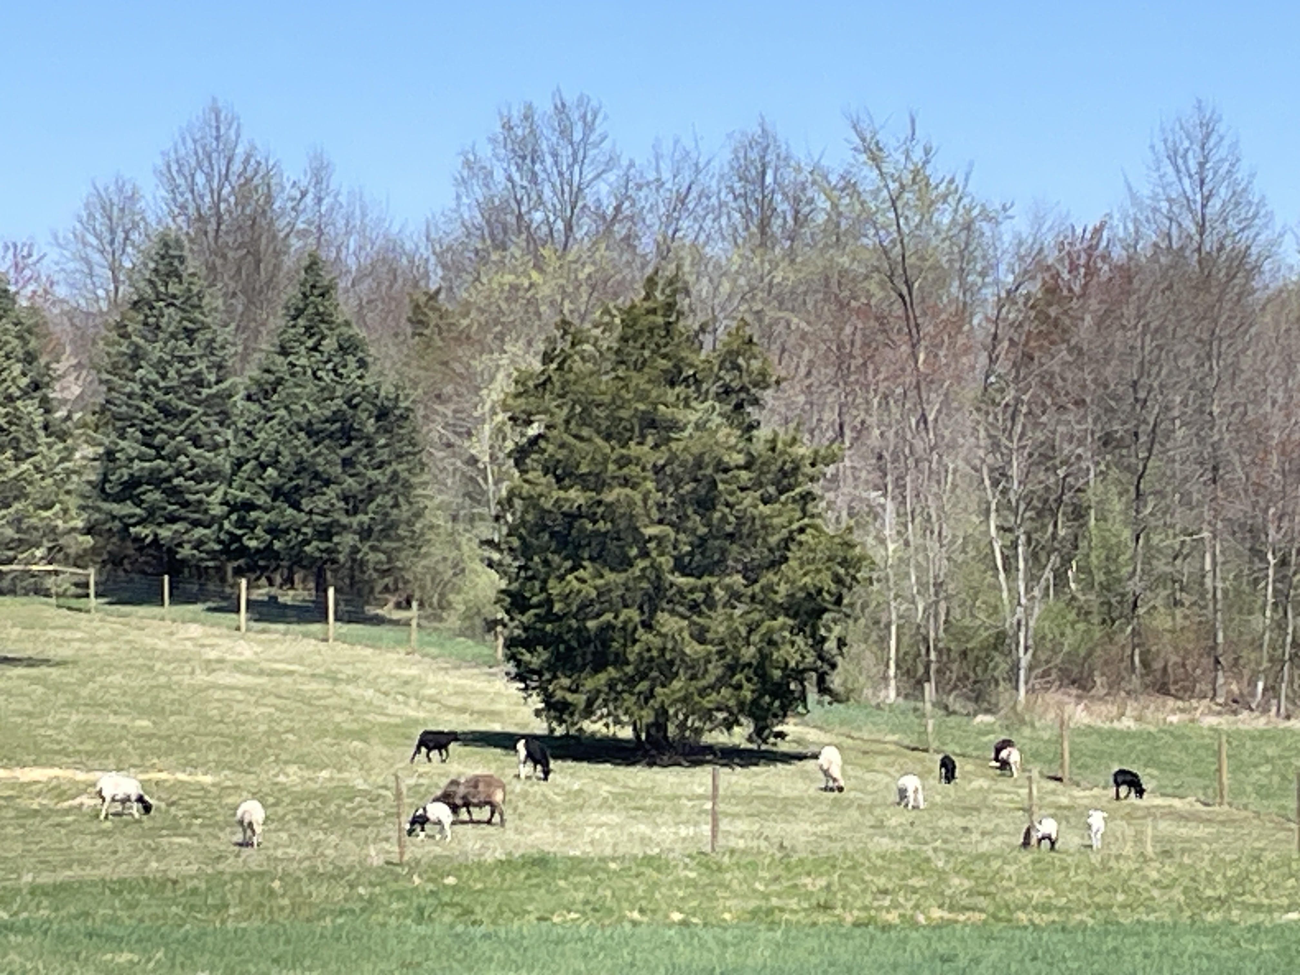
Welcome
My sheep hear my voice, and they follow ME.
And I (Jesus) give unto them eternal life. John 10:27,28

Slide 2
Scripture Reading
Psalm 78:1-8
Psalm 71:15-19

Slide 3
Opportunities to talk about our God
Psalm 78
1 Give ear, O my people, to my teaching; tune your ears to the words of my mouth!
2 I will open my mouth in a parable; I will utter dark sayings from of old,
3 things that we have heard and known, that our fathers have told us.

Slide 4
Ps 78:4 We will not hide them from their children, but tell to the coming generation the glorious deeds of the LORD, and his might, and the wonders that he has done.

Slide 5
Ps 78:1 Give ear, O my people, to my teaching; incline your ears to the words of my mouth!
Prepare for opportunities to speak.
Watch for ears that are “inclined”.
Prov 18:2 - consider opinions beyond their own.
Prov 19:20 - ask for advice & instruction.
James 1:19 - quicker to hear than to speak.
James 1:22 - looks to do, not just hear.

Slide 6
Prepare for opportunities to speak.
Watch for ears that are “inclined”.
Navigate barriers between what is said and what is heard (Matt 13).
➢ No understanding & work of the wicked one.
(19) When anyone hears and does not understand, then the wicked one comes and snatches away what was sown in his heart.

Slide 7
barriers between what is said & heard (Mt 13).
(19) no understanding & work of the wicked one.
(20,21) reflex emotions & untested foundations.
Some hear and immediately receive it with joy; yet they have no root in themselves, but endure only for a while. For when tribulation or persecution arise, immediately they stumble.

Slide 8
barriers between what is said & heard (Mt 13).
(19) no understanding & work of the wicked one.
(20,21) reflex emotions & untested foundations.
(22) competing cares & deceptive priorities.
Some hear, but the cares of this world and the deceitfulness of riches choke out the word, and they become unfruitful.

Slide 9
Ps 78:2 I will open my mouth in a parable; I will utter dark sayings from of old.
parable = simple story or illustration
dark saying = confusing or difficult topic
➢ Some things become clearer from the perspective of age.
Ps 37:25 I have been young, and now am old; Yet I have not seen the righteous forsaken, or his descendants begging bread (provision).

Slide 10
Prov 22:6 Train up a child in the way he should go, and when he is old, he will not depart from it (parenting).
Eccl 11:9 Rejoice, O young man, in your youth, and let your heart cheer you in the days of your youth; Walk in the ways of your heart, and the sight of your eyes; But know that for all these God will bring you into judgment (accountability).

Slide 11
Ps 78:3 (I open my mouth in parables) that we have heard and known, that our fathers have told us.
Hearing becomes knowing when it is personalized and can be explained.
II Tim 3:14 Continue in the things you have learned and been assured of, knowing from whom you have learned them.

Slide 12
Ps 78:4 We will not hide them from the children, but tell to the coming generation the glorious deeds of the LORD, His might, and the wonders that He has done.
a testimony should not be hidden, even if it reveals unflattering things about me.
but a testimony that is powerful & impacts generations quickly moves to exalting God.

Slide 13
Do you have accounts of God’s glorious deeds, might, and wonders in your life?
➢ Can you tell others how God saved you from sin?
- His grace & forgiveness.
John 3:16 - God loves & gives; I believe & live
Admit; Believe; Count the Cost; Decide
➢ Can you tell others how God provided for you physically and/or financially? - His providence.
➢ Can you tell others how God has led you thru “dangers, toils, and snares”? - His guidance.

Slide 14
Motivations for talking about our God
Ps 78:6 That the next generation might know them, the children yet unborn, and arise and tell them to their children,
7 so that they should set their hope in God and not forget the works of God, but keep his commandments;
8 and that they should not be like their fathers, a stubborn and rebellious generation, a generation whose heart was not steadfast, whose spirit was not faithful to God.

