Slide 1
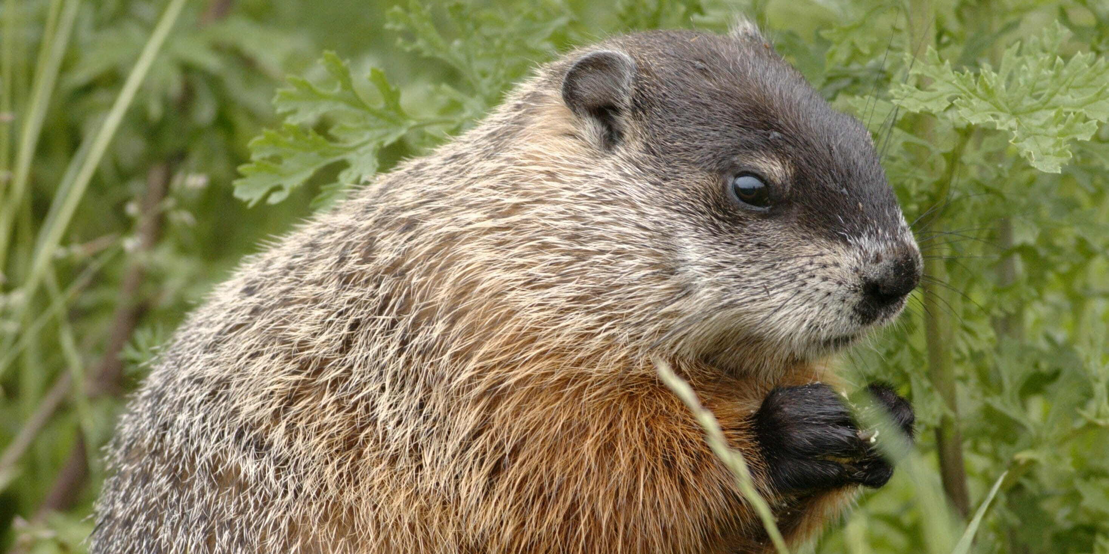
Welcome
to GBC
Acts 1:7 It is not for you to know times or seasons which the Father has put in His own authority.
February 2, 2025

Slide 2
Exploring Our Name at GBC
Grace - God’s Unearned Favor (2023)
Bible - God’s Inspired Word (2024)
Chapel or Church (2025)

Slide 3
LAST Names or Surnames
In Western societies, like those in Europe and North America, last names generally follow these distinct categories.
Patronymics - “Son of …”; MacDonald (Scotland); Petrovich (Russia); Johnson (English).
Occupation - Taylor, Smith, Baker, Miller.
Geography - Hill, Brook, DaVinci (from Vinci).
Descriptions - Armstrong, Swift, Little.

Slide 4
Exploring Our “Last Name” at GBC - Church
OT - The word “church” found 0 times
NT - found 115 times (but only 2x in Gospels)
Matthew 16:18 I (Jesus) say to you that you are Peter, and on this rock I will build My church, and the gates of Hades shall not prevail against it.
Spoken in northern Israel, far from the negative reactions of the Jerusalem Jews and the apparent failure of the Messiah (John 1:11; Matt 16:21).

Slide 5
Jesus speaks words of …
Certainty - I will build my church
Not a future possibility, but a timeless promise.
Construction - I will build my church
With a blueprint (foreknowledge - Titus 1:1,2)
Through a process (foundations - Eph 2:19-22)
Along a path (Jerusalem, Judea/Samaria, world - Acts 1:8)
Acts 2:41 (3,000); 4:4 (5,000); 5:14 (multitudes);
11:24 (great many); Rev 5:11,12 (10,000 x 10,000)

Slide 6
The New Testament is a written record
of Jesus building His Church
Gospels (4) - Matthew, Mark, Luke, John
History (1) - Acts
Epistles (21) - Letters to believers/churches
Prophesy (1) - Revelation (Letters to 7 Churches)
(Theme for 1st Sunday of the Month preaching)

Slide 7
Jesus speaks words of …
Certainty - I will
Construction - I will build
Contrast - I will build my church
distinct from God’s Messianic Kingdom (based on His “now & not yet” promises to Israel - Jer 31:35-37)
gathering of grafted in, “called out ones” (Rm 11:17,18)
universal as well as local form (I Cor 1:1,2)
body of believers from every time and place, from Pentecost (Acts 2) through the Rapture (I Thess 4).

Slide 8
Jesus speaks words of …
Certainty - I will
Construction - I will build
Contrast - I will build my church
Connection - I will build my church
Col 1:18 He is the head of the body, the church, who is the beginning, the firstborn from the dead, that in all things He may have the preeminence.
Cornerstone, Savior, Lord, Shepherd (Rev 1:12,13,20)

Slide 9
Jesus speaks words of …
Conflict - the gates of hell
gates = places of power and protection.
hell/hades = death, grave, Satan’s domain and destiny (Rev 20:1-3,7-15).

Slide 10
Acts 8:1 - persecuted church
8:3 - made havoc of the church
12:1 - harassed the church
20:28 Take heed to yourselves and to all the flock, among which the Holy Spirit has made you overseers, to shepherd the church of God which He purchased with His own blood.
29 For after my departure savage wolves will come in among you, not sparing the flock.
Eph 6:11,12 - armored and wrestling church

Slide 11
Jesus speaks words of …
Conflict - the gates of hell
Conquest - gates of hell will not prevail against it
Jesus’ resurrection battered through Satan’s greatest wall, the power of death (Mt 16:21-23).
Our promised resurrection shatters Satan’s strong grip on men’s hearts, the fear of death (Heb 2:14,15).
Wherefore, comfort one another with these words!

Slide 12
Exploring Our “Last Name” at GBC
Chapel or Church (2025)
Rev 22:16 I, Jesus, have sent My messenger to testify to you these things in the churches. I am the Root and the Offspring of David, the Bright and Morning Star.
17 And the Spirit and the bride say, "Come!" And let him who hears say, "Come!" And let him who thirsts come. Whoever desires, let him take the water of life freely.

