Slide 1
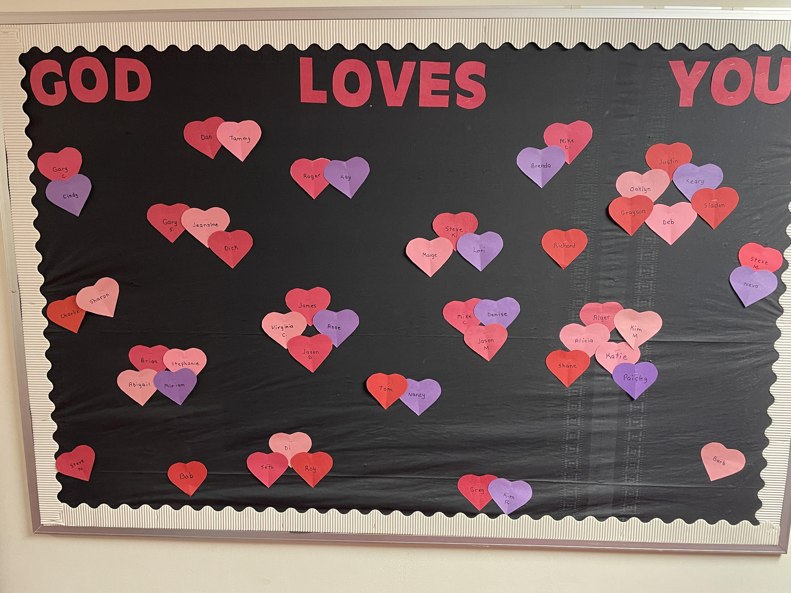
Welcome

Slide 2
New Adult
Sunday School Class
on GRACE
starting NEXT Sunday at 9:30 AM.
Pick-up your copy of
the class book
on the back table.

Slide 3
Acts 4:32 The multitude of those who believed were of one heart and one soul; neither did anyone say that any of the things he possessed was his own, but they had all things in common.
33 And with great power the apostles gave witness to the resurrection of the Lord Jesus. And great grace was upon them all.

Slide 4
Acts 4 - Persecution from the OUTSIDE has only fanned flames of growth for this baby Church.
- proof of Jesus’ words in Mt 16:18 - I will build my Church and Hell’s gates will not prevail.
Acts 5 - Sin on the INSIDE reveals both wheat and tares in God’s field (Mt 13:24-26).
- why Jesus’ only other reference to His Church (Mt 18:15-17) describes what to do about sin.

Slide 5
The church is not a showcase for saints,
but a hospital for sinners
who know their need and are seeking a cure.
I Thess 5:12 - General and honest description of church members - unruly (break God’s rules); fainthearted (discouraged); weak (prone to fail).
Acts 4:33 - Hallelujah, in the face of sinful realities, greater realities exist - great power; great grace.

Slide 6
Acts 4:32-37 Saints sharing resources because …
it all belongs to God.
the gospel must be spread.
Jesus may return very soon!
(32-35) Unparalleled situation (all things common)
(36,37) Specific illustration (Barnabas - opposite of heartless Levite in Jesus’ Good Samaritan account).

Slide 7
Acts 4:32-37 - Saints sharing
Acts 5 - Saints sinning
(1) Ananias (Lord is gracious) & Sapphira (beautiful)
- part of the believing congregation (4:32).
(4) not an issue of giving or the amount given
lying - 8th command; what God hates Prov 6:16-19, specifically lying to God (Acts 5:3,9)
hypocrisy = wearing a mask; deliberately trying to create a false impression of yourself.

Slide 8
Ananias and Sapphira are a portrait of how Jesus described the Pharisees
- whitewashed tombs, full of death and decay.
- Hypocrites!!
Secret sins on earth are open sins in heaven.
Num 32:23 Behold, you have sinned against the LORD: and be sure your sin will find you out.

Slide 9
Which sin would you have thought God would address first in His newborn Church?
- Stealing, immorality, blasphemy, anger, abuse,
drunkenness, bitterness, theological error?
- Hypocrisy - pretending to be something I am not
(1,2) Sinful Pretense
(3,4) Supernatural Perception
- Ananias had opened himself up to Satan’s control (cp 4:31) - possession? oppression? influence?

Slide 10
Satan, the “father of lies” (source) had found willing participants.
Ananias & Sapphira gave “place to the devil” (Eph 4:27)
(5) Swift Punishment (startling severity)
- Garden of Eden bloodshed (start of civilization).
- Egypt Passover bloodshed (start of redeemed people).
- Achan & Promised Land bloodshed (start of Nation).
- Ananias & Sapphira death (start of the Church).
(6-11) Serious People - Fear of God; the beginning of wisdom = seeing life from God’s perspective.

Slide 11
(12-16) Solomon’s Porch
- Back to the place of preaching, miracles, unity, and public impact (John 10:23; Acts 3:11)
- Evangelism is now a priority.
1 = Purity (Acts 5:1-11) - a clean church
2 = Power (12-16) - signs of Apostles (II Cor 12:12; Rom 1:16)
3 = Persecution (17-28) - prison (18), prohibition (28), beating (40)
4 = Persistence (29-32) - bold as a lion (Prov 28:1)
They witness clearly, precisely, factually, boldly, leading to men facing their responsibility.

Slide 12
5 - Productivity (33-42)
(33) Conviction - cut to the heart, furious
work of God’s Word (Heb 4:12)
work of God’s Spirit (John 16:7,8)
conviction of sin = in my current state, I am at odds with and separated from God; a sinner.
righteousness = I need to be right with God; His Son, Jesus, is the only righteous One.
judgment = I will face God either now in humble repentance, or later as a hell-bound rebel.

Slide 13
Responses to Conviction
(33) Blind Hostility - see Acts 9:22,23
(34-39) Feigned Neutrality - Gamaliel illustrates all who refuse to “pick a side”(Matt 12:30).
(40-42; 6:1) Saving Acceptance - disciples multiplied

Slide 14
Acts 5
Seriousness of sin - Ananias & Sapphira
Suffering and Boldness and Joy of any who “obey God rather than man” - Peter and other Apostles
Acts 5:41 So they departed from the presence of the council, rejoicing that they were counted worthy to suffer shame for His name.

Slide 15
God has not promised skies always blue,
flower-strewn pathways all our lives through.
God has not promised sun without rain,
joy without sorrow, peace without pain.
But God has promised His strength for the day,
His rest as we labor, His light on the way,
His grace for each trial, His help from above,
His unfailing sympathy, undying love.

