Slide 1
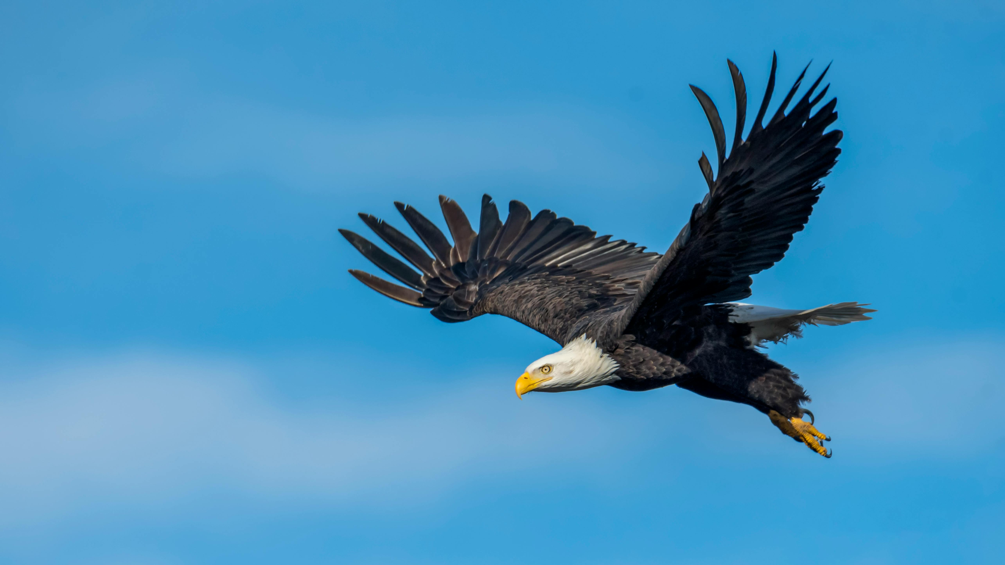
WELCOME
They that wait upon the LORD shall mount up with wings like Isaiah 40:31

Slide 2
Acts 4:1 As Peter & John spoke to the people, the authorities came,
2 being greatly disturbed that they taught the people and preached in Jesus the resurrection from the dead.
3 And they laid hands on them, and put them in custody until the next day, for it was already evening.

Slide 3
It is GOD’S WILL that I be …
Saved (I Tim 2:3,4) - turn from sin to the Savior.
Spirit-Filled (Eph 5:17,18) - Guided & empowered by God.
Sanctified (I Th 4:3) - Progressively made more like Jesus.
Submissive (I Pet 2:13,15) - Trusting God’s control.
Suffering (I Pet 3:17) - Following God despite pain.
Saying Thanks (I Thess 5:18) - Noticing and appreciating the goodness of God and others.
Psalm 40:8 I delight to do Your will, O my God.

Slide 4
Acts 4 = first of many church persecutions.
Sometimes physical violence (Heb 11:36-38).
In America often psychological and social intimidation (Rev 3:1).
Jesus’ warning - John 15:20 A servant is not greater than his master. If they persecuted Me, they will also persecute you. If they kept My word, they will keep yours also.

Slide 5
How does God describe Persecution in Acts 4?
(1) Persecutors
priests = workers, oversee temple sacrifices
captain of the temple = security guards
Sadducees = religious liberals who …
only accept the 5 Books of Moses;
deny the resurrection;
believe angels are a myth;
believe men master their own fates.

Slide 6
(2) Problem - Grieved = angry, upset about …
unapproved teaching;
uneducated teachers (from Galilee);
unacceptable topic (resurrection)
(3) Procedure - arrested and jailed messengers
(4) Product - growth of the church
(5-18) Profile

Slide 7
God’s Profile of Persecutors
(5,6) Have their own tight-knit circle of buddies.
(7) Use isolation and interrogation to get their way.
(13) Put people in categories (uneducated/untrained).
(14,16) Refuse to be moved by inconvenient facts.
(15) Throw around their authority and retreat to their private club.
(17,18) Issue threats/prohibitions to retain control.
(19,20) It’s about power, not truth or righteousness.

Slide 8
Persecution and Persecutors Described
How can God’s People Profit from Persecution?
(8) Learn to act under the Spirit’s control, not react in the flesh.
(9,10) Realize that you are in a battle between good and evil, with consequences beyond just you.
(11,12) Look for opportunities to share the gospel.
(19,20) Remind yourself and others of God’s role, and boldly say what you know to be true.
(21,22) Watch as God defends Himself and you.

Slide 9
How can God’s People Profit from Persecution?
(23) Keep a record of what is going on, and share it with those you trust.
(24-26) Pray to God and look in the Bible for what He says about the situation.
(27,28) Identify with Jesus, and rest in God’s bigger purposes.
(29,30) Ask God to replace fear with bold faith, and to give you His power to help others.
(31) Watch God shake up you and others in supernatural ways.

Slide 10
What God can do at the other end of persecution?
(32) Give a new sense of unity and generosity.
(33) Increase spiritual power and grace for outreach.
(34,35) Reveal new and practical ways to meet needs.
(36,37) Elevate future spiritual leaders and sources of encouragement.

Slide 11
GOD’S WILL on display in Acts 4
Saved (4,12) - Turn from sin to the Savior.
Spirit-Filled (8,31) - Guided & empowered by God.
Sanctified (13) - Progressively made more like Jesus.
Submissive (15,18-20,28) - Trusting God’s control.
Suffering (3,21,29) - Following God despite pain.
Saying Thanks (21,22) - Appreciating the goodness of God and others.
Acts 4:28 Everything was according to Your purpose.

