Slide 1
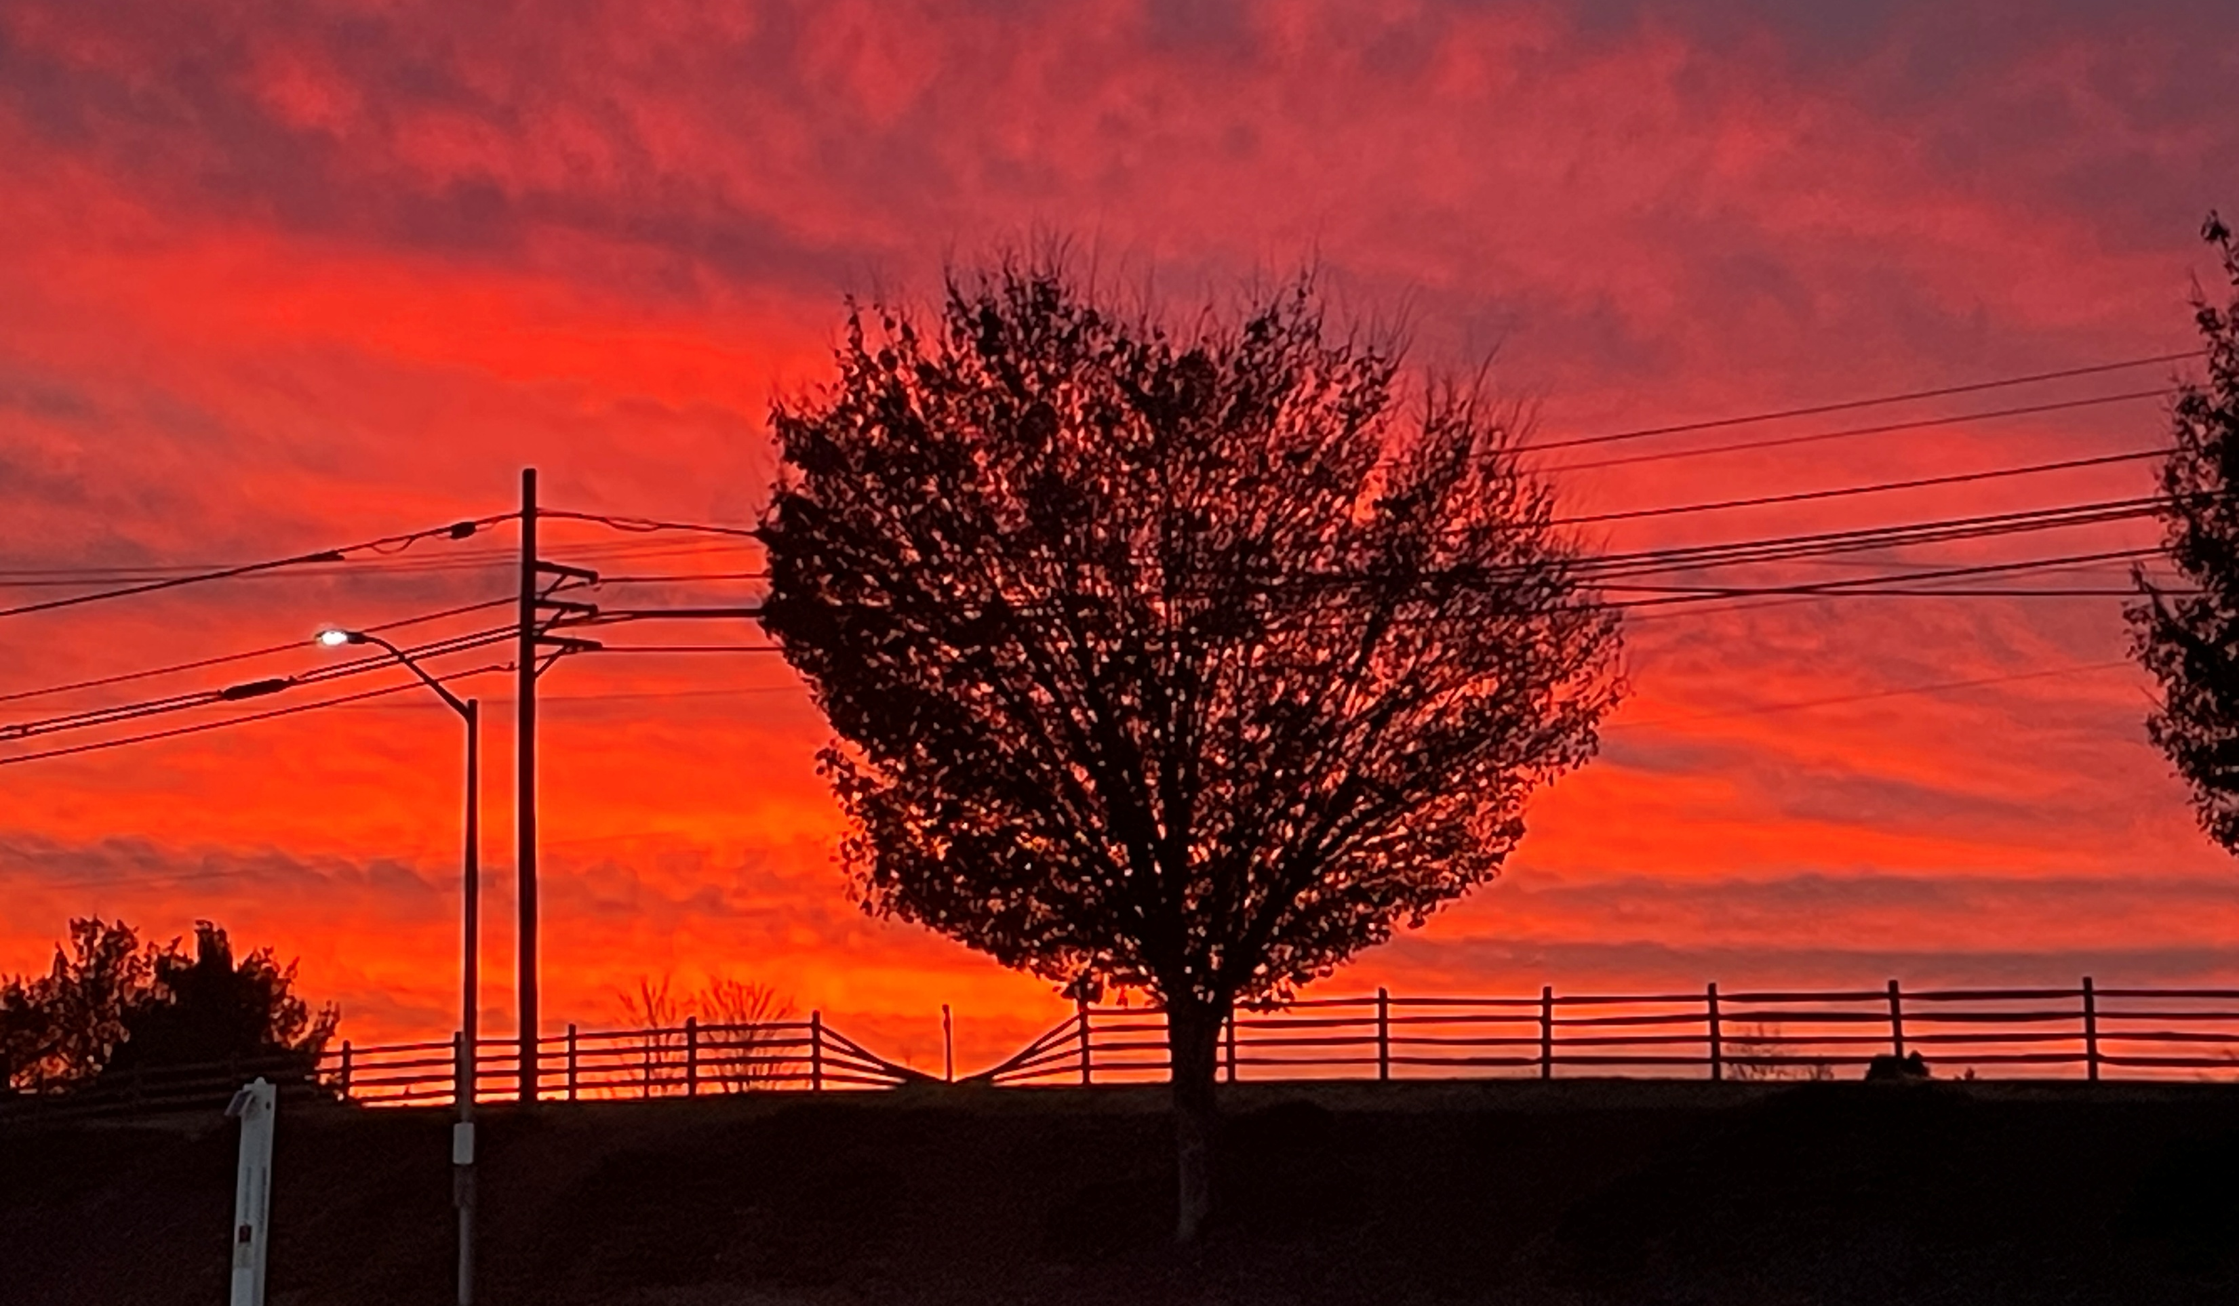
Welcome to GBC
I must work the works of Him who sent Me while it is day;
the night is coming when no one can work. John 9:4

Slide 2
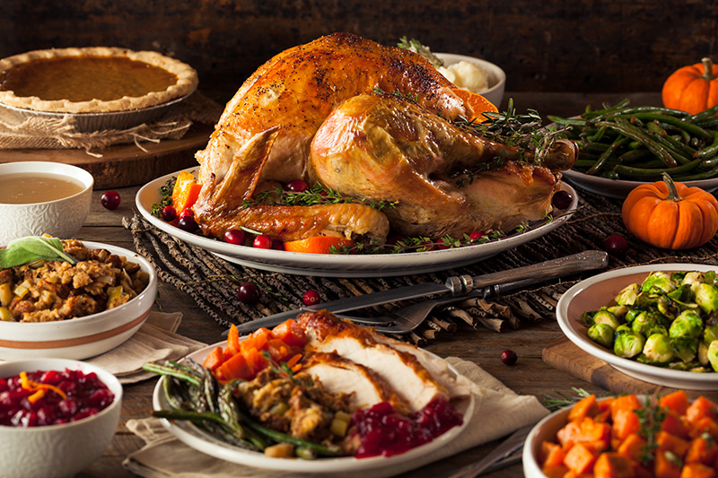
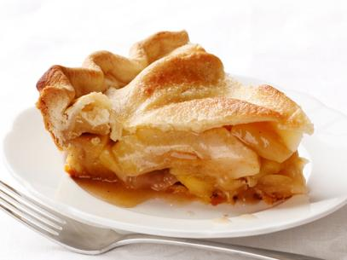
Taste and see that the Lord is GOOD!
Psalm 34:8
Praise & Pie
7 PM Tuesday

Slide 3
The Lord is good at CREATION
Gen 1:31 God saw everything that He had made, and indeed it was very good.
Ps 19:1 The heavens declare the glory of God; the firmament shows His handiwork.

Slide 4
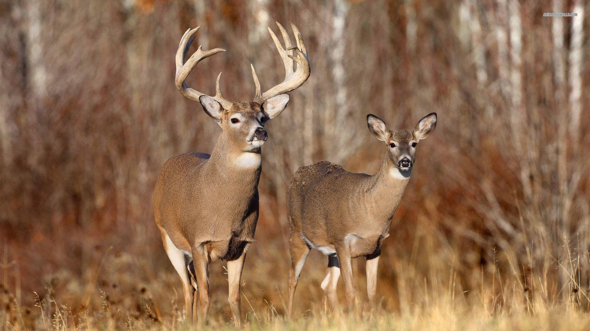
The beasts of the fields

Slide 5
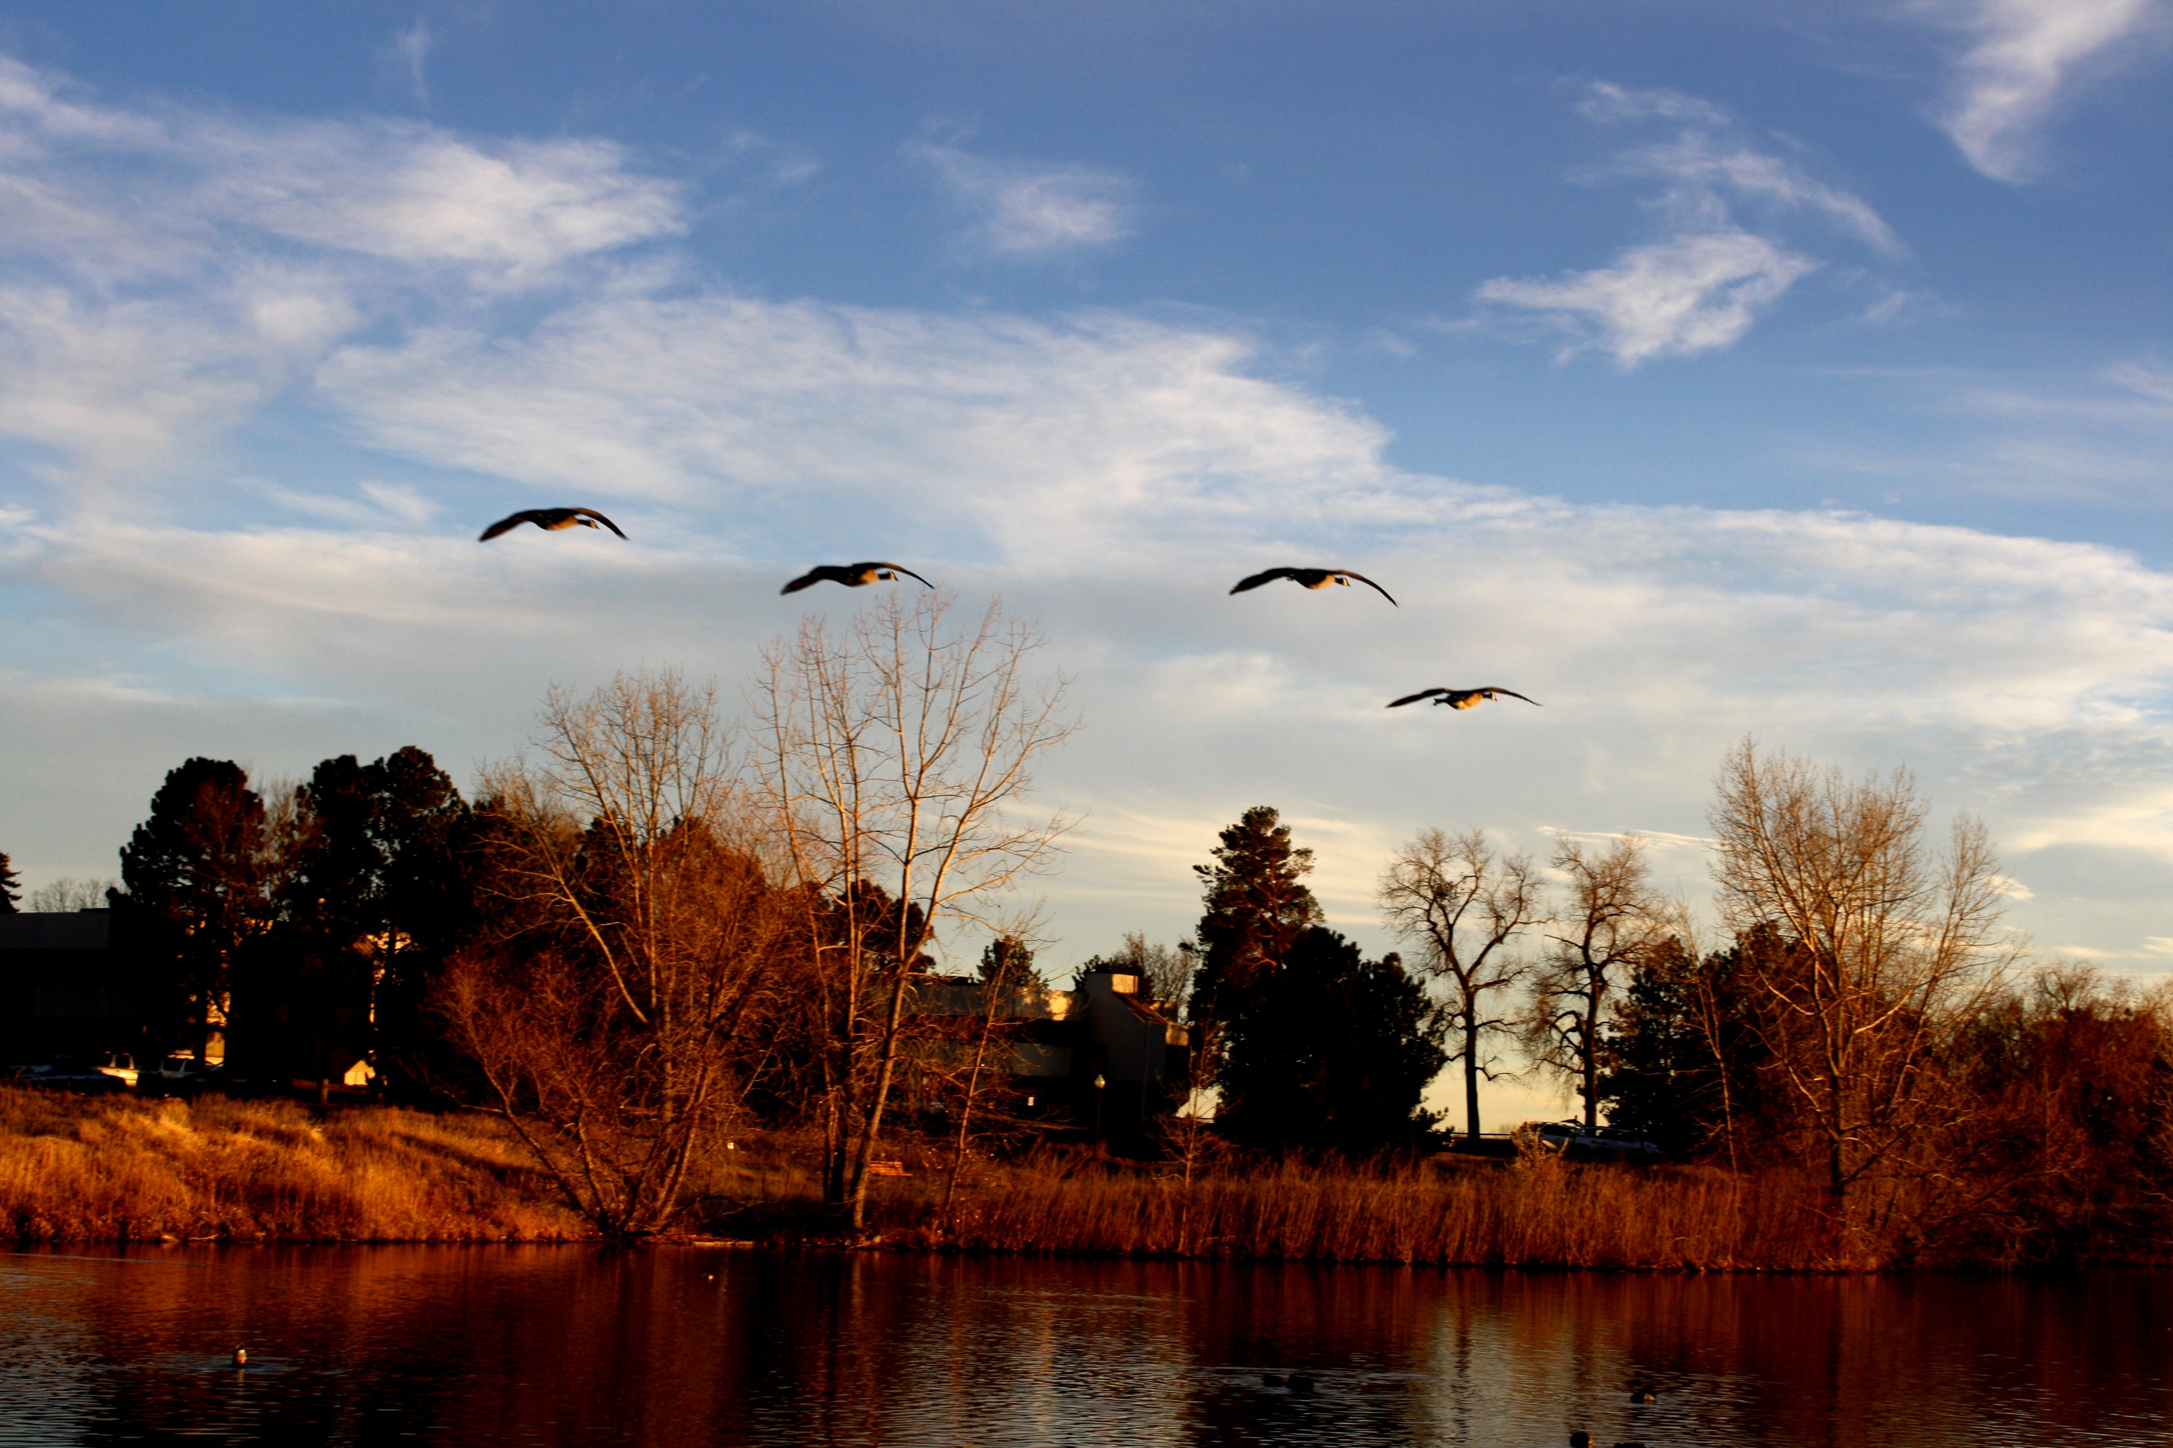
The birds of the air

Slide 6
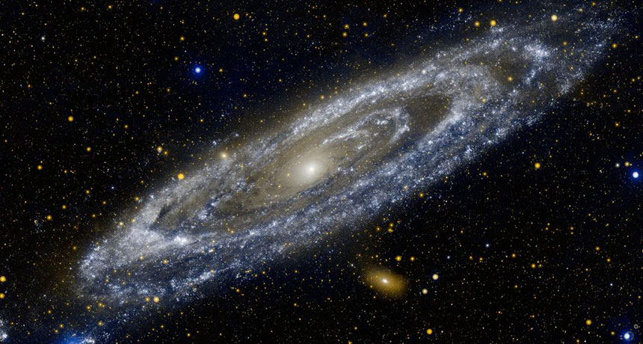
The stars of the sky

Slide 7
Ps 8:3 When I consider Your heavens, the work of Your fingers, the moon and the stars, which You have ordained,
4 What is man that You are mindful of him, and the son of man that You visit him?
9 O LORD, our Lord, how excellent is Your name in all the earth!

Slide 8
Taste & see that God is good … at Creation
➢ Not to “see” the Creator in His creation has some extreme consequences.
Rom 1:20 Since the creation of the world His invisible attributes are clearly seen, being understood by the things that are made, even His eternal power and Godhead, so that they are without excuse,

Slide 9
Rom 1:21 because, although they knew God, they did not glorify Him as God, nor were thankful, but became futile in their thoughts, and their foolish hearts were darkened.
22 Professing to be wise, they became fools,
23 and changed the glory of the incorruptible God into an image made like corruptible man—and birds and four-footed animals and creeping things.

Slide 10
Rom 1:24 Therefore God also gave them up to uncleanness, in the lusts of their hearts, to dishonor their bodies among themselves,
25 who exchanged the truth of God for the lie, and worshiped and served the creature rather than the Creator, who is blessed forever.
26 For this reason God gave them up to vile passions. For even their women exchanged the natural use for what is against nature.

Slide 11
Rom 1:27 Likewise also the men, leaving the natural use of the woman, burned in their lust for one another, men with men committing what is shameful, and receiving in themselves the penalty of their error which was due.
28 And even as they did not like to retain God in their knowledge, God gave them over to a debased mind, to do those things which are not fitting.

Slide 12
Not to “see” the Creator in His creation has some extreme consequences.
How do you explain the current denial of only 2 genders, despite clear genetics?
How do you explain the belief that women can equally compete in sports with grown men?
How can you justify mutilating children to fulfil medical & psychological theories?
How can you explain the origin and complexity of the creation without a Creator?

Slide 13
Taste & see that God is good … at Creation
God is good … at COMMUNICATING
2Kings 20:19 Hezekiah said to Isaiah, "The word of the LORD which you have spoken is good!"

Slide 14
Psalm 19:7 The law of the LORD is perfect (complete), reviving the soul; the testimony of the LORD is sure (foundational), making wise the simple;
8 the precepts of the LORD are right (straightforward), rejoicing the heart; the commandment of the LORD is pure (clear), enlightening the eyes;

Slide 15
Psalm 19:9 the fear of the LORD is clean (healthy), enduring forever; the rules of the LORD are true (trustworthy), and righteous (good) altogether.
11 By them is your servant warned (protected); in keeping them there is great reward (abundant blessing).

Slide 16
There are abundant blessings when …
(II Tim 3:16,17) the Bible is followed
(Eph 5:33) husbands love & wives respect
(Eph 6:1-4) children obey & parents train
(Eph 6:5-9) employees & employers humbly serve
(Rom 13:8) debt is avoided
(Mt 23:23; II Cor 9:7,8) generosity is practiced
(Matt 6:33) God’s Kingdom is prioritized

Slide 17
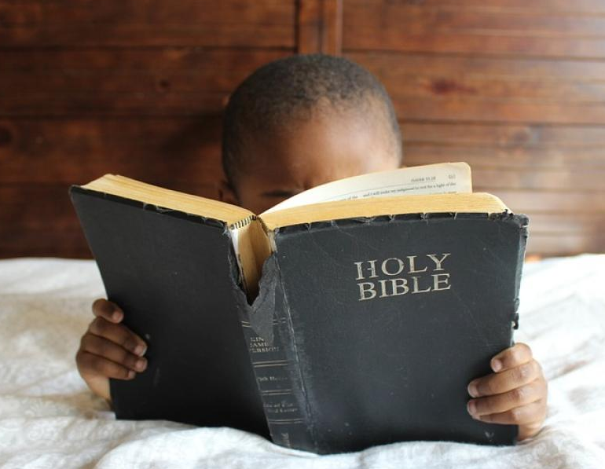
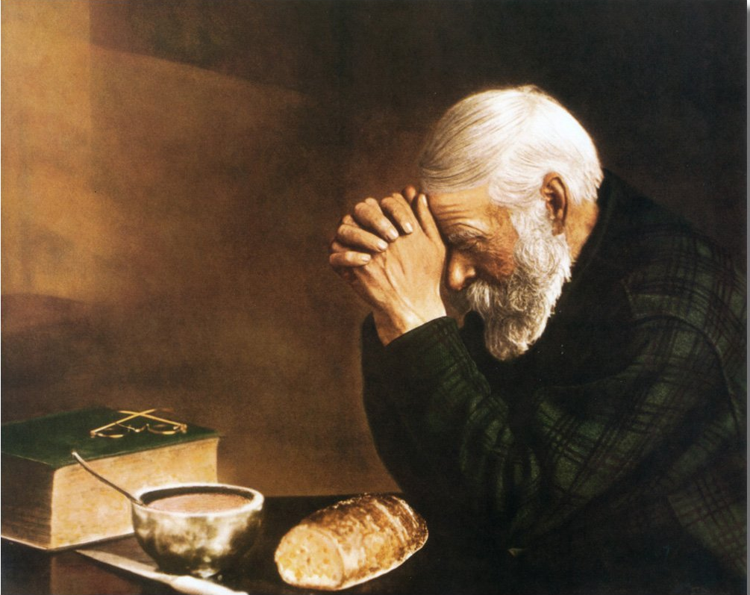
God is good … at Communicating

Slide 18
Not to “see” what God is saying will have some eternal consequences.
John 1:1 In the beginning was the Word. The Word was with God and was God.
2 He was in the beginning with God.
3 All things were made through Him, and without Him nothing was made that was made.

Slide 19
John 1:10 He was in the world, and the world was made through Him, and the world did not know Him.
11 He came to His own, and His own did not receive Him.
12 But as many as received Him, to them He gave the right to become children of God, to those who believe in His name:

Slide 20
John 1:13 who were born, not of blood (family lines), nor of the will of the flesh (physical efforts), nor of the will of man (top-down decisions), but of God.
14 And the Word became flesh and dwelt among us, and we beheld His glory, the glory as of the only begotten of the Father, full of grace and truth.

Slide 21
Taste and see
that the Lord is good …
at Creation (The World)
at Communicating (The Word)
at RESCUING PEOPLE

Slide 22
Matt 19:16 Now behold, one came and said to Jesus, "Good Teacher, what good thing shall I do that I may have eternal life?“
Rom 3:10 It is written: "No one is righteous, no, not one;
12 All have turned aside; together they have become worthless; no one does good, not even one."

Slide 23
John 10:11 I (Jesus) am the good shepherd. The good shepherd gives His life for the sheep.
Rom 5:7 One will scarcely die for a righteous person—though perhaps for a good person one would dare even to die—
8 but God shows his love in that while we were still sinners, Christ died for us.

Slide 24
Psalm 34:8 O, taste and see that the Lord is good;
at Creation
at Communicating
at Rescuing People
Blessed is the one who trusts in Him.

Slide 25
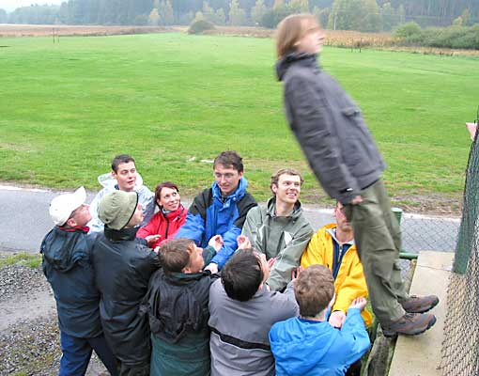

Slide 26
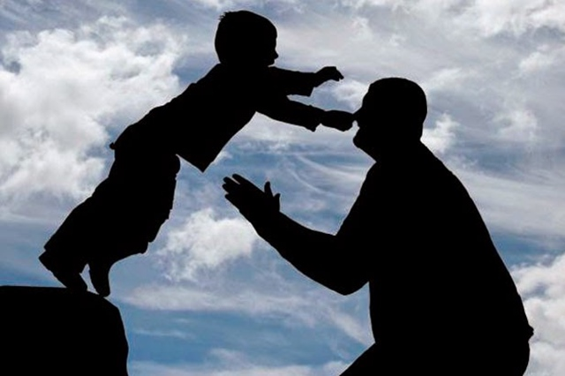

Slide 27
God is good … at Rescuing People
All who don’t trust Jesus will “taste death” without His help.
Heb 2:9 But we see Jesus, who was made a little lower than the angels, for the suffering of death crowned with glory and honor, that He, by the grace of God, might taste death for everyone.

Slide 28
All who don’t trust Jesus will not “taste His grace”.
1Peter 2:2 As newborn babes, desire the pure milk of the word, that you may grow thereby,
3 if indeed you have tasted that the Lord is gracious.

Slide 29
“Tasting” Jesus, but then not trusting Him makes certain things impossible.
Heb 6:4 It is impossible for those who were once enlightened, and have tasted the heavenly gift, and have become partakers of the Holy Spirit,
5 and have tasted the good word of God and the powers of the age to come,

Slide 30
Heb 6:6 if they fall away, (it is impossible) to renew them again to repentance, since they crucify again for themselves the Son of God, and put Him to an open shame.
Rom 2:4 Or do you despise the riches of His goodness, forbearance, and longsuffering, not knowing that the goodness of God leads you to repentance?

Slide 31
O taste and see that the Lord is GOOD!
Admit I am not good (I am a sinner).
Believe Jesus is perfectly good, and will exchange His goodness for my sinfulness.
Count the Cost of rejecting His goodness, and the cost of receiving His good gift.
Decide to start trusting and following Jesus, today!
Blessed is the one who TRUSTS in Him.

Slide 32
What a Friend We Have in Jesus (244)
What a friend we have in Jesus,
all our sins and griefs to bear!
What a privilege to carry
everything to God in prayer!

Slide 33
O what peace we often forfeit,
O what needless pain we bear,
all because we do not carry
everything to God in prayer!

Slide 34
O taste and see that
the Lord is GOOD!
Blessed is the one who TRUSTS in Him.
Psalm 34:8

