Slide 1
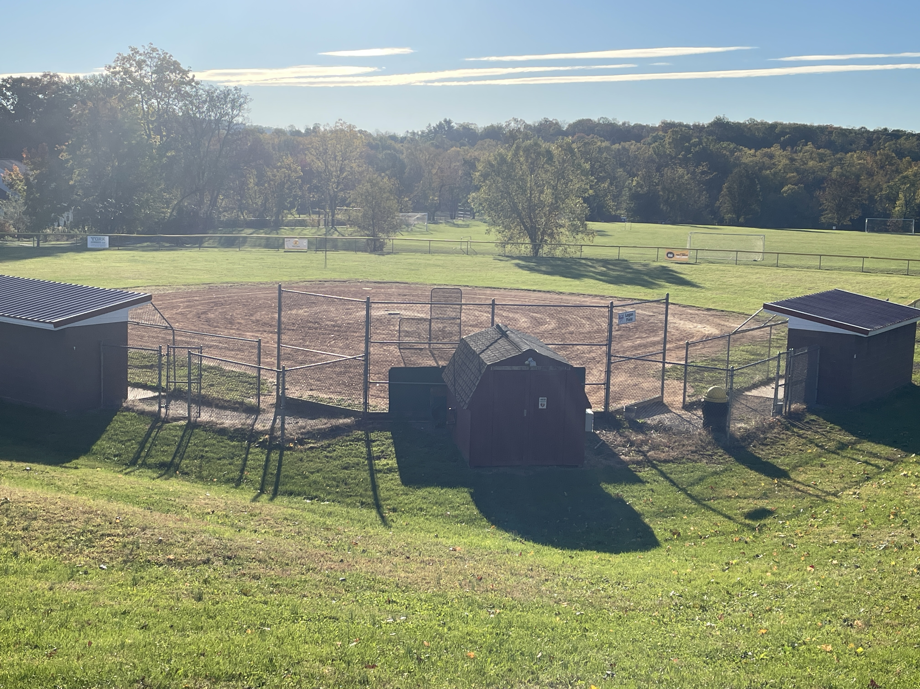
Welcome
At the command of the LORD they pitched. Numbers 9:18

Slide 2
AMERICAN IDOLS
Worshipping at the altar of …
Entertainment – Popularizing play without productivity.
Sports – Producing heroes without holiness.

Slide 3
Biblical Freedom to Enjoy
I Tim 4:4,5 Every creature of God is good, and nothing is to be refused if it is received with thanksgiving; for it is sanctified by the word of God and prayer.
➢ Appreciate God’s good gifts and gratefully bring Him into the moment.
➢ Athletes celebrating by kneeling to pray.

Slide 4
Biblical Freedom to Enjoy
I Cor 10:31 Whether you eat or drink, or whatever you do, do all to the glory of God.
➢ Even little things can reflect God’s character to anyone watching.
➢ Athletes using their “platform” to thank God, and their face paint to praise Him.
➢ Teams voluntarily sharing end-of-game prayer.

Slide 5
Bible “Sports & Exercise”
Archery - David, Jesus (Rev 6:2), Rom 3:23
Sailing - Noah, Jonah, Galilee
Running - Elijah, John, Isa 40:31
Those who wait on the LORD will renew their strength; They will run and not be weary; walk and not faint.

Slide 6
Sports in America (Pew Research Center)
- 48% took part in organized & competitive sports in High School or College.
- 82% view their participation positively.
- 38% closely follow college/professional sports.
- 53% football; 27% baseball; 8% basketball
- 19% bet money on sports in the past year.

Slide 7
Biblical Cautions for our Freedoms
Gal 5:13 You have been called to liberty; but do not use liberty as an opportunity for the flesh, but through love serve one another.
I Pet 2:16 Live as free, but do not use liberty as an excuse for vice, but as servants of God.

Slide 8
Luke 16:13 No servant can serve two masters; for either he will hate the one and love the other, or else he will be loyal to the one and despise the other. You cannot serve God and _________.
Sports

Slide 9
How can I tell if SPORTS (or anything else) has become my “god” or idol?
Psalm 106
1 – I take my cues from culture.
Ps 106:35 But (God’s people) mingled with the Gentiles and learned their works.

Slide 10
Sports may be an “idol” if …
2 – I am controlled, rather than in control.
Ps 106:36 They served their idols, which became a snare.

Slide 11
I may have an “idol” if …
3 – I sacrifice or even “kill” relationships for it.
Ps 106:37 They even sacrificed their sons and their daughters to demons,
38 And shed innocent blood, the blood of their sons and daughters, whom they sacrificed to the idols of Canaan.

Slide 12
Written statements by early Christians
“What happens in the arena is unworthy of your sight: the punches, kicks, blows into the face, impudent behavior of the fighters' hands and all the disfigurements of the human face, this image of God.”
Organized Athletics were rejected by the early Christian authors (especially wrestling and boxing) not only because of their cruelty and brutality, but also because of the associated eating practices.

Slide 13
But the decisive argument of early Christians against these athletic activities is its combination with idolatry.
“Even the outside apparatus of the games is stained by idolatry, by "sinful" wreathes of victory, by the oversight by the priesthood, and finally by the sacrificial blood of an ox.”

Slide 14
Has American Football become a Religion?
Holy Days/Nights -
Cathedrals/Churches -
Communion Table -
Sacraments -
Denominations -
Heaven -
MNF; TNF; Sundays
Stadiums
Tailgate Parties
Hot Dogs & Cold Beers
SEC; ACC; Big 10; Pac-12; AFC; NFC
Canton, Ohio; Hall of Fame

Slide 15
I may have an “idol” if …
4 – It leaves me feeling dirty and cheap.
Ps 106:39 Thus they were defiled by their own works, and played the harlot by their own deeds.

Slide 16
Modern sport can promote physical health and well-being and encourage the stewardship of our bodies.
At the same time, sport entails an elevated risk of injury and the potential for abuse.
Sometimes sport encourages violence as part of a competitive strategy and increases the probability of injury beyond a reasonable level.

Slide 17
An unhealthy pursuit of “winning” can encourage the use of questionable training habits and harmful performance-enhancing practices.
The human body is a reflection of the image of God and such practices should not be condoned.
Excusing injury/abuse
Encouraging violence
Using questionable performance enhancers

Slide 18
1Cor 6:19 Do you not know that your body is the temple of the Holy Spirit who is in you, whom you have from God, and you are not your own?
➢ Would you discredit “my body, my choice” as an abortion rational, but accept it for sports?
1Cor 6:20 For you were bought at a price; therefore glorify God in your body and in your spirit, which are God’s.

Slide 19
I may have an “idol” if …
5 – By my involvement I lose the desire for and sense of God’s blessing.
Ps 106:40 Therefore the wrath of the LORD was kindled against His people, so that He abhorred His own inheritance.

Slide 20
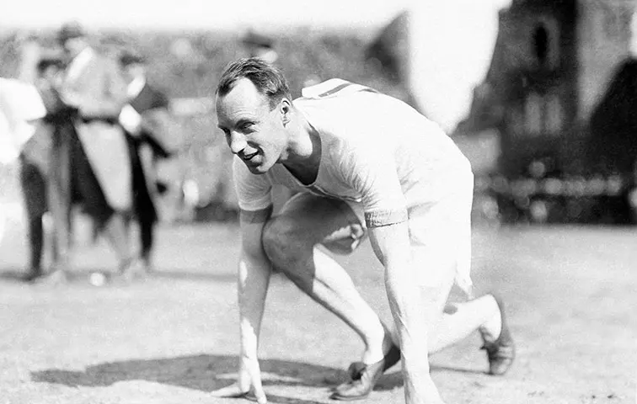
“God made me for
a purpose, but He
also made me fast.
And when I run, I
feel His pleasure.”
Eric Liddell (Chariots of Fire)
1924 Olympian
1945 Missionary Martyr

Slide 21
IF I have an idol …
6 – God’s mercy is essential.
Ps 106:44 Nevertheless He regarded their affliction, when He heard their cry;
Ps 106:45 And for their sake He remembered His covenant, and relented according to the multitude of His mercies.

Slide 22
God “redeems” athletics to teach us.
Heb 12:1,2 Lay aside every weight, and the sin which so easily ensnares, and run with endurance the race that is set before us.
Looking unto Jesus, the author and finisher of our faith, who for the joy that was set before Him endured the cross, despising the shame, and has sat down at the right hand of the throne of God.

Slide 23
Lessons from Heb 12:1,2
- Ditch distractions (weight/sin which entangle)
- Endurance is essential (run the race)
- Get to know the course (set before us)
- Learn from finishers (cloud of witnesses … looking to Jesus, THE author & finisher)
- Remember the rewards (joy before us)

Slide 24
I Cor 9:24 Those who run in a race all run, but one receives the prize. Run in such a way that you may obtain it.
25 Everyone who competes for the prize is self-controlled in all things. Now they do it to obtain a perishable crown, but we for an imperishable crown.

Slide 25
I Cor 9:26 And so I run, but not with uncertainty. I fight, but not as one who beats the air.
27 I discipline my body and bring it into subjection, lest, when I have preached to others, I myself should become disqualified.

Slide 26
Lessons from I Cor 9:24-27
Rewards are noble (24) - run to obtain it
Self-control is required (25) - in all things
Winning takes planning (26) - no uncertainty
Talk is cheap (27) - preached to others
“Losing” is serious (27) - disqualified
Titus 1:16 They profess to know God, but in works they deny Him, being abominable, disobedient, and disqualified for every good work.

Slide 27
Comparing … REWARDS
Sports - rewarded for winning
only 1 wins, others excluded by definition
the prize for winning is temporary
Soul - rewarded for faithfulness
wins are joint efforts
no shortage of awards
rewards are eternal

Slide 28
Comparing … COMPETITION
Sports - Effort & rivalry are good
Soul - effort is always good (Phil 3:14)
rivalry is usually bad (Phil 2:3,4)
provoking can be good
Col 3:21 - Dads DON’T provoke children to anger.
Heb 10:24,25 - believers DO provoke each other to love and good works.

Slide 29
Is there any question that sports have become idols in the hearts of many people?
Followers of Jesus Christ guide their life by “different rules” than the NCAA, NBA, NFL, MLB, MLS, etc.
Guard what is happening in your heart and with your family, too!

Slide 30
When GOOD things turn BAD
2Kgs 18:1 Hezekiah son of Ahaz began to rule over Judah in the third year of King Hoshea's reign in Israel.
3 He did what was pleasing in the LORD's sight, just as his ancestor David had done.
4 He removed the pagan shrines, smashed the sacred pillars, and cut down the Asherah poles.

Slide 31
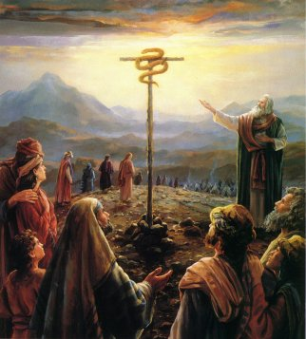
He broke up the bronze serpent that Moses had made,
because the people
of Israel had been
offering sacrifices to it.
The bronze serpent
was called Nehushtan.

Slide 32
Tear down that Idol (sports) if …
Culture, not Christ, is setting the rules.
Sports are controlling you, not you them.
Relationships are being killed, not blessed.
You’re left feeling cheap & dirty, not strong.
You win games, but are losing God’s blessing.
A good thing has turned bad.

