Slide 1
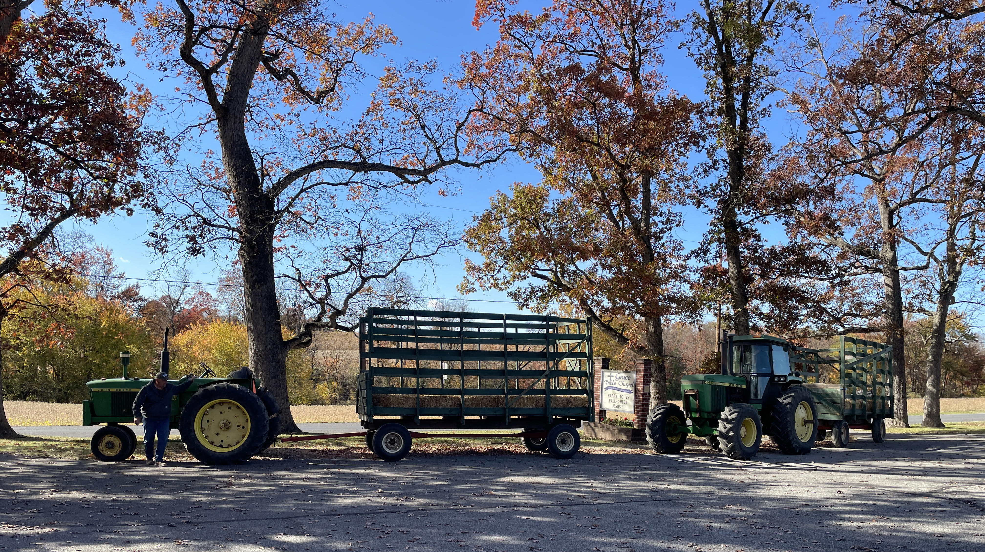
Welcome
Happy to be Fall-☺ween Jesus!

Slide 2
Pulling Down IDOLS
Exodus 20:3-5 You shall have no other gods before Me. You shall not make for yourself a carved image, you shall not bow down to them or serve them.
1Cor 10:14 My beloved, flee from idolatry.
1John 5:21 Keep yourselves from idols.

Slide 3
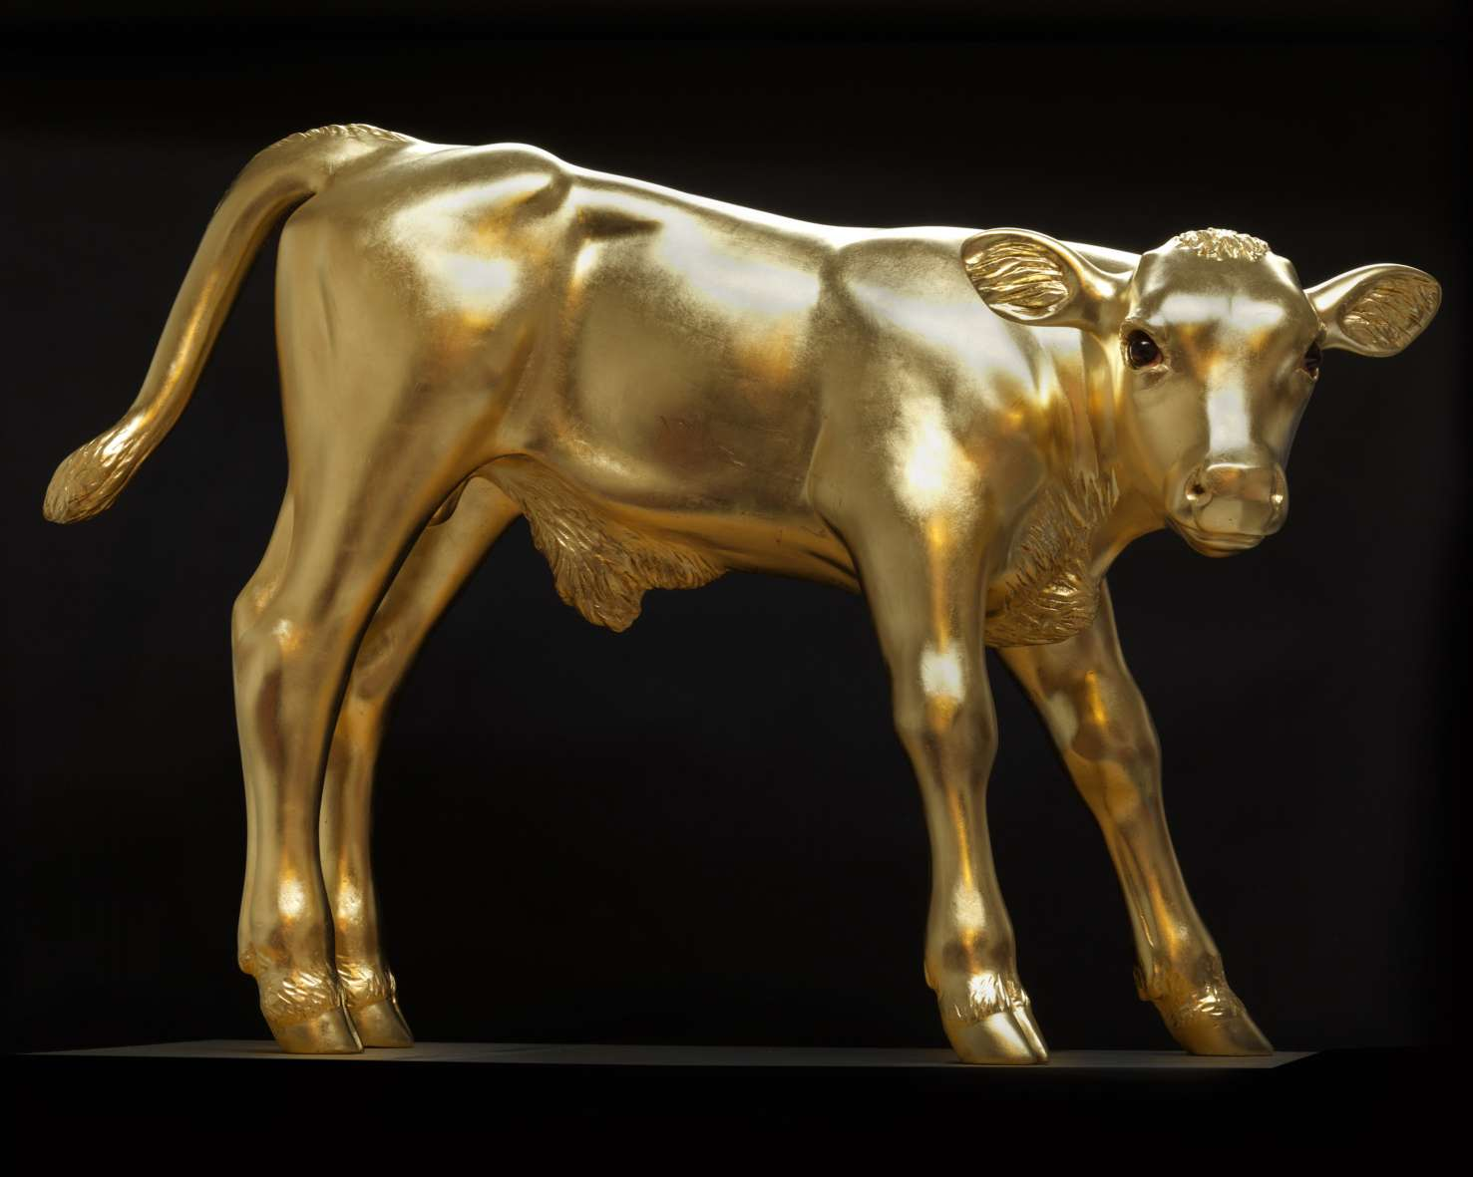
Egypt’s Golden Calf

Slide 4
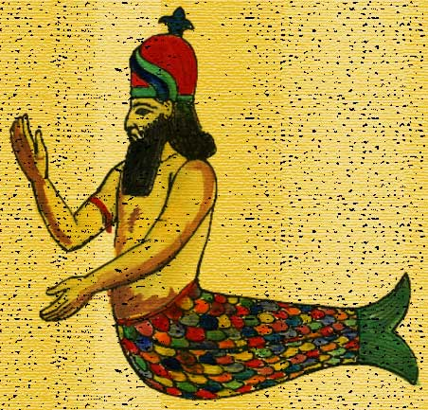
Philistine’s Dagon

Slide 5
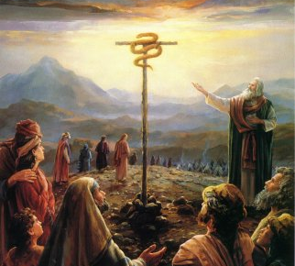
Israel’s Brass Serpent

Slide 6
It may be an Idol if (Psalm 106) …
(35) Culture, not Christ, is setting the rules.
(36) It is controlling you, not you it.
(37,38) Relationships are being killed, not blessed.
(39) You’re left feeling cheap & dirty, not strong.
(40) You are losing a desire for God’s blessing.
A good thing has turned bad (II Kings 18:4)

Slide 7
Daniel 3:1 Nebuchadnezzar the king made an image of gold. He set it up in the plain of Dura, in the province of Babylon.
4,5 Then a herald cried aloud: “At the time you hear the sound of the horn, flute, harp, lyre, and psaltery, you will fall down and worship the gold image that King Nebuchadnezzar has set up;

Slide 8
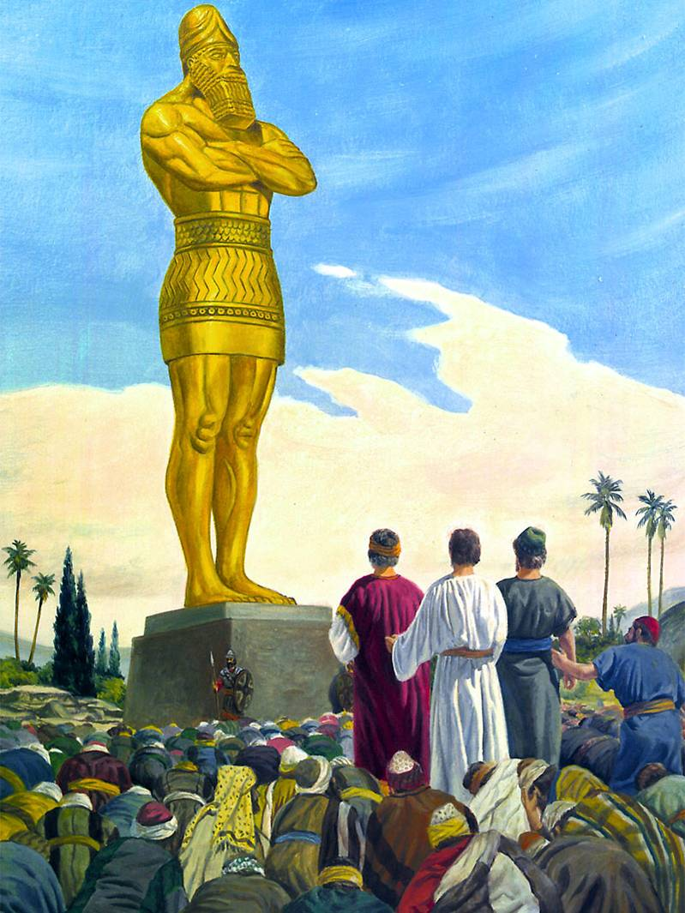
Daniel 3:1 Nebuchadnezzar the king made an image of gold. He set it up in the plain of Dura, in the province of Babylon.

Slide 9
Dan 3:4,5 Then a herald cried aloud: “When you hear the sound of the horn, flute, harp, lyre, and psaltery, you will fall down and worship the gold image set up by King Nebuchadnezzar.

Slide 10
Dan 3:6 and whoever does not fall down and worship will be cast immediately into a burning fiery furnace."

Slide 11
Worshipping at the altar of …
ENTERTAINMENT
Popularizing play without productivity
SPORTS
Exalting heroes without holiness
HEALTH
Pursuing eternal life apart from the God of eternity

Slide 12
Prov 3:7 Do not be wise in your own eyes; fear the LORD and depart from evil.
8 It will be HEALTH to your flesh, and strength to your bones.
3 John 1:2 Beloved, I pray that you may prosper in all things and be in HEALTH, just as your soul prospers.

Slide 13
Proverbs 3:1 My son, do not forget my law, but let your heart keep my commands;
2 For length of days and long life and peace (shalom) they will add to you.
shalom = peace, what God intended, completeness, soundness, welfare.
“wholistic health” before it was a fad!

Slide 14
Jesus’ Teaching (Matt 6) applied to Idols
24 No one can serve two masters. You cannot serve God and money.
Following the money is one of the surest ways to discover who or what are the idols.
Consider what the following figures reveal.

Slide 15
In 2022, Americans spent $13,493
per person on health care, totaling
$4.6 Trillion for the country.
The average American adult spends $1,860 per year on health & fitness.
Americans average $1,754 per year buying beauty products, cosmetics and services.

Slide 16
Jesus’ Teaching (Matt 6) applied to Idols
25 Therefore (since you can’t serve both God and your idol) do not worry about your life, what you will eat or drink; nor about your body, what you will put on.
➢ Idols cause life-dominating anxiety.
I constantly worry that I don’t exercise enough.
I always worry that I don’t eat the right food.
I worry everyday that I eat too much.

Slide 17
I may have a HEALTH idol if I am consumed by crazed calorie counting, mealtime manipulation, and weigh-in worries.
I may be living in unhealthy WORRY if I am wearing a mask while driving or walking alone.
➢ Idols cause life-dominating anxiety.

Slide 18
Jesus’ Teaching (Matt 6)
25 … Is not life more than food and the body more than clothing?
➢ Worshippers radically reduce life to the suffocating boundaries of their idol.
I will starve myself rather than look fat.
I will bankrupt myself to wear that outfit.
I will harm my body so that I can appear ripped or sexy or youthful.

Slide 19
Jesus’ Teaching (Matt 6)
26 Look at the birds. They don’t sow, reap or gather; yet your heavenly Father feeds them. Are you not of more value than they?
➢ Idol worshippers calculate their “worth” in terms of their idol.
No one likes me because I _____.
I hate myself because I _____.
God would love me if only I ____.

Slide 20
Fundamental differences between idols & God.
Pagan gods (demons) keep their worshippers feeling worthless & guessing what is wrong, all the while requiring greater & greater sacrifices.
(Prophets of Baal on Mount Carmel)
The God of the Bible clearly defines how to please Him, constantly assures of His love, and Himself provides the sacrifice when worshippers fail Him.
(Abram and Isaac on Mount Moriah)

Slide 21
John 3:16 God so loved the world (you) that He gave His only begotten Son (Jesus), that whoever believes in Him will not perish (Hell) but have everlasting life (Spiritual health now and Heaven forever).
Romans 5:8 God demonstrates his love toward us, in that, while we were yet sinners, Christ died for us.

Slide 22
Jesus’ Teaching (Matt 6)
27 Which of you by worrying (worshipping) can add a cubit (18 inches) to his stature?
➢ Idol worshippers are unrealistic.
More attention, more resources, more time will get me to the “big times”.
I’m inferior because my ___ is too small.
I’m superior because my ___ is so big.

Slide 23
Jesus’ Teaching (Matt 6)
28 Why do you worry about clothing?
30 If God clothes the grass of the field, which today is, and tomorrow is thrown into the oven, will He not much more clothe you, O you of little faith?
Idol worshippers have a FAITH issue.
I don’t believe God can be trusted with ___.

Slide 24
Heb 11:6 Without faith it is impossible to please Him, for he who comes to God must believe that He exists, and that He is a rewarder of those who diligently seek Him.
Prov 3:7 Do not be wise in your own eyes; FEAR the LORD and depart from evil.
8 It will be health to your flesh, and strength to your bones.

Slide 25
Matthew 6
(25) Idols cause life-dominating worry.
(25) Worshippers radically reduce life to the suffocating boundaries of their idol.
(26) Idol worshippers calculate their “worth” in terms of their idol.
(27) Idol worshippers are unrealistic.
(30) Idol worshippers have a faith issue.
(33) Idol worshippers have a KING decision.

Slide 26
Matt 6:33 Seek first the kingdom of God and His righteousness and all these things will be added to you.
Rom 14:17 The kingdom of God is not eating and drinking (Health), but (rather) righteousness and peace (shalom) and joy in the Holy Spirit.

Slide 27
What One Man Learned When
Christ Became His King
2Cor 4:14 He who raised up the Lord Jesus will also raise us up with Jesus, and will present us with you.
16 Therefore we do not lose heart. Even though our outward man is perishing, yet the inward man is being renewed daily.

Slide 28
2Cor 4:17 For our light affliction, which is but for a moment, is working for us an exceeding and eternal weight of glory,
18 while we do not look at the things which are seen, but at the things which are not seen. For the things which are seen are temporary, but the things which are not seen are eternal.

Slide 29
2Cor 12:7 Lest I (Paul) should be exalted above measure by the abundance of the revelations, a thorn in the flesh was given to me, a messenger of Satan to buffet me, lest I be exalted above measure.
8 Concerning this thing I pleaded with the Lord three times that it might depart from me.

Slide 30
2Cor 12:9 And He said to me, "My grace is sufficient for you, for My strength is made perfect in weakness.” Therefore most gladly I will boast in my infirmities (my health is not my King), that the power of Christ may rest upon me.

Slide 31
It began with HEALTH
Daniel 1:1 In the third year of the reign of Jehoiakim king of Judah, Nebuchadnezzar king of Babylon came to Jerusalem and besieged it.

Slide 32
Dan 1:2 And the Lord gave Jehoiakim king of Judah into Nebuchadnezzar’s hand, with some of the articles of the house of God, which he carried into the land of Babylon to the house of his god; and he brought the articles into the treasure house of his god.
3 Then the king instructed Ashpenaz, the master of his eunuchs, to bring some of the children of Israel and some of the king's descendants and some of the nobles,

Slide 33
Dan 1:4 young men in whom there was no blemish, but good-looking (healthy), gifted in all wisdom, possessing knowledge and quick to understand, who had ability to serve in the king's palace, and whom they might teach the language and literature of the Babylonians.
5 And the king appointed for them a daily provision of the king's delicacies and of the wine which he drank, and three years of training for them, so that at the end of that time they might serve before the king.

Slide 34
Dan 1:6 Now from among those of the sons of Judah were Daniel, Hananiah, Mishael, and Azariah.
7 To them the chief of the eunuchs gave names: Daniel was named Belteshazzar; Hananiah, Shadrach; Mishael, Meshach; Azariah, Abed-Nego.
8 But Daniel purposed in his heart that he would not defile himself with the portion of the king's delicacies, nor with the wine which he drank; therefore he requested of the chief of the eunuchs that he might not defile himself.

Slide 35
Fast Forward
Daniel 3:1 Nebuchadnezzar the king made an image of gold. He set it up in the plain of Dura, in the province of Babylon.

Slide 36
Dan 3:4,5 Then a herald cried aloud: “When you hear the sound of the horn, flute, harp, lyre, and psaltery, you will fall down and worship the gold image set up by King Nebuchadnezzar.

Slide 37
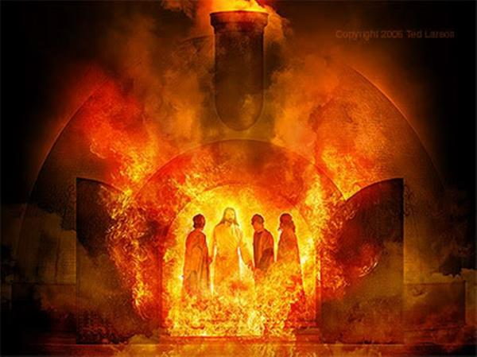
Dan 3:6 and whoever does not fall down and worship will be cast immediately into a burning fiery furnace."

Slide 38
Dan 3:16 Shadrach, Meshach, and Abed-Nego answered and said to the king, "O Nebuchadnezzar, we have no need to answer you in this matter.

Slide 39
Dan 3:17 If that is the case, our God whom we serve is able to deliver us from the burning fiery furnace, and He will deliver us from your hand, O king.
Dan 3:18 But if not, let it be known to you, O king, that we do not serve your gods, nor will we worship the gold image which you have set up."

Slide 40
Dan 3:28 Nebuchadnezzar spoke, saying, "Blessed be the God of Shadrach, Meshach, and Abed-Nego, who sent His Angel and delivered His servants who trusted in Him, and they have frustrated the king's word, and yielded their bodies, that they should not serve nor worship any god except their own God!

Slide 41
Matt 6:33 Seek first the kingdom of God.
Rom 12:1 I beseech you by the mercies of God, that you present your bodies a living sacrifice, holy, acceptable to God, which is your reasonable service.
2 And do not be conformed to this world, but be transformed by the renewing of your mind, that you may prove what is that good and acceptable and perfect will of God.

Slide 42
Worshipping
at the altar …
of HEALTH
Pursuing eternal LIFE
apart from the God of ETERNITY

Slide 43
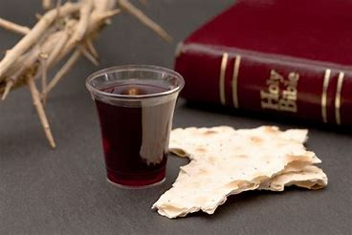

Slide 44
Give Me Jesus
In the morning when I rise,
In the morning when I rise.
In the morning when I rise.
Give me Jesus!

Slide 45
Give Me Jesus,
Give me Jesus!
You can have all this world,
but give me Jesus!

Slide 46
And when I am alone,
Yes, and when I am alone.
Oh when I am alone,
Give me Jesus!

Slide 47
Give Me Jesus,
Give me Jesus!
You can have all this world,
but give me Jesus!

Slide 48
And when I come to die,
Yes, and when I come to die.
Oh when I come to die,
Give me Jesus!

Slide 49
Give Me Jesus,
Give me Jesus!
You can have all this world,
but give me Jesus!

