Slide 1
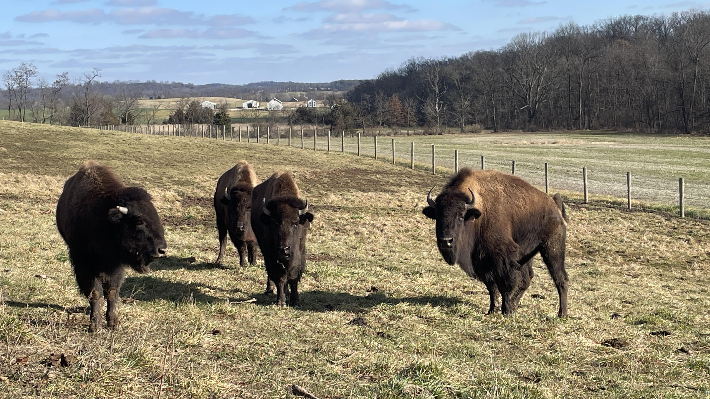
Welcome
“O give me a home …”
In My Father’s house are many mansions. Jn 14:2

Slide 2
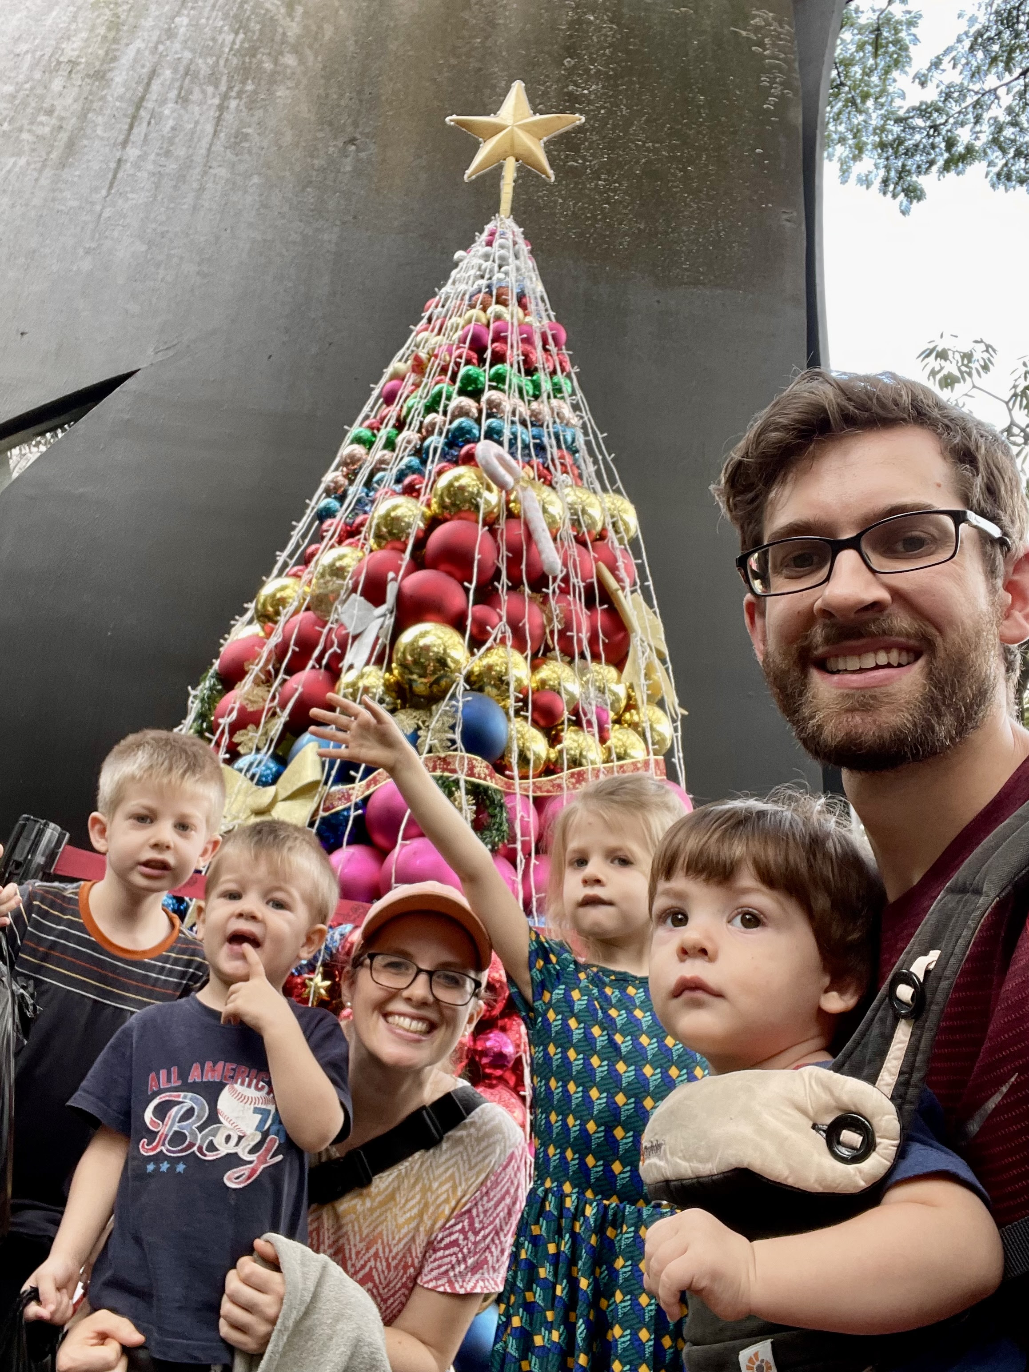
The Wagners
Serving in Indonesia
Caleb & Rebekah
Timothy, Charity.
Silas, Elias

Slide 3
GRACE BIBLE CHAPEL
Exploring our “Middle Name”
in 2024

Slide 4
Middle Names
Roman men used them as the family name, with the “last name” as a nickname.
Roman women had 2 names, slaves 1.
Europeans used names of saints as a sort of good luck feature.
Americans began using middle names widely at the start of the 1800’s (John Quincy Adams).
Main purpose = preserving family ties.

Slide 5
Has anyone ever asked you if “Jesus” was the Lord Jesus Christ’s “middle name”?
Jesus of Nazareth (John 18:5)
Jesus of Galilee (Matt 26:69)
Jesus Ben (son of) Joseph (John 1:45)
Carpenter, son of Mary (Mark 6:3)

Slide 6
Church Names
Denomination - Ground Oak Lutheran
Number - Tenth Presbyterian
Location - Pine Valley Baptist
Saints - Saint Francis Xavier Catholic Church
Fruit of the Spirit - Hope Church
Inviting - Open Arms Christian Fellowship
Grace Bible Chapel

Slide 7
Our “Middle Name” - BIBLE
Book of the Law (Deut 31:26)
The Scroll (Ps 40:7)
Sword of the Spirit (Eph 6:17)
Engrafted Word (James 1:21)
Word of Life (Phil 2:16)
Scripture (2 Tim 3:16)
Word of God (Luke 11:28)

Slide 8
many competitors
Other “holy books” (Mormon, Islam, Manifestos)
Popular and personal opinions
Psychology (DSM-5), philosophy, New Age, “isms” (Buddhism, Hinduism, Taoism, socialism, humanism, materialism, environmentalism, etc.)

Slide 9
Psalm 19:7 The law of the LORD is perfect, converting the soul; The testimony of the LORD is sure, making wise the simple;
8 The statutes of the LORD are right, rejoicing the heart; The commandment of the LORD is pure, enlightening the eyes;
9 The fear of the LORD is clean, enduring forever; The judgments of the LORD are true and righteous altogether.

Slide 10
Psalm 19:7-9
6 names for the Bible
6 characteristics of the Bible
6 benefits from the Bible
1 source for the Bible = “… of the LORD”

Slide 11
Ps 19:7 The LAW of the LORD (name for the Bible)
- God’s explanation of His rule over everything
- Not suggestions, but divine universal absolutes
➢ is perfect (characteristic of the Bible)
- complete, comprehensive, lacking nothing
converting the soul (benefit of the Bible)
- reviving, restoring, refreshing, redirecting
- having the power to totally transform the whole inner person.

Slide 12
Ps 19:7 The TESTIMONY of the LORD
- God’s revelation of Himself, His profile
- Key: “What does this tell me about God”?
➢ is sure
- trustworthy, “more sure word” (II Pet 2:19)
➢ making wise the simple (door swinging open)
- God’s biblical revelation makes naive & simple-minded folk skilled in godly living.

Slide 13
Ps 19:8 The STATUTES of the LORD
- statements of doctrine and theology (9:30 SS)
- principles for thinking & acting (One Year Bible)

Slide 14
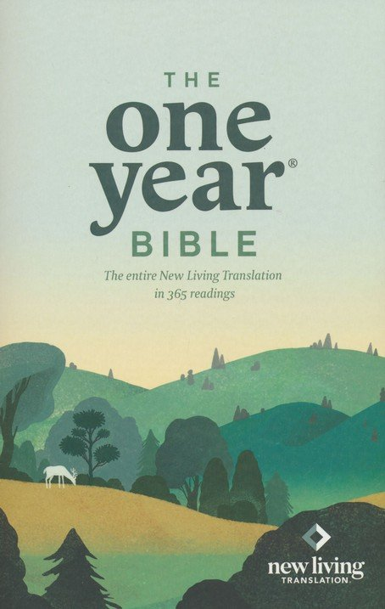
2024 GBC middle name
series.
Wednesdays favorite verse or insight for Jan & Feb.

Slide 15
Ps 19:8 The STATUTES of the LORD
- statements of doctrine and theology (9:30 SS)
- principles for thinking & acting (One Year Bible)
➢ are right
- defines the path between right & wrong
➢ rejoicing the heart
- deep joy from knowing and pleasing God
- spiritual antidote to confusion and depression

Slide 16
1John 1:4 These things we write to you that your joy may be full.
Jeremiah 15:16 Your words were found, and I ate them, and Your word was to me the joy and rejoicing of my heart; For I am called by Your name, O LORD God of hosts.
Col 3:16 Let the word of Christ dwell in you richly in all wisdom, teaching and admonishing one another in psalms and hymns and spiritual songs,
singing with grace in your hearts to the Lord.

Slide 17
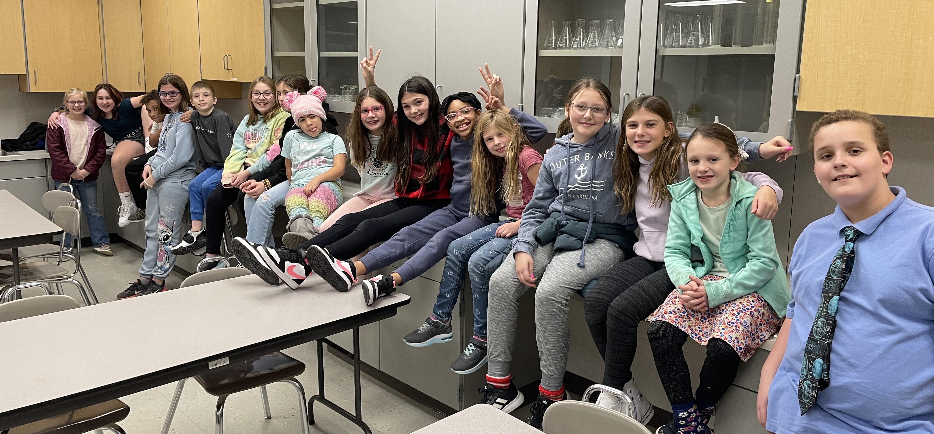
Conewago Valley Intermediate - Good News Club

Slide 18
Ps 19:8 The COMMANDMENT of the LORD
- Divine decrees, binding, nonoptional directives
- disobedience brings judgment, obedience blessing
➢ is pure
- clear, unclouded, easy to see, straightforward
➢ enlightening the eyes
- illuminates, reveals, “turns the light on”
- permeates life’s darkest corners with reality

Slide 19
John 14:1 Let not your heart be troubled; you believe in God, believe also in Me (Jesus).
2 In My Father's house are many mansions. I go to prepare a place for you.
3 I will come again and receive you to Myself; that where I am, there you may be also.
6 I am the way, the truth, and the life. No one comes to the Father except through Me.

Slide 20
Ps 19:9 The FEAR of the LORD
- humble, sober, wise response to GOD’s words.
- The Bible is a God-given manual for worship (Isa 6:1-5; John 4:23,24; Rev 1:9-17)
➢ is clean
- without error or corruption, undefiled, holy
➢ enduring forever
- always relevant, never out-of-date, beyond 17324
- “outside the box, but never outside the Bible”

Slide 21
Ps 19:9 The JUDGMENTS of the LORD
- Divine verdicts from the Divine Judge.
- rulings from the Supreme Court of the universe
➢ are true and righteous
- based on all the facts, without deceitful bias
- Shall not the Judge of all the earth do right? (Gen 18:25)
➢ altogether
- able to be totally & completely trusted & applied
- the SUFFICIENCY of scripture (Rev 22:18,19)

Slide 22
Psalm 19:10 More to be desired are they than gold, Yea, than much fine gold (valuable);
Sweeter also than honey and the honeycomb (desirable).
11 By them Your servant is warned (protects),
and in keeping them there is great reward (benefits).

Slide 23
GRACE BIBLE CHAPEL
Exploring our “Middle Name”

Slide 24
The law of the LORD is perfect, converting the soul;
The testimony of the LORD is sure, making wise the simple *
The statutes of the LORD are right, rejoicing the heart;
The commandment of the LORD is pure, enlightening the eyes *
The fear of the LORD is clean, enduring forever;
The judgments of the LORD are true & righteous altogether *
*More to be desired are they than gold, Yea, than much fine gold; Sweeter also than honey and the honeycomb.
Moreover by them is Your servant warned, And in keeping them there is great reward.

Slide 25
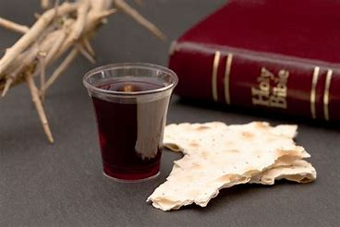

Slide 26
Psalm 19:14 Let the words of my mouth and the meditation of my heart be acceptable in Your sight, O LORD, my strength and my Redeemer.

