Slide 1
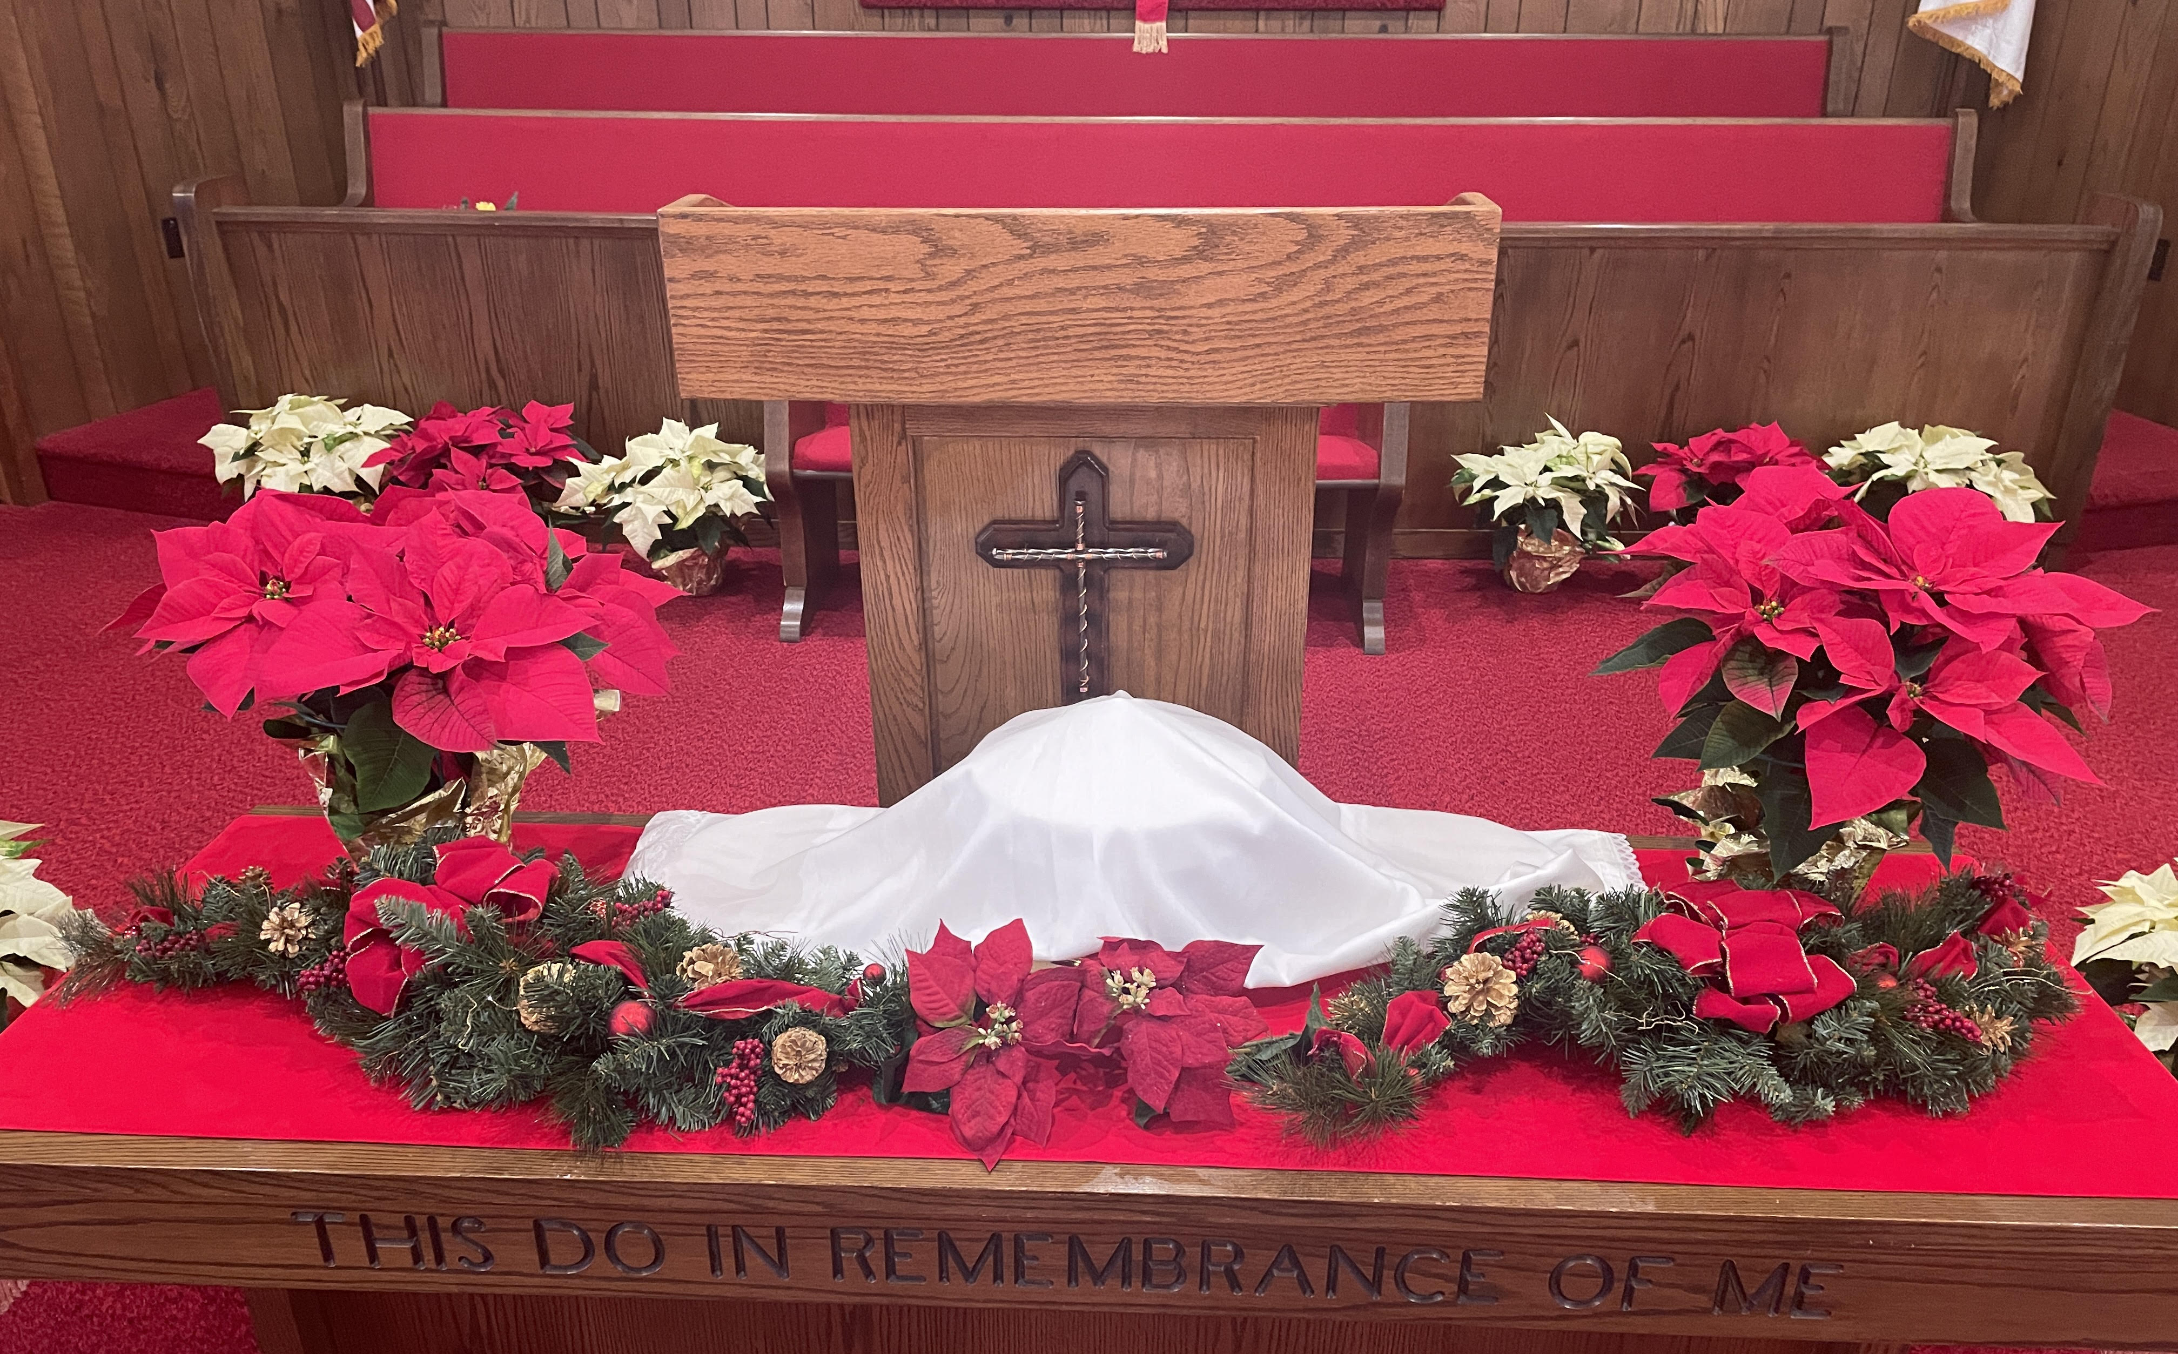
Welcome
Born to Die

Slide 2
Joy Has Dawned
Joy has dawned upon the world,
Promised from creation:
God’s salvation now unfurled,
Hope for ev’ry nation.

Slide 3
Not with fanfares from above,
Not with scenes of glory,
But a humble gift of love:
Jesus born of Mary.

Slide 4
Sounds of wonder fill the sky
With the songs of angels,
As the mighty Prince of Life
Shelters in a stable.

Slide 5
Hands that set each star in place,
Shaped the earth in darkness,
Cling now to a mother’s breast,
Vulner’ble and helpless.

Slide 6
Shepherds bow before the Lamb,
Gazing at the glory;
Gifts of men from distant lands
Prophesy the story.

Slide 7
Gold, a King is born today,
Incense, God is with us,
Myrrh, His death will make a way,
By His blood He’ll win us.

Slide 8
Son of Adam, Son of heav’n,
Given as a ransom,
Reconciling God and man,
Christ our mighty Champion!

Slide 9
What a Savior, what a Friend,
What a glorious mystery:
Once a babe in Bethlehem,
Now the Lord of history.
X

Slide 10
Go, Tell It on the Mountain (# 205)
While shepherds kept their watching o’er silent flocks by night, behold throughout the heavens, there shone a holy light.

Slide 11
Go, tell it on the mountain, over the hills and everywhere. Go, tell it on the mountain that Jesus Christ is born.

Slide 12
The shepherds feared and trembled when lo! above the earth rang out the angel chorus that hailed our Savior's birth.

Slide 13
Go, tell it on the mountain, over the hills and everywhere. Go, tell it on the mountain that Jesus Christ is born.

Slide 14
Down in a lowly manger our humble Christ was born, and God sent us salvation, that blessed Christmas morn.

Slide 15
Go, tell it on the mountain, over the hills and everywhere. Go, tell it on the mountain that Jesus Christ is born.
X

Slide 16
Isaiah 9:6
No Sunday or Wednesday weather cancellations.
All others, contact event leader.
Always travel at your own discretion.

Slide 17
Isaiah 9:6
Unto us a Child is born,
unto us a Son is given;
the government will be upon His shoulder.
and His name will be called …

Slide 18
What’s in a NAME?
Most popular names in US (2020)
- Baby girls – Olivia, Emma, Ava
- Baby boys – Liam, Noah, Oliver
Least popular names (2021 Social Security)
- Yaritza (“small butterfly”)
- Vivaan
- Marissa

Slide 19
What’s in a BIBLE Name?
- Origen (Adam = dust, dirt; Eve = living)
- Purpose (Sarah = princess; Peter = rock)
- Character (Jacob = deceiver; David = beloved)
When characters change, names change
- Jacob becomes Israel = contends with God
- Saul becomes Paul = small or humble
- Lucifer (light bearer) becomes Satan (adversary)

Slide 20
Context of Isaiah 9:6
Chpt 1 – Judah is rebellious, dull and dead.
Ch 5 – Nation filled with greed, conceit, defiance, hypocrisy, moral impurity (6:5)
Discipline has failed. God’s judgment awaits.
Ch 9,10 – Yet, His hand stretches out (5x).
Ray of light (9:2); hope for a remnant (10:21)
Child will be born, a Son will be given (9:6)

Slide 21
Is 9:6 He will be called Wonderful Counselor.
What He DOES will be wonderful.
Ex 15:11 Who is like You, O LORD, among the gods? Glorious in holiness, fearful in praises, doing wonders.
Isa 25:1 O LORD, I will praise Your name, for You have done wonderful things; Your counsels of old are faithfulness and truth.

Slide 22
What He DOES will be miraculous.
Ex 3:20 I will stretch out My hand and strike Egypt with all My wonders which I will do in its midst; after that he will let you go.
Zech 8:6 If it is wonderful to this people in these days, will it also be wonderful in My eyes? says the LORD of hosts.

Slide 23
What He SAYS will be wonderful.
Ps 119:129 Your testimonies are wonderful; therefore my soul keeps them.
John 1:1 In the beginning was the Word, and the Word was God.
3 All things were made through Him.
Luke 4:22 All bore witness to Him (Jesus), and marveled at the gracious words.

Slide 24
His BIRTH will be wonderful
(this Child born, this Son given)
Luke 2:18 All those who heard it marveled at the things told them by the shepherds.
Luke 2:33 Joseph and Mary marveled at those things which were spoken of Jesus.
II Cor 9:15 Thanks be to God for His unspeakable (mind-blowing) gift!

Slide 25
His COUNSEL will be wonderful
Ps 16:7 I will bless the LORD who has given me counsel; My heart also instructs me in the night seasons.
John 3:2 Nicodemus came to Jesus by night and said, “We know that You are a teacher come from God; for no one can do these signs that You do unless God is with him."

Slide 26
Jesus Wonderfully Counsels
“Outcasts” (John 4 - Woman at the well)
Jesus crosses barriers wonderfully.
(4,5) racial - Samaritans married Canaanites
(6) cultural - 6th hour (noon) is too late
(7) gender - men don’t speak with women
(17,18) moral - multiple marriages, live-in
(9) How is it that you talk with me?

Slide 27
Jesus exposes her heart wonderfully.
(4:10) Are you trusting Who or what?
(13) Are your needs eternal or temporary?
(14) Are your solutions internal or external?
(15-18) You need humility not humiliation.
(8:3) adulterous woman; (Lk 7:37) woman of the city
(19) I perceive that You are a prophet.

Slide 28
Jesus addresses worship wonderfully
(20,21) Not fathers (tradition) but Father (relation)
(21) Where you worship is not the issue.
(23) Who you worship is critical.
(24) How you worship reflects Who you worship.
in spirit = from your heart & enthusiastically
in truth = with your mind & biblically

Slide 29
Jesus offers Himself wonderfully.
(25,26) The promised Messiah.
(28,29) One for whom you leave all lesser things.
(39) One Who knows you, yet still loves you.
(41,42) One Who loves your friends, too.

Slide 30
Jesus Wonderfully Counsels
“Outcasts” (Woman at the well)
By probing her lack of satisfaction - Thirst
“Insiders” (John 3 - Nicodemus)
By confronting his self-satisfaction - Birth
(1) Despite his religious & political accomplishment
(2) Despite his theological & personal humility
(7) You must be born again, with no personal credit

Slide 31
We understand why Jesus treats the “outcast” as a needy sinner - all messed up!
We may not understand why Jesus treats this “insider” as a sinner - all dressed up.
Sin is looking to someone/something other than God (including yourself) for salvation.
Salvation is God’s free gift of grace with no outside contribution but repentance.

Slide 32
Both outcast and insider can be saved, not because of what they have done,
but because of what Jesus has done!
Because He said, “I thirst”, He can save.
Because He was “born of a virgin”, He can save.
Because He is the Wonderful Counselor, what He says and does is what all sinners need!
O Come, Let Us Adore Him!

