Slide 1
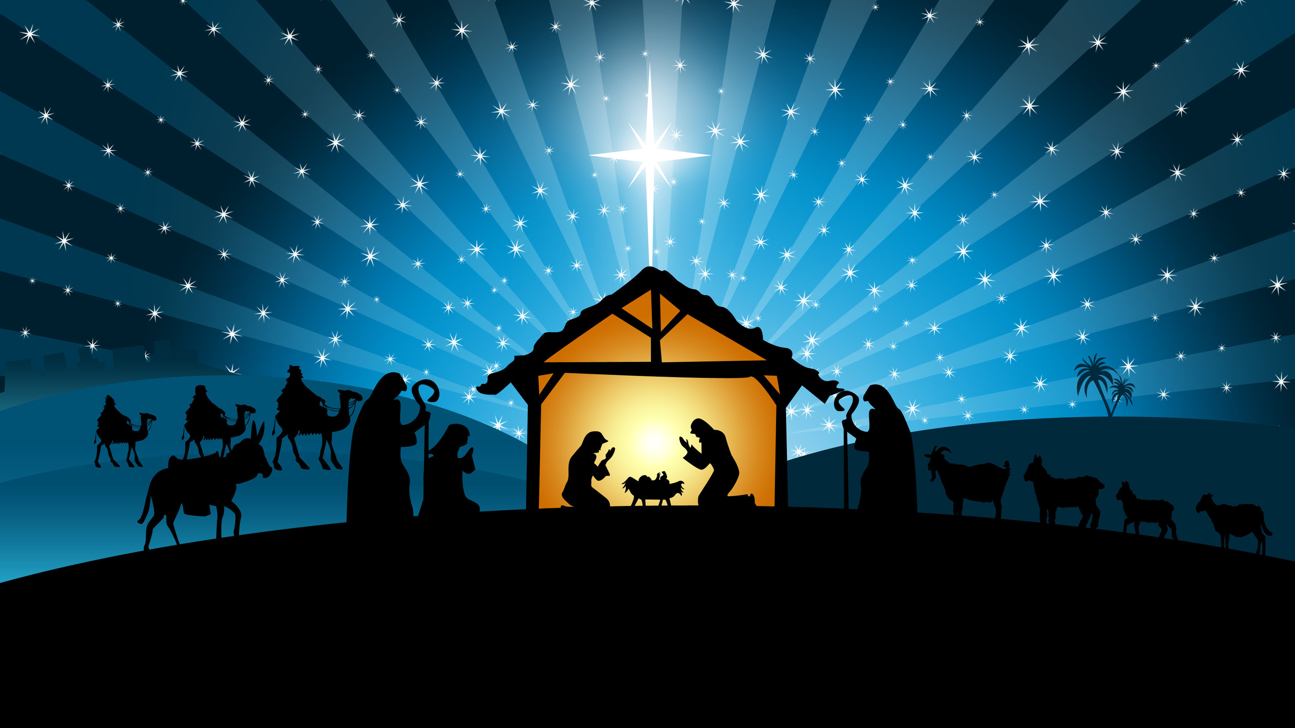
Welcome to GBC
2 Cor 9:15 Thanks be to God for His indescribable gift!
December 24, 2023

Slide 2
Isaiah 9:6
Unto us a Child is born, unto us a Son is given; And the government will be upon His shoulder. And His name will be called Wonderful Counselor, Mighty God, Everlasting Father,
Prince of Peace.

Slide 3
Vacation in Hawaii - “Aloha!”
Travel to Australia - “Good on ya, mate!”
Arrive in Israel - “Shalom!”
Jerusalem (yer-oo-shaw-lah-yim)
Solomon (shelomoh)
God - Judges 6:24 - Jehovah Shalom
- Isa 9:6 - Prince of Shalom

Slide 4
Prince of Peace
Prince = captain, keeper, governor, leader
Isa 1:23 - rebellious, companions of thieves
3:4 - replaced with immature children
3:14,15 - plunder & beat the most vulnerable
9:6,7 - But … help and hope is coming!!
Prince of Peace = Shalom

Slide 5
In the Bible, SHALOM means …
– universal flourishing, wholeness and delight,
– a rich state of affairs where natural needs are satisfied and natural gifts are fruitfully employed,
– a condition inspiring joyful wonder as the Creator and Savior opens doors and welcomes the creatures in whom He delights.
– Shalom, in a word, is the way things ought to be. - Cornelius Plantinga

Slide 6
1 - Shalom can be BETWEEN people
➢ Alternative to a probable fight.
Deut 20:10 When you go near a city to fight against it, then proclaim an offer of peace to it.
➢ Alternative to war
Ps 120:7 I am for peace; But they are for war.
Eccl 3:1,8 To everything there is a season. A time of war, and a time of peace.

Slide 7
2 - Shalom can be BETWEEN people & nature
➢ harmful beasts banished & briers tamed.
Lev 26:6 I will give peace in the land, and you shall lie down, and none will make you afraid; I will rid the land of evil beasts, and the sword will not go through your land.

Slide 8
2 - Shalom can be BETWEEN people & nature
➢ harmful beasts banished & briers tamed.
Isa 55:12,13 You will go out with joy, and be led out with peace; The mountains and the hills will break forth into singing before you, and all the trees of the field will clap their hands.
Instead of the thorn will come up the cypress tree, and instead of the brier the myrtle tree.

Slide 9
2 - Shalom can be BETWEEN people & nature
➢ dangerous winds & waves calmed
Mark 4:37-39 A great windstorm arose, and the waves beat into the boat, so that it was already filling. And they awoke Jesus and said to Him, "Teacher, do You not care that we are perishing?" Then He arose and rebuked the wind, and said to the sea, "Peace, be still!" And the wind ceased and there was a great calm.

Slide 10
3 - Shalom can be WITHIN a man or woman
➢ peace on the heart level (John 14:27)
Peace I (Jesus) leave with you, my peace I give to you; not as the world gives. Let not your heart be troubled, neither let it be afraid.
➢ well-being “as it’s meant to be” (Jer 29:11)
I know the thoughts that I think toward you, says the LORD, thoughts of shalom and not of evil, to give you a future and a hope.

Slide 11
➢ Eden (Genesis 3) - Loss of Shalom.
(2-6) loss rooted in conflict with God
(7,8,10) producing inner conflict & outer covering
(11,12) resulting in interpersonal conflict
(16,17) including conflict in and with creation
Violence, pain, heartache and death are very real proofs that peace, the “way things are meant to be”, has been lost long ago.

Slide 12
Until the root conflict with God is ended,
the fruit of that conflict remains.
- conflict inside a person
- conflict between people
- conflict between people and nature
Jer 6:14 They have healed the hurt of My people lightly, Saying, Shalom, shalom!' When there is no shalom.

Slide 13
➢ Prophecy (Isaiah 53) - Restoration of Shalom
(9) One is coming who has no conflict with God.
(4,10) He will choose to be part of the peace plan.
(4,5,12) He will pay for peace with His sinless life.
(4,5,6) He will die because of our conflict with God.
(5) Peace with God is available only in Him.
Rom 5:1 Being justified by faith, we have peace with God through our Lord Jesus Christ.”

Slide 14
➢ Announcement - The arrival of Shalom
Luke 2:14 Glory to God in the highest, and on earth peace (shalom), goodwill toward men!
First, God’s shalom is available personally to men and women right now. “Peace among men with whom He is pleased.”
Secondly, the angel’s announcement of “on earth shalom” declared the arrival of the only One who can bring lasting peace worldwide.

Slide 15
John 16:33 These things I (Jesus) have spoken to you, that in Me you may have shalom. In the world you will have tribulation; but be of good cheer, I have overcome the world.
Rom 14:17 The kingdom of God is not eating and drinking, but righteousness and shalom and joy in the Holy Spirit.
Gal 5:22 The fruit of the Spirit is love, joy, peace.

Slide 16
Phil 4:6 Be anxious for nothing, but in everything by prayer and supplication, with thanksgiving, let your requests be made known to God;
7 and the peace (shalom) of God, which surpasses all understanding, will guard your hearts and minds through Christ Jesus.

Slide 17
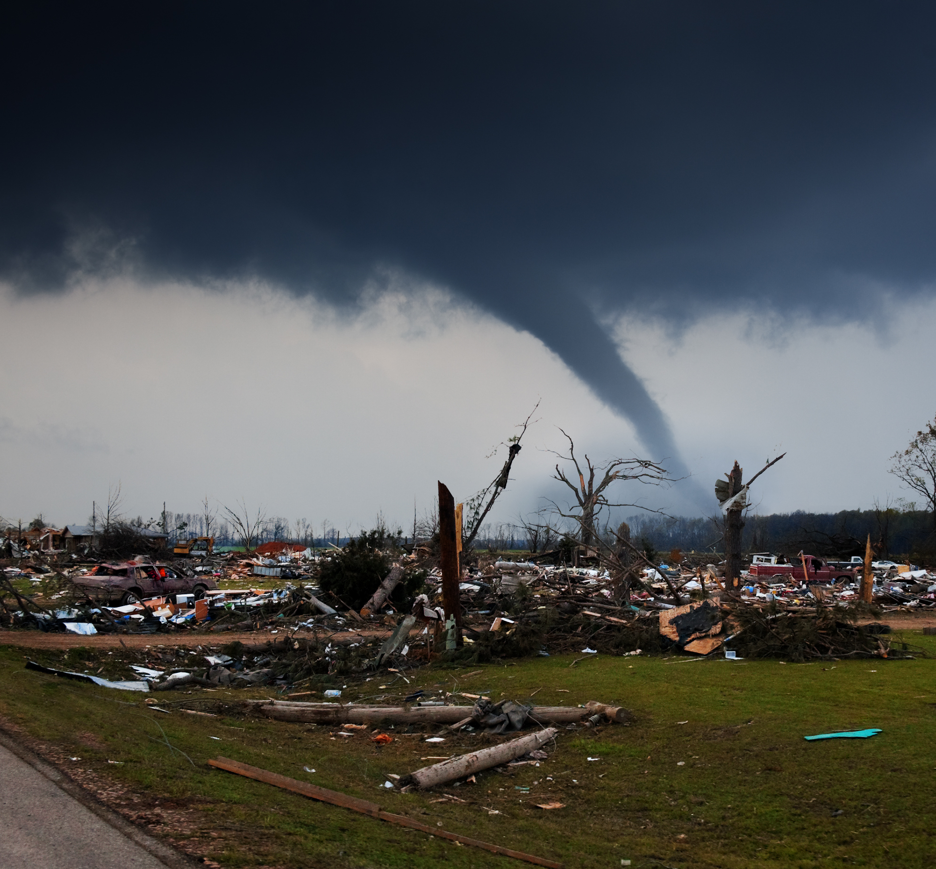
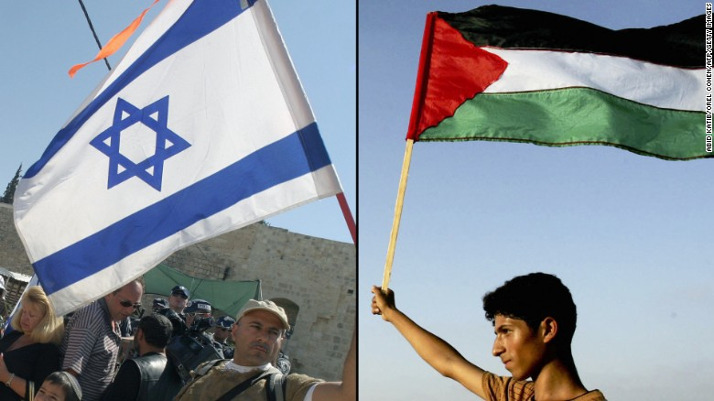

Isaiah 9:6
For unto us a Child is born, unto us a Son is given. And His name will be called … Prince of Peace.

Slide 18
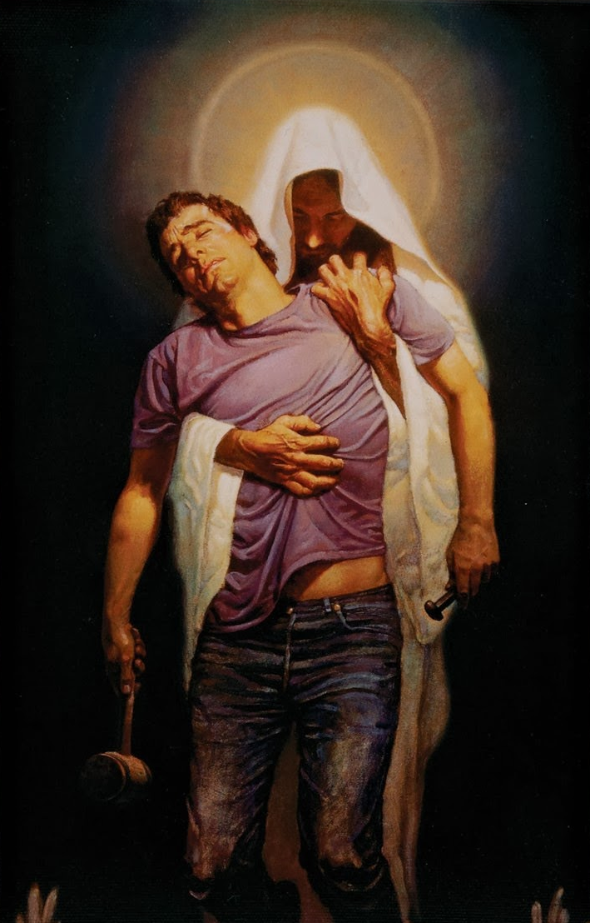
Prince of Peace.

Slide 19
When peace, like a river, attendeth my way,
When sorrows like sea billows roll;
Whatever my lot,
Thou hast taught me to say,
It is well, it is well with my soul.

Slide 20
Though Satan should buffet, though trials should come,
Let this blest assurance control,
That Christ hath regarded my helpless estate,
And hath shed His own blood for my soul.

Slide 21
  It is well
  with my soul,
  It is well, it is well
  with my soul.

Slide 22
My sin—oh, the bliss of this glorious thought!—
My sin, not in part but the whole,
Is nailed to the cross, and I bear it no more,
Praise the Lord, praise the Lord,
O my soul!

Slide 23
And Lord, haste the day when the faith shall be sight,
The clouds be rolled back as a scroll;
The trump shall resound,
and the Lord shall descend,
Even so, it is well with my soul.

Slide 24
  It is well
  with my soul,
  It is well, it is well
  with my soul.

