Slide 1
Welcome to GBC
They presented gifts to Him: gold, frankincense, and myrrh.

Slide 2
GRACE BIBLE CHAPEL
Exploring our “First Name”
Grow in the GRACE and knowledge of our Lord Jesus Christ. II Peter 3:18
Grace for Grace

Slide 3
John 1:14 The Word became flesh and dwelt among us, and we beheld His glory, the glory as of the only begotten of the Father, full of grace and truth. (Grace Arrives)
15 John bore witness and said, "This was He of whom I said, 'He who comes after me is preferred before me, for He was before me.’ “ (Grace Announced)
16 Of His fullness we have all received, and grace for grace. (Grace’s Activity)
17 The law was given through Moses, but grace and truth came through Jesus Christ. (Grace’s Alternative)

Slide 4
Five Responses to God’s Amazing Grace
G – Giving (II Corinthians 8:7,9)
7 As you abound in everything—in faith, speech, knowledge, diligence, and love for us—see that you abound in this grace also.
9 For you know the grace of our Lord Jesus Christ, that though He was rich, yet for your sakes He became poor, that you through His poverty might become rich.

Slide 5
The GRACE of Giving for …
Zacchaeus (Luke 19:1-10)
Woman of the City (Luke 7:36-50)

Slide 6
Five Responses to God’s Amazing Grace
G – Giving
R – Reading (Acts 20:32; I Peter 2:2,3)
Acts 20:32 Brothers, I commend you to God and to the word of His grace.
1Peter 2:2,3 As newborn babes, desire the pure milk of the word, that you may grow,
if indeed you have tasted that the Lord is gracious.

Slide 7
The GRACE of “Being with Jesus” for …
Man with an unclean spirit (Mark 5:1-20)
(17) Crowd – “we lost, so you leave”
(18) Man – “I’m loosed, please don’t leave”

Slide 8
Five Responses to God’s Amazing Grace
G – Giving
R – Reading
A – Assisting (I Cor 15:10; Rom 12:6)
1Cor 15:10 God’s grace toward me was not in vain; but I labored more abundantly than they all, yet not I, but the grace of God which was with me.
Rom 12:6 Having gifts differing according to the grace given to us, let us use them.

Slide 9
The GRACE of Assisting for …
Jailer at Philippi (Acts 16:25-34)
(33) first-aid
(34) hospitality

Slide 10
Five Responses to God’s Amazing Grace
G – Giving
R – Reading
A – Assisting
C – Coming Boldly (Hebrews 4:14,16)
14 Seeing that we have a great High Priest, Jesus the Son of God,
16 Let us come boldly to the throne of grace, that we may obtain mercy and find grace to help in time of need.

Slide 11
The GRACE of Praying …
In times of need (Heb 4)
(14,15) WHO grace connects us to
Jesus who is ascended, beloved, sympathetic, tested, triumphant
(16) WHAT grace lets us do
come boldly, obtain mercy, find more grace (frapping of a ship – Acts 27:17)

Slide 12
Five Responses to God’s Amazing Grace
G – Giving
R – Reading
A – Assisting
C – Coming Boldly
E – Evangelizing (Ephesians 3:8)
8 To me (Paul), who am less than the least of all the saints, this grace was given, that I should preach among the Gentiles the unsearchable riches of Christ.

Slide 13
2Cor 9:15 Thanks be to God for his unspeakable gift.
Rom 5:1,2 Our Lord Jesus Christ, through Whom also we have access by faith into this grace in which we stand and rejoice in hope of the glory of God.

Slide 14
Grace Living in Acts 2
G – Giving
Acts 2:45 They sold their possessions and goods, and divided them among all, as anyone had need.
Invitation to regularly give of your resources (sharing & tithing).

Slide 15
Grace Living in Acts 2
G – Giving
R – Reading
Acts 2:42 They continued steadfastly in the apostles' doctrine.
Invitation to read your Bible at least 3 days each week.

Slide 16
Grace Living in Acts 2
G – Giving
R – Reading
A – Assisting
Acts 2:44,46 All who believed had all things in common … continuing daily in the temple, and breaking bread from house to house.
Invitation to personally bless others at least once each month/week.

Slide 17
Grace Living in Acts 2
G – Giving
R – Reading
A – Assisting
C – Coming Boldly
Acts 2:42,47 They continued steadfastly … in prayers … praising God.
Invitation to participate in at least 1 GBC Prayer Time each month/week.

Slide 18
Grace Living in Acts 2
G – Giving
R – Reading
A – Assisting
C – Coming Boldly
E – Evangelizing
Acts 2:47 And the Lord added to the church daily those who were being saved.
Invitation to speak of Jesus with at least 1 person each month.

Slide 19
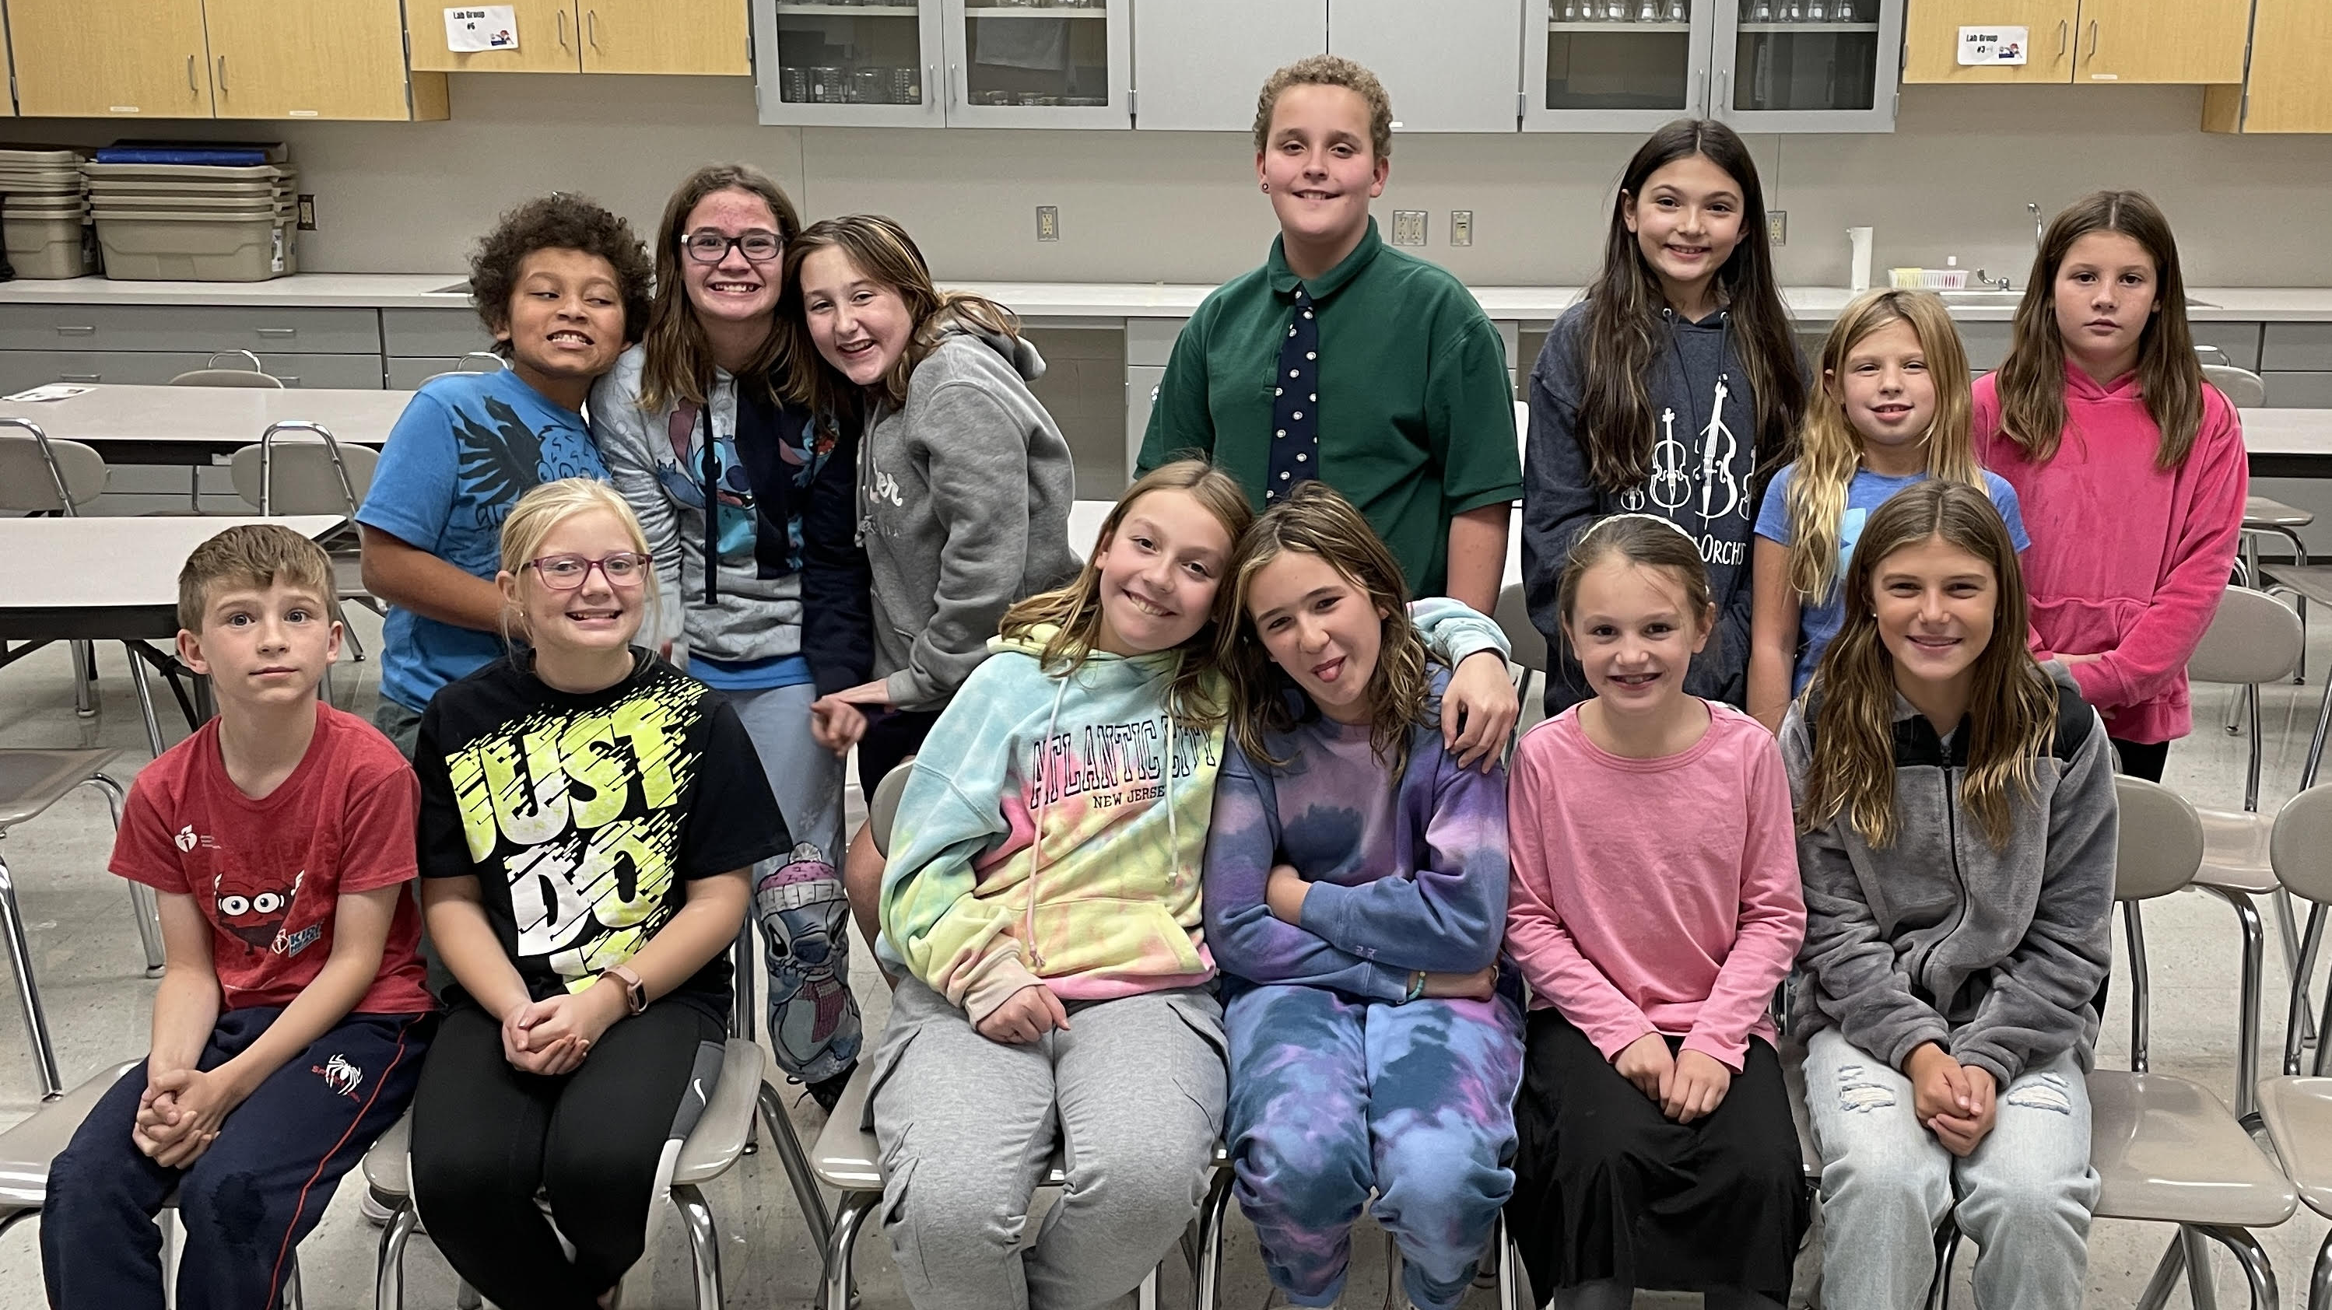

Slide 20
GRACE BIBLE CHAPEL
Exploring our “First Name”
Grow in the GRACE and knowledge of our Lord Jesus Christ. II Peter 3:18
G.R.A.C.E. for Grace

Slide 21
Grace Alone (# 128)
Every promise we can make,
Every prayer and step of faith,
Every difference we will make
- Is only by His grace.

Slide 22
Every mountain we will climb,
Every ray of hope we shine,
Every blessing left behind
- Is only by His grace.

Slide 23
Grace alone which God supplies,
Strength unknown He will provide.
Christ in us, our Cornerstone;
We will go forth
In grace alone.

Slide 24
Every soul we long to reach,
Every heart we hope to teach,
Every where we share His peace
- Is only by His grace.

Slide 25
Every loving word we say,
Every tear we wipe away,
Every sorrow turned to praise,
- Is only by His grace.

Slide 26
Grace alone which God supplies,
Strength unknown He will provide.
Christ in us, our Cornerstone;
We will go forth
In grace alone.

Slide 27
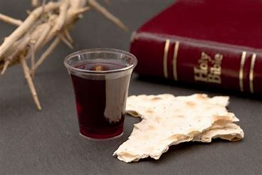

Slide 28
(# 570)
Blessed be the tie that binds
our hearts in Christian love.
The fellowship of kindred minds
is like to that above.

Slide 29
Before our Father's throne, We pour our ardent prayers; Our fears, our hopes, our aims are one-- Our comforts and our cares.

Slide 30
When we asunder part, It gives us inward pain; But we shall still be joined in heart, And hope to meet again.

Slide 31
Welcome to GBC
Thanks be to God for His unspeakable gift.

