Slide 1
Basic Biblical Doctrines
TRINITY (God Is)
REVELATION (God speaks)
CREATION (God Makes)
IMAGE (God Reflected)
FALL (God Rejected)

Slide 2
Gen 1-11 - We see God calling creation into existence and then its catastrophic spiral down into deepest wickedness.
Spiral # 1 - Lucifer and angels in Heaven
Spiral # 2 - Serpent and Adam & Eve in Eden
Spiral # 3 - Sons of God & daughters of men at flood
Spiral # 4 - Mankind divided & scattered at Babel
Gen 12-50 - God calling people into covenant to restart His program to redeem sinners.

Slide 3
Basic Biblical Doctrines
TRINITY (God Is)
REVELATION (God speaks)
CREATION (God Makes)
IMAGE (God Reflected)
FALL (God Rejected)
COVENANT (God Pursues)

Slide 4
BIBLICAL COVENANTS
God’s Covenant with NOAH - Genesis 9
(1) Mediator - Noah (grace 6:8; and obedience 6:22)
(4-6) Conditions - Not drinking animal blood and protecting the sanctity of human life
(11) Blessings - Physical salvation and promise not to destroy the earth again with a flood
(12-17) Sign = Internal is faith, External is rainbow
(18,19) Community - Family (Heb 11:7)
(20,21) Beginnings of trouble - Drunkenness

Slide 5
God’s Covenant with ABRAHAM – Genesis 15
(1) Mediator - Abraham
- born in modern day Iraq (Neh 9:7; Acts 7:2,3).
- may have been near or even involved with the ill-fated building project at “Babel”.
- like Noah, he was only a sinner, from a pagan family, who “found grace” (Josh 24:2).
- Important ties to Gen 3:15 and the promised “seed” (Gal 3:16).

Slide 6
God’s Covenant with ABRAHAM – Genesis 15
(4,5,7) Blessings - Isaac the heir (not Eliezar or Ishmael),
w/countless descendants (including the Messiah
Land included (see also 18-21)
(6) Conditions - Faith in the Promise Giver - pivotal verse. Rom 4:3; Gal 3:6; James 2:23,24; Heb 11:8-19
(8-11,17) Sign - Party passes between split animals

Slide 7
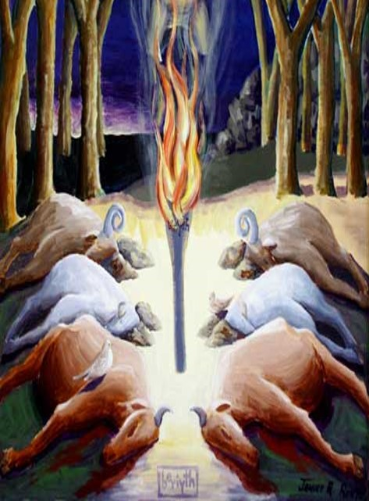
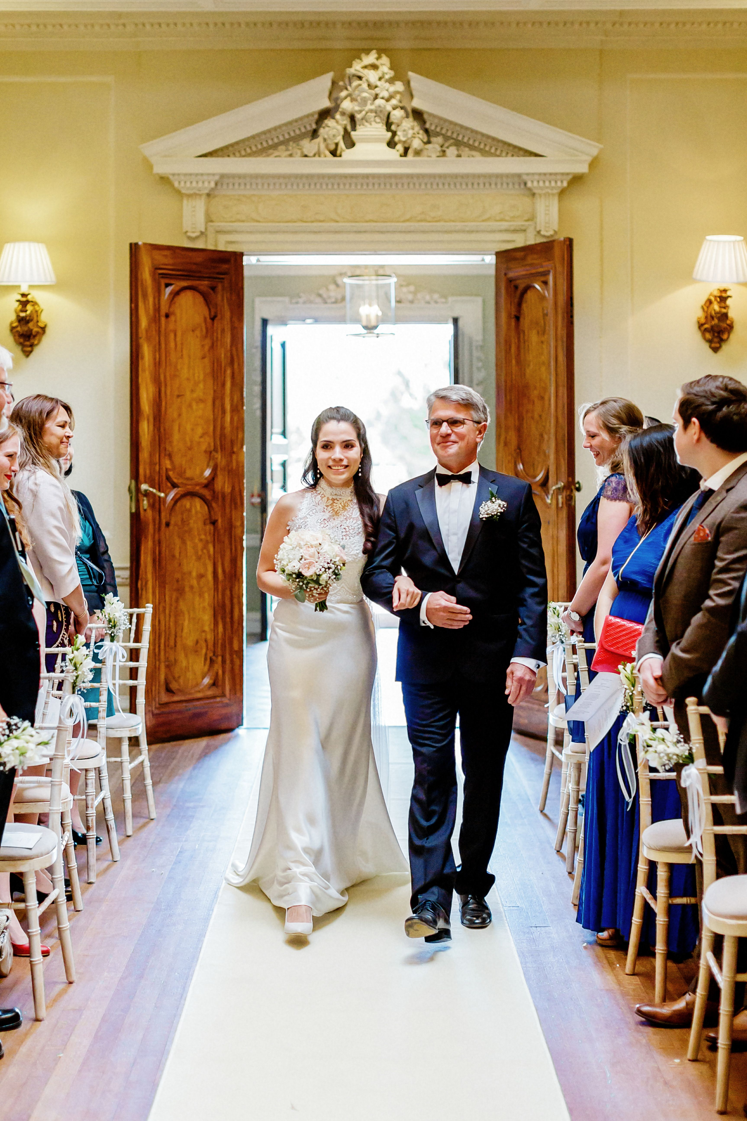
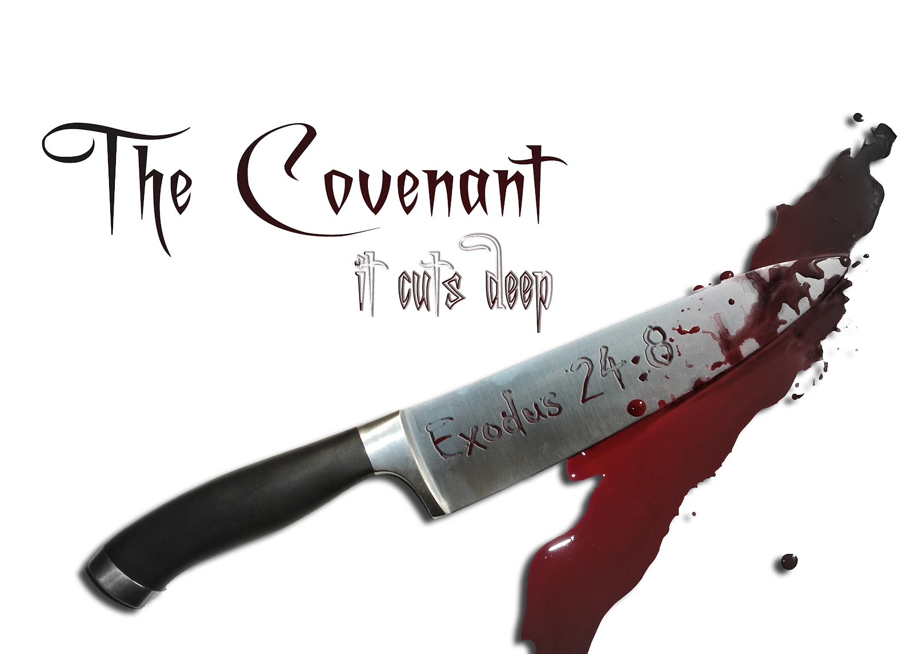
“Cutting the Covenant”

Slide 8
God’s Covenant with ABRAHAM – Genesis 15
(4,5,7) Blessings - Isaac the heir (not Eliezar or Ishmael),
w/countless descendants (including the Messiah
Land included (see also 18-21)
(6) Conditions - Faith in the Promise Giver - pivotal verse. Rom 4:3; Gal 3:6; James 2:23,24; Heb 11:8-19
(8-11,17) Sign - Party passes between split animals;
later circumcision (Gen 17:10)
(12-16) Community - Abraham and his descendants
(16:1,2) Beginnings of trouble - Hagar

Slide 9
Abraham’s Faith in God Tested - Genesis 22
Isaac and Jesus
- Both sons of promises given years before their birth.
- Both born of women requiring a miracle conception.
- Both firstborn sons.
- Both greatly loved by their father/Father.
- Both went to the top of Mount Moriah/Mount Zion.
- Both carried wood to their own sacrifice.
- Both submitted to the will of their father/Father.
- Both brought back from the dead figuratively or literally.

Slide 10
God’s Covenant with MOSES - Exodus 20
Mediator - Moses (commissioned at burning bush - Ex 3:10)
Conditions - Obeying Laws, including 10 commandments
Blessings - Redemption from slavery in Egypt
Sign - Internal is faith (Heb 11:23-29), External is Passover meal
Community – Nation of Israel ministering as Kings and Priests before the other nations; Ratified through a blood sacrifice and meal (Ex 24:1-11)
(Ex 32) Beginnings of trouble - Golden Calf

Slide 11
God’s Covenant with DAVID - II Samuel 7:8-19
Mediator - David
Conditions - Worship of God
Blessings - Kingdom culminating in King Jesus
Sign - Internal is faith, External is the Throne
Community – The Kingdom
(I Kgs 12) Beginnings of trouble - Apostacy of Solomon (I Kgs 11:4); Division of kingdom (12:16);
golden calves (28); competing altar (31-33).

Slide 12
NEW Covenant - Jer 31:31-34; Matt 26:26-29
Mediator - Jesus (Book of Hebrews)
Conditions - Trust and follow the One whose body was broken and blood shed.
Blessings - Salvation & God’s Holy Spirit Indwelling.
Sign - Internal is faith, External is water baptism, the Lord’s supper, love for other disciples (Jn 13:34,35).
Community – Faith Family of God (John 1:12,13).
not blood = ancestry; not will of flesh = personal ambition;
not will of man = other’s decisions; but of God.

Slide 13
Basic Biblical Doctrines
TRINITY (God Is)
REVELATION (God speaks)
CREATION (God Makes)
IMAGE (God Reflected)
FALL (God Rejected)
COVENANT (God Pursues)
INCARNATION (God Comes)

Slide 14
No traitor to any king or nation has even approached the wickedness of our treason before God…When we sin as the image bearers of God, we are saying to the whole creation, to all of nature under our dominion, to the birds of the air and the beasts of the field: “This is how God is. This is how your Creator behaves. Look in his mirror; look at us, and you will see the character of the Almighty.” We say to the world, “God is covetous; God is ruthless; God is bitter; God is a murderer, a thief, a slanderer, an adulterer. God is all of these things that we are doing.”
What would you do if you were God and were treated as He has been by sinners, in general, and by our first parents, in particular? Would your first instinct be to act in grace toward sinners by pursuing them, speaking to them, teaching them, covering them, and promising them that the His Son would come to suffer and die at the hands of sinners for their salvation?
The stunning account of Genesis shows a God that no one would ever have invented, because He does what no one ever could have predicted. Later in the storyline of the Bible, we learn that Jesus did come to save sinners, turning enemies into family.b He did this by becoming the one who succeeded where the first Adam failed.c He died in our place for our sins and rose for our salvation. The good news of the Bible is that we are more evil than we can fear, and God is more loving than we can hope.

