Slide 1
Basic Biblical Doctrines
TRINITY (GOD IS)
REVELATION (GOD SPEAKS) through …
GENERAL Revelation
Creation (telescopes & microscopes)
Common Grace/God’s Providence
Conscience
SPECIAL Revelation
Living Word of God - Jesus
Written Word of God - Bible

Slide 2
SPIRIT of GOD - I Cor 2:10-13
“comparing”
things of MAN
things of GOD
Thus saith the Lord …

Slide 3
God prepared the writers (their education, occupation, vocabulary, experiences, etc.)
so that when they wrote, they used the exact words (rhema) God intended
for the communication of His written Word (logos).

Slide 4
Written in Hebrew & Aramaic (OT), Greek (NT)
over a period of 1500+ years
on 3 continents (Asia, Africa, Europe)
totaling 66 Books (39 OT & 27 NT)
by 40+ Spirit-guided men like …
Matthew (tax collector) - financial words
Luke (physician) - medical words
Peter (fisherman) - nautical words
Paul (Pharisee) - theological words

Slide 5
The Old Testament was originally written on papyrus—a form of paper made out of reeds.
By the time the New Testament was written, parchment (prepared animal skins) was also used (II Tim 4:13).
Pages were stitched and glued together into scrolls (Jer 36:23) & books (biblos - Acts 19:19).
Chapters (1200 AD) and verses (1500 AD) were added to make reading & study easier.

Slide 6
What is the CANON of Scripture?
The word means “ruler” or “measuring rod”.
Bible books recognized as inspired by God.
All Jews and all Christians accept the 39 books in our present-day OT.
The OT was translated into Greek as it became the common language in and around Israel.
This Greek Septuagint (200 BC) “added” some books (Apocrypha), but none were widely accepted.

Slide 7
What is the CANON of Scripture?
NT books were written between 40 and 90 AD.
Peter called Paul’s letters “scripture” (II Pet 3:15,16).
Some were questioned (Hebrews, James), but the issue was settled at a 397 AD Church Council.
Signs of canonicity included:
- internal conformity to orthodoxy.
- authored by eyewitnesses (Apostles) or tied to them (Mark & Peter; Luke & Paul; James & Jude & Jesus).
- widespread acceptance by believers.

Slide 8
The Church no more gave us the NT canon than Isaac Newton gave us the force of gravity.
God gave us gravity, by His work of creation, and similarly He gave us the NT canon, by inspiring the individual books that make it up. - J.I.Packer
2Tim 3:16 All Scripture is given by inspiration of God, and is profitable for doctrine, for reproof, for correction, for instruction in righteousness.

Slide 9
Common OBJECTIONS to the Bible
“The Bible is full of errors & contradictions.”
- Please show me an example.
Paradox may take more study (faith & works)
Mystery may take more time (double prophecies)
Contradiction would be serious if true
- Description doesn’t equal support (slavery, incest, polygamy).
- Missing facts/factors (God’s harsh judgments)

Slide 10
Common OBJECTIONS to the Bible
“It was written long after the actual events.”
- Tremendous value of archeology for OT.
- Minimal gaps between NT eyewitnesses & their writings.
➢ Earliest books (James/Galatians) within 20 yrs.
➢ Earliest gospel (Mark) within 25 yrs.
➢ Final book (Revelation) within 60 yrs.

Slide 11
Common OBJECTIONS to the Bible
“Copying the Bible has produced errors”.
- Can we have confidence that we still have God’s Word?
➢ Oldest OT copies pre-1946 dated @ 800 AD (writing style, ink, parchment, etc.)
➢ 1946-1956 “Dead Sea Scrolls” discovered

Slide 12
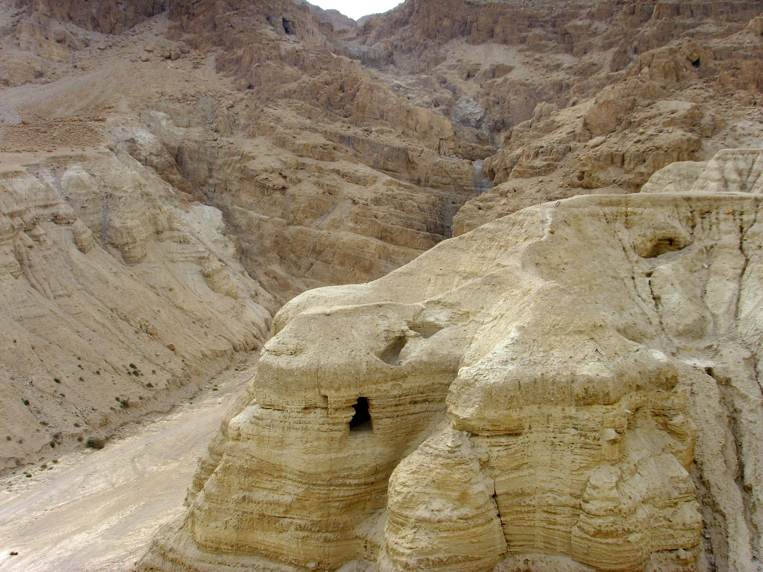
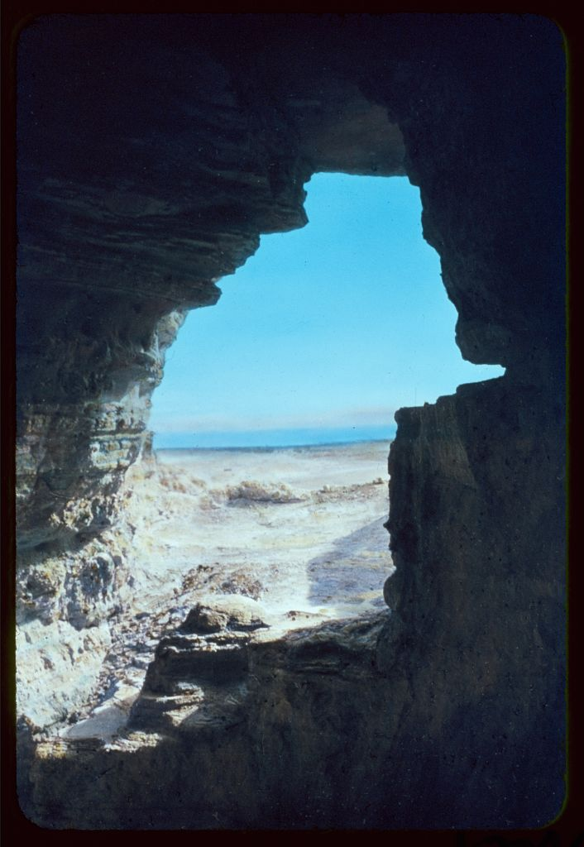
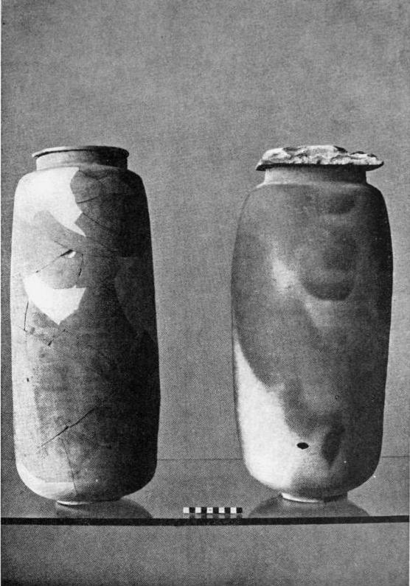

Slide 13
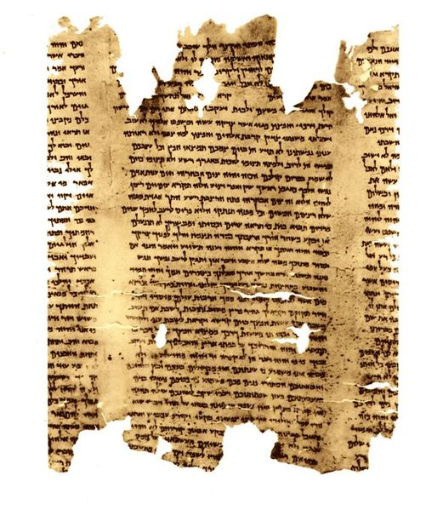
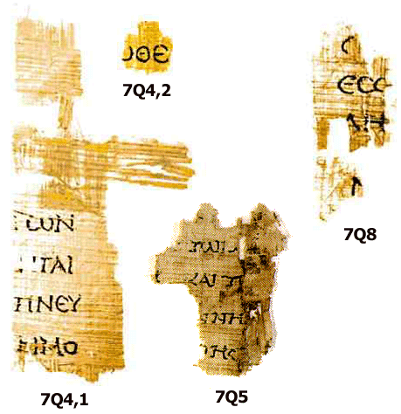

Slide 14
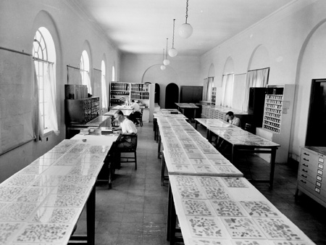

Slide 15
➢ Oldest OT copies pre-1946 dated @ 800 AD (writing style, ink, parchment, etc.)
➢ 1946-1956 “Dead Sea Scrolls” found
➢ Oldest OT copies AFTER ‘56 dated approx. 150 BC (closed the “gap” by 950-years)
amount of change < 5%
Ps 12:6,7 Ps 12:6 The words of the LORD are pure words. You, O LORD, will keep them; you will guard us from this generation forever.

Slide 16
Matt 5:17 Do not think that I (Jesus) have come to abolish the Law or the Prophets; I have not come to abolish them but to fulfill them.
Matt 5:18 For truly, I say to you, until heaven and earth pass away, not one jot (iota), not a tittle (tail), will pass from the Law until all is accomplished.

Slide 17
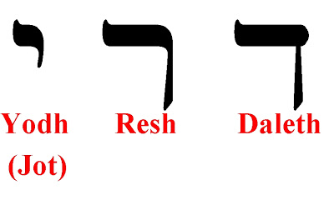
(Tittle)

Slide 18
As we compare copies of both Old and New Testaments, we do find variations, but most of the variations in the many handwritten copies involve easily recognized and correctable examples of spelling, word order, or style .
Less than 1 percent of all the variations have anything to do with doctrine, and no doctrine is affected by any variation.

Slide 19
Because we have so many manuscripts to check and compare, we are virtually certain that the text of the New Testament is 99.5% textually pure.
Jesus used copies and translations (in Mark 7:6–7, Jesus apparently quotes the Greek Septuagint of Isa 29:13).
He trusted them, so we can too, especially when the science of textual criticism has confirmed that our text is accurate.

Slide 20
Common OBJECTIONS to the Bible
“The Bible is a mixture of other older religions.”
- Moses’ law from Hammurabi’s Babylonian code.
- Virgin birth from Egyptian Osiris/Isis/Horus myth.
- Resurrection from Persian myths.
If there are similarities, Biblical scholars believe it is more likely that other pagan religions borrowed from the Bible than vice-versa.
The Quran and Book of Mormon also “borrow”.

Slide 21
Common OBJECTIONS to the Bible
“Important parts of the Bible are lost/missing.”
- “The Da Vinci Code” by Dan Brown (2003)
- Gospel of Thomas; Shepherd of Hermas; Didache
Less than 30 other “gospels”, all referenced
by Church Father’s, but none considered inspired.
➢ Oldest “other gospels” dated 100 yrs after Christ, while most dated 200+ yrs after Jesus.
➢ 4 Inspired gospels dated within 50 yrs of Christ.

Slide 22
Reminder - Canonicity is seen in …
- Apostolicity (a book was written by an apostle or a close associate of an apostle),
- Coherence (a book does not contradict previously accepted Scripture),
- Catholicity (widespread acceptance as particularly relevant and normative within all major segments of the early Christian community).

Slide 23
Supernatural power of the Bible
1Peter 1:23 We have been born again, not of corruptible seed but incorruptible, through the word of God which lives and abides forever.
Ps 19:7 The law of the LORD is perfect, converting the soul; ... the testimony of the LORD is sure, making wise the simple;
Ps 19:8 the statutes of the LORD are right, rejoicing the heart; ... the commandment of the LORD is pure, enlightening the eyes;

Slide 24
Ps 19:9 The fear of the LORD is clean, enduring for ever:
... the judgments of the LORD are true and righteous altogether.
Ps 19:11 Moreover, by them is thy servant warned; and in keeping of them there is great reward.

Slide 25
Choosing an English Bible Translation
Word for Word (KJV, NKJV, ESV, NASB)
pro - closeness to the original, precision
con - use dated rather than modern English
Thought for Thought (NIV, NLT, CEV)
pro - clarifies meaning, reproduces effect
con - introduce foreign ideas, miss original point
Paraphrase (Message, TLB, Amplified)
pro - readability
con - loss of connection to original words

Slide 26
Choosing an English Bible Translation
Word for Word (KJV, NKJV, ESV, NASB)
pro - closeness to the original, precision
con - use dated rather than modern English
Thought for Thought (NIV, NLT, CEV)
pro - clarifies meaning, reproduces effect
con - introduce foreign ideas, miss original point
Paraphrase (Message, TLB, Amplified)
pro - readability
con - loss of connection to original words

Slide 27
Basic Biblical Doctrines
TRINITY (God Is)
REVELATION (God Speaks)
next time
CREATION (God Makes)

