Slide 1
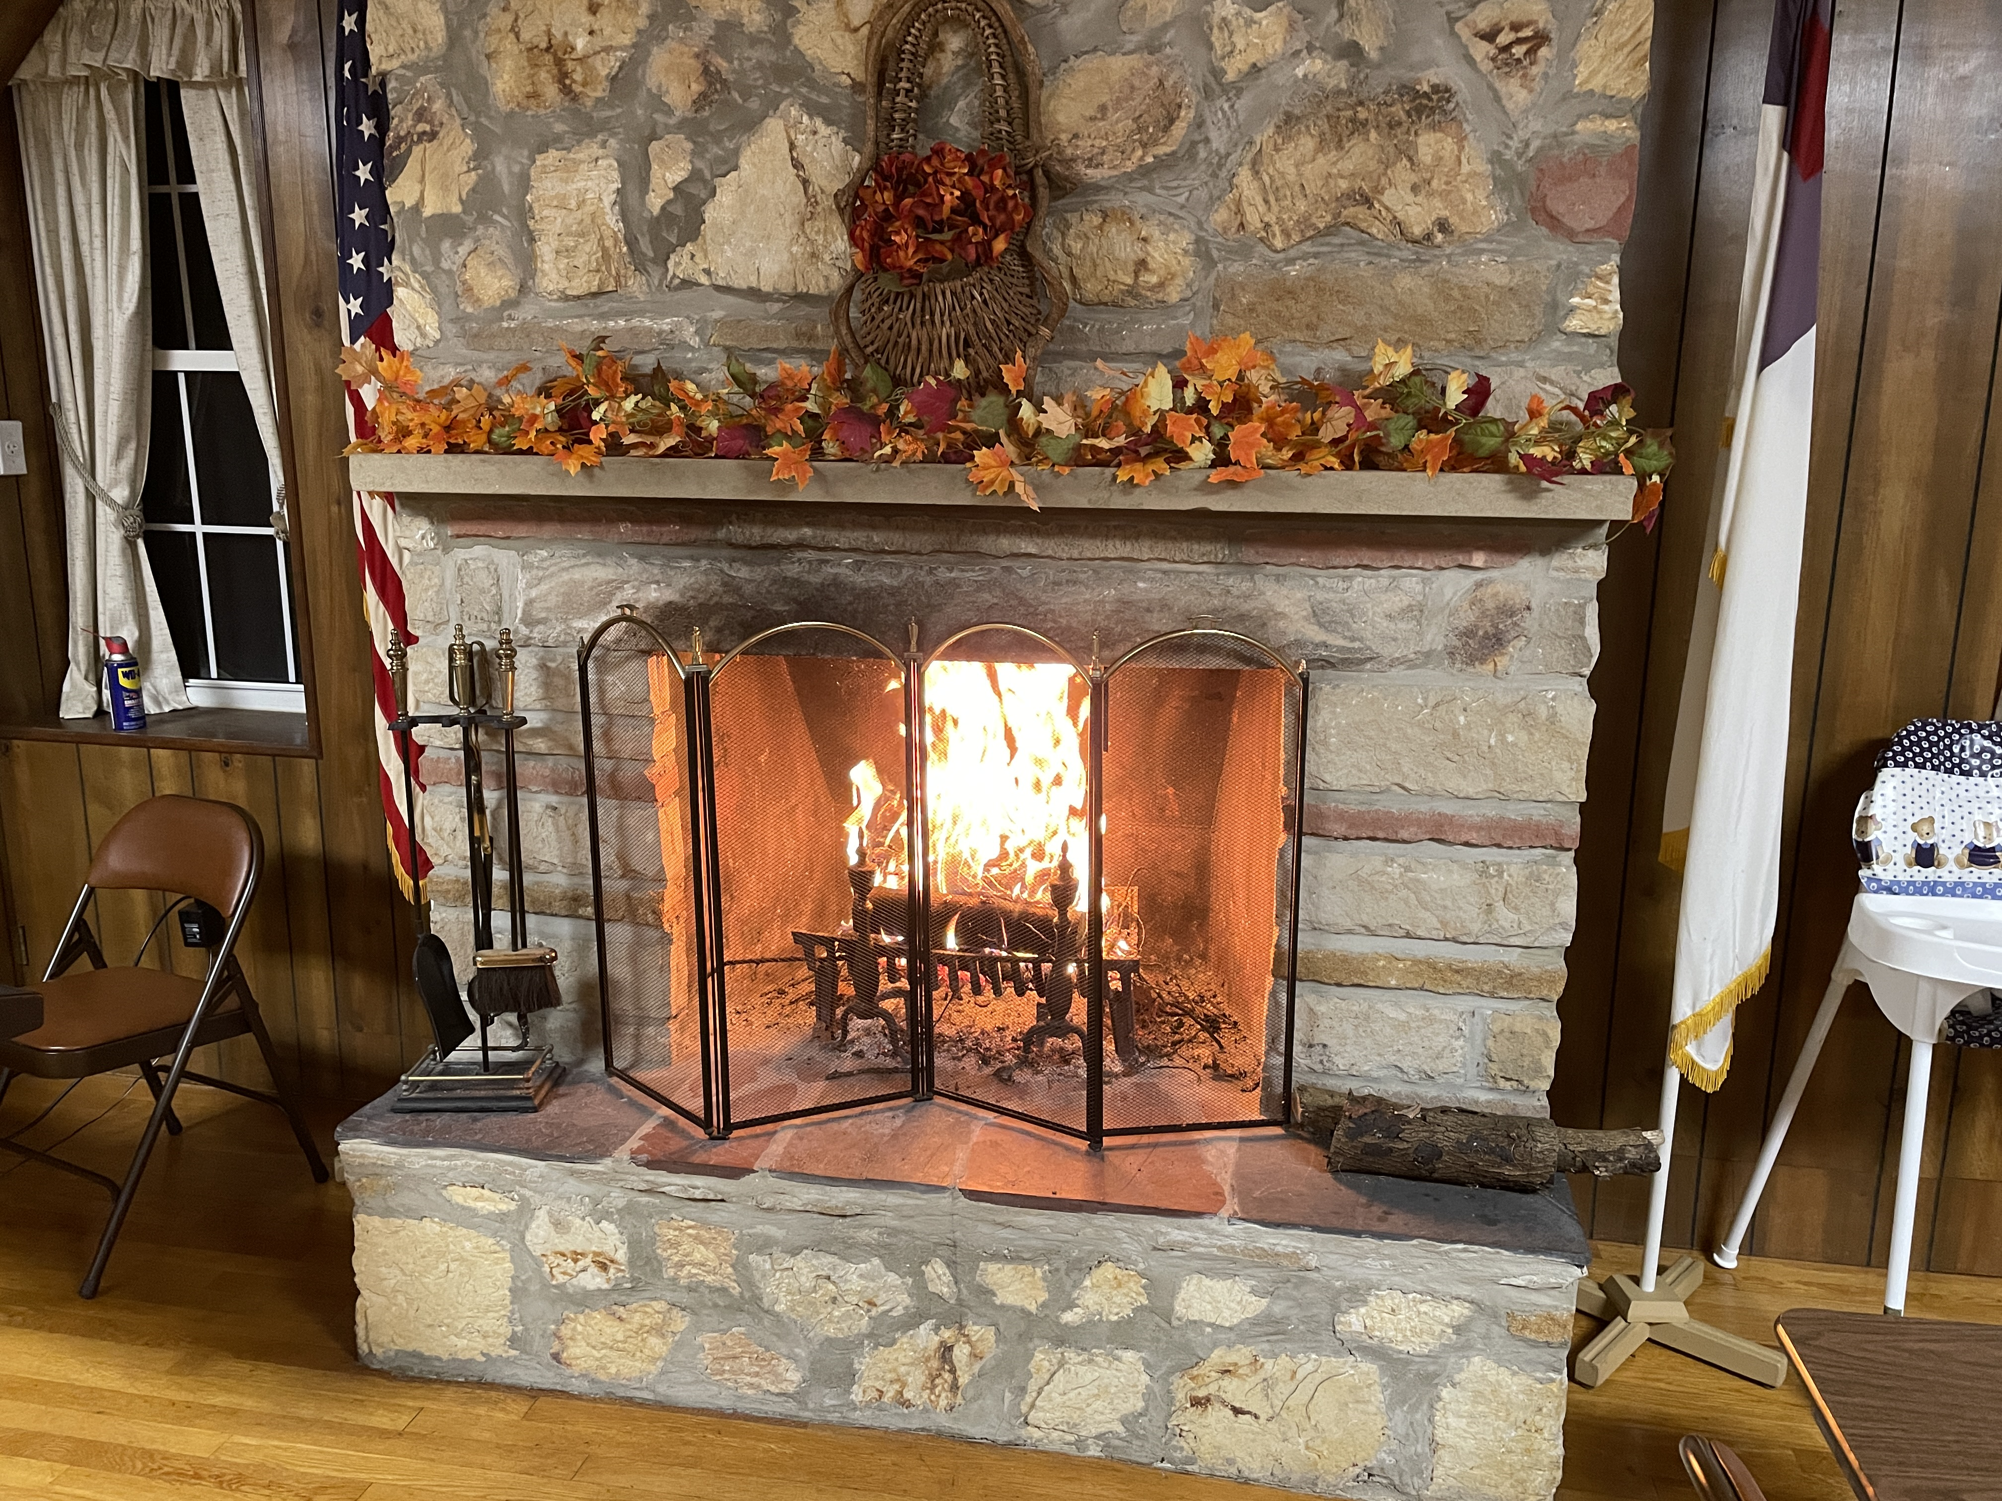
WELCOME to GBC
Ps 66:12 We went through fire and water;
You brought us out to rich fulfillment.

Slide 2
Sermon on the Mount - Matthew
Chpt 5 - What Jesus’ Followers ARE
Chpt 6 - What Jesus’ Followers DO
Chpt 7 - What Jesus’ Followers DON’T DO
(1) Don’t Judge
(6) Don’t Cast Pearls Before Swine
(7-12) Don’t Stop Praying
➢ (13-23) Don’t Miss Jesus’ Warnings

Slide 3
Matt 7:13 Enter by the narrow gate; for wide is the gate and broad is the way that leads to destruction, and there are many who go in by it.
14 Because narrow is the gate and difficult is the way which leads to life, and there are few who find it.
15 Beware of false prophets, who come to you in sheep's clothing, but inwardly they are ravenous wolves.
16 You will know them by their fruits. Do men gather grapes from thornbushes or figs from thistles?
17 Even so, every good tree bears good fruit, but a bad tree bears bad fruit.
18 A good tree cannot bear bad fruit, or a bad tree bear good fruit.

Slide 4
Matt 7:19 Every tree that does not bear good fruit is cut down and thrown into the fire.
20 Therefore by their fruits you will know them.
21 Not everyone who says to Me, “Lord, Lord,” shall enter the kingdom of heaven, but he who does the will of My Father in heaven.
22 Many will say to Me in that day, “Lord, Lord, have we not prophesied in Your name, cast out demons in Your name, and done many wonders in Your name?”
23 And then I will declare to them, “I never knew you; depart from Me, you who practice lawlessness!”

Slide 5
(13,14) Beware of FALSE PATHS
Check the Gate (Entrance) - Wide or Narrow?
Check the Way (Path) - Broad (Easy) or Difficult?
Check the Destination - Destruction or Life?
Check the Travelers - Many or Few?
(13) Disregarding Jesus is easy & popular but destroys.
(14) Following Jesus is hard & lonely but abundant.

Slide 6
(13,14) Beware of FALSE PATHS
(15-23) Beware of FALSE PROPHETS
Check their Heart - Sheep or Wolf? (15)
Check their Fruit - Good or Bad? (16-20)
Check their Testimony
- Talk about God’s Name or Do God’s Will? (21)
- Credit God for Deeds while Practicing Lawlessness (22,23)
- “In the Know” about God but Never Known by God (23)
☑ II Peter 2:1-22

Slide 7
Sermon on the Mount - Matthew
☑ Chpt 5 - What Jesus’ Followers ARE
☑ Chpt 6 - What Jesus’ Followers DO
☑ Chpt 7 - What Jesus’ Followers DON’T DO
(13-23) Don’t Miss Jesus’ Warnings
Disregarding Jesus is easy & popular but destroys.
Following Jesus is hard & lonely but abundant.
☑ Matthew 7:24-8:1

Slide 8
He Will Hold Me Fast
When I fear my faith will fail,
Christ will hold me fast.
When the tempter would prevail,
He will hold me fast.

Slide 9
I could never keep my hold
Through life's fearful path.
For my love is often cold,
He must hold me fast.

Slide 10
He will hold me fast,
He will hold me fast.
For my Savior loves me so,
He will hold me fast!

Slide 11
Those He saves are His delight,
Christ will hold me fast.
Precious in His holy sight,
He will hold me fast.

Slide 12
He'll not let my soul be lost,
His promises shall last.
Bought by Him at such a cost,
He will hold me fast.

Slide 13
He will hold me fast,
He will hold me fast.
For my Savior loves me so,
He will hold me fast!

Slide 14
For my life He bled and died,
Christ will hold me fast.
Justice has been satisfied,
He will hold me fast.

Slide 15
Raised with Him to endless life,
He will hold me fast.
'Til our faith is turned to sight,
When He comes at last!

Slide 16
He will hold me fast,
He will hold me fast.
For my Savior loves me so,
He will hold me fast!

Slide 17
Be Thou My Vision #143
O Lord of my heart.
Naught be all else to me,
save that Thou art.
Thou my best thought,
by day or by night.
Waking or sleeping,
Thy presence my light

Slide 18
Be Thou my Wisdom
And Thou my true Word;
I ever with Thee,
And Thou with me, Lord
Thou my great Father,
And I Thy true son,
Thou in me dwelling,
and I with Thee, one.

Slide 19
Riches I heed not,
Nor man’s empty praise.
Thou mine inheritance
Now and always.
Thou, and Thou only,
First in my heart
High King of Heaven
My Treasure Thou art.

Slide 20
High King of Heaven
My victory won.
May I reach heaven’s joys
O bright heaven’s Sun!
Heart of my own heart,
Whatever befall,
Still by my Vision,
O Ruler of all!

Slide 21
WELCOME to GBC
Ps 66:12 We went through fire and water;
You brought us out to rich fulfillment.

