Slide 1
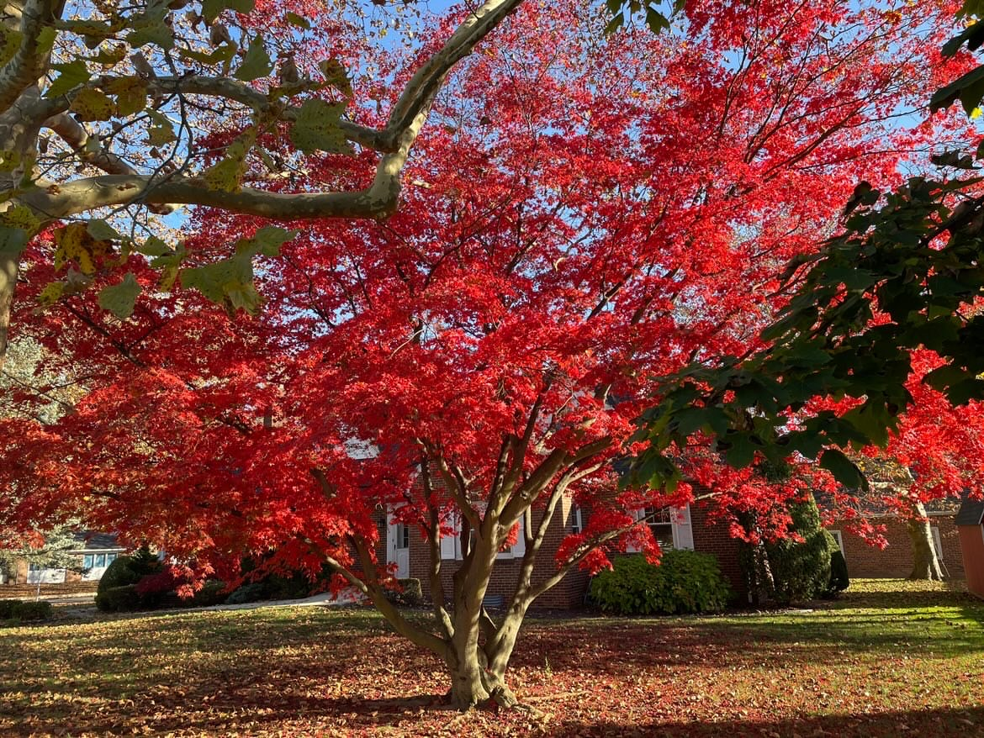
WELCOME to GBC
November 5th, 2023

Slide 2
Lord, let Your light Light of Your face Shine on us Lord, let Your light Light of Your face Shine on us

Slide 3
That we may be saved That we may have life To find our way
in the darkest night Let Your light shine on us

Slide 4
Lord, let Your grace Grace from Your hand Fall on us Lord, let Your grace Grace from Your hand Fall on us

Slide 5
That we may be saved That we may have life To find our way
in the darkest night Let Your light shine on us

Slide 6
Lord, let Your love Love with no end Come over us Lord, let Your love Love with no end Come over us

Slide 7
That we may be saved That we may have life To find our way
in the darkest night Let Your love come over us Let Your light shine on us

Slide 8
WELCOME to GBC
November 5th, 2023

Slide 9
GRACE BIBLE CHAPEL
Exploring our “First Name”
Grow in the GRACE and knowledge of our Lord Jesus Christ. II Peter 3:18

Slide 10
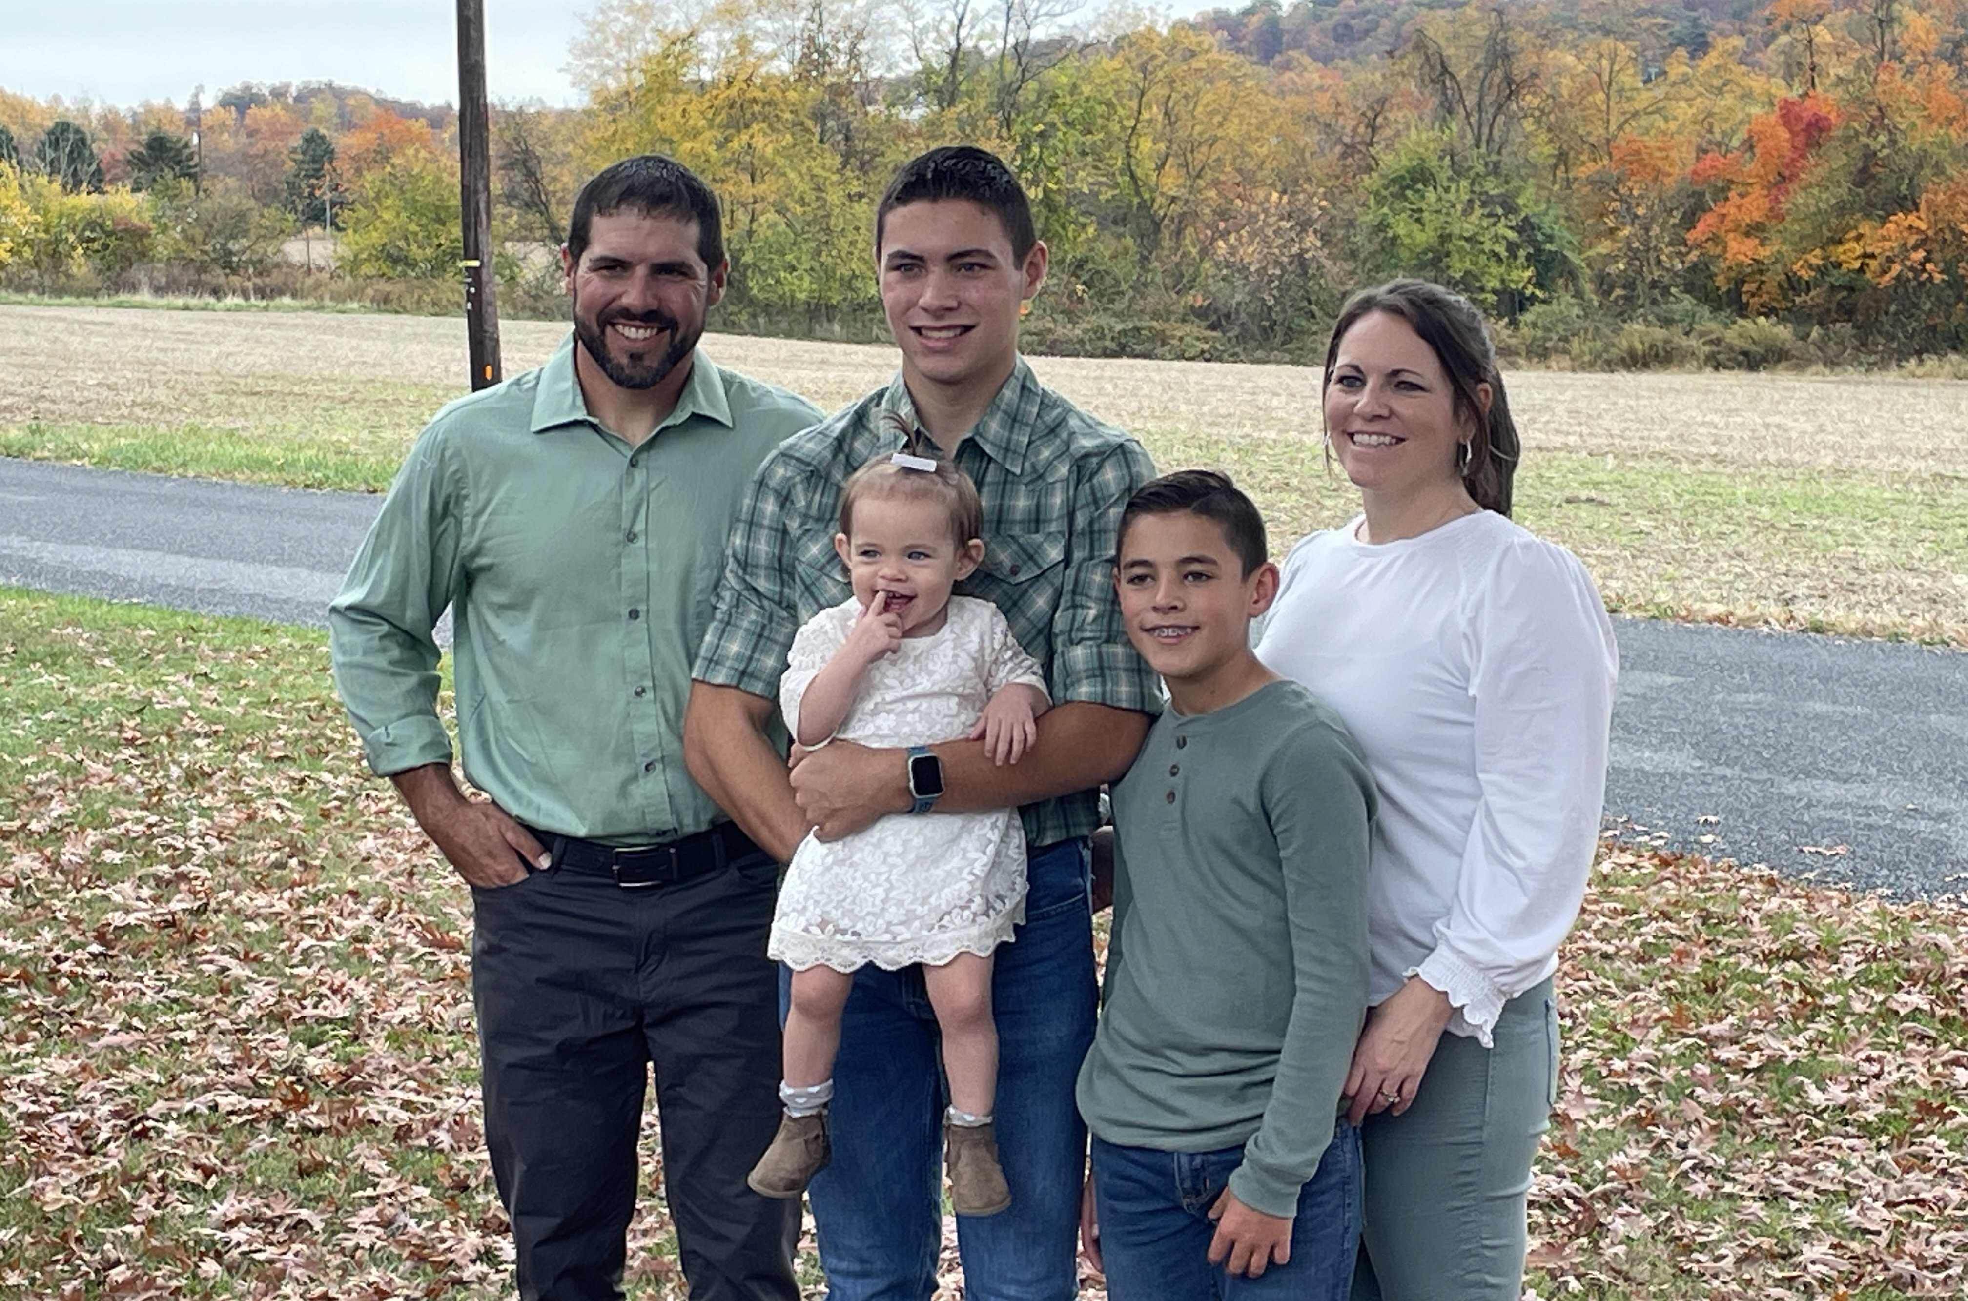

Slide 11
Grow in the GRACE and knowledge of our Lord Jesus Christ. II Peter 3:18
Grace and Aging
Grace and DYING

Slide 12
Grace When Others are Dying
Grace When You are Dying
Grace Because of Jesus Dying

Slide 13
Grace When Others are Dying
2Corinthians 9:8 God is able to make all grace abound toward you, that you, always having all sufficiency in all things, may have an abundance for every good work.

Slide 14
Grace When Others are Dying
➢ Peter’s GRACELESS example - Matthew 26
(33) We may think too highly of our abilities.
(35) We may promise more than we can deliver.
(40) We may burn out physically & spiritually.
(51) We may make rash decisions.
(74) We may deny responsibility or relationship.
(75) We may end with bitter regrets.

Slide 15
Grace When Others are Dying
➢ Jesus’ GRACIOUS example - John 11
(5) This is when godly love is displayed.
(8) This is when selflessness will be tested.
(16) This is when a support team is valuable.
(23) This is when God’s promises are embraced.
(33,35) This is when sorrows can overwhelm.
(37) This is when we trust God with our reputation.
(41) This is when fervent prayers are heard.
(45) This is when some may become believers.

Slide 16
Grace When You are Dying
Heb 4:16 Let us come boldly to the throne of grace, that we may obtain mercy and find grace to help in time of need.
➢ Stephen’s encouraging example - Acts 7
(55) Heaven becomes clearer.
(56) Witnessing becomes bolder.
(59) My spirit (rather than body) becomes center.
(60) Forgiving becomes easier.

Slide 17
Grace When You are Dying
Psalm 23:4 Yea, though I walk through the valley of the shadow of death, I will fear no evil: for thou art with me; thy rod and thy staff they comfort me.
5 Thou preparest a table before me in the presence of mine enemies: thou anointest my head with oil; my cup runneth over.
6 Surely goodness and mercy shall follow me all the days of my life: and I will dwell in the house of the LORD for ever.

Slide 18
Grace Because of Jesus Dying
➢ He gives Free Grace that REDEEMS us
Rom 3:24 Being justified freely by His grace through the redemption in Christ Jesus.
➢ He gives Rich Grace that FORGIVES us
Eph 1:7 In Jesus we have redemption through His blood, the forgiveness of sins, according to the riches of His grace.

Slide 19
Grace Because of Jesus Dying
➢ He gives Grace that brings us to GLORY
Heb 2:9 But we see Jesus, who … by the grace of God tastes death for everyone.
Heb 2:10 For it was fitting for Him … to bring many sons to glory.
John 1:12 As many as receive Him, to them He gave the right to become children of God.

Slide 20
Grow in the GRACE of our Lord Jesus Christ. II Peter 3:18
Serving Grace When Others are Dying
Sustaining Grace When You are Dying
Saving Grace Because of Jesus Dying

Slide 21
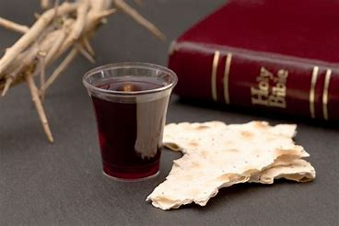

Slide 22
Give Me Jesus (# 270)
In the morning when I rise,
In the morning when I rise.
In the morning when I rise.
Give me Jesus!

Slide 23
Give Me Jesus,
Give me Jesus!
You can have all this world,
but give me Jesus!

Slide 24
And when I am alone,
Yes, and when I am alone.
Oh when I am alone,
Give me Jesus!

Slide 25
Give Me Jesus,
Give me Jesus!
You can have all this world,
but give me Jesus!

Slide 27
And when I come to die (# 270)
Yes, and when I come to die.
Oh when I come to die,
Give me Jesus!

Slide 28
Give Me Jesus,
Give me Jesus!
You can have all this world,
but give me Jesus!

