Slide 1
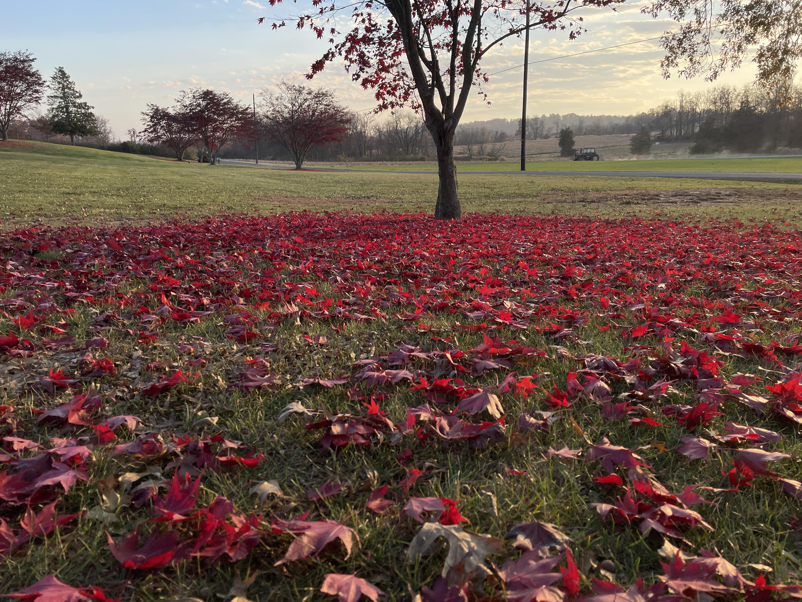
Welcome to GBC
Psalm 69:30 Let us praise the name of God with a song. We will magnify Him with THANKSGIVING.

Slide 2
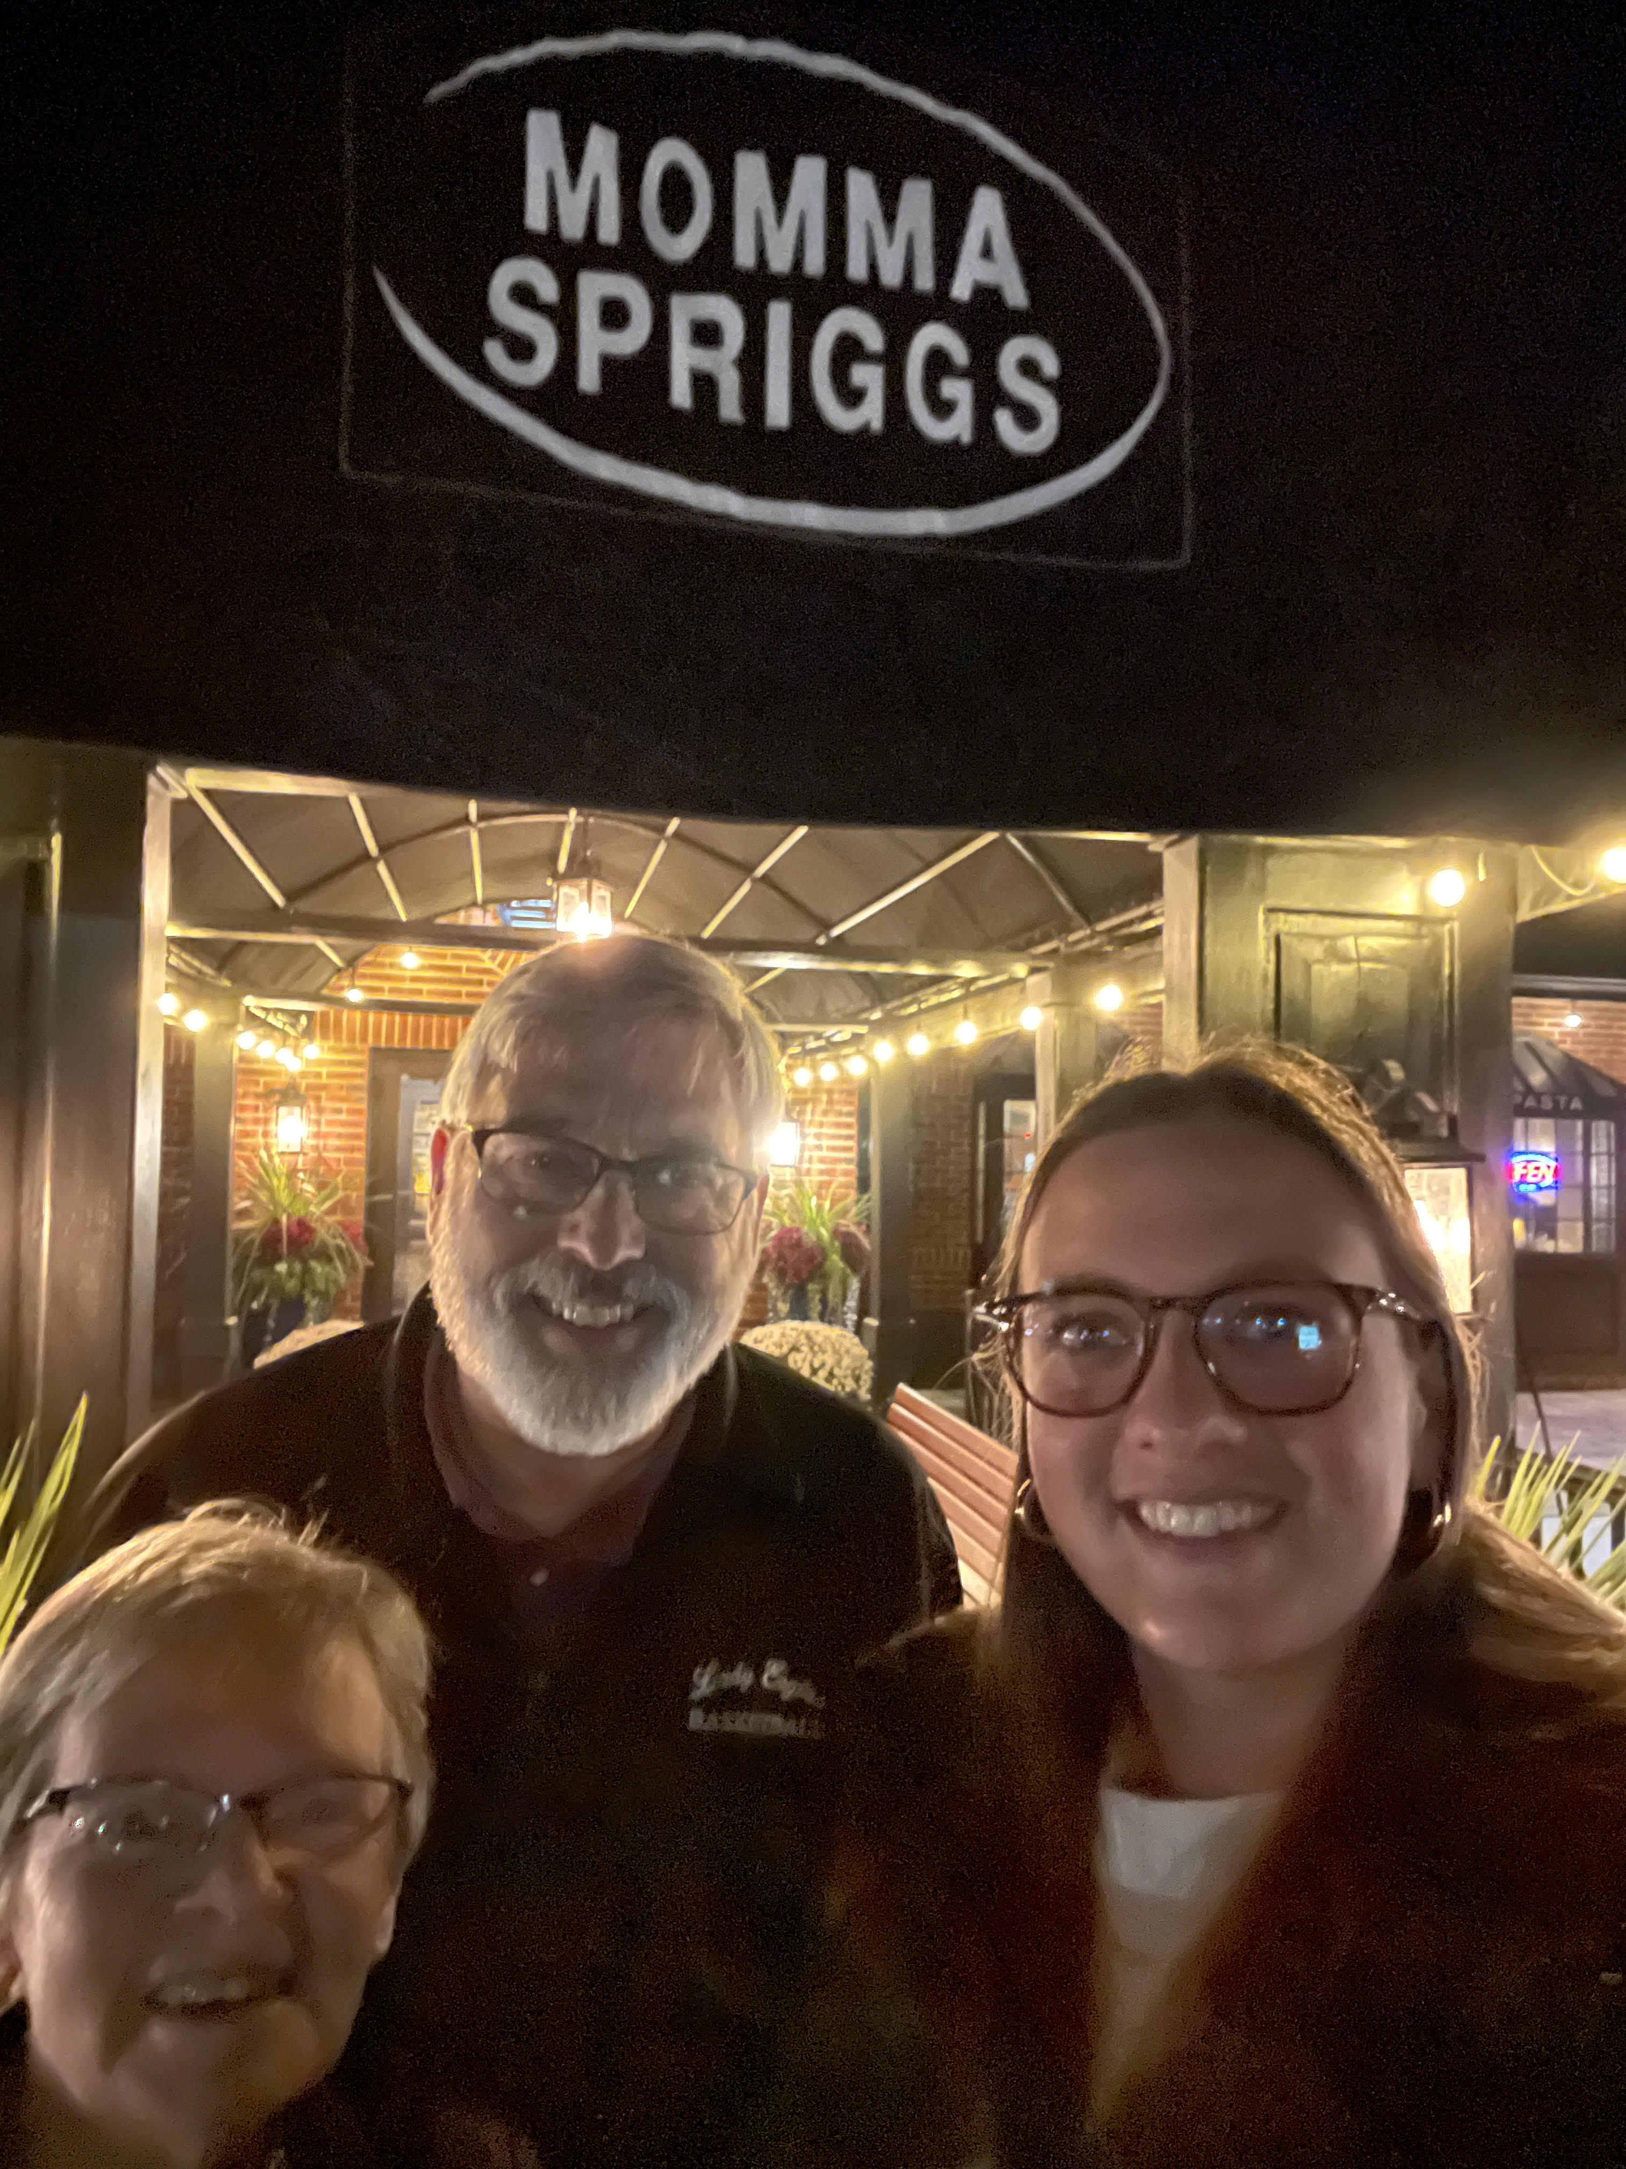
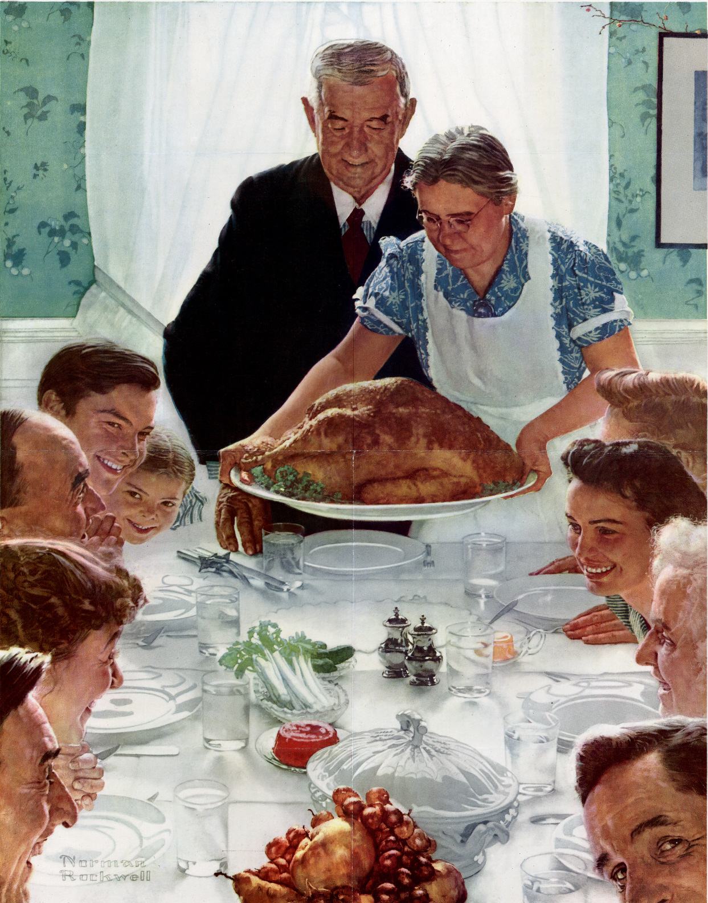

Slide 3
Sermon on the Mount - Matthew
Chpt 5 - What Jesus’ Followers ARE
Chpt 6 - What Jesus’ Followers DO
Chpt 7 - What Jesus’ Followers DON’T DO
(1) Don’t Judge
(6) Don’t Cast Pearls Before Swine
➢ (7-12) Don’t Stop Praying

Slide 4
Previous Teaching on Prayer
Matt 6:3 Avoid hypocrisy when praying
6:9-13 Avoid empty repetition when praying
7:7-12 Don’t miss discoveries when praying

Slide 5
Matthew 7:7 Ask, and it will be given to you; seek, and you will find; knock, and it will be opened to you.
8 For everyone who asks receives, and he who seeks finds, and to him who knocks it will be opened.

Slide 6
Matthew 7:9 Or what man is there among you who, if his son asks for bread, will give him a stone?
10 Or if he asks for a fish, will he give him a serpent?

Slide 7
Matthew 7:11 If you then, being evil, know how to give good gifts to your children, how much more will your Father who is in heaven give good things to those who ask Him!
12 Therefore, whatever you want men to do to you, do also to them, for this is the Law and the Prophets.

Slide 8
Don’t miss DISCOVERIES about MYSELF
(7) I may lack HUMILITY - I’ve stopped asking
Luke 18:11,12 The Pharisee stood and prayed thus with himself, “God, I thank You that I am not like other men—extortioners, unjust, adulterers, or even as this tax collector. I fast twice a week; I give tithes of all that I possess.”

Slide 9
Luke 18:13 But the tax collector, standing afar off, would not so much as raise his eyes to heaven, but beat his breast, saying, “God, be merciful to me a sinner!”
14 I tell you this man went down to his house justified rather than the other; for everyone who exalts himself will be humbled, and he who humbles himself will be exalted.

Slide 10
DISCOVERIES about MYSELF
(7) I may lack HOPE - I’ve stopped seeking
Jer 29:11 I know the thoughts that I think toward you, says the LORD, thoughts of peace and not of evil, to give you a future and a hope.
12 Then you will call upon Me and go and pray to Me, and I will listen to you.
13 You will seek Me and find Me, when you search for Me with all your heart.

Slide 11
Eph 3:20 Now to Him who is able to do exceedingly abundantly above all that we ask or think, according to the power that works in us.

Slide 12
DISCOVERIES about MYSELF
(7) I may lack HUMILITY - I’ve stopped asking
(7) I may lack HOPE - I’ve stopped seeking
(7) I may lack HARD WORK - I’ve stopped knocking
Rev 3:19 As many as I (Jesus) love, I rebuke and chasten. Therefore, be zealous and repent.
20 Behold, I stand at the door and knock. If anyone hears My voice and opens the door, I will come in to him and dine with him, and he with Me.

Slide 13
DISCOVERIES about MYSELF
(7) I may lack HUMILITY - I’ve stopped asking
(7) I may lack HOPE - I’ve stopped seeking
(7) I may lack HARD WORK - I’ve stopped knocking
(9,10) I may lack HEART - So I am unkind
1John 3:17 Whoever has this world's goods, and sees his brother in need, and shuts up his heart from him, how does the love of God abide in him?
18 My little children, let us not love in word or in tongue, but in deed and in truth.

Slide 14
DISCOVERIES about MYSELF
HUMILITY - I’ve stopped asking (☑ my MOUTH)
HOPE - I’ve stopped seeking (☑ my EYES)
HARD WORK - I’ve stopped knocking (☑ my HANDS)
HEART - I am unkind (☑ my GIVING)
(11) I may lack HOLINESS - I am evil
I need a NEW Heart (Salvation)
I may need a RENEWED Heart (Spirit Filling)

Slide 15
Don’t miss DISCOVERIES about GOD
(7) He loves to GIVE what is needed
(7) He loves to REVEAL what is missing
(7) He loves to OPEN what is closed
(11) He is a “MUCH MORE” Father
(12) He wants to make me more like HIMSELF

Slide 16
Sermon on the Mount - Matthew
Chpt 5 - What Jesus’ Followers ARE
Chpt 6 - What Jesus’ Followers DO
Chpt 7 - What Jesus’ Followers DON’T DO
(1) Don’t Judge
(6) Don’t Cast Pearls Before Swine
(7-12) Don’t Stop Praying

Slide 17
Eph 3:14-19 For this reason I bow my knees to the Father of our Lord Jesus Christ, from whom the whole family in heaven and earth is named, that He would grant you, according to the riches of His glory, to be strengthened with might through His Spirit in the inner man, that Christ may dwell in your hearts through faith; that you, being rooted and grounded in love, may be able to comprehend with all the saints what is the width and length and depth and height—to know the love of Christ which passes knowledge; that you may be filled with all the fullness of God.

Slide 18
Seek Ye First (# 411)
Seek ye first the Kingdom of God
and His Righteousness.
And all these things
will be added unto you.
Allelu, Alleluia!

Slide 19
Ask, and it shall be given unto you.
Seek, and ye shall find.
Knock, and the door
will be opened unto you.
Allelu, Alleluia!

Slide 20
Psalm 69:30 Let us praise the name of God with a song. We will magnify Him with THANKSGIVING.

