Slide 1
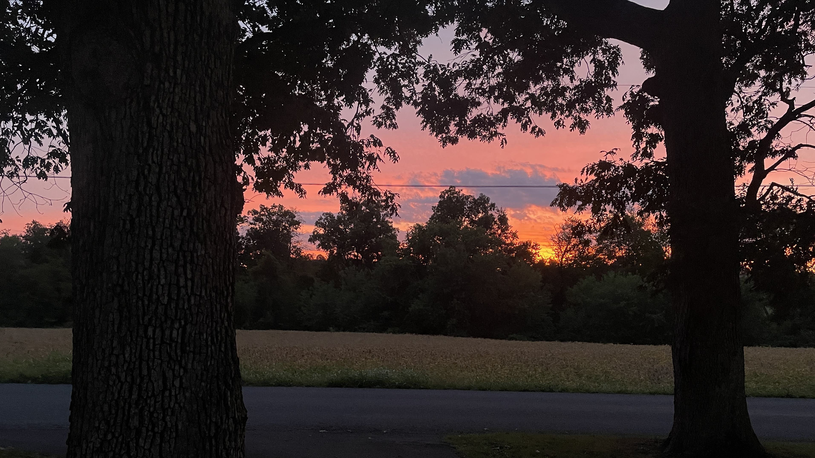
Welcome to GBC
From the rising of the sun to its going down;
The LORD's name is to be praised. Psalm 113:3

Slide 2
His Mercy Is More
What love could remember, no wrongs we have done? Omniscient all-knowing, He counts not their sum. Thrown into a sea, without bottom or shore; Our sins they are many, His mercy is more!

Slide 3
Praise the Lord,
His mercy is more! Stronger than darkness, new every morn; Our sins they are many, His mercy is more.

Slide 4
What patience would wait as we constantly roam? What Father so tender is calling us home? He welcomes the weakest, the vilest, the poor; Our sins they are many, His mercy is more!

Slide 5
Praise the Lord,
His mercy is more! Stronger than darkness, new every morn; Our sins they are many, His mercy is more.

Slide 6
What riches of kindness He lavished on us! His blood was the payment, His life was the cost. We stood 'neath a debt we could never afford; Our sins they are many, His mercy is more!

Slide 7
Praise the Lord, His mercy is more! Stronger than darkness, new every morn. Our sins they are many, His mercy is more, Our sins they are many, His mercy is more!

Slide 8
GRACE BIBLE CHAPEL
Exploring our “First Name”
Grow in the GRACE and knowledge of our Lord Jesus Christ. II Peter 3:18
Grace and Aging

Slide 9
BAD news - We are all getting older
Rom 5:12 Through one man (Adam) sin entered the world, and (aging &) death through sin, and so (aging &) death spread to all mankind, because all sinned—
Eccl 12:1-7 - poetic description of aging

Slide 10
GOOD news - Grace abounds!
Rom 5:20 Where sin (with aging & death) abounded, grace abounded much more.
James 4:6 God resists the proud but gives grace to the humble (which aging can produce).
2Cor 12:9 God said to me, "My grace is sufficient for you, for My strength is made perfect in weakness (part of aging)."

Slide 11
God’s exalted view of AGING
Lev 19:32 Rise before the gray headed and honor the presence of an old man and fear your God: I am the LORD.
Prov 16:31 The silver-haired head is a crown of glory, if found in the way of righteousness.
1Tim 5:1 Do not rebuke an older man but appeal to him respectfully as to your father.

Slide 12
When interacting w/ elders … Grow in Grace!
Be different from a disrespectful world.
Ask for God’s help to view aging people as treasures, not troubles.
As we experience aging … Grow in Grace!
God’s strength can be displayed in our times of weakness.

Slide 13
For those who are feeling their age …
Psalm 71 - A Senior’s Psalm
(note verses 9,17,18)
(1-8) Faith of a Senior Saint (Praises)
(9-13) Fears of a Senior Saint (Prayers)
(14-18) Future of a Senior Saint (Purposes)

Slide 14
Psalm 71
(1-8) Grow in the Grace of PRAISING
Key verses - 5,6
➢ Focus not on what you WERE, but who God IS
(1) He is Trustworthy
(2) He is Righteous - His character is to be right
(3) He is Strong, Rock (stable), Fortress (secure)
(5) He is the Source of Hope - Won’t disappoint

Slide 15
(1-8) Grow in the Grace of PRAISING
➢ Focus not on what you CAN’T DO, but on what God DOES
(2) He Delivers, Liberates, Listens, Saves
(3) He Commands
(6) He Upholds
As I grow old, I could start listing COMPLAINTS.
But as I grow in grace, I should list PRAISES (6,14).

Slide 16
Psalm 113:3 From sunrise to sunset;
The LORD's name is to be praised.

Slide 17
(9-13) Grow in the Grace of PRAYING
➢ Grace helps me humbly pray …
(9) God, I fear being useless - cast-off (I Cor 9:25-27)
(9) God, I fear weakness
(10,11) God, I fear being defenseless
(12a) God, I fear loneliness
(12b) God, I fear slowness - mine, other’s, Yours
(9-13) God, I fear selfishness - me, my, mine

Slide 18
(14-18) Grow in the Grace of PLANNING
(14) “But …” in contrast to all the fears
“I will …” (4x) make plans, make choices
Opportunities for an aging Christian
(15) Urgency about evangelism
(16) Traveling ministries - “I will go …”
Mentoring ministries
(17) recall what it was like being younger
(18) pass the torch to the next generation

Slide 19
A Powerful Prayer
(18) Now when I am old and gray headed, O God, do not forsake me until I _____.
I can’t do what I used to do, but with Your grace I’ll do what I can do, even if it’s different.
Help me grow in the grace of PRAISING
Help me grow in the grace of PRAYING
Help me grow in the grace of PLANNING
Help me be a Grace-Full Gray-Head!

Slide 20
Grace and Aging
Grow in the GRACE and knowledge of our Lord Jesus Christ. II Peter 3:18
More praising, more planning, more praying!

Slide 21
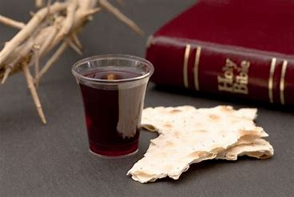

Slide 22
The Lord Is My Salvation
The grace of God has reached for me And pulled me from the raging sea And I am safe on this solid ground The Lord is my salvation

Slide 23
I will not fear when darkness falls His strength will help me scale
these walls I'll see the dawn of the rising sun The Lord is my salvation

Slide 24
Who is like the Lord our God? Strong to save, faithful in love My debt is paid and the vict'ry won The Lord is my salvation

Slide 25
My hope is hidden in the Lord He flow'rs each promise of His Word When winter fades
I know spring will come The Lord is my salvation

Slide 26
In times of waiting, times of need When I know loss, when I am weak I know His grace will renew these days The Lord is my salvation

Slide 27
Who is like the Lord our God? Strong to save, faithful in love My debt is paid and the vict'ry won The Lord is my salvation

Slide 29
And when I reach my final day He will not leave me in the grave But I will rise, He will call me home The Lord is my salvation

Slide 30
Who is like the Lord our God? Strong to save, faithful in love My debt is paid and the vict'ry won The Lord is my salvation

