Slide 1
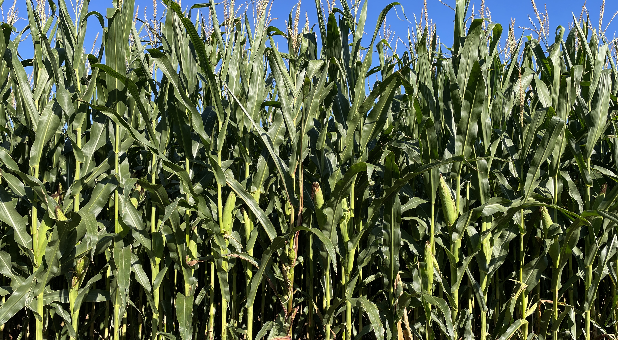
September 3, 2023
Welcome to GBC
You have put gladness in my heart, more than in the season that corn and wine increase. Psalm 4:7

Slide 2
I once was lost in darkest night Yet thought I knew the way The sin that promised joy and life Had led me to the grave I had no hope that You would own A rebel to Your will And if You had not loved me first I would refuse You still

Slide 3
But as I ran my hell-bound race Indifferent to the cost You looked upon my helpless state And led me to the cross And I beheld God's love displayed You suffered in my place You bore the wrath reserved for me Now all I know is grace

Slide 4
Hallelujah!
All I have is Christ Hallelujah!
Jesus is my life

Slide 5
Now, Lord, I would be Yours alone And live so all might see The strength to follow Your commands Could never come from me Oh Father, use my ransomed life
in any way You choose And let my song forever be
my only boast is You

Slide 6
Hallelujah! All I have is Christ Hallelujah! Jesus is my life
Hallelujah! All I have is Christ Hallelujah! Jesus is my life

Slide 7
Grace and Laboring
I Peter 2:18-25

Slide 8
GRACE - Undeserved Kindness
SAVING grace draws a helpless sinner into God’s forgiveness (Eph 2:8,9).
SUSTAINING grace empowers a forgiven sinner to live like Jesus (Titus 2:11,12).
My Humility invites grace from God & others.
I Peter 5:5 God resists the proud
but gives grace to the humble.

Slide 9
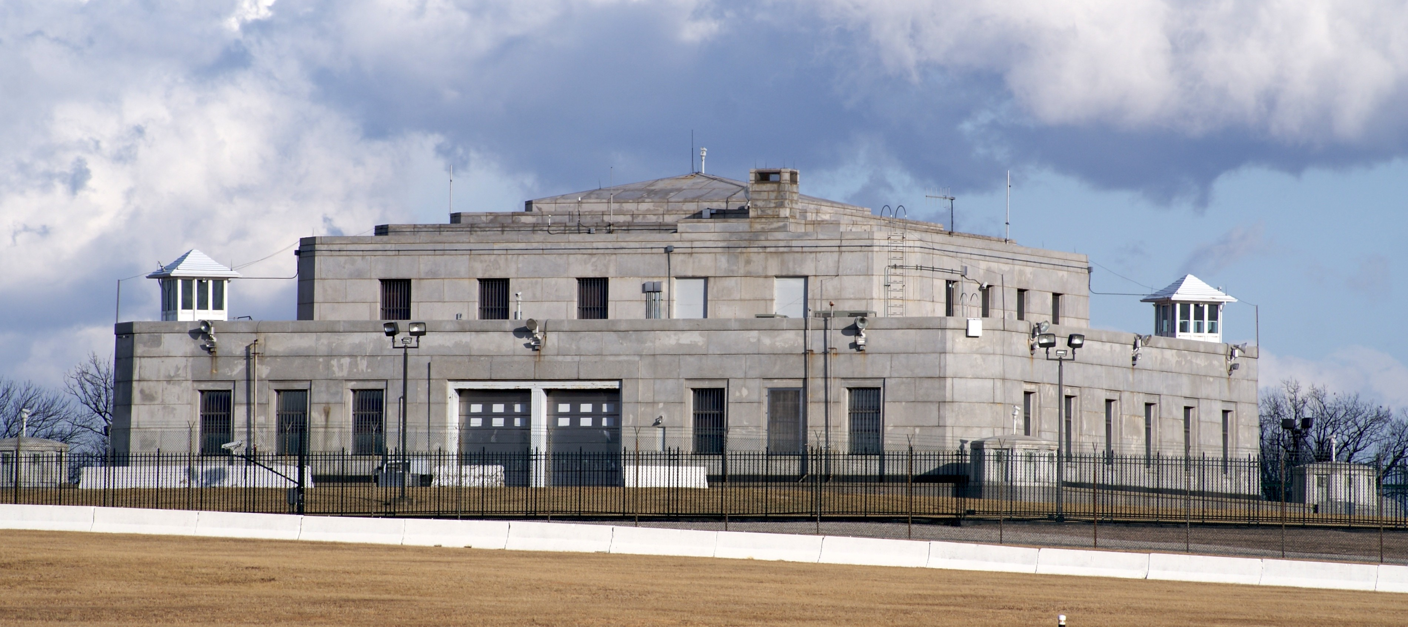
If GRACE is the “Fort Knox”
of God’s loving kindness,
then HUMILITY is the “key”
that opens the vault.

Slide 10
Peter knew about being HUMBLED
Luke 5:8 - Depart from me, for I am a sinful man, O Lord!
Luke 22:61,62 - “Before the rooster crows, you will deny me 3 x’s”. Peter remembered, went out, and wept bitterly.
John 21:17 - Peter was grieved because Jesus said 3 x’s, “Do you love me”?

Slide 11
Peter also knew about GRACE
Acts 4:33 - great grace was upon them all.
I Peter 3:7 - heirs together of the grace of life.
4:10 - good stewards of the grace of God.
5:5 - God gives grace to the humble.
5:10 - the God of all grace has called us.
5:12 - the grace of God in which you stand.

Slide 12
Grace, Humility and Laboring
1Peter 2:18 Servants (laborers), be submissive to your masters with all fear (humble respect), not only to the good and gentle, but also to the harsh.
19 For this is commendable (grace), if because of conscience toward God one endures grief, suffering wrongfully.

Slide 13
1Peter 2:20 For what credit is it if, when you are beaten for your faults, you take it patiently (humbly)? But when you do good and suffer, if you take it patiently (humbly), this is commendable (grace) before God.

Slide 14
Submitting to any earthly authority can be humbling, especially if he/she is harsh.
Such times are intended by God for our growth in and displaying of His grace.
Peter gives the ultimate illustration of humility and grace in the life of Jesus.

Slide 15
1Peter 2:21 For to this you were called, because Christ also suffered for us, leaving us an example, that you should follow His steps:
22 “Who committed no sin, nor was deceit found in His mouth";

Slide 16
1Peter 2:23 who, when He was reviled, did not revile in return; when He suffered, He did not threaten, but committed Himself to Him who judges righteously;
24 who Himself bore our sins in His own body on the tree, that we, having died to sins, might live for righteousness—by whose stripes you were healed.

Slide 17
1Peter 2:25 For you were like sheep going astray but have now returned to the Shepherd and Overseer of your souls.

Slide 18
Following Jesus’ Example of HUMILITY
(18) GRACE may not come easily.
good and gentle authorities can make being humble and gracious easier.
harsh = warped, perverse, crooked
Jesus humbly submitted to brutal authorities.
Are authorities in your life sometimes harsh?

Slide 19
(19,20) GRACE encircles times of suffering.
conscience toward God (being keenly aware of Him) is how grace happens.
times of grief (sadness) and suffering wrongfully is when grace can happen.
enduring (graciousness) and taking it patiently (humility) is what can happen.

Slide 20
GRACE empowers us (like Jesus) to …
(22) stop sinning (this may be a new response)
(22) guard our words (guile = deceit)
(23) not return evil for evil (revile = vilify)
(23) not make threats (plotting revenge)
(23) stop assuming God’s role (judging)
“Into Thy hands I commit my _____”

Slide 21
(24) GRACE empowers us (as Jesus) to take …
personal steps (himself, own body)
painful steps (stripes = blows)
life giving steps (humbly addressing what is dead, wrong, sick)
healing steps (make whole & healthy)
(25) humble steps (we once were astray, but Jesus has changed our very souls)

Slide 22
In the next few minutes, we will celebrate God’s saving grace available at the cross.
Thru the coming week, we will experience God’s sustaining grace, especially in times of grief and wrongful suffering.
In such humbling moments God will help us grow in grace and reflect His grace to those who are lost without it.

Slide 23
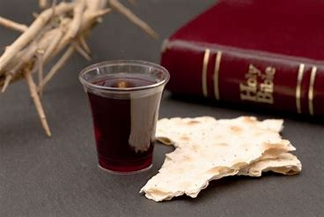

Slide 24
The Lord Is My Salvation
The grace of God has reached for me And pulled me from the raging sea And I am safe on this solid ground The Lord is my salvation

Slide 25
I will not fear when darkness falls His strength will help me scale
these walls I'll see the dawn of the rising sun The Lord is my salvation

Slide 26
Who is like the Lord our God? Strong to save, faithful in love My debt is paid and the vict'ry won The Lord is my salvation

Slide 27
My hope is hidden in the Lord He flow'rs each promise of His Word When winter fades
I know spring will come The Lord is my salvation

Slide 28
In times of waiting, times of need When I know loss, when I am weak I know His grace will renew these days The Lord is my salvation

Slide 29
Who is like the Lord our God? Strong to save, faithful in love My debt is paid and the vict'ry won The Lord is my salvation

Slide 30
1Peter 2:24 Jesus bore our sins in His own body on the tree, that we, having died to sins, might live for righteousness—by whose stripes you were healed.
1Peter 2:25 For you were like sheep going astray but have now returned to the Shepherd and Overseer of your souls.

Slide 32
And when I reach my final day He will not leave me in the grave But I will rise, He will call me home The Lord is my salvation

Slide 33
Who is like the Lord our God? Strong to save, faithful in love My debt is paid and the vict'ry won The Lord is my salvation

Slide 34
Glory be to God the Father Glory be to God the Son Glory be to God the Spirit The Lord is our salvation
The Lord is our salvation!

