Slide 1
Song of Solomon 1:7-17
Making time for En Gedi

Slide 2
Questions for Couples to Discuss at Home
1 - How are you doing at open & honest communication about your desires and insecurities? What needs to be said in a kind, loving, and inviting way?
2 - What are your honest initial thoughts about the woman speaking first and most, and about her being passionate and strongly vocal about desires and concerns for their relationship?
3 - Who are the friends you want to be the wise counsel in your life? Are there unhealthy friends or extended family that should not be given a voice in the details and decisions effecting your marriage?

Slide 3
Questions for Couples to Discuss at Home
4 - Is there anything in your spouse’s character that you can encourage and show gratitude for? Is there anything in your spouse’s character on which you can lovingly and kindly request improvement, responding humbly and not defensively?
5 - How can you pray for each other this week?
(borrowed from “Real Romance” by Mark & Grace Driscoll)

Slide 4
Song 1:7 (She) Tell me, O you whom I love, where you feed your flock, where you make it rest at noon. For why should I be as one who veils herself by the flocks of your companions?
(Don’t make me act like a prostitute - Gen 38:14,15)
8 (He) If you don’t know, O fairest among women, follow in the footsteps of the flock, and feed your little goats beside the shepherds' tents.
(Here’s a plan for spending time together)

Slide 5
Romance in a Busy Schedule
➢ People no more “fall in love” than they do “fall into health or wisdom”. It take work!
➢ Don’t be so busy IN your marriage that you don’t work ON your marriage.

Slide 6
Little Ideas for Big Blessings
Daily - Share a digital or common calendar.
Weekly - Plan a “sync meeting” (time for meshing schedules - separate from a date night).
Yearly - Go on a Vision Retreat (planning for healthy relationships as Christians, a couple, with each child, work/life balance, extended family, ministries).
Periodic - Put FUN on the calendar (a change of pace may require a change of place).

Slide 7
Song 1:9 (He) I have compared you, my love, to my filly among Pharaoh's chariots.
10 Your cheeks are lovely with ornaments, your neck with chains of gold.

Slide 8
Nicknames and Compliments
(Love Language) - Words of Encouragement
He calls her - most beautiful, my love, filly, lily, lovely, lover, my bride, etc.
She calls him - beloved, delightful, handsome, pleasant, stud, etc.
Song 2:6 His banner over me is love
- I feel safe/protected when we face adversity.
- He fights for me, not with me.

Slide 9
Song 1:11 (They) We will make you ornaments of gold with silver studs. (Love Language - Gift Giving)
Attitudes about Money
1. Hoarder: “$ (and things) gives me security”.
2. Spender: “$ gives me rewards”.
3. Avoider: “$ and bills stress me out”.
4. Hater: “$ is evil and dangerous”.
5. Manipulator: “$ buys me influence/control”.
6. Show-Off: “$ gives me status”.
7. Giver: “$ is how I show God and people love”.

Slide 10
Song 1:12 (She) While the king is at his table, my spikenard sends forth its fragrance.
13 A bundle of myrrh is my beloved to me, that lies all night between my breasts.
14 My beloved is to me a cluster of henna blooms in the vineyards of En Gedi.
15 (He) Behold, you are fair, my love! Behold, you are fair! You have dove's eyes.

Slide 11
Song 1:16 (She) Behold, you are handsome, my beloved! Yes, pleasant! Also our bed is green.
17 The beams of our houses are cedar, and our rafters of fir.

Slide 12
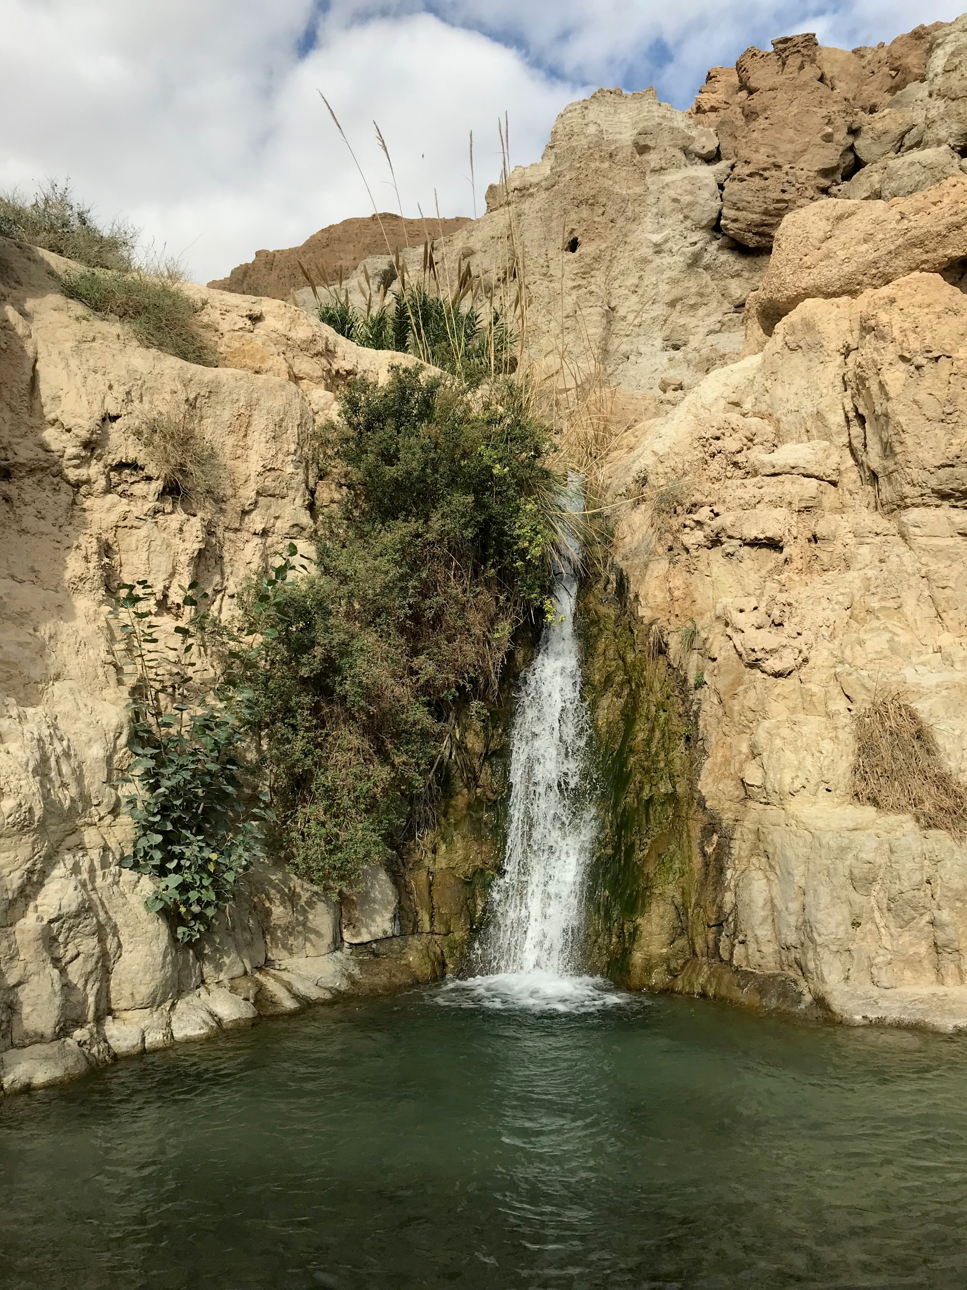
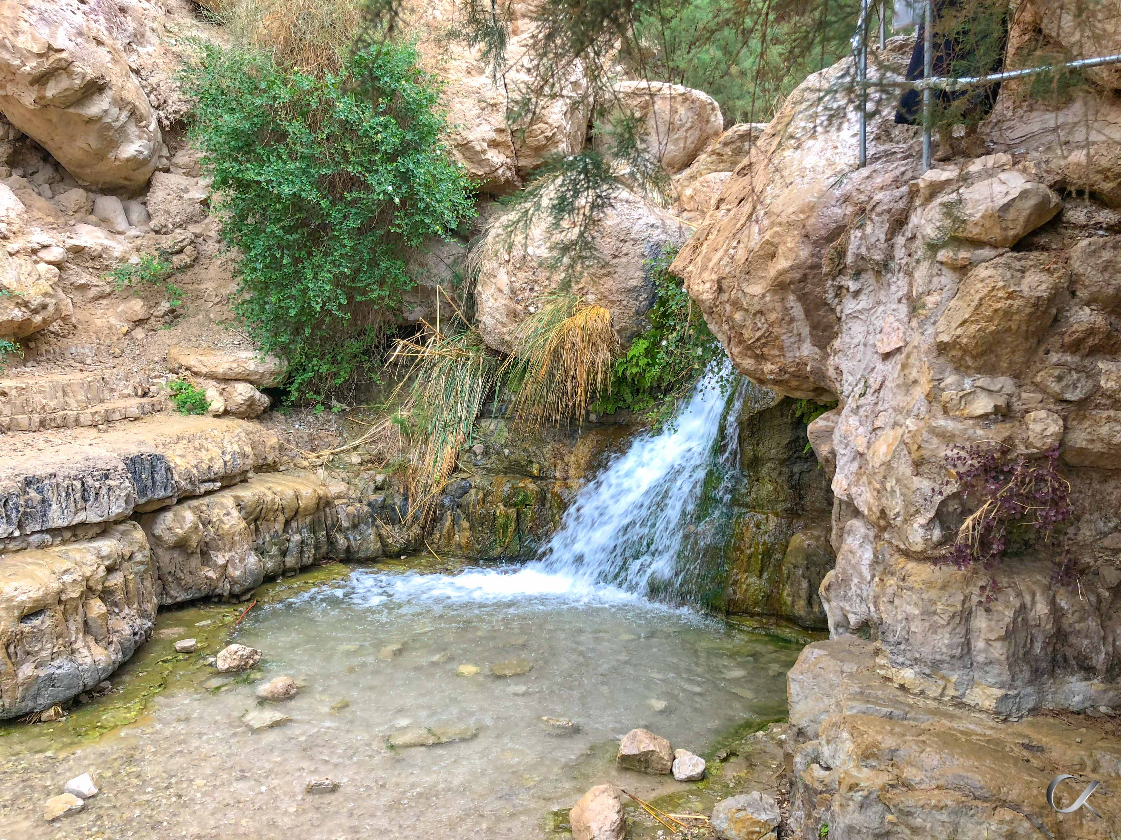
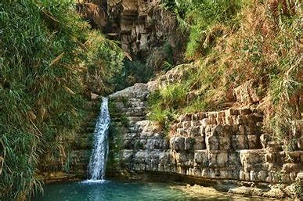
En Gedi

Slide 13
Making Your Own “En Gedi” Places
- a romantic retreat.
- bedrooms, homes, getaway places where a wife and husband can be private, relaxed, make memories and build relationships.
- may require budgeting time and money.
- allows for Song 1:12-2:7 conversations and activities.

Slide 14
(Re)Building My Spouse
Song 2:1 (She) I am the rose of Sharon, and the lily of the valleys.
- I consider myself a common wild-flower or weed.
2 (He) Like a lily among thorns, so is my love among the daughters.
- This is how I see you. You are incomparable. Prov 31:29 Many daughters have done well, but you excel them all.

Slide 15
Communicating Acceptance
- I love you because ___________
- What I most appreciate about you is ______
- The reason I first began to love you is ______
- My favorite memories with you are ______
- What makes you special is _______
- What I look forward to most in our future together is ______
- Thank you for ______

Slide 16
How God Sees You and Me (Ephesians)
Chosen & wanted, not an obligation (1:4)
Adopted, not Satan’s child of wrath (1:5;2:3)
Accepted in the Beloved, not endured (1:6)
Redeemed, not enslaved (1:7)
Forgiven, not condemned (1:7; 4:32)
His “poem”, not a cosmic accident (2:10)
“In Christ”(1:1,3,4,11; 2:6 - II Cor 5:17)

Slide 17
Be not afraid
For I have redeemed you
Be not afraid
I've called you my name
My love for you is everlasting
My love for you shall have no end

Slide 18
When you pass through the waters
I will surround you
When you pass through the floods
They will not sweep o'er
When you walk through the fire
You will not be consumed
You are my child! You are my child!
You are so precious to me

Slide 19
Next Time
Song of Solomon 2
The Little Foxes

