Slide 1
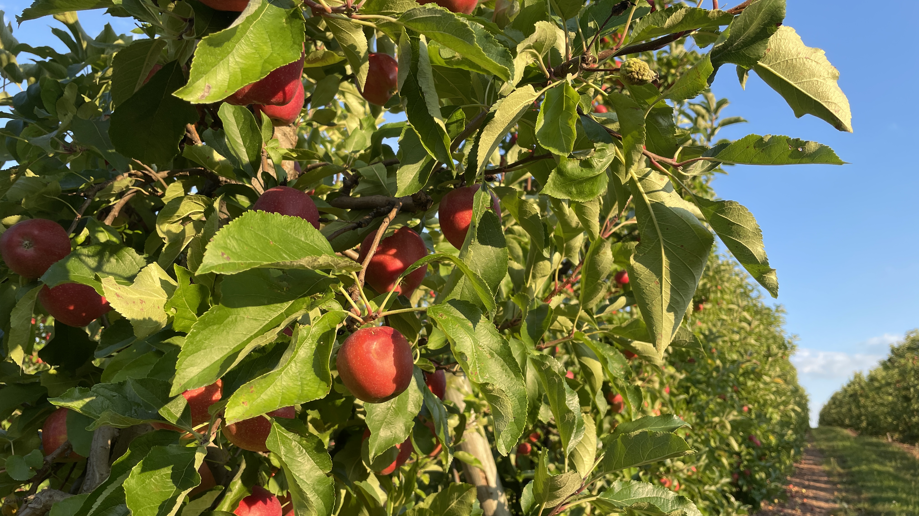
Welcome to GBC
Aug
20th
2023
Ps 17:8 Keep me as the apple of Your eye.

Slide 2
TEACHER TRAINING at GBC
Aug 26 (Sat) in the Fellowship Hall
Session 1 (8:30-9:25) - WHO & WHY
Session 2 (9:30-10:25) - WHY & HOW
Break/Snack (10:25-10:45)
Session 3 (10:45-11:30) - HOW
Session 4 (11:35-12:00) - Sample & Q&A

Slide 3
There Is a Hope
There is a hope that burns within my heart,
That gives me strength for every passing day;
A glimpse of glory now revealed in meagre part,
Yet drives all doubt away:

Slide 4
I stand in Christ, with sins forgiven;
And Christ in me, the hope of heaven!
My highest calling and my deepest joy,
To make His will my home.

Slide 5
There is a hope that lifts my weary head,
A consolation strong against despair,
That when the world has plunged me in its deepest pit,
I find the Savior there!

Slide 6
Through present sufferings,
future's fear,
He whispers 'courage' in my ear.
For I am safe in everlasting arms,
And they will lead me home.

Slide 7
There is a hope that stands the test of time,
That lifts my eyes beyond the beckoning grave,
To see the matchless beauty of a day divine
When I behold His face!

Slide 8
When sufferings cease and sorrows die,
And every longing satisfied.
Then joy unspeakable will flood my soul,
For I am truly home! (repeat)

Slide 9
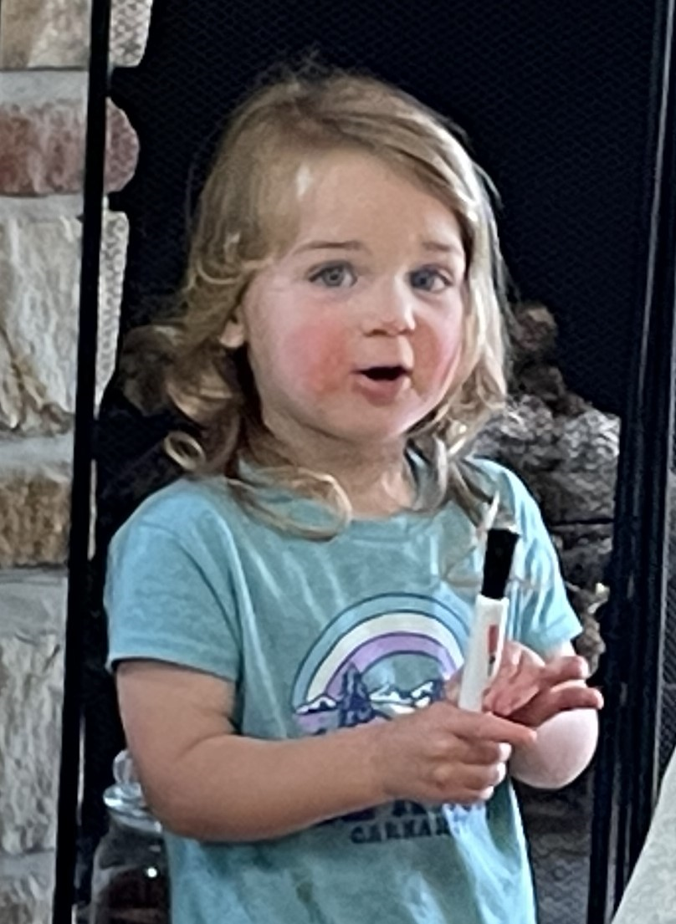
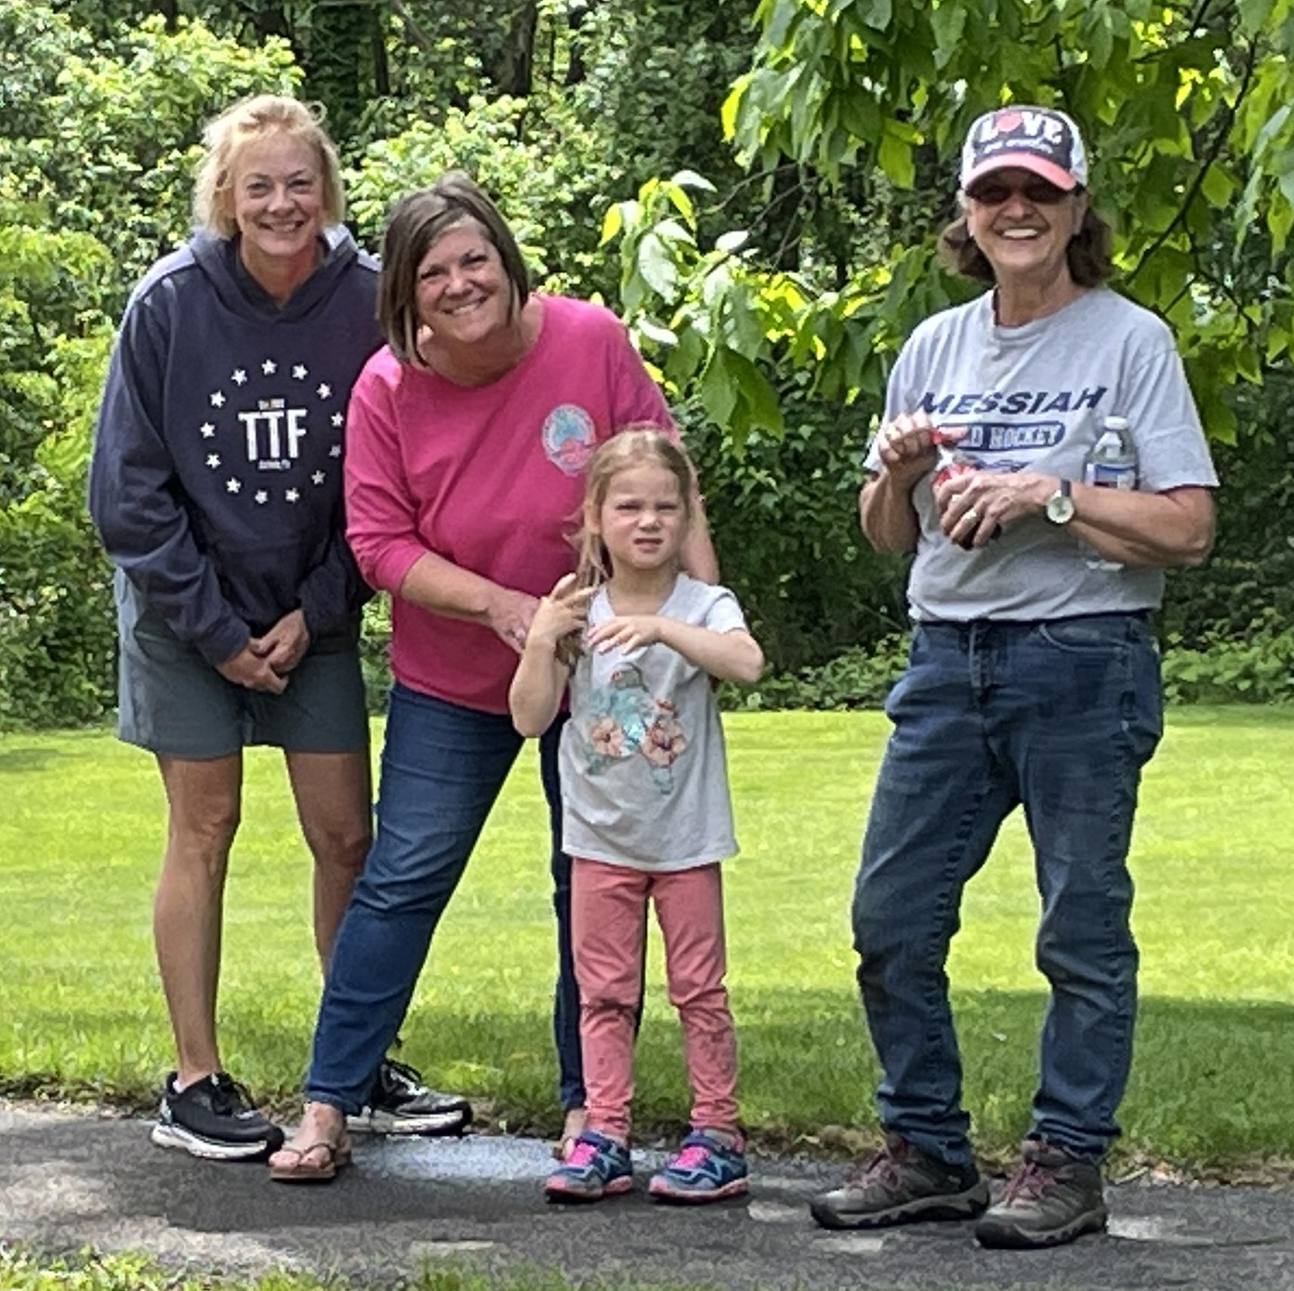
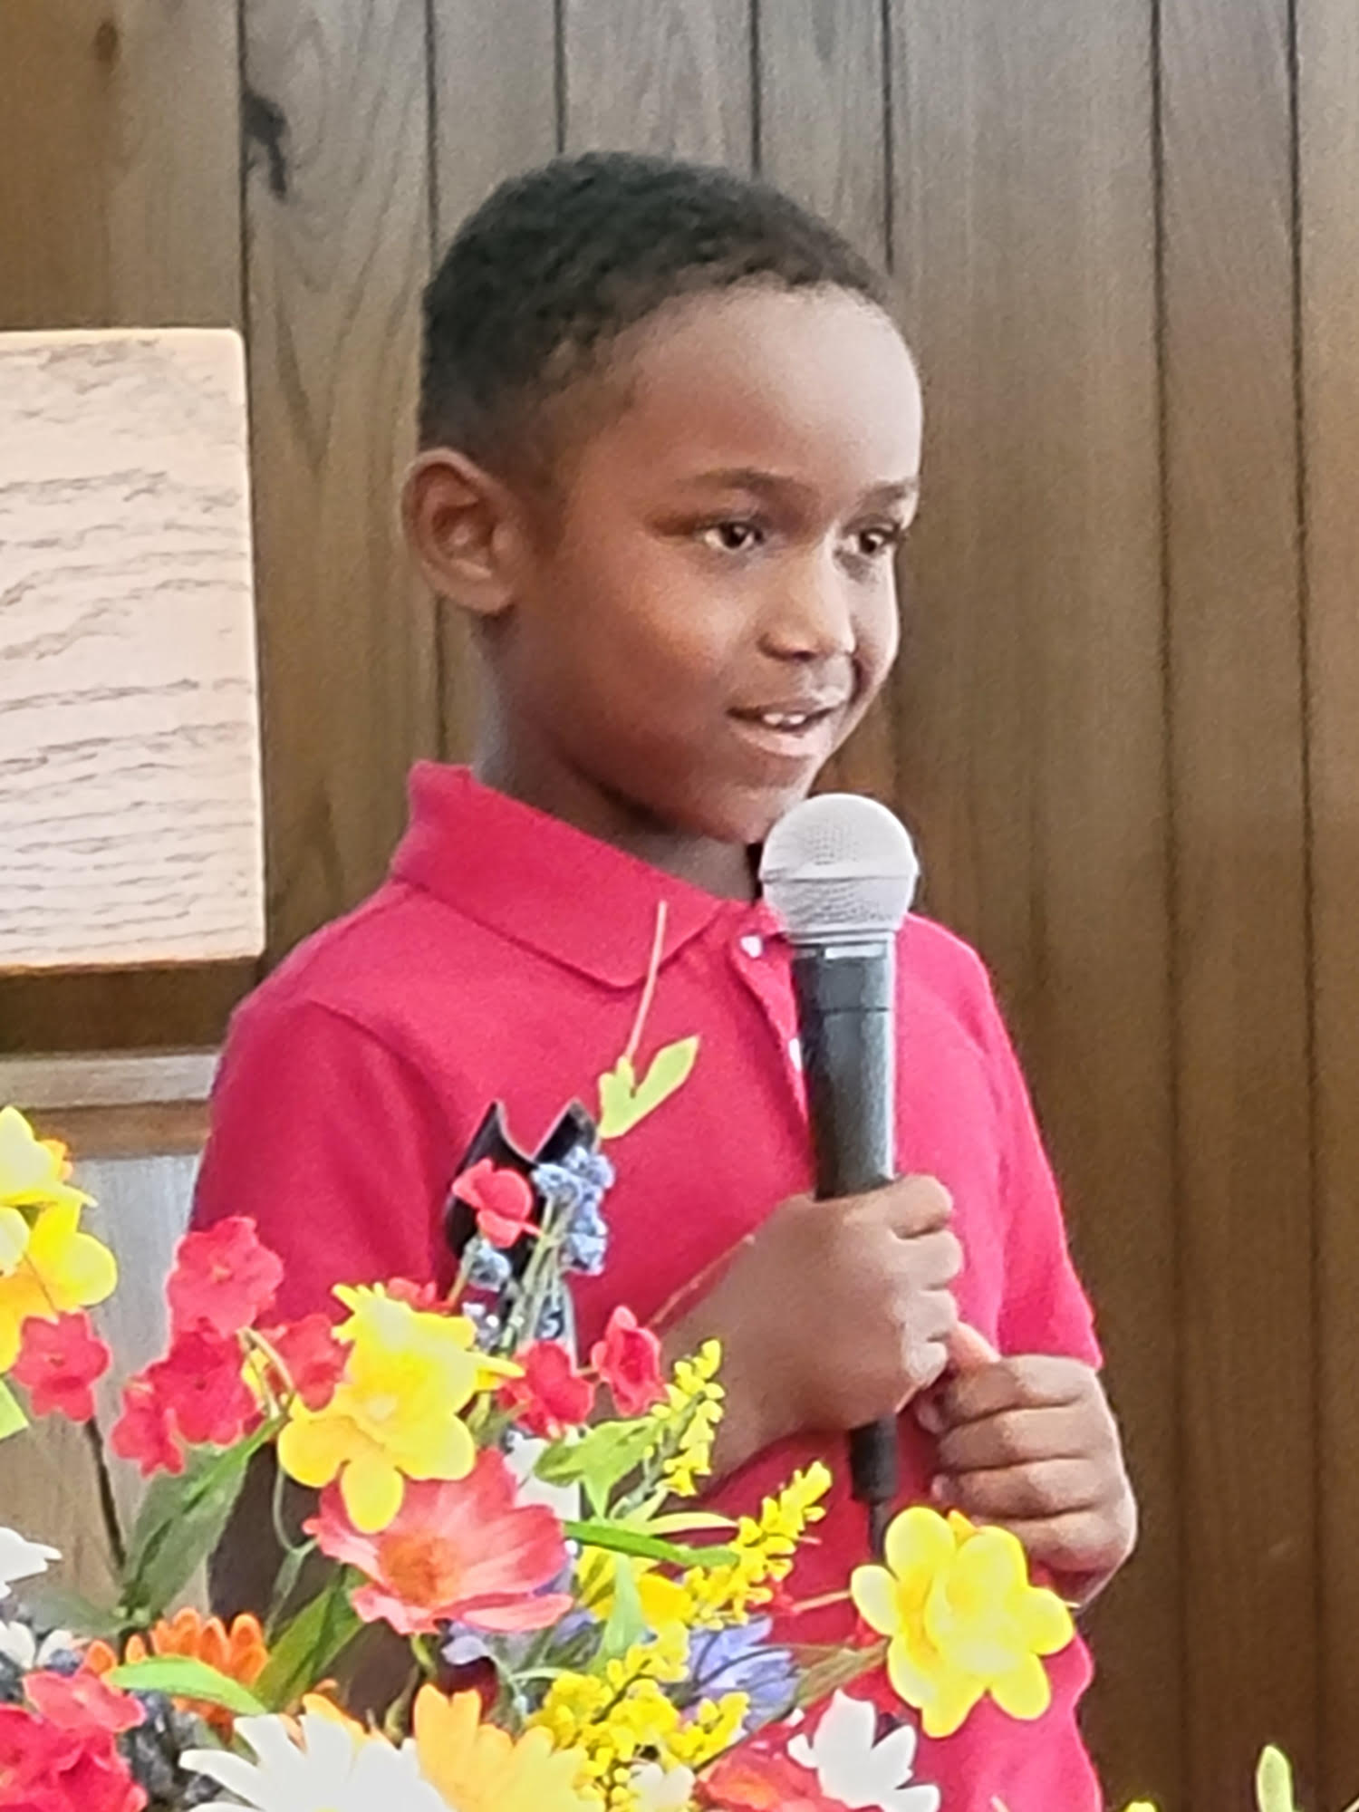
Kids KOrner

Slide 10
Jesus, Strong and Kind
Jesus said that if I thirst,
I should come to Him.
No one else can satisfy,
I should come to Him.

Slide 11
Jesus said, if I am weak,
I should come to Him.
No one else can be my strength,
I should come to Him.

Slide 12
For the Lord is good and faithful,
He will keep us day and night.
We can always run to Jesus,
Jesus, strong and kind.

Slide 13
Jesus said that if I fear,
I should come to Him.
No one else can be my shield,
I should come to Him.

Slide 14
For the Lord is good and faithful,
He will keep us day and night.
We can always run to Jesus,
Jesus, strong and kind.

Slide 15
Jesus said, if I am lost,
He will come to me.
And He showed me on that cross
He will come to me!

Slide 16
For the Lord is good and faithful,
He will keep us day and night.
We can always run to Jesus.
Jesus, strong and kind,
Jesus, strong and kind!

Slide 17
Praying at GBC
Central in 2 out of 4 weekly gatherings
Included in each weekly bulletin
Significant part of our missionary and ministry support
Reason for our updated foyer display
Luke 11:1 “Lord, teach us to pray …”
Sermon on the Mount - Matthew 6

Slide 18
Matt 6:5 When you pray, you shall not be like the hypocrites. For they love to pray standing in the synagogues and on the corners of the streets, that they may be seen by men. Assuredly, I say to you, they have their reward.
➢ When you pray, avoid Hypocrisy

Slide 19
Matt 6:6 But you, when you pray, go into your room, and when you have shut your door, pray to your Father who is in the secret place; and your Father who sees in secret will reward you openly.
➢ When you pray, prefer Privacy

Slide 20
Matt 6:7 And when you pray, do not use vain repetitions as the heathen do. For they think that they will be heard for their many words.
➢ When you pray, speak with Simplicity

Slide 21
Mark 12:38 Beware of the scribes, who desire to go around in long robes, love greetings in the marketplaces,
39 the best seats in the synagogues, and the best places at feasts,
40 who devour widows' houses, and who pretend to be godly by making long prayers. These will receive greater condemnation.

Slide 22
Matt 6:8 Therefore do not be like them. For your Father knows the things you have need of before you ask Him.
When you pray, come to God Expectantly
Prayer is about worship and relationship, not just needs.

Slide 23
Matt 6:9 In this manner, therefore, pray:
Our Father in heaven, Hallowed be Your name.
➢ When you pray, begin with Perspective
Our Father - wonderful relationships
in heaven - not bound by earthly limits
Holy is Your Name - perfect character

Slide 24
Matt 6:10 Your kingdom come. Your will be done on earth as it is in heaven.
➢ When you pray, desire God’s Purpose
Purposes that are present & future
Purposes corresponding with God’s will
Purposes from heaven that impact earth

Slide 25
Matt 6:11 Give us this day our daily bread.
➢ When you pray, request God’s Provision
give us - embrace dependency
this day - accept life’s immediacy
bread - be satisfied with simplicity

Slide 26
Matt 6:12 And forgive us our debts, as we forgive our debtors.
➢ When you pray, seek God’s Pardon
forgiveness for when I sin
forgiveness for when I am sinned against
only theme Jesus repeats & expands (14,15)

Slide 27
Matt 6:14 For if you forgive men their trespasses, your heavenly Father will also forgive you.
Matt 6:15 But if you do not forgive men their trespasses, neither will your Father forgive your trespasses.

Slide 28
Matt 6:13 Do not lead us into temptation but deliver us from the evil one.
➢ When you pray, ask for God’s Protection
Temptation is natural (James 1:14,15)
Deliverance is supernatural (I Cor 10:12,13)
Humility is essential - take heed lest you fall
Others have endured the same - common to man
Parameters have been set - God will not allow
Escape will be provided - so we can bear it

Slide 29
Matt 6:13 For Yours is the kingdom and the power and the glory forever. Amen.
When you pray, include Praises for God’s …
Kingdom - He has the authority
Power - He has the ability
Glory - He gets the applause
Forever - This is true always
Amen! - I affirm this!

Slide 30
These themes shape our prayers
Perspective - “Our Father in heaven”
Purpose - “Thy will be done”
Provision - “Give us this day”
Pardon - “Forgive our debts”
Protection - “Deliver from evil”
Praise - “Thine forever. Amen”!

Slide 31
To REALLY pray …
“Our Father” -
I must trust the SAVIOR
“Thy will be done” -
I must know & obey the SCRIPTURES
“Give us daily bread” -
I must look to the SUPPLIER

Slide 32
To REALLY pray …
“Forgive us our debts” -
I must submit to the SANCTIFIER
“Lead and deliver us” -
I must follow the SHEPHERD
“Thine … forever. Amen!” -
The Father in Heaven must be SECOND to none!

Slide 33
Praise God from Whom all blessings flow.
Praise Him all creatures here below.
Praise Him above ye heavenly host.
Praise Father, Son, and Holy Ghost.
AMEN!

