Slide 1
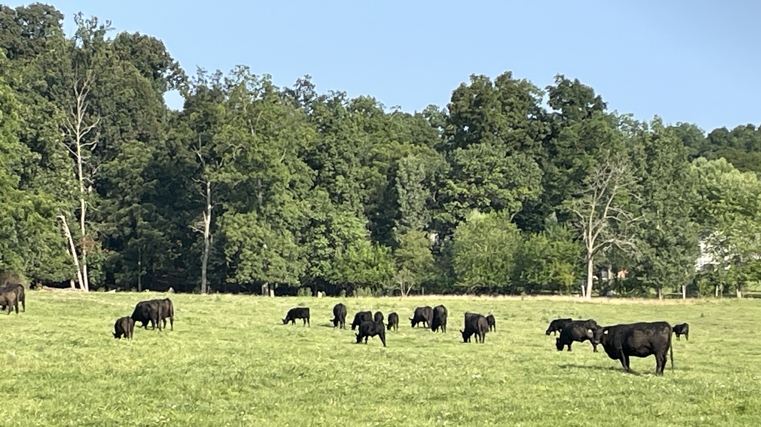
August 6, 2023
Welcome to GBC
God owns the cattle on a thousand hills,
I know that He will care for me.

Slide 2
You are invited to a
GBC TEACHER TRAINING SEMINAR
with CEF Director Pam Blankenship
and Pastor James as instructors.
Topics = The Who, Why, & How of Teaching
August 26 (Sat) from 8:30 to Noon

Slide 3
The Lord Is My Salvation
The grace of God has reached for me And pulled me from the raging sea And I am safe on this solid ground The Lord is my salvation

Slide 4
I will not fear when darkness falls His strength will help me scale
these walls I'll see the dawn of the rising sun The Lord is my salvation

Slide 5
Who is like the Lord our God? Strong to save, faithful in love My debt is paid and the vict'ry won The Lord is my salvation

Slide 6
My hope is hidden in the Lord He flow'rs each promise of His Word When winter fades
I know spring will come The Lord is my salvation

Slide 7
In times of waiting, times of need When I know loss, when I am weak I know His grace will renew these days The Lord is my salvation

Slide 8
Who is like the Lord our God? Strong to save, faithful in love My debt is paid and the vict'ry won The Lord is my salvation

Slide 9
And when I reach my final day He will not leave me in the grave But I will rise, He will call me home The Lord is my salvation

Slide 10
Who is like the Lord our God? Strong to save, faithful in love My debt is paid and the vict'ry won The Lord is my salvation

Slide 11
Glory be to God the Father Glory be to God the Son Glory be to God the Spirit The Lord is our salvation
The Lord is our salvation
The Lord is our salvation

Slide 12
Jesus, Strong and Kind
Jesus said that if I thirst,
I should come to Him.
No one else can satisfy,
I should come to Him.

Slide 13
Jesus said, if I am weak,
I should come to Him.
No one else can be my strength,
I should come to Him.

Slide 14
For the Lord is good and faithful,
He will keep us day and night.
We can always run to Jesus,
Jesus, strong and kind.

Slide 15
Jesus said that if I fear,
I should come to Him.
No one else can be my shield,
I should come to Him.

Slide 16
For the Lord is good and faithful,
He will keep us day and night.
We can always run to Jesus,
Jesus, strong and kind.

Slide 17
Jesus said, if I am lost,
He will come to me.
And He showed me on that cross
He will come to me!

Slide 18
For the Lord is good and faithful,
He will keep us day and night.
We can always run to Jesus.
Jesus, strong and kind,
Jesus, strong and kind!

Slide 19
GRACE BIBLE CHAPEL
Exploring our “First Name”
Grow in the GRACE and knowledge of our Lord and Savior Jesus Christ.
II Peter 3:18

Slide 20
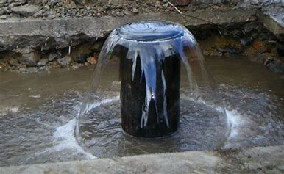
Grace

Slide 21
Grace and Forgiveness
God will forgive us
Blessed is he whose transgression is forgiven, whose sin is covered. Ps 32:1

Slide 22
Grace and Forgiveness
Will we forgive others?
Be kind, tenderhearted, forgiving others as God in Christ forgave you. Eph 4:32

Slide 23
Grace experienced
is meant to become
grace expressed.

Slide 24
Natural tendency
expect God to be just like me.
when I’m wronged, that person must pay.
seek revenge and justice.
Supernatural calling
become more like God.
replace my natural tendencies with godliness.
release not revenge; mercy not justice; blessing not condemnation; forgiveness not retribution.

Slide 25
Luke 17:1-6 - Grace and Forgiveness
(1) Warning to all - offense(s) will occur.
(2) Warning to offenders - better to face the mafia than God.
(3) Warning to offended - be very alert to yourself (not the natural focus).
(3) Steps toward reconciliation are not easy, but they are clear.

Slide 26
Definitions in verse 3
trespass - to step over God’s boundary, sin.
rebuke - face-to-face, private conversation humbly identifying the trespass and the desire for reconciliation (Mt 18:15).
If your brother sins against you, go and tell him his fault between you and him alone. If he hears you, you have gained your brother.

Slide 27
Definitions in verse 3
trespass -- rebuke
repentance - change of mind and direction with a request to be forgiven (Isa 55:7).
Let the wicked forsake his way, and the unrighteous man his thoughts; Let him return to the LORD, and He will have mercy on him; And to our God, for He will abundantly pardon.

Slide 28
Definitions in verse 3
trespass -- rebuke -- repentance
forgive - how grace responds to repentance.
1John 1:9 If we confess our sins (repent), He is faithful and just to forgive us our sins and to cleanse us from all unrighteousness.
➢ Forgiving can restore what a trespass ruins.

Slide 29
Mar 11:25 Whenever you stand praying, if you have anything against anyone, forgive him, that your Father in heaven may also forgive you your trespasses.
26 But if you do not forgive, neither will your Father in heaven forgive your trespasses.
➢ Unforgiveness has eternal consequences.

Slide 30
Luke 17:1-6 - Grace and Forgiveness
(4) Impossible? - many trespasses, each followed by requests for forgiveness (repentance), should result in forgiveness.
➢ Voluntary restitution helps (Zacchaeus).
(5,6) Not an issue of increased faith, but
increased obedience (vs 10 duty = debt).
➢ Remember how God forgives us (Eph 4:32).

Slide 31
Grace experienced
is meant to become
grace expressed.

Slide 32
Are you an unforgiving person?
Have days, weeks, months, years passed, and you’re still making someone “pay”?
Could an unwillingness to forgive says more about the condition of your heart than about the person you refuse to forgive?
Do you need to repent and ask God to help you grow in the grace of forgiveness?

Slide 33
Eph 4:31,32 Let all bitterness, wrath, anger, clamor, and evil speaking be put away from you, with all malice. And be kind to one another, tenderhearted, forgiving one another, even as God in Christ forgave you.

Slide 34
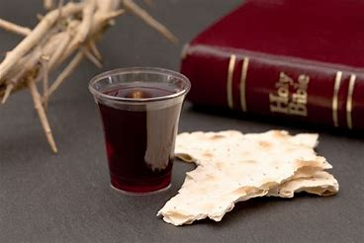

Slide 35
5:2 And walk in love, as Christ also has loved us and given Himself for us, an offering and a sacrifice to God for a sweet-smelling aroma.

Slide 37
Blessed be the tie that binds
our hearts in Christian love.
The fellowship of kindred minds
is like to that above.

Slide 38
Before our Father's throne, We pour our ardent prayers; Our fears, our hopes, our aims are one-- Our comforts and our cares.

Slide 39
When we asunder part, It gives us inward pain; But we shall still be joined in heart, And hope to meet again.

