Slide 1
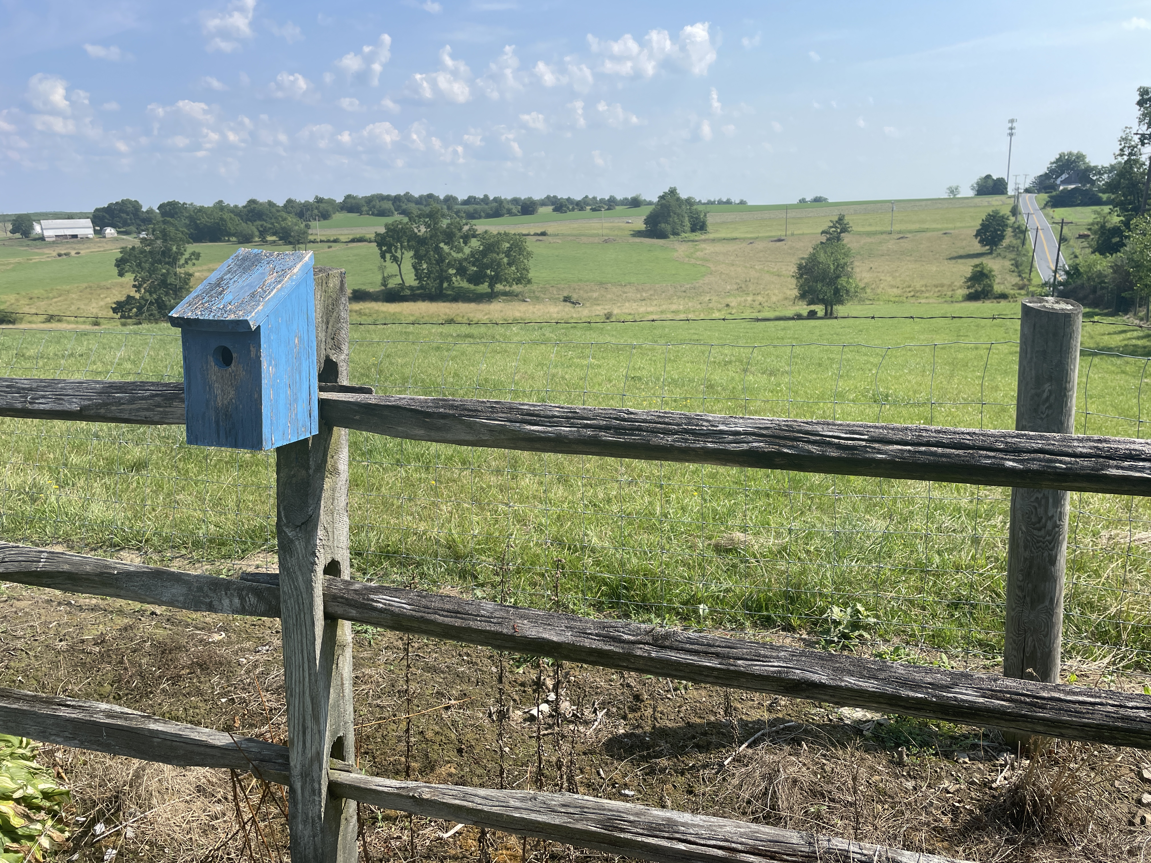
Welcome to GBC
July 23, 2023
Matthew 6:26 Look at the birds of the air, for they neither sow nor reap nor gather into barns; yet your heavenly Father feeds them. Are you not of more value than they?

Slide 2
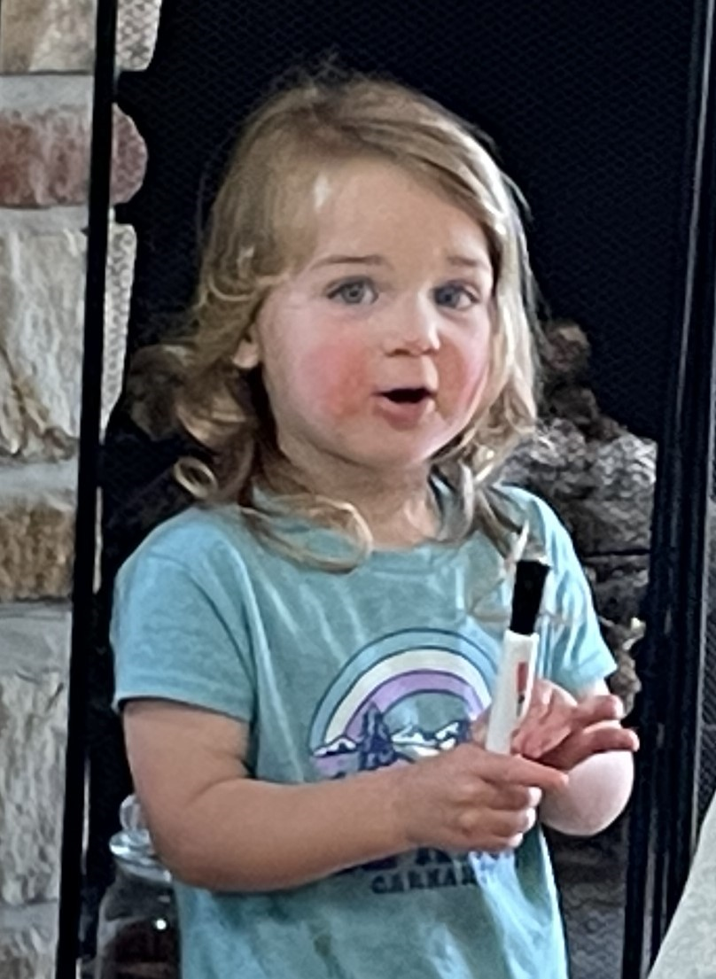
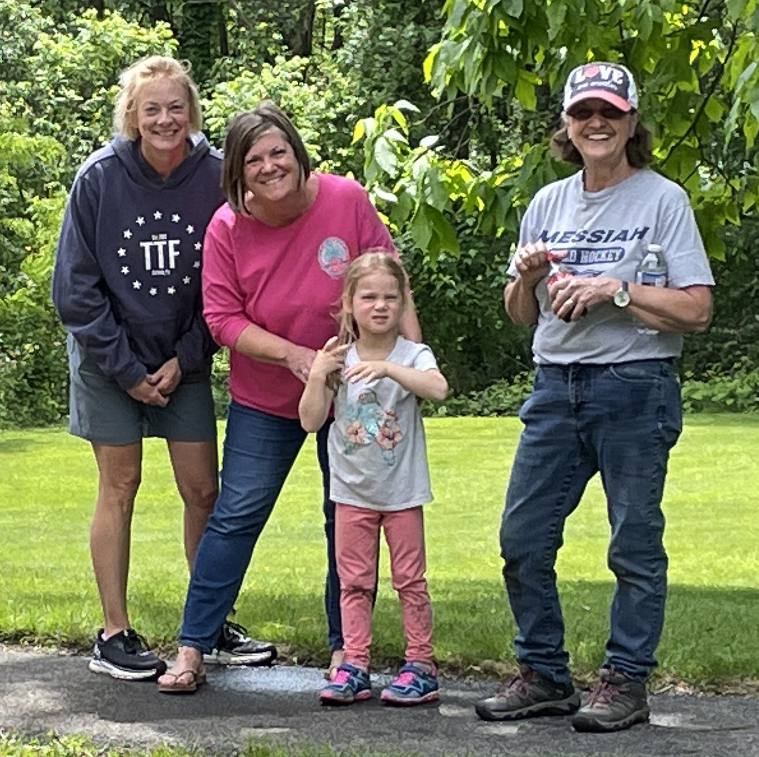
Kids KOrner

Slide 3
Praise Him, praise Him,
all ye little children,
God is love, God is love;
Praise Him, praise Him,
all ye little children,
God is love, God is love.

Slide 4
Love Him, love Him,
all ye little children,
God is love, God is love;
Love Him, love Him,
all ye little children,
God is love, God is love.

Slide 5
Thank Him, thank Him,
all ye little children,
God is love, God is love;
Thank Him, thank Him,
all ye little children,
God is love, God is love.

Slide 6
Sermon on the Mount
Chpt 5 - What Jesus’ followers ARE
(3-12) We are BLESSED (approved by God)
(13-16) We are to be DIFFERENT (salt & light)
(17-48) We are to be DEEPER (letter vs spirit)
- exceed the Scribes & Pharisees righteousness (20)
- you have heard (current misapplications),
but I say (spirit vs letter of God’s law) (21-48)

Slide 7
(21-26) deeper than no murder … no anger.
(27-30) deeper than no adultery … no lust.
(31-32) deeper than proper divorce papers to … (except for fornication) ’til death parts us.
(33-37) deeper than no lies to … no oaths at all.
(38-42) deeper than “tit for tat” to … self-denial.
➢ (43-48) deeper than love your neighbor to …
love your enemies.

Slide 8
Matthew 5:43 You have heard that it was said, “You shall love your neighbor and hate your enemy.”
44 But I say to you, love your enemies, bless those who curse you, do good to those who hate you, and pray for those who spitefully use you and persecute you,

Slide 9
Matt 5:45 that you may be sons of your Father in heaven; for He makes His sun rise on the evil and on the good and sends rain on the just and on the unjust.
46 For if you love those who love you, what reward have you? Do not even the tax collectors do the same?

Slide 10
Matt 5:47 And if you greet your brethren only, what do you do more than others? Do not even the tax collectors do so?
48 Therefore you shall be perfect, just as your Father in heaven is perfect.

Slide 11
Matthew 5:43 You have heard, “You shall love your neighbor and hate your enemy.”
statement with an omission (Lev 19:18 “Love your neighbor as yourself”),
and an addition (“hate your enemy”) which is nowhere found in the Bible.
In fact, the opposite is found.

Slide 12
Job 31:29 I (have not) rejoiced at the destruction of him that hated me, or lifted up myself when evil found him:
30 Neither have I suffered my mouth to sin by wishing a curse to his soul.

Slide 13
Psalm 7:3 O LORD my God, if I have done this: If there is iniquity in my hands,
4 If I have repaid evil to him who was at peace with me, or have plundered my enemy without cause,
5 Let the enemy pursue me and overtake me; Yes, let him trample my life to the earth, and lay my honor in the dust.

Slide 14
Psalm 35:11 Fierce witnesses rise up; They ask me things that I do not know.
12 They reward me evil for good, to the sorrow of my soul.
13 But as for me, when they were sick, my clothing was sackcloth; I humbled myself with fasting; And my prayer would return to my own heart.

Slide 15
14 I paced about as though he were my friend or brother; I bowed down heavily, as one who mourns for his mother.
Prov 25:21 If your enemy is hungry, give him bread to eat; And if he is thirsty, give him water to drink;
22 For so you will heap coals of fire on his head, and the LORD will reward you.

Slide 16
How was “hating enemies” justified?
God’s command to annihilate Canaanites
(judicial [not individual] call of God to rid the earth of extreme vileness).
Imprecatory Prayers asking God to deal harshly with wickedness)
Verses like Ps 69:22-28 must be read in the light of vs 9 “zeal for God’s house”).

Slide 17
Great tension in the Bible between …
- perfect and personal hatred (Ps 139:21,22)
- hating sin and loving a sinner (John 8:11).
- righteous indignation and personal retaliation out of injury, hatred, pride, prejudice (Luke 19:45,46).
- “You have heard …” and “But I say …”

Slide 18
What “neighbors” did Pharisees love?
NOT Gentiles (I Thess 4:5 - know not God)
NOT Samaritans (John 4:9 - no dealings)
NOT Jews who were …
- tax collectors (agents of pagan Rome) or sinners (Mt 9:11 - no eating together)
- uneducated in God’s Law (Jn 7:49 - cursed)
NOT Jesus (John 11:53 - plotted His death)

Slide 19
I say to you, “love your enemy” (44)
enemies = those who curse you (verbal),
hate you (emotional),
abuse and persecute you (physical).
love = to respond by blessing them (verbal),
doing good to them (physical),
praying for them (spiritual) …
- like Jesus on the cross (Father forgive them).
- like Stephen under stones (Don’t charge them)

Slide 20
Asking God to meet deep needs like …
demonic control
anger, bitterness, fears, pride
healing of wounds
peace with God and others
forgiveness
repentance and salvation

Slide 21
Love for an enemy is not just …
philos = friendship love (common interests)
storgay = family love (common ancestors)
eros = feelings love (common emotions)
But agapay = godly love, selfless serving.
- like Jesus washing feet (John 13)
- displaying fruit of the Spirit (Galatians 5)

Slide 22
Loving my enemy means I am …
(45) Displaying common grace like our Father
- pouring out blessing without partiality
(46,47) Exceeding common social conventions
- giving not just good for good, but good for evil.
(48) Following a standard of perfection
- not because I am religious (20)
- because of a supernatural relationship (48)

Slide 23
A relationship that …
(3-6) begins with genuine repentance.
(13-16) will make you and me different.
(17-19) Jesus offers you and me by perfectly fulfilling the Law in our place.
(20-48) calls you and me to live by a power and to a standard greater than man’s religion.
(48) restores the perfection God intended.

Slide 24
Hymn #553
Come, Thou Fount of every blessing, Tune my heart to sing Thy grace; Streams of mercy, never ceasing, Call for songs of loudest praise.

Slide 25
Jesus sought me when a stranger,
Wand’ring from the face of God;
He, to save my soul from danger,
Interposed His precious blood.

Slide 26
O to grace how great a debtor Daily I’m constrained to be! Let Thy goodness, like a fetter, Bind my wandering heart to Thee.

Slide 27
Prone to wander, Lord, I feel it, Prone to leave the God I love; Here’s my heart, O take and seal it, Seal it for Thy courts above.

