Slide 1
So … You Believe There Is a Divine Planner?
Ecclesiastes 4

Slide 2
Chpt 1,2 – It is NOT WISE to make life equal to your Work, your Wisdom, your Wealth, or your (legal) Will
Chpt 3 – It IS WISE to see life as …
Purposeful – So discover God’s Plan (Scientist)
Beautiful – So enjoy God’s Plan (Artist)
Accountable – So obey God’s Plan (Servant)

Slide 3
Chpt 4 – Despite such a Plan,
how will you face …
(1-3) OPPRESSED, who experience …
tears (part of the curse - Rev 21:4)
unfairness (Eccl 3:16,17)
hopelessness (Eccl 2:24-26)
➢ Consider Ps 73:16,17; Lk 4:18,19

Slide 4
Ps 73:16 When I thought how to understand this, it was too painful for me— Until
Ps 73:17 I went into the sanctuary of God; Then I understood their end.
Q - How can being together in God’s house put life into perspective?

Slide 5
Luke 4:18,19 The Spirit of the Lord has anointed me to proclaim good news to the poor. He has sent me to proclaim liberty to the captives and recovering of sight to the blind, to set at liberty those who are oppressed, to proclaim the year of the Lord's favor.
Q - How does the gospel help the oppressed?

Slide 7
How will you face …
(4-6) WORKERS, who experience …
envy – excellence produces enemies
(Cain & Abel; Jacob & Laban;
Joseph & brothers; Daniel & Politicians;
Mordechai & Haman; Jesus & Pharisees)
laziness (Prov 24:30-34)
greed (Matt 6:33)
➢ Consider Col 3:23,24

Slide 8
Col 3:23 Whatever you do, do it heartily, as to the Lord and not to men,
Col 3:24 knowing that from the Lord you will receive the reward of the inheritance; for you serve the Lord Christ.
Q - What factors sustain a Christian worker thru hard circumstances?

Slide 9
How will you face
(7-12) LONERS while they are …
(8,9) Working (Mark 6:7 - “two by two”)
(10) Walking (Gal 6:1 - “you who are spiritual”)
(11) Warming (Gen 2:18 - “not good alone”)
(12) Withstanding (Mk 14:37; Heb 10:24,25)
➢ Consider “One Another” Commands

Slide 10
John 13:34 - love one another
Rom 15:7 - receive one another
Rom 15:14 - admonish one another
II Cor 13:12 - greet one another
Gal 5:13 - serve one another
Gal 6:2 - bear one another’s burdens
Eph 4:32 - forgive one another

Slide 11
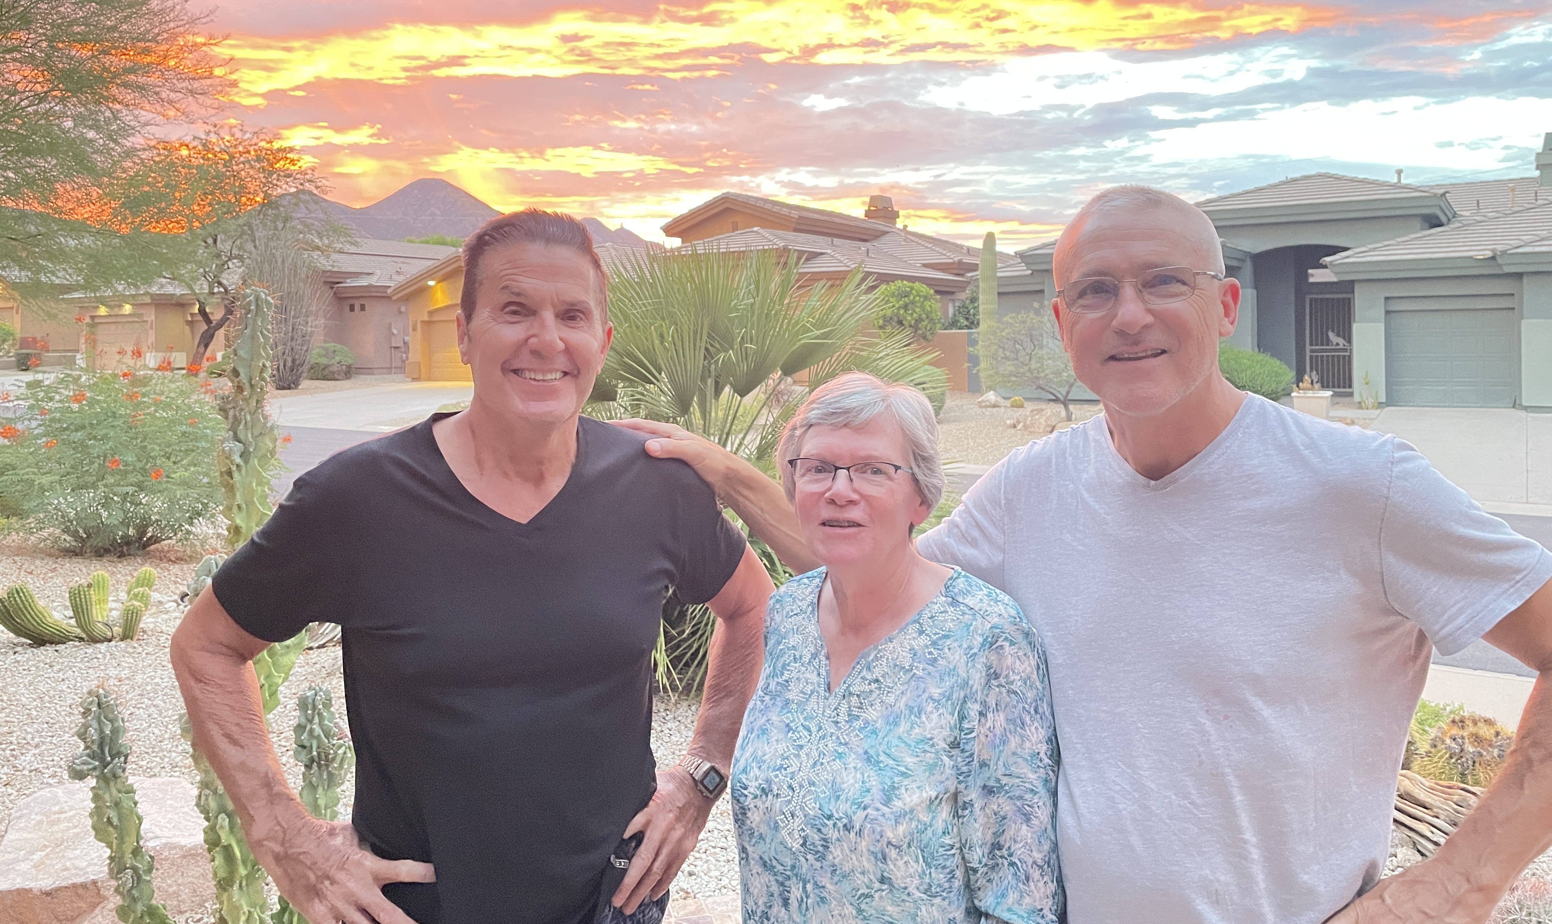

Slide 12
If you believe there is a Divine Planner,
how will you face
(13-16) Changing POLITICAL Landscapes with …
(13,14) Irregularities among Leaders
(15,16) Fickleness among Followers
➢ Consider Psalm 20:7-9

Slide 13
Ps 20:7 Some trust in chariots, and some in horses; but we will remember the name of the LORD our God.
Ps 20:8 They have bowed down and fallen; but we have risen and stand upright.
Ps 20:9 Save, LORD! May the King answer us when we call.
Q - How do Christians do elections differently?

Slide 14
Next Time - Ecclesiastes 5
(1-7) Wisdom in God’s House
(8,9) Wisdom in Government
(10-17) Wisdom in Economics
(18-20) Wisdom in Summary

