Slide 1
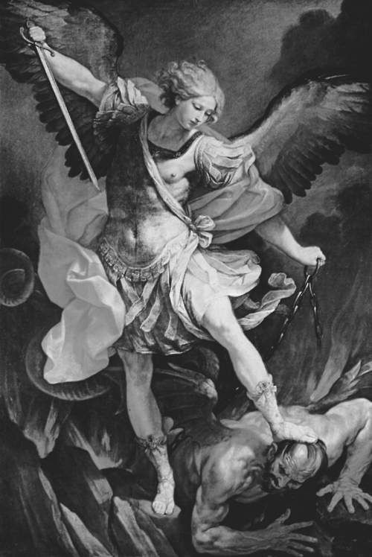
The
Spirit
World
(Spiritual Warfare)

Slide 2
Review
1 - The created spirit world is real & powerful.
2 - There are both holy & unholy spirits.
3 - Evil spirits are led by the fallen angel, Satan.
4 - Satan uses many methods (17).
5 - Satan pursues some ancient overarching goals:
being worshipped as God, undermining God’s Word,
dominating God’s world, destroying Jews and church,
attacking families and especially children.

Slide 3
Weapons Available for Resisting the Devil
Staying humble, clean & close to God (Jms 4:6-8)
The Sword of the Spirit (Matt 4:4 - rhema)
Fervent Prayer (Matt 6:13; Eph 6:18)
Fasting (Dan 9:3,20-23; Matt 17:21; I Cor 7:5)
Fleeing (I Cor 6:18; 10:14; I Tim 6:11; II Tim 2:2)
Casting out demons (Mark 16:17; John 12:31; Acts 19:12,13)

Slide 4
Practices in Deliverance Ministries
diagnosis - questions about life, relationships,
evil practices, evil places and objects, etc.
name demon(s) - gain authority, pursue confession
expulsion - recite scripture, pray, invoke the name and blood of Jesus, rebuke, anoint.
actions to keep the demon from returning - repent & forsake, head covering, burn items.

Slide 5
Biblical Truths on Spiritual Warfare
2Cor 10:3 Though we walk in the flesh, we do not war according to the flesh (in but not of).
4 The weapons of our warfare are not carnal but mighty in God for pulling down strongholds,
5 casting down arguments and every high thing that exalts itself against the knowledge of God, bringing every thought into captivity to the obedience of Christ.

Slide 6
What does Spiritual Warfare ACCOMPLISH?
II Corinthians 10
(4) Pull down strongholds (“isms” & attitudes).
(5) Cast down arguments/imaginations against knowing God (Ex 20:4) .
(5) Cast down high things (elevated places, people, things = idols; Deut 12:2).
(5) Bring thoughts (devices) into captivity/obedience.

Slide 7
What ATTITUDES are brought into warfare?
2Tim 2:24 A servant of the Lord must not quarrel but be gentle to all, able to teach, patient,
25 humbly correcting those who are in opposition (Jms 4:6-8), if God perhaps will grant them repentance, so that they may know the truth,
26 and that they may come to their senses and escape the snare of the devil, having been taken captive by him to do his will.

Slide 8
Putting on the Armor of God - Eph 6
11 Put on the whole armor of God, that you may be able to stand against the devil’s wiles.
14 having girded your waist with truth (knowing God’s truth holds our “uniform” together and keeps our “limbs” free),
having put on the breastplate of righteousness (understanding how we are clothed with Christ’s righteousness (Phil 3:9) guards our vitals),

Slide 9
15 having shod your feet with the preparation of the gospel of peace
(knowledge of and facility with the gospel helps us to navigate difficult battlegrounds);
16 taking the shield of faith so as to be able to quench all the fiery darts of the wicked one
(trusting God’s promises is what extinguishes doubts, not detailed knowledge of satanic darts or demonic attackers - Rom 16:19).

Slide 10
17 take the helmet of salvation,
(our head/thinking is protected by clearly knowing Who saves and keeps us, and how He does it),
and take the sword of the Spirit, which is the word of God.
(sword = dagger; word = rhema. This is our most powerful, effective, offensive weapon against any spiritual enemy - Heb 4:12);

Slide 11
18 praying always
(speaking to demons is not something the Bible commends. The only speaking to demons we see is rebuking them in Jesus’s name (Acts 19:11-16; Jude 1:9).
Praying to God (checking with Headquarters) is what we are mainly commanded to do when confronting demonic powers).

Slide 12
The “OVERCOMERS” Credentials
Rev 12:11 They overcame him (Satan) by …
the blood of the Lamb (believing you are saved, and Satan defeated by Christ’s death) and by …
the word of their testimony (preaching, teaching, applying Jesus’ resurrection - Acts 1:22), and …
not loving their lives to the death (so sacrificially dedicated to people's lives that you are willing to die rather than run away from a situation).

Slide 13
The
Spirit
World
(Spiritual Warfare)

