Slide 1
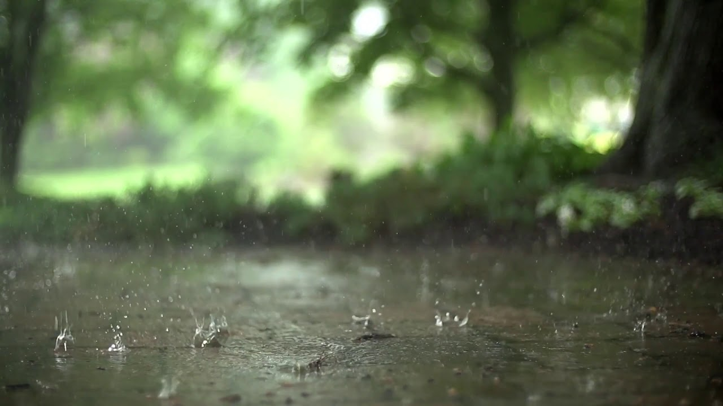
June 4th, 2023
Welcome to GBC
Psalm 147:8 He covers the heavens with clouds, prepares rain for the earth, makes grass to grow on the mountains.

Slide 2
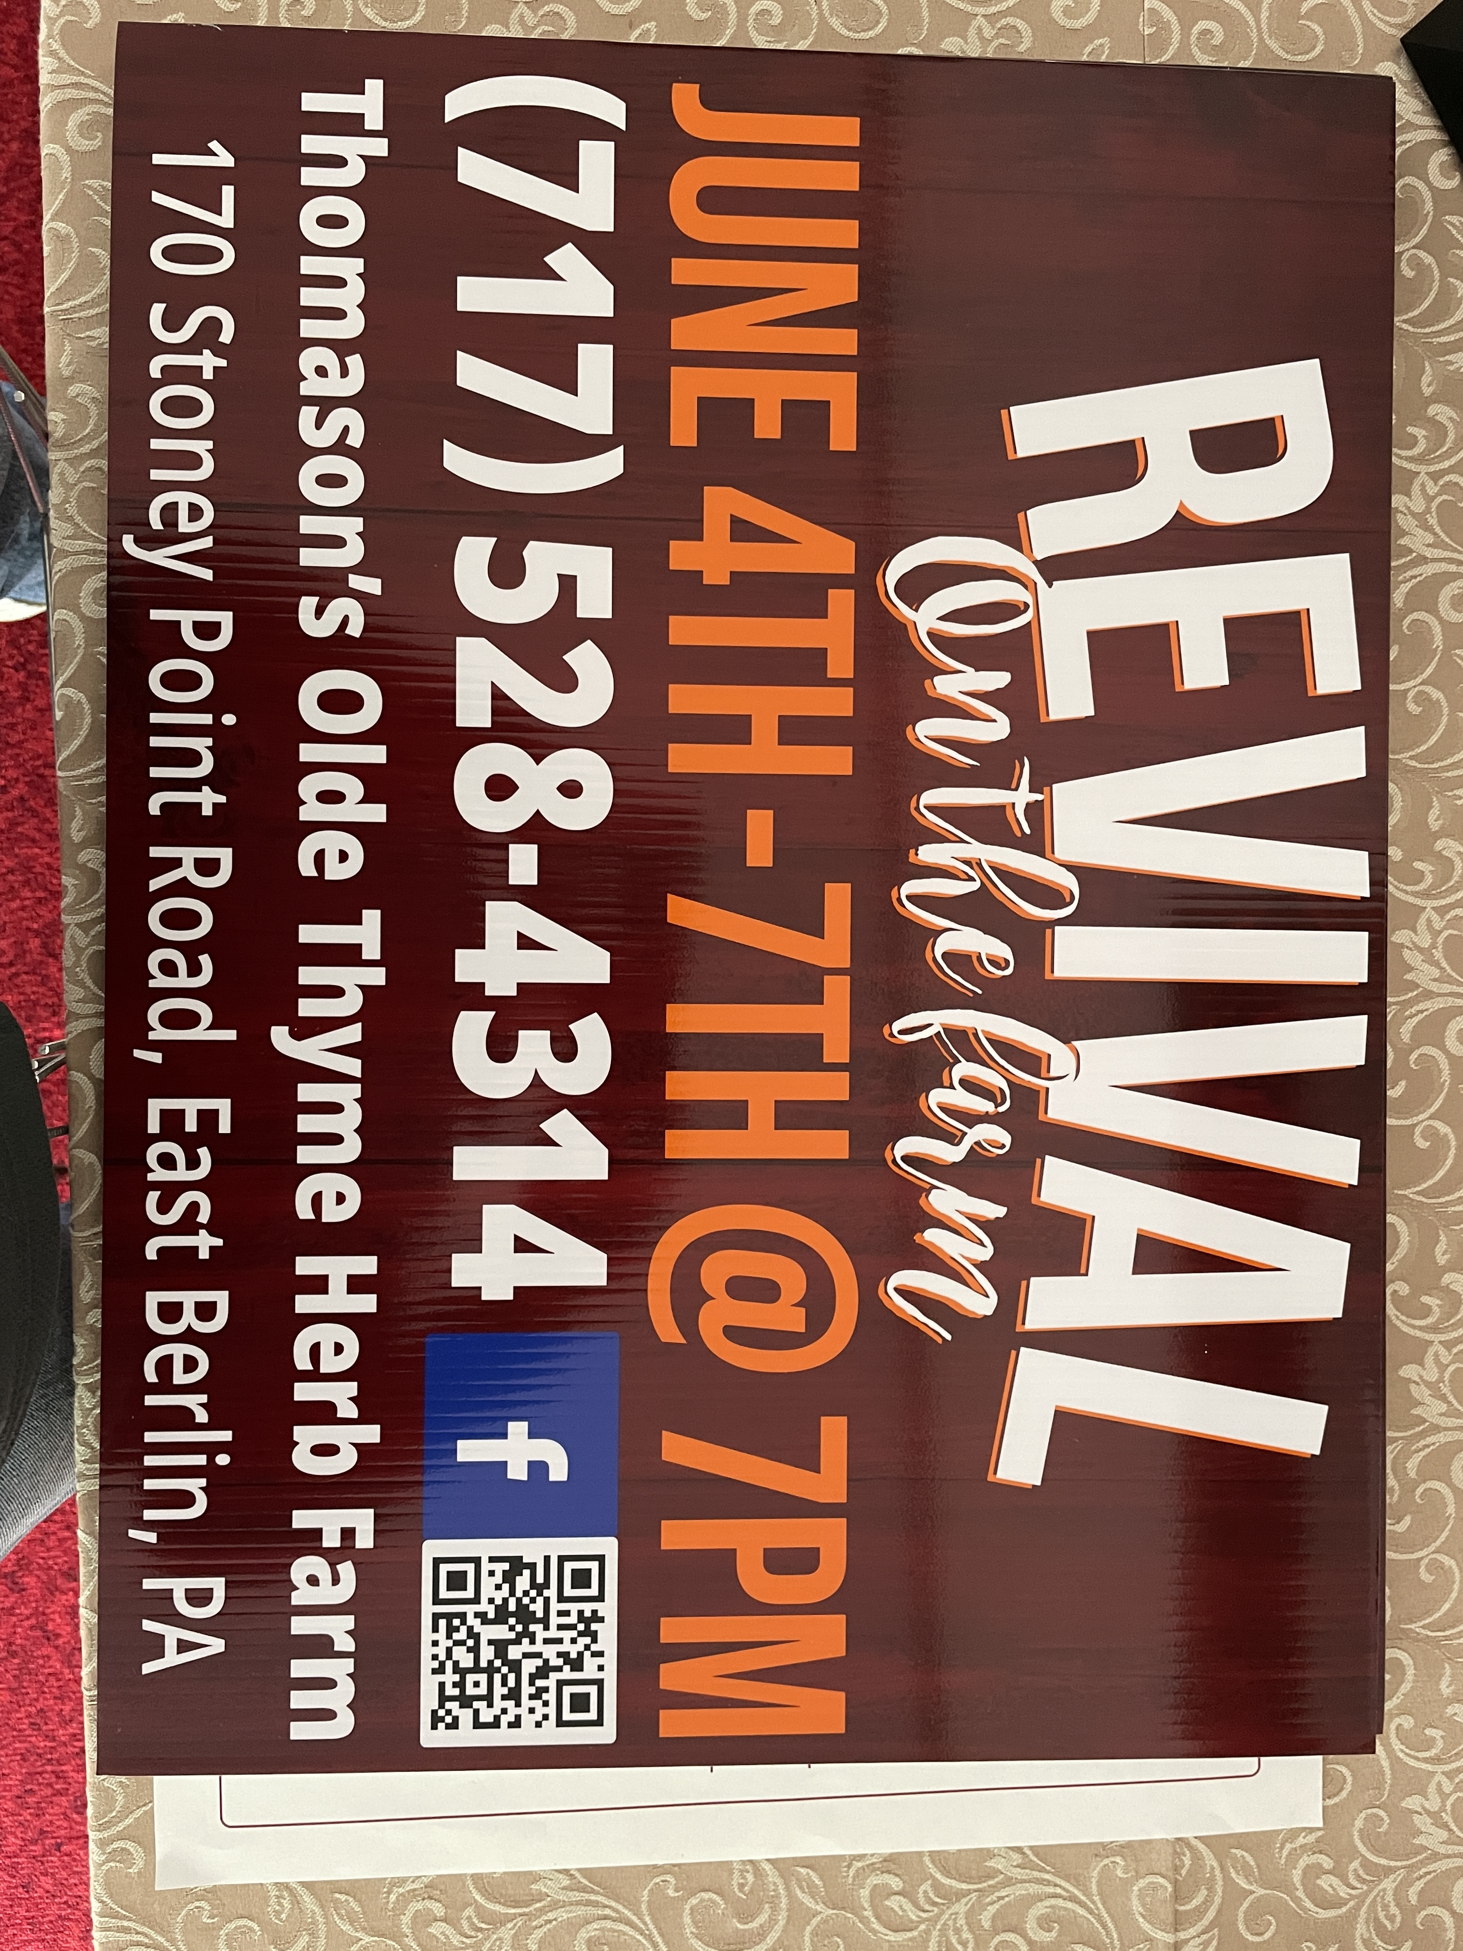

Slide 3
GBCMINISTRY.com

Slide 4
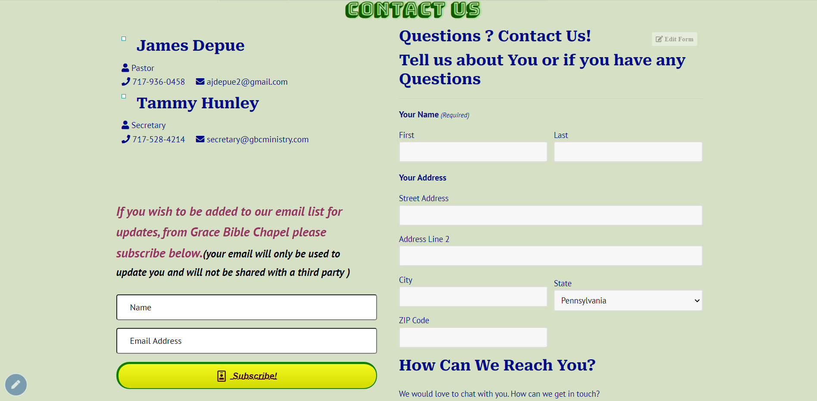
GBCMINISTRY.com

Slide 5
June 4th, 2023
Welcome to GBC
Psalm 147:8 He covers the heavens with clouds, prepares rain for the earth, makes grass to grow on the mountains.

Slide 6
Holy Spirit, living Breath of God, Breathe new life into my willing soul. Bring the presence of the risen Lord To renew my heart and make me whole.

Slide 7
Cause Your Word to come alive in me; Give me faith for what I cannot see; Give me passion for Your purity. Holy Spirit, breathe new life in me.

Slide 8
Holy Spirit, from creation's birth, Giving life to all that God has made, Show Your power once again on earth; Cause Your church to hunger for Your ways.

Slide 9
Let the fragrance of our prayers arise. Lead us on the road of sacrifice That in unity the face of Christ Will be clear for all the world to see.

Slide 10
Holy Spirit, come abide within; May Your joy be seen in all we do— Love enough to cover ev'ry sin In each thought and deed and attitude,

Slide 11
Kindness to the greatest and the least, Gentleness that sows the path of peace. Turn our striving into works of grace. Breath of God, show Christ in all we do.

Slide 12
GRACE BIBLE CHAPEL
Exploring our “First Name”
Grow in the GRACE and knowledge of our Lord and Savior Jesus Christ.
II Peter 3:18

Slide 13
Romans 1-16
A goldmine of God’s GRACE (22 x)
Romans 7
A lesson on God’s Grace and LAW (20 x)
How do “rules” fit in a Christian’s life?

Slide 14
What is the LAW?
Rom 7:7 - 10 Commandments. Defines sin.
3:23 - It reveals God’s glory and exposes sinners.
13:8,9 - It describes loving God & neighbor.
5:20,21 - It shows our need for God’s grace and for a sinless Savior.
Gal 3:24 The law was our schoolmaster to bring us to Christ.

Slide 15
Three Questions
Rom 6:1 - Should Christians keep sinning because God loves to forgive sinners?
Answer (12,13) = Don’t surrender to sin.
6:15 - Are Christians free to sin because the law has been replaced by grace?
Answer (19) = We’re freed to serve, not to sin.
7:7 - Is the law sin? • Answer = God forbid!

Slide 16
Attitudes toward the Law
Legalist (Rom 7:1-6) - Misses grace.
Seeks salvation and security in the law.
➢ Worships the law & is bound by it.
Libertine (7-12) - Abuses grace.
Lives for self rather than for God & others.
➢ Rejects the law & claims to be free from it.

Slide 17
Attitudes toward the Law
Legalist (7:1-6) - Misses grace.
Libertine (7-12) - Abuses grace.
Lover of the Law Giver (13-25) Increasingly grows in grace.
➢ Loves the law because of the Law Giver and is humbled by it.

Slide 18
Are you a LEGALIST?
(Rom 7:1) Do you know the law, but not the life & death issues connected with it?
(2,3) Marriage illustration
- the law (like marriage vows) binds for life.
- death breaks law’s bonds (like the death of a spouse) and gives freedom.

Slide 19
Are you a LEGALIST?
(4) Christian application
- identifying by faith with Jesus’ death ends any claims the law may have on you.
- identifying by faith with Jesus’ life allows you to “marry” the living Savior,
and to produce fruit from that new union.

Slide 20
Galatians 2:20 I have been crucified with Christ; it is no longer I who live, but Christ lives in me; and the life which I now live in the flesh I live by faith in the Son of God, who loved me and gave Himself for me.

Slide 21
(5,6) Consider the options
- embracing the law leaves you producing the old fleshly things the law condemns.
- embracing Christ releases you from the law’s grip and produces a new life of loving service.
Ex 21:5 If (after 7 years) the Hebrew servant says, “I love my master. I will not go out free”.
6 Then his master will bring him to the door post; and his master will bore his ear through with an aul; and he will serve him for ever.

Slide 22
Are Christians released from the Law?
Yes - Instead of having to obey laws as a slaves,
we want to obey Jesus as His bride and
are enabled to obey by the indwelling Spirit.
Yes & No - Grace produces a grateful heart.
What once was seen as prison bars
are now welcomed as guardrails.
➢ Rules-focus replaced with relationship-focus

Slide 23
Are You a Libertine?
(One who rejects the law. Abuses grace)
Since God’s grace frees me from law’s penalty, then is the law sinful, destroying my liberty in Christ?
(7) Short answer = “God forbid!”
(12) Long = The Law is holy, just, good (not evil)
It’s like a mirror (7) - reveals my sins
like a magnet (8) - pulls my sins to the surface
like a mortician (9-11) - certifies the truth

Slide 24
Are You a Libertine?
(12,13) Need to grasp the “beauty of holiness”,
the “exceeding sinfulness” of sin, and
the deeply personal nature of sin (I, me).
Both legalists and libertines are proud
- 1st boasts of his/her efforts to keep the law.
- 2nd boasts of his/her freedoms from the law.

Slide 25
Are You a Lover of the Law-Giver?
(14) Have you seen that the problem is not the law (mirror, magnet, mortician), but you?
(15,16) Do you experience 2 competing natures?
- An old nature that still wants to practice what displeases God.
- A new nature that hates displeasing God.
- A love/hate view of God’s law and my heart.

Slide 26
(21-23) Do you experience 2 competing laws?
- God’s law that delights your new heart (22)
- Sin’s law that captivates your old flesh (23)
(24,25) Do you express 2 humble heart cries?
- I am such a wretched man! (24)
- I am so grateful for the Perfect Man! (25)
Are You a Lover of the Law-Giver?

Slide 27
Romans 7
How do “rules” fit in a Christian’s life?
Legalism - rules define my relationship with God.
Libertine - rules harm my relationship with God.
Love for the Law-Giver - Because of my relationship with God, I seek to please Him.
1John 4:19 We love Him because
He first loved us.

Slide 28
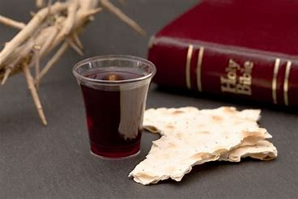

Slide 29
(#371)
Once For All
Free from the law, O happy condition, Jesus has bled, and there is remission;
Cursed by the law and bruised by the fall,
Grace has redeemed us once for all.

Slide 30
Once for all, O sinner, receive it,
Once for all, O brother, believe it;
Cling to the cross, the burden will fall,
Christ has redeemed us once for all.

Slide 31
Now we are free, there's no condemnation,
Jesus provides a perfect salvation;
"Come unto Me," O hear His sweet call,
Come, and He saves us once for all.

Slide 32
Once for all, O sinner, receive it,
Once for all, O brother, believe it;
Cling to the cross, the burden will fall,
Christ has redeemed us once for all.

Slide 34
"Children of God," O glorious calling,
Surely His grace will keep us from falling;
Passing from death to life at His call,
Blessed salvation once for all.

Slide 35
Once for all, O sinner, receive it,
Once for all, O brother, believe it;
Cling to the cross, the burden will fall,
Christ has redeemed us once for all.

