Slide 1
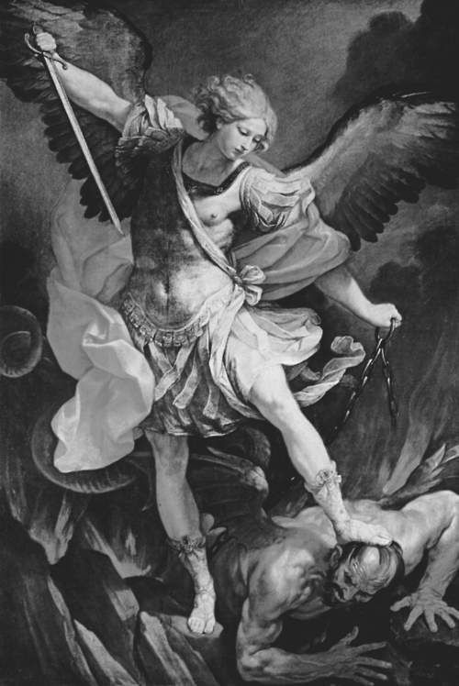
The
Spirit
World
(Satan’s Methods)

Slide 2
A-B-C’s of Satan’s Methods/Devices
(top class “vote-getters”)
Deceive
False Teaching
Tempt
Schemes/Methods

Slide 3
Temptation - Gen 3 & Matt 4
Matt 4:1 Jesus was led up by the Spirit into the wilderness to be tempted by the devil.
Targets of Temptation (I John 2:16)
flesh = tastes good (G); turn stones to bread (M)
eyes = looks good (G); show kingdoms & glory (M)
pride = be like God (G); throw down, control destiny (M)

Slide 4
WHO is to blame for Temptation?
1 - Satan called “the tempter” (I Thess 3:5)
2 - Not God (James 1:13)
God cannot be tempted by evil, nor does He Himself tempt anyone.
3 - Myself (James 1:14)
Each one is tempted when he is drawn away by his own desires and enticed.

Slide 5
James 1:15 Then, when desire has conceived, it gives birth to sin; and sin, when it is full-grown, brings forth death.
Temptation – external influence (world, Satan)
Desires & Enjoyment – my internal response
Conception – temptation + desire = birth of sin
Growth – sinfulness matures, spreads, permeates
Death – spiritual, physical, “second death”

Slide 6
Satan’s Methods/Devices
Temptation (key = James 1:21,22)
James 1:21 Lay aside all filthiness and overflow of wickedness, and receive with meekness the implanted word (like Jesus Matt 4:3,4; using the “sword of the Spirit” Eph 6:17), which is able to save your souls.
22 But be doers of the word, and not hearers only, deceiving yourselves.

Slide 7
Satan’s Methods/Devices
Tempt
Wiles - Eph 6:11
Put on the whole armor of God, that you may be able to stand against the devil’s wiles (underlying, overarching, ancient goals)

Slide 8
➢ Satanic “World” domination (I John 5:19)
We know that we are of God, and the whole world lies under the sway of the wicked one.
planet (John 1:10) - worship of creation
people (John 3:16) - idolize or euthanize
system (I John 2:16) - goal = removal of God
Godless economics and government
Godless education and science
Godless philosophy and religion

Slide 9
➢ Satanic Church destruction (Matt 16:18)
I (Jesus) will build My church, and the gates of Hades shall not prevail against it.
“Deliverance” Ministries (Theological Conservatives)
- Anglican Mainstream
- Conservative Baptist Network
- Global Methodists
- Lutheran Missouri Synod
- Presbyterian Church in America (Tim Keller)

Slide 10
➢ Satanic Child elimination (Gen 4; Ex 1; Mt 2)
(abortion, gender deception, godless schooling, sex for gratification over procreation)
Local “Deliverance” Ministries
Capital Area Pregnancy Center (CAPC)
Child Evangelism Fellowship (CEF)
Adams County Christian Academy (ACCA)

Slide 11
The
Spirit
World
(Spiritual Warfare)

