Slide 1
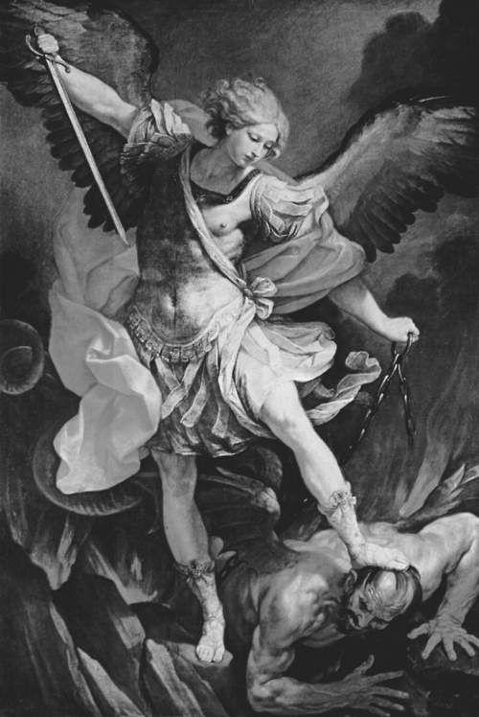
The
Spirit
World
(Created Beings)

Slide 2
Principalities and Powers
Eph 6:12 We do not wrestle against flesh and blood, but against principalities, powers, rulers of the darkness of this age, spiritual hosts of wickedness in the heavenly places.
1 - Michael
2 - Gabriel
3 - Satan

Slide 3
Satan’s Kingdom
Matt 12:26 If Satan casts out Satan, he is divided against himself. How then will his kingdom stand?
(Dan 10:5-7) how spirit beings might look
(10-12) prayer’s impact in the spirit world
(13) warfare & timeframes in the spirit world

Slide 4
Satan’s Kingdom
Rev 12:7 War broke out in heaven: Michael and his angels fought with the dragon; and the dragon and his angels fought,
8 but they did not prevail, nor was a place found for them in heaven any longer.
9 So the great dragon was cast out, that serpent of old, called the Devil and Satan, who deceives the whole world; he was cast to the earth, and his angels were cast out with him.

Slide 5
10 Then I heard a loud voice saying in heaven, "Now salvation, and strength, and the kingdom of our God, and the power of His Christ have come, for the accuser of our brethren, who accused them before our God day and night, has been cast down.
*11 And they overcame him by the blood of the Lamb and by the word of their testimony, and they did not love their lives to the death.

Slide 6
12 Therefore rejoice, O heavens, and you who dwell in them! Woe to the inhabitants of the earth and the sea! For the devil has come down to you, having great wrath, because he knows that he has a short time."

Slide 7
Satan’s End
Rev 20:1 I saw an angel coming down from heaven, having the key to the bottomless pit and a great chain in his hand.
2 He laid hold of the dragon, that serpent of old, who is the Devil and Satan, and bound him for a thousand years.

Slide 8
7 Now when the thousand years have expired, Satan will be released from his prison
8 and will go out to deceive the nations which are in the four corners of the earth, Gog and Magog, to gather them together to battle, whose number is as the sand of the sea.

Slide 9
9 They went up on the breadth of the earth and surrounded the camp of the saints and the beloved city. And fire came down from God out of heaven and devoured them.
10 The devil, who deceived them, was cast into the lake of fire and brimstone where the beast and the false prophet are. And they will be tormented day and night forever and ever.

Slide 10
The
Spirit
World
(Spirit World Activity)

Slide 11
SPIRIT WORLD REALITIES
Genesis 3:1-15
(1) Able to “use” creatures & human language
(1) Aware of history and moral issues
(4,5,13) Willing to oppose God & manipulate human desires (James 1:14)
(5) Knowing evil is not always good (Rm 16:19)
(15) Start of heavenly & earthly enmity
(15) Hint at “seed of the serpent” (Gen 6?)

Slide 12
SPIRIT WORLD REALITIES
1 Samuel 16:13-23 (Saul & David)
(14) God permits & sometimes orchestrates activities of evil beings
*control vs create evil - Isa 10:5 Woe to Assyria, the rod of My anger and the staff in whose hand is My indignation.
(23) music can impact evil spirits

Slide 13
SPIRIT WORLD REALITIES
1 Samuel 28:3-25 (Saul and the Witch)
(3,7) there are “familiar (guiding) spirits”
(8) disguises and darkness tied to séances
(13) some spirits arise from the earth
(14) spirits take on recognizable human forms
(15) communication with spirits is possible
(16-19) spirits grasp past & future events

Slide 14
SPIRIT WORLD REALITIES
1 Kings 22:6-28 (Micaiah and Ahab)
(19) spirit beings have access to God
(20) God hears input from spirit beings
(22,23) there are lying spirits (and lying humans) used by God to fulfill His plans
*control vs create evil - Judas Iscariot, Satan, & God

Slide 15
SPIRIT WORLD REALITIES
Job 1:6-12
(6) spirit beings called “sons of God” (ben Elohim)
(6) Satan allowed in God’s centralized presence (face) at times
(7) Satan goes to and fro on the earth but must answer to God
(12) Satan and all spirit beings have limits

Slide 16
The
Spirit
World
(Satan’s Methods)

Slide 17
A-B-C’s of Satan’s Methods/Devices
Rom 16:19 I want you to be wise in what is good, and simple concerning evil.
2Cor 2:11 Lest Satan should take advantage of us; for we are not ignorant of his devices.
Bind with infirmities - Luke 13:11,16
Blind - II Cor 4:3,4 (unbelievers)
Buffet - II Cor 12:7 (Paul’s thorn)

Slide 18
Counterfeit - II Cor 11:13-15; II Th 2:9,10
Deceive - Gen 3:1-5; Rev 12:9; 20:10
Devour - I Peter 5:8 (like a lion)
False Teaching - I Tim 4:1 (II Th 2:8-12; II Cor 10:3-5)
Fill hearts - Acts 5:3 (Ananias)
Hinder - I Thess 2:18 (Paul’s travels)
Infiltrate - Matt 13:36-39 (tares)

Slide 19
Oppress - Acts 10:38 (Jesus’ ministry)
Plant ideas - Jn 13:2,27 (Judas Iscariot)
Remove scripture - Luke 8:11,12
Schemes/Methods - Eph 6:11 (4:14)
Sift - Luke 22:31 (Simon Peter)
Snare - I Tim 3:7 (Lk 21:34-36; I Tim 6:9; II Tim 2:24-26)
Tempt - Matt 4:1; I Cor 7:5 (Jesus; spouse)

Slide 20
Most Christians agree with four propositions, despite other differences.
1 - We are involved in spiritual warfare.
2 - Jesus is the triumphant Deliverer & King.
3 - The modern age deadens people to the reality of spiritual warfare.
4 - Errors and excesses occur in deliverance ministries (as well as other ministries).

Slide 21
A-B-C’s of Satan’s Methods/Devices
Bind with infirmities
Luke 13:11 There was a woman who had a spirit of infirmity (frail, sick, diseased) 18 years and was bent over and could in no way raise herself up.
16 Ought not this woman, being a daughter of Abraham, whom Satan has bound, be loosed from this bond on the Sabbath?

Slide 22
Satan can bind with infirmities
Many human ailments are simply caused by living in a fallen world.
There are many instances in Luke’s gospel of people being healed of diseases with no mention of a demonic cause (12 of 17).
Yet, here (Luke 13) is biblical proof that evil spirit beings CAN use infirmities as one of “Satan’s devices”.

Slide 23
Should GBC consider a Deliverance Ministry?
1 - Jesus did it (Luke 13:10-17)
2 - Jesus said believers would do it
Mark 16:17,18 These signs will follow those who believe: In My name they will cast out demons; speak with new tongues; take up serpents; and if they drink anything deadly, it will by no means hurt them; they will lay hands on the sick, and they will recover.

Slide 24
Should GBC consider a Deliverance Ministry?
1 - Jesus did it (Luke 13)
2 - Jesus said believers would do it (Mark 16)
3 - Paul did it (Acts 19)
11 Now God worked unusual miracles by the hands of Paul,
12 so that even handkerchiefs or aprons were brought from his body to the sick, and diseases left them, and evil spirits went out of them.

Slide 25
Should GBC consider a Deliverance Ministry?
1 - Jesus did it (Luke 13)
2 - Jesus said believers would do it (Mark 16)
3 - Paul did it (Acts 19)
4 - James 5 tells local churches how to do it.
14,15 Is anyone among you sick? Let him call for the elders of the church, and let them pray over him, anointing him with oil in the name of the Lord. And the prayer of faith will save the sick, and the Lord will raise him up.

