Slide 3
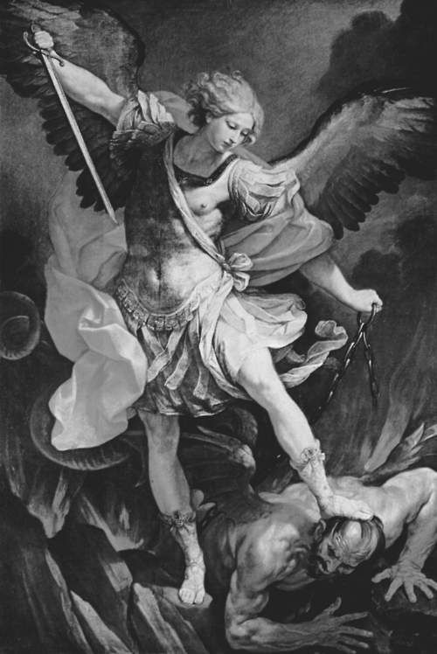
The
Spirit
World
(created beings)

Slide 4
Eph 6:11 Put on the whole armor of God, that you may be able to stand against the wiles of the devil.
Eph 6:12 For we do not wrestle against flesh and blood, but against principalities, powers, rulers of the darkness of this age, spiritual hosts of wickedness in the heavenly places.

Slide 5
Created SPIRIT Beings
Seraphim
Cherubim
Angels (good and bad)
Principalities
Powers
Rulers of Darkness
Thrones
Dominions
Wicked Spirits
Fallen Angels
Spirits in Prison
Demons
Seducing Spirits

Slide 6
Created SPIRIT Beings
Heb 1:14 - ministering spirits for believers
Heb 12:22 - innumerable
II Thess 1:7 - mighty, but not almighty
II Thess 1:8 - takers of vengeance
Matt 24:31 - gatherers of the elect

Slide 7
Principalities and Powers
1 - Michael
Dan 10:13 - chief prince
Dan 12:1,2 - stands for Jews (Rev 12:7-9)
Jude 1:9 - only named Archangel (I Th 4:16)
2 - Gabriel
Dan 9:20-27 - describes Messiah’s 1st coming
Luke 1:19-38 - announces Jesus’ birth

Slide 8
Principalities and Powers
3 - Satan (also known by the names …)
Devil; Beelzebub; Belial; Adversary;
Dragon; Lucifer; Serpent
II Cor 4:4 - god of this age
Eph 2:2 - prince of the power of the air

Slide 9
Satan’s Origin
Ezek 28 (earth & heaven intertwined)
(13) in Eden (Gen 3)
(14) anointed cherub who covers (angel)
(15) perfect when created (sinless)
(16) cast out of the mountain of God
(17) pride (sin) over beauty (I Tim 3:6)

Slide 10
Isa 14 (earth & heaven intertwined)
(12) falls from heaven (moral & location issues)
(12) cast down to the earth (initiated by God)
(13) sought to ascend to God’s throne (rule)
(14) desired to be like the Most High (rival)
sin = followed his will, not God’s will
selfishly rebelled against God’s rule & rules

Slide 11
Satan’s Current Location
Job 1
(6) in God’s centralized presence (face) at times
(7) goes to and fro on the earth
(11,12) God’s hand … Satan’s hand
(12) “do not lay a hand” (limitations)
“The devil is God’s devil” (Martin Luther)

Slide 12
Satan’s Kingdom
Matt 12:26 If Satan casts out Satan, he is divided against himself. How then will his kingdom stand?
Eph 6:12 We do not wrestle against flesh and blood, but against principalities, powers, rulers of the darkness of this age, against spiritual hosts of wickedness in the heavenly places. (Dan 10:10-13)

Slide 13
Satan’s Methods/Devices (II Cor 2:11)
1 - Deception - Gen 3:1-5; Rev 12:9; 20:10
2 - Blinding - II Cor 4:3,4
3 - False Teaching - I Tim 4:1; II Thess 2:8-12; II Cor 10:3-5
4 - Devouring - I Peter 5:8
5 - Snares - I Tim 3:7 (Lk 21:34-36; I Tim 6:9; II Tim 2:24-26)
6 - Schemes - Eph 6:11 (4:14)
7 - Temptation - Matt 4:1; I Cor 7:5
8 - Infiltration - Matt 13:36-39 (tares)
9 - Removal of scripture - Luke 8:11,12

Slide 14
10 - Planting ideas - Jn 13:2,27 (Judas Iscariot)
11 - Oppression - Acts 10:38
12 - Binding with infirmities - Luke 13:11,16
13 - Sifting - Luke 22:31 (Simon Peter)
14 - Fill hearts - Acts 5:3 (Ananias)
15 - Counterfeit - II Cor 11:13-15; II Th 2:9,10
16 - Buffet - II Cor 12:7 (Paul’s thorn)
17 - Hinder - I Thess 2:18 (Paul’s travels)

Slide 15
Satan’s End
Rev 12:7 War broke out in heaven: Michael and his angels fought with the dragon; and the dragon and his angels fought,
8 but they did not prevail, nor was a place found for them in heaven any longer.
9 So the great dragon was cast out, that serpent of old, called the Devil and Satan, who deceives the whole world; he was cast to the earth, and his angels were cast out with him.

Slide 16
Rev 12:10 Then I heard a loud voice saying in heaven, "Now salvation, and strength, and the kingdom of our God, and the power of His Christ have come, for the accuser of our brethren, who accused them before our God day and night, has been cast down.
11 And they overcame him by the blood of the Lamb and by the word of their testimony, and they did not love their lives to the death.

Slide 17
Rev 12:12 Therefore rejoice, O heavens, and you who dwell in them! Woe to the inhabitants of the earth and the sea! For the devil has come down to you, having great wrath, because he knows that he has a short time."

Slide 18
Satan’s End
Rev 20:1 I saw an angel coming down from heaven, having the key to the bottomless pit and a great chain in his hand.
2 He laid hold of the dragon, that serpent of old, who is the Devil and Satan, and bound him for a thousand years;

Slide 19
3 and he cast him into the bottomless pit, and shut him up, and set a seal on him, so that he should deceive the nations no more till the thousand years were finished. But after these things he must be released for a little while.

Slide 20
4 I saw thrones, and they sat on them, and judgment was committed to them. Then I saw the souls of those who had been beheaded for their witness to Jesus and for the word of God, who had not worshiped the beast or his image, and had not received his mark on their foreheads or on their hands. And they lived and reigned with Christ for a thousand years.

Slide 21
5 But the rest of the dead did not live again until the thousand years were finished. This is the first resurrection.
6 Blessed and holy is he who has part in the first resurrection. Over such the second death has no power, but they shall be priests of God and of Christ and shall reign with Him a thousand years.

Slide 22
7 Now when the thousand years have expired, Satan will be released from his prison
8 and will go out to deceive the nations which are in the four corners of the earth, Gog and Magog, to gather them together to battle, whose number is as the sand of the sea.

Slide 23
9 They went up on the breadth of the earth and surrounded the camp of the saints and the beloved city. And fire came down from God out of heaven and devoured them.
10 The devil, who deceived them, was cast into the lake of fire and brimstone where the beast and the false prophet are. And they will be tormented day and night forever and ever.

