Slide 1
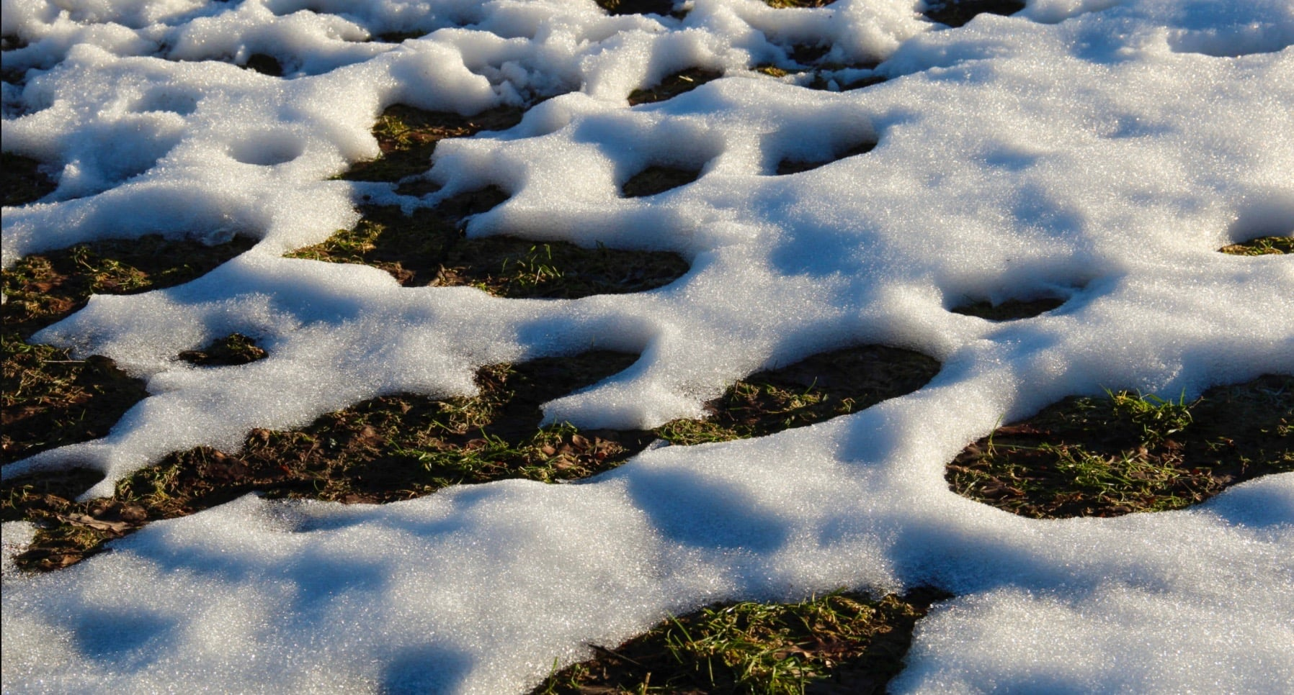
Welcome to GBC
March 19, 2023
Job 38:27 (The LORD) causes the bud of the tender herb to spring forth.

Slide 2
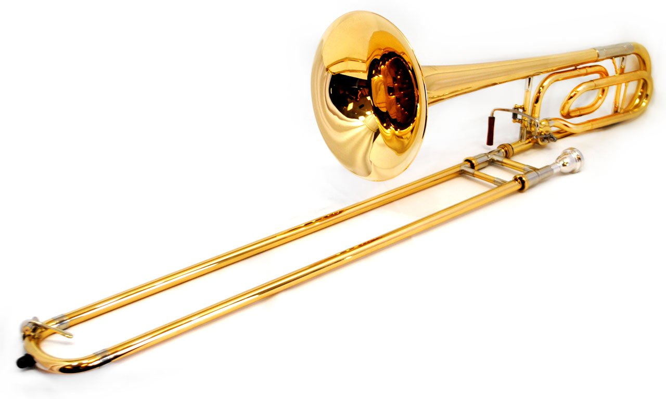
Kids K☺rner
Pastor James

Slide 3
The Lord Is My Salvation
The grace of God has reached for me And pulled me from the raging sea And I am safe on this solid ground The Lord is my salvation

Slide 4
I will not fear when darkness falls His strength will help me scale
these walls I'll see the dawn of the rising sun The Lord is my salvation

Slide 5
Who is like the Lord our God? Strong to save, faithful in love My debt is paid and the vict'ry won The Lord is my salvation

Slide 6
My hope is hidden in the Lord He flow'rs each promise of His Word When winter fades
I know spring will come The Lord is my salvation

Slide 7
In times of waiting, times of need When I know loss, when I am weak I know His grace will renew these days The Lord is my salvation

Slide 8
Who is like the Lord our God? Strong to save, faithful in love My debt is paid and the vict'ry won The Lord is my salvation

Slide 9
And when I reach the final day He will not leave me in the grave But I will rise, Christ will call me home The Lord is my salvation

Slide 10
Who is like the Lord our God? Strong to save, faithful in love My debt is paid and the vict'ry won The Lord is my salvation

Slide 11
Glory be to God the Father Glory be to God the Son Glory be to God the Spirit The Lord is our salvation
The Lord is our salvation

Slide 12
Matthew 5 - Blessed are …
3 the poor in spirit, for theirs is the kingdom of heaven.
4 those who mourn, for they shall be comforted.
5 the meek, for they shall inherit the earth.
6 those who hunger and thirst for righteousness, for they shall be filled.
7 the merciful, for they shall obtain mercy.

Slide 13
Matthew 5:8 Blessed are the pure in heart, for they shall see God.

Slide 14
HEART mentioned over 800 times in the Bible
- not simply our emotions.
- the “core or our being”, the real you, the part God sees.
I Sam 16:7 The LORD does not see as man sees; man looks at the outward appearance, but the LORD looks at the heart.

Slide 15
How did we become spiritually IMPURE and unable to SEE GOD?
Gen 3:8 They heard the sound of the LORD God walking in the garden in the cool of the day, and Adam and his wife hid themselves from the presence of the LORD God among the trees of the garden.

Slide 16
Gen 3:24 (Following their disobedience) The LORD God drove out the man; and He placed cherubim at the east of the garden of Eden, and a flaming sword which turned every way, to guard the way to the tree of life.

Slide 17
Ps 76:7 You, Yourself, are to be feared; And who may stand in Your presence when once You are angry?
Ps 139:7 Where can I go from Your Spirit? Or where can I flee from Your presence?

Slide 18
The cry of a true child of God
Ps 51:10 Create in me a clean heart, O God.
86:11 Unite my heart to fear Your name.
All because …
Jeremiah 17:9 The heart is deceitful and desperately wicked: who can know it?
Mark 7:20-23 - source of evil defilement
Rom 7:22-25 - source of wretched death

Slide 19
Man’s Religion - head focus (think something) and hands focus (do something).
Matt 23:25 Woe to you, scribes and Pharisees, hypocrites! For you clean the outside of the cup and dish, but inside they are full of extortion and self-indulgence.

Slide 20
Biblical Christianity - prioritize the heart, followed by the rest of my body.
Matt 23:26 Blind Pharisee, first cleanse the inside of the cup and dish, that the outside of them may be clean also.
Prov 4:23 Keep your heart with all diligence; out of it spring the issues of life.

Slide 21
How can I make my evil heart PURE?
The Gospel Truth is … I CAN’T
Matthew 5: 3 - I am poor in spirit (about self)
 (4) I mourn (over sin)
 (5) I become meek (toward others)
 (6) I am hungry to be right (with God)
 (7) I cry out for God’s mercy
 (8) I fix my eyes on God ALONE to purify

Slide 22
The cry of a true child of God
Rom 7:24,25 O wretched man that I am! Who will deliver me? I thank God—through Jesus Christ our Lord!
II Cor 5:17 If anyone is in Christ, he is a new creation, old things are passed away. Behold, all things have become new.
Ps 51:10 Create in me a clean heart, O God.

Slide 23
What does it mean to be PURE in HEART?
David
Ps 24:3 Who may stand in the Lord’s holy place?
4 He who has clean hands and a pure heart, who has not lifted up his soul to an idol, nor sworn deceitfully.
5 He shall receive blessing from the LORD.
6 This is the generation of those who seek Your face.

Slide 24
What does it mean to be PURE IN HEART?
James
James 4:8 Draw near to God and He will draw near to you. Cleanse your hands, you sinners; and purify your hearts, you double-minded.

Slide 25
What does it mean to be PURE in HEART?
Jesus
Mt 22:37 Which is the great commandment?
37 Jesus said, you shall love the Lord your God with all your heart, soul, and mind.
1Tim 1:5 The purpose of the law is love from a pure heart, from a good conscience, and from sincere faith.

Slide 26
How does God give me a PURE in HEART?
By SALVATION
Titus 3:5 Not by works of righteousness which we have done, but according to His mercy He saved us, through the washing of regeneration and renewing of the Holy Spirit,
6 whom He poured out on us abundantly through Jesus Christ our Savior.

Slide 27
How does God give me a PURE in HEART?
By CONFESSION
1John 1:8 If we say that we have no sin, we deceive ourselves, and the truth is not in us.
9 If we confess our sins, He is faithful and just to forgive us our sins and to cleanse us from all unrighteousness.

Slide 28
How does God give me a PURE in HEART?
By His COMING
1John 3:2 It has not yet been revealed what we shall be, but we know that when He is revealed, we shall be like Him, for we shall see Him as He is (expectation).
3 He who has this hope in Him purifies himself, just as He is pure (motivation).

Slide 29
What does it mean to SEE GOD?
➢ To be admitted to his presence.
Ex 10:28 Pharaoh said to him, "Get away from me! Take heed to yourself and see my face no more! For in the day you see my face you shall die!"
29 So Moses said, "You have spoken well. I will never see your face again."

Slide 30
What does it mean to SEE GOD?
To be awestruck by his glory.
Job 42:5,6 I have heard of You by the hearing of the ear, but now my eye sees You. Therefore, I abhor myself and repent in dust and ashes.

Slide 31
What does it mean to SEE GOD?
To be comforted by his mercy.
Ps 27:7,8 Hear, O LORD, when I cry with my voice! Have mercy also upon me and answer me. When You said, "Seek My face," My heart said to You, "Your face, LORD, I will seek."

Slide 32
Matthew 5 - Blessed are …
7 the merciful, for they shall obtain mercy.
8 the pure in heart, for they shall see God.
⬥ Savior from sin’s penalty - Trust in HIM
⬥ Sanctifier from sin’s power - Confess to HIM
⬥ Glorifier from sin’s presence - Watch for HIM

