Slide 1
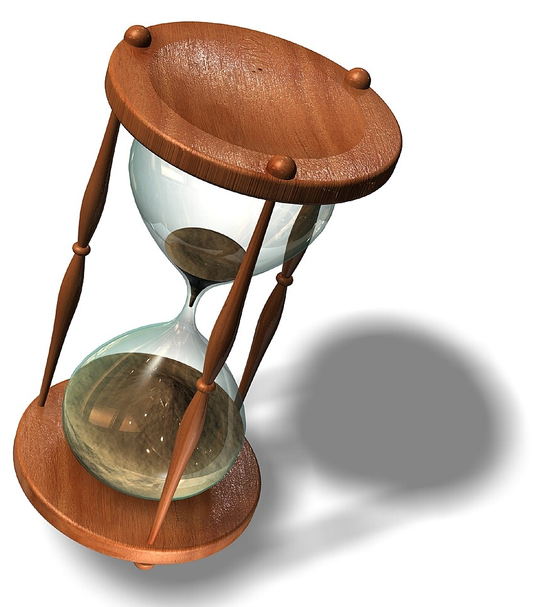
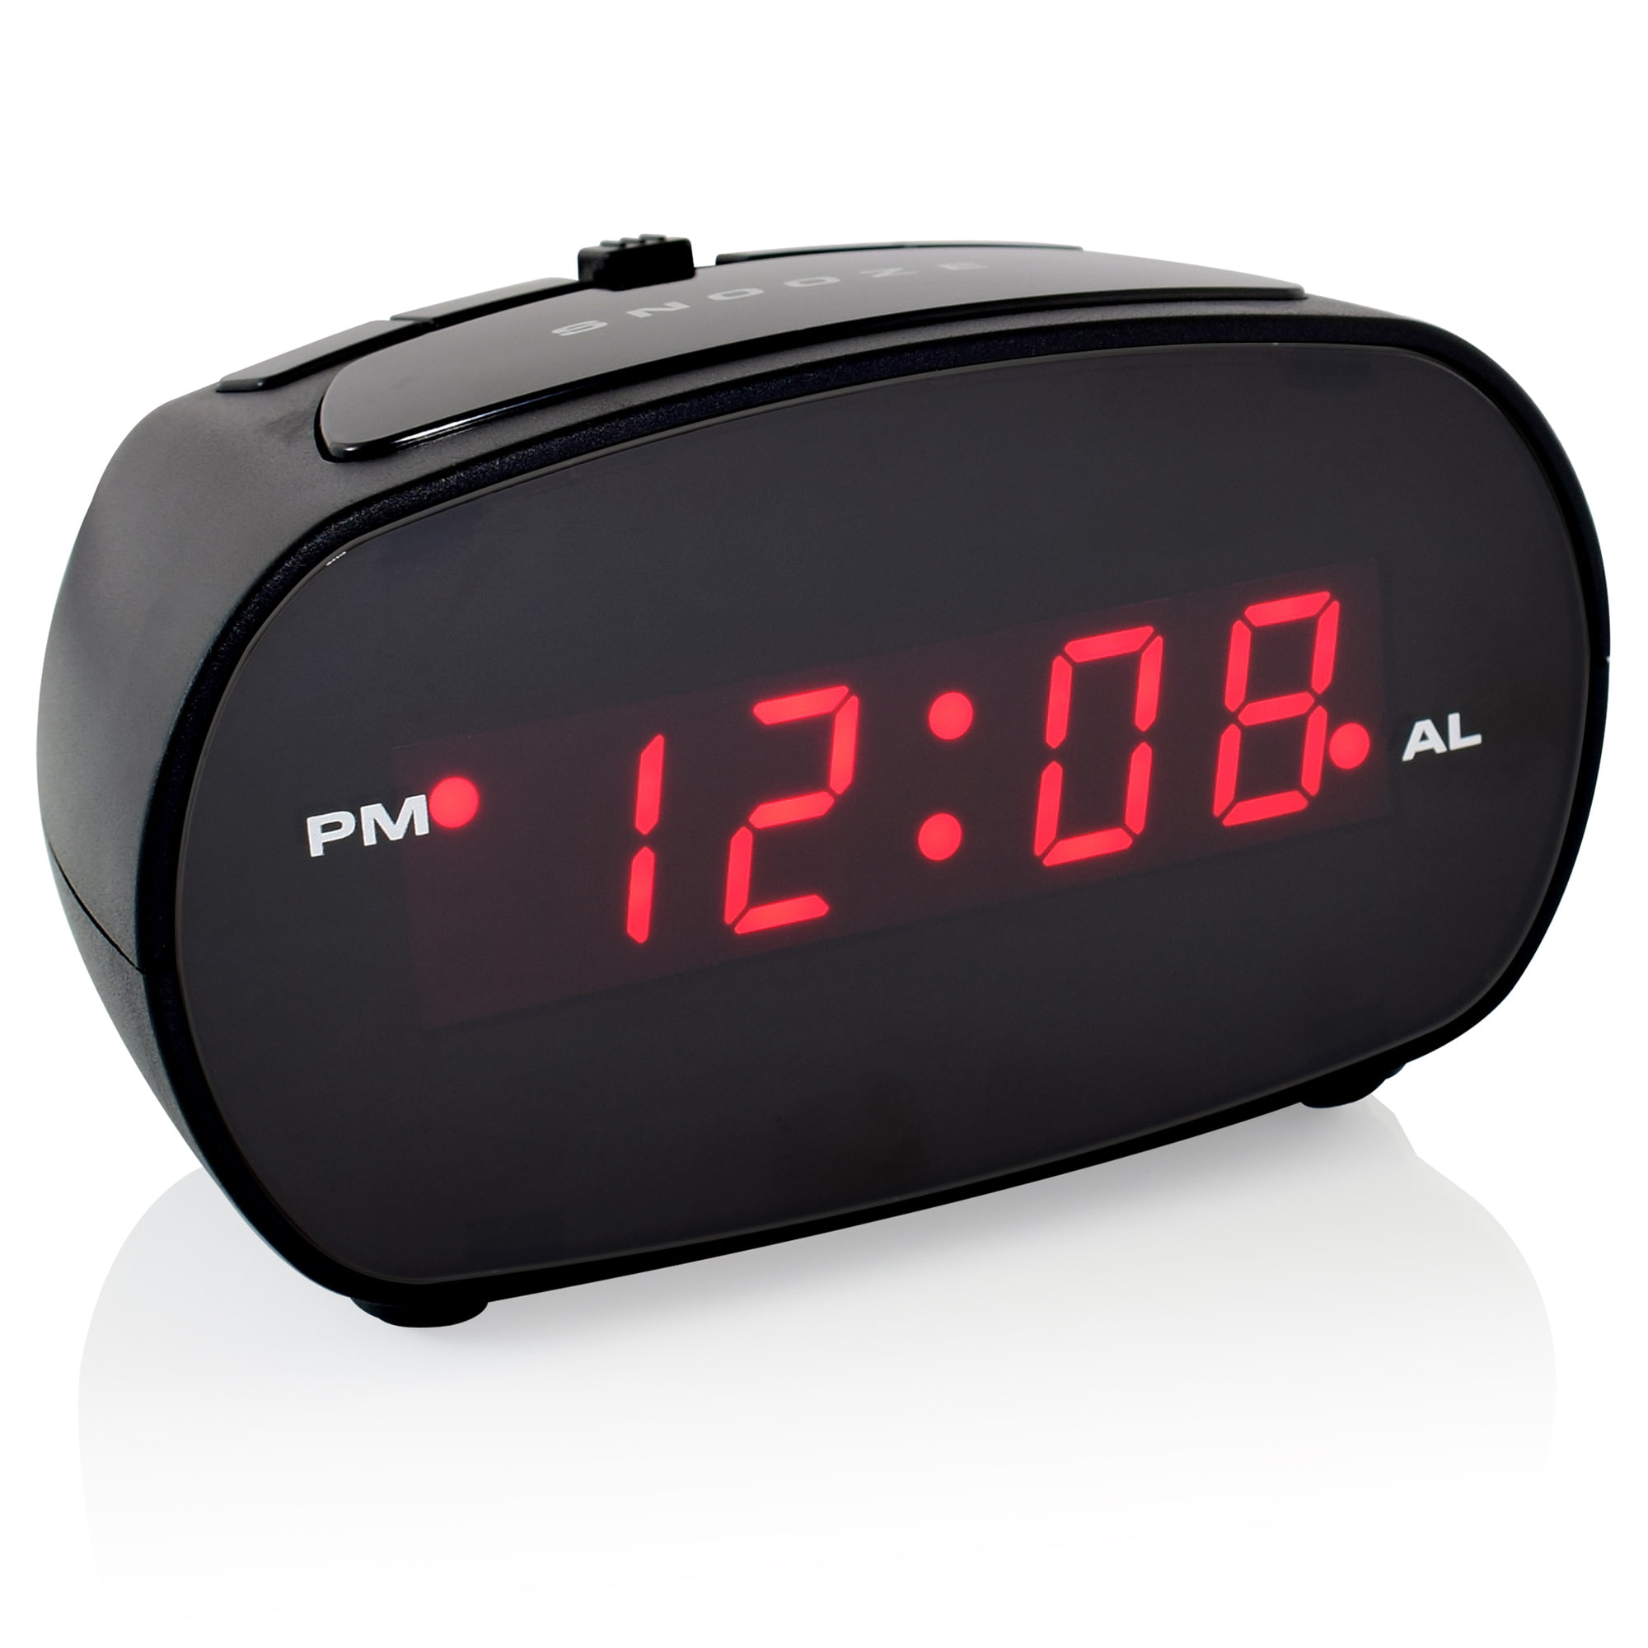
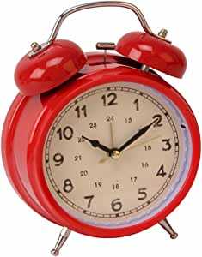
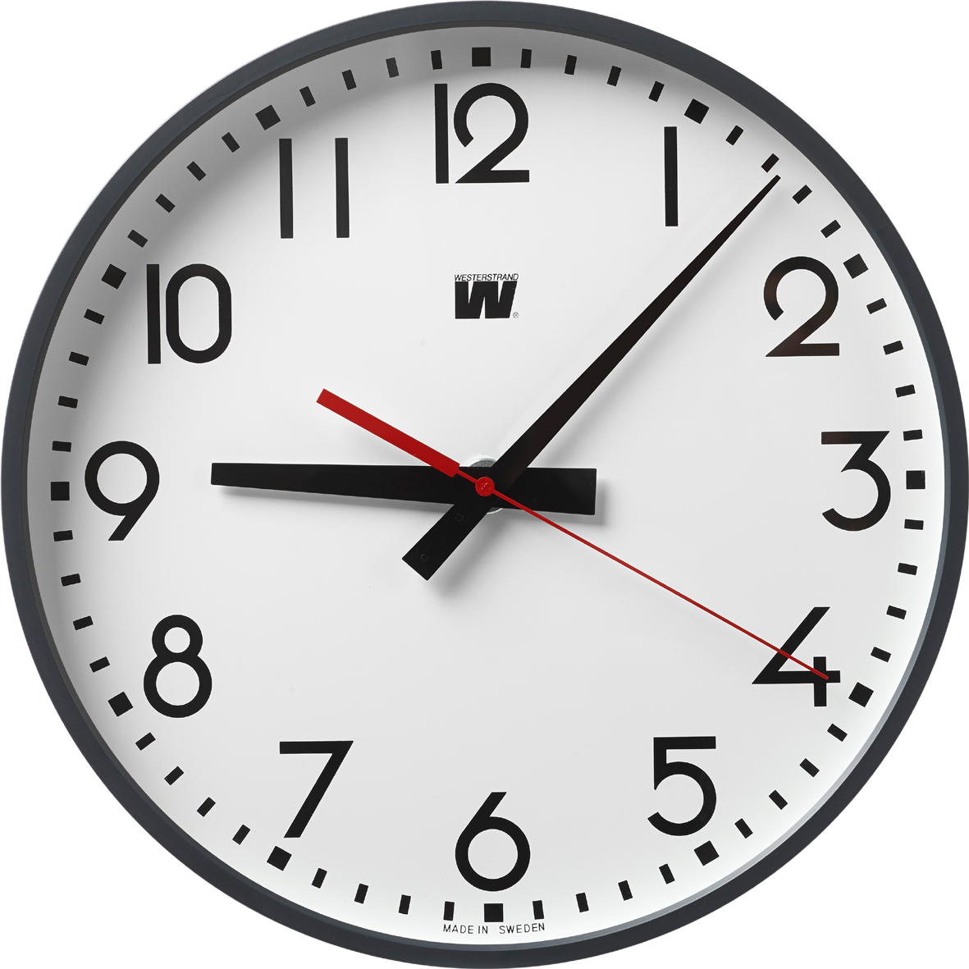
Welcome to GBC
March 12, 2023
Psalm 34:1 I will bless the LORD at all times; His praise shall continually be in my mouth.

Slide 2


Kids K☺rner
Mr. Keilholtz

Slide 3
The Lord Is My Salvation
The grace of God has reached for me
And pulled me from the raging sea
And I am safe on this solid ground
The Lord is my salvation

Slide 4
I will not fear when darkness falls
His strength will help me scale
these walls
I'll see the dawn of the rising sun
The Lord is my salvation

Slide 5
Who is like the Lord our God?
Strong to save, faithful in love
My debt is paid and the vict'ry won
The Lord is my salvation

Slide 6
My hope is hidden in the Lord
He flow'rs each promise of His Word
When winter fades
I know spring will come
The Lord is my salvation

Slide 7
In times of waiting, times of need
When I know loss, when I am weak
I know His grace will renew these days
The Lord is my salvation

Slide 8
Who is like the Lord our God?
Strong to save, faithful in love
My debt is paid and the vict'ry won
The Lord is my salvation

Slide 9
And when I reach the final day
He will not leave me in the grave
But I will rise,
Christ will call me home
The Lord is my salvation

Slide 10
Who is like the Lord our God?
Strong to save, faithful in love
My debt is paid and the vict'ry won
The Lord is my salvation

Slide 11
Glory be to God the Father
Glory be to God the Son
Glory be to God the Spirit
The Lord is our salvation
The Lord is our salvation

Slide 12
The Beatitudes - Matthew 5

Slide 13






Church Logo (letterhead, bulletin, webpage, fliers, etc.)
Please vote for TWO - 1 = First Choice; 2 = Second Choice

Slide 14
Church Logo (letterhead, bulletin, webpage, fliers, etc.)
Please vote for TWO - 1 = First Choice; 2 = Second Choice

Slide 15
Matthew 5 - Blessed are …
3 the poor in spirit, for theirs is the kingdom of heaven.
4 those who mourn, for they shall be comforted.
5 the meek, for they shall inherit the earth.
6 those who hunger and thirst for righteousness, for they shall be filled.
7 the merciful, for they shall obtain mercy.

Slide 16
Grounds for Blessings becoming more attractive
poor in spirit (about self)
 mourn (over sin)
 meek (toward others)
 hungry to be right (with God)
… for they shall be filled. 
peacemaker (known peace)
pure (known forgiveness) 
merciful (known mercy) 

Slide 17
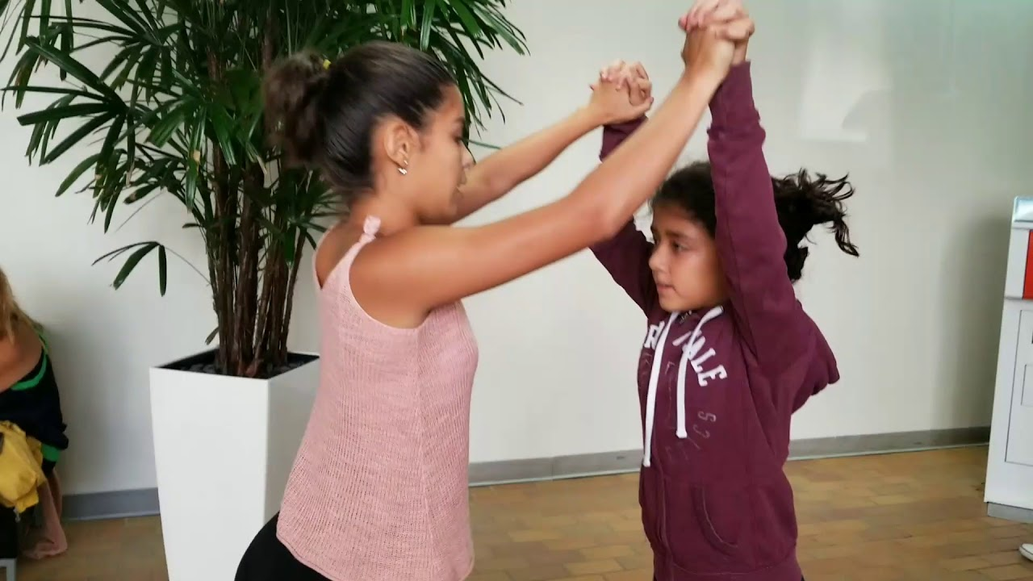
WHAT is Mercy?

Slide 18
WHAT is Mercy?
Grace means I get what I do NOT deserve.
Mercy means I do not get what I DO deserve.
Psalm 103:10 The LORD has not dealt with us according to our sins, nor punished us according to our iniquities.
11 For as the heavens are high above the earth, so great is His mercy toward those who fear Him.

Slide 19
WHAT is Mercy?
➢ Part of God’s 10 Commandments
Exodus 20:4-6 You shall not make for yourself a carved image to bow down to them nor serve them. For I am a jealous God, visiting the iniquity of the fathers upon the children to the third and fourth generations of those who hate Me, but showing mercy to thousands, to those who love Me and keep My commandments.

Slide 20
➢ MERCY is part of God’s character
Exodus 34:5 Now the LORD descended in the cloud and stood with Moses and proclaimed His name.
6 “The LORD, the LORD God, merciful and gracious, longsuffering, and abounding in mercy and truth”.

Slide 21
➢ Mercy is part of God’s covenant (promises)
1Kings 8:23 LORD God of Israel, there is no god in heaven above or on earth below like You, who keep Your covenant and mercy.
24 You have kept what You promised Your servant David my father; You have both spoken with Your mouth and fulfilled it with Your hand, as it is this day.

Slide 22
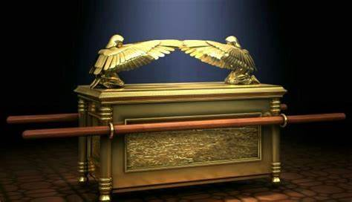
Mercy is central to worship
Hosea 6:6 I desire mercy and not sacrifice; the knowledge of God more than burnt offerings.

Slide 23
God delights in and prioritizes MERCY
Jeremiah 9:24 Let him who glories glory in this, that he understands and knows Me, that I am the LORD, exercising mercy, justice, and righteousness in the earth. For in these I delight," says the LORD.
Matthew 23:23 You have neglected the weightier matters of the law: justice and mercy and faith.

Slide 24
WHY have we been shown Mercy?
Micah 7:18 Who is a God like You, pardoning iniquity and passing over the transgression of the remnant of His heritage? He does not retain His anger forever, because He delights in mercy.

Slide 25
How have we been shown Mercy?
Psalm 103:10 The LORD has not dealt with us according to our sins, nor punished us according to our iniquities.
11 For as the heavens are high above the earth, so great is His mercy toward those who fear Him;
12 As far as the east is from the west, so far has He removed our transgressions from us.

Slide 26
WHO is shown God’s Mercy?
Luke 18:9 Jesus spoke this parable to some who trusted in themselves that they were righteous, and despised others:
10 "Two men went up to the temple to pray, one a Pharisee and the other a tax collector.
11 The Pharisee stood and prayed thus with himself, 'God, I thank You that I am not like other men—extortioners, unjust, adulterers, or even as this tax collector.

Slide 27
12 I fast twice a week; I give tithes of all that I possess.’ (I deserve God’s blessing)
13 But the tax collector, standing afar off, would not so much as raise his eyes to heaven, but beat his breast, saying, 'God, be merciful to me a sinner!’ (I deserve God’s judgment)
14 I tell you this man went down to his house justified rather than the other; for everyone who exalts himself will be humbled, and he who humbles himself will be exalted."

Slide 28
WHO is shown God’s Mercy?
poor in spirit (about self)
 mourn (over sin)
 meek (toward others)
 hungry to be right (with God)
… for they shall be filled. 
The key to becoming a merciful person is to become a broken person who has asked for and experienced God’s mercy.
merciful (known mercy)

Slide 29
Eph 2:4,5 God, who is rich in mercy, even when we were dead in trespasses, has made us alive together with Christ (by grace you are saved).
Heb 4:16 Let us therefore come boldly to the throne of grace, that we may obtain mercy and find grace to help in time of need.

Slide 30
How Do MERCIFUL PEOPLE LIVE?
Luke 10:30-37
(33) They notice distress: “A Samaritan, as he journeyed, came to where he was; and he saw him”.
(33) They respond internally with a heart of compassion or pity toward a person in distress: “He had compassion on him”.

Slide 31
How Do MERCIFUL PEOPLE LIVE?
(34) They respond externally with a practical effort to relieve the distress:
“He went to him (effort) and bound up his wounds, pouring oil and wine (first aid);
he set him on his own beast (transportation),
brought him to an inn (shelter)
and took care of him” (extended care).

Slide 32
How Do MERCIFUL PEOPLE LIVE?
(33) They do all this even when the person in distress is an enemy:
“But a Samaritan …“ (a half-breed Jew with a warped religious tradition stops to help the Jew who probably hates him).

Slide 33
How Do we who have experienced god’s mercy LIVE?
We don’t always give to others what they very well may deserve.
We make mercy part of our godliness.
We include mercy in our promises.
We pursue mercy as part of our worship.
We show mercy even to our “enemies”.

Slide 34
We show mercy with cheerfulness.
Rom 12:6-8 Having gifts differing according to the grace given to us, let us use them: prophecy … ministry … teaching … exhortation … giving … leading …
he who shows mercy, with cheerfulness.
We show mercy because of our God.
Psalm 136 “For His mercy endures forever”

Slide 35
Matthew 5:7 Blessed are the merciful, for they will obtain mercy.

