Slide 1
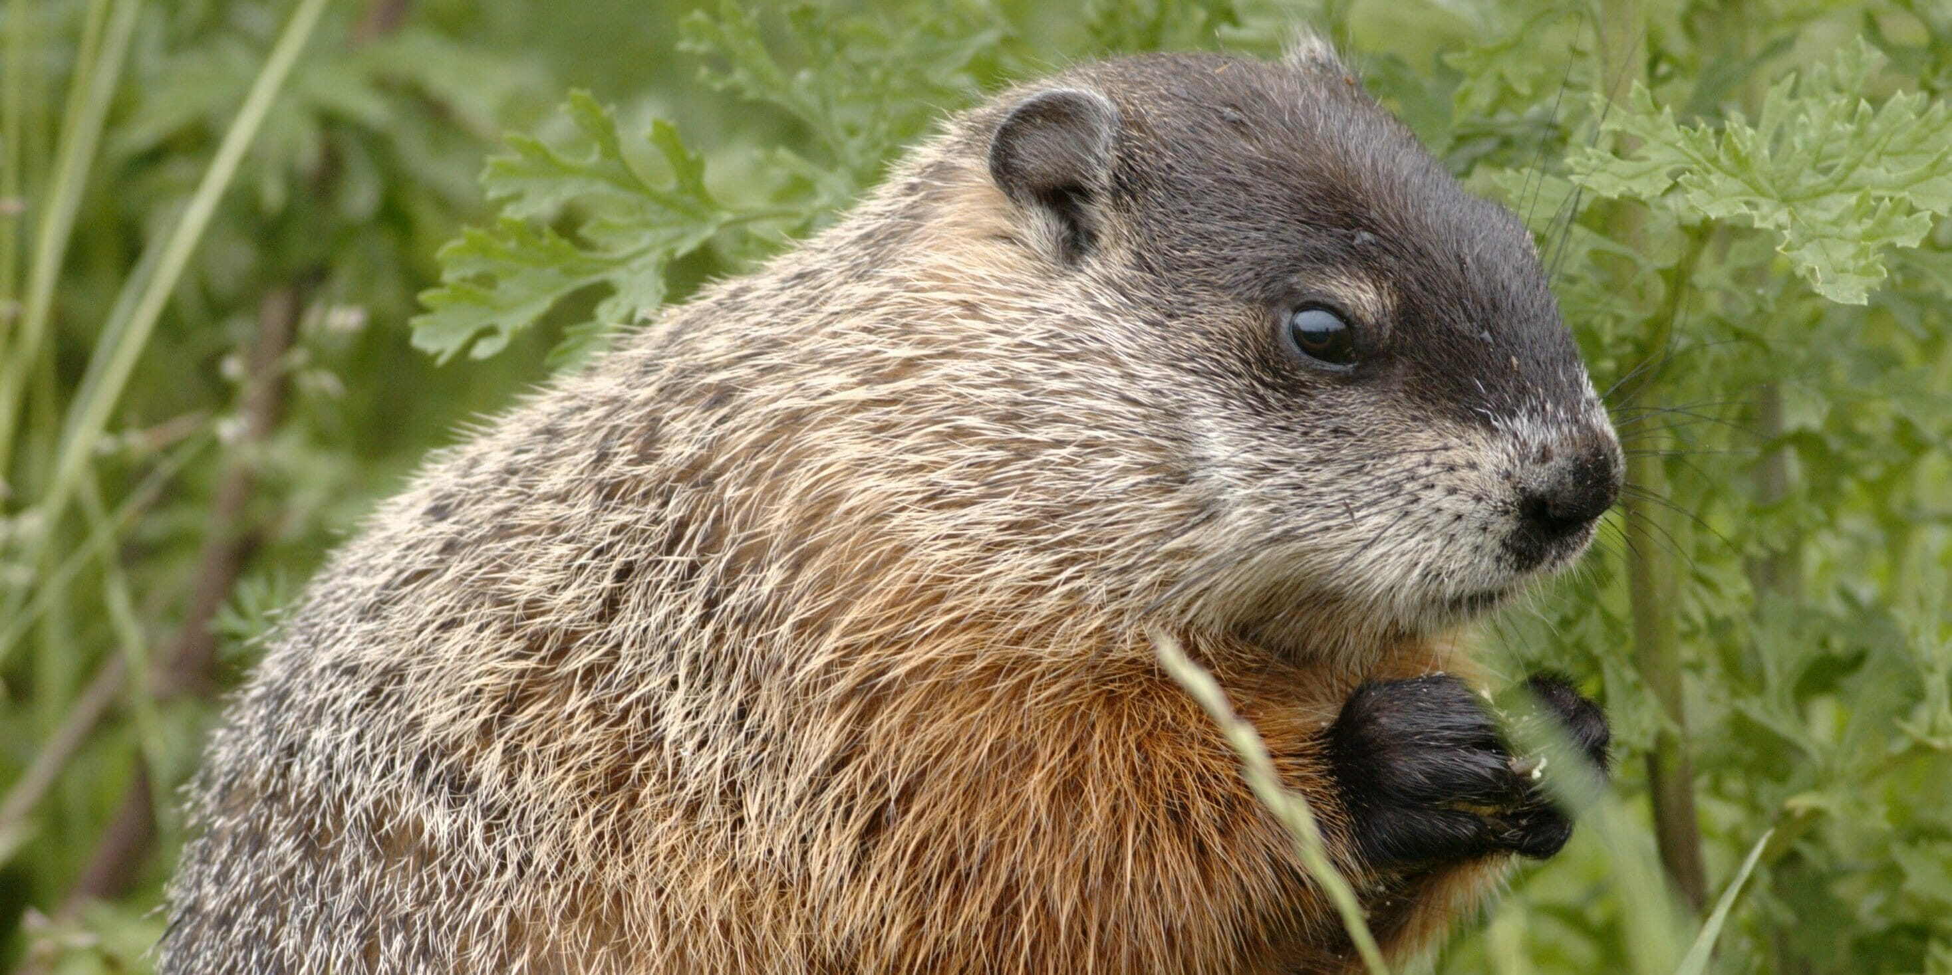
Welcome
to GBC
Acts 1:7 It is not for you to know times or seasons which the Father has put in His own authority.
January 29, 2023

Slide 2
Sermon on the Mount - Beatitudes
Matt 5 - What Jesus’ followers are to BE
5:1 Jesus went up on a mountain, and when He was seated His disciples came to Him.
2 Then He taught them, saying:
3 Blessed are the poor in spirit, for theirs is the kingdom of heaven.
4 Blessed are those who mourn, for they shall be comforted.

Slide 3
Matt 5:5 Blessed are the meek, for they shall inherit the earth.
contrary to science - survival of fittest
contrary to business - dog eat dog
contrary to politics - negative campaigns
contrary to experience - “I play by the rules and then get mocked by goof-offs and taken for granted by management”.

Slide 4
Bumper Sticker
“How can the meek inherit the earth when they can’t even get a parking spot?”

Slide 5
Blessed = fortunate, approved by God, fit for eternity
the meek = humble, power under control, strength subdued, advantages unclaimed
Matt 21:5 Tell the daughter of Zion, “Behold, your King is coming to you, meek, and sitting on a donkey.”

Slide 6
Blessed are the meek
for they will inherit the earth.
Psalm 37:9 Evildoers will be cut off: but those that wait upon the LORD will INHERIT THE EARTH.
I Cor 6:2,3 - Do you not know that the saints will judge the world?
II Tim 2:12 - If we suffer with Christ, we will also reign with Him

Slide 7
Examples of Meekness
Gen 13 (Abraham toward Lot)
Abraham held the age advantage (uncle)
(2) He held the wealth advantage
(3,4) He held the property advantage
(8,9) Yet he chose meekness, not strife
➢ Meekness = generosity in the face of selfishness
(14-17) Abraham inheriting the promised land

Slide 8
Examples of Meekness
Gen 50 (Joseph toward brothers)
(4) Joseph held the advantage in influence
(9) He held the advantage in resources
(15) He held the moral “high ground”
(19-21) Yet he chose meekness, not vengeance
➢ Meekness = trusting God to overcome evil
(22,23) Joseph inherited a healthy family

Slide 9
Examples of Meekness
Num 12 (Moses toward Aaron & Miriam)
(1) Moses practiced greater impartiality
(6-8) He had closer communion with God
(9,10) He experienced more of God’s favor
(13) Yet he chose meekness, not revenge
➢ Meekness = interceding rather than indicting
(3,7) Moses inherited unmatched character

Slide 10
Meekness is …
⬥ being generous in the face of selfishness (like Abraham with his nephew)
⬥ trusting God to overcome evil (like Joseph with his brothers)
⬥ interceding rather than indicting (like Moses with his siblings)
⬥ power under control (like Jesus with us)

Slide 11
What do the Meek “INHERIT”?
➢ I Peter 3:14,15 - influence in conversations
14 Even if you should suffer for righteousness' sake, you are blessed. “Do not be afraid of their threats, nor be troubled."
15 But sanctify the Lord God in your hearts, and always be ready to give a defense to everyone who asks you a reason for the hope that is in you, with meekness and respect.

Slide 12
The Meek INHERIT …
➢ I Peter 3:1-4 - impact at home
1 Wives, be submissive to your own husbands, that even if some do not obey the word, they, without a word, may be won by your conduct.
3 Do not let your adornment be merely outward.
4 Rather let it be the hidden person of the heart, with the incorruptible beauty of a meek and quiet spirit, which is very precious in the sight of God.

Slide 13
The Meek INHERIT …
➢ Eph 4:1-3 - unifying roles in the Church
1 I, Paul, the prisoner of the Lord, beseech you to walk worthy of the calling with which you were called,
2 with all lowliness and meekness, with patience, bearing with one another in love,
3 endeavoring to keep the unity of the Spirit in the bond of peace.

Slide 14
The Meek INHERIT …
➢ Galatians 6:1 - usefulness as a healer
If anyone is overtaken in any trespass, you who are spiritual restore such a one in a spirit of meekness, considering yourself lest you also be tempted.

Slide 15
The Meek INHERIT …
➢ Matthew 11:29 - the character of Jesus
Take My yoke upon you and learn from Me, for I am meek and lowly in heart, and you will find rest for your souls.
Gal 5:22,23 The fruit of the Spirit is love, joy, peace, longsuffering, gentleness, goodness, faith, meekness.

Slide 16
What Jesus empowers you and me to BE
Matt 5:3 Blessed are the poor in spirit.
- BE spiritually bankrupt before God
5:4 Blessed are those who mourn.
- BE broken-hearted over sin
5:5 Blessed are the meek.
- BE humble before God and others
strength subdued; advantages unclaimed

Slide 17
Grace Alone (# 128)
Every promise we can make,
Every prayer and step of faith,
Every difference we will make
- Is only by His grace.

Slide 18
Every mountain we will climb,
Every ray of hope we shine,
Every blessing left behind
- Is only by His grace.

Slide 19
Grace alone which God supplies,
Strength unknown He will provide.
Christ in us, our Cornerstone;
We will go forth
In grace alone.

Slide 20
Every soul we long to reach,
Every heart we hope to teach,
Every where we share His peace
- Is only by His grace.

Slide 21
Every loving word we say,
Every tear we wipe away,
Every sorrow turned to praise,
- Is only by His grace.

Slide 22
Grace alone which God supplies,
Strength unknown He will provide.
Christ in us, our Cornerstone;
We will go forth
In grace alone.

