Slide 1
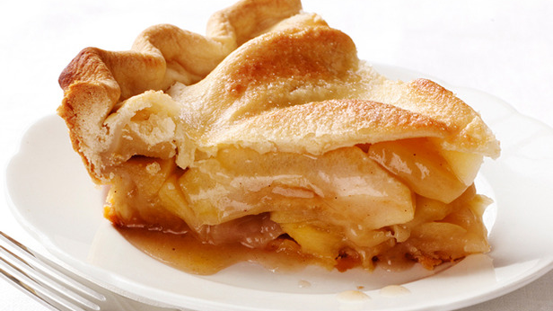
May 14th
Welcome
Exodus 20:12 Honor … your mother.

Slide 2
Jesus, the Law, and His Mother
Matthew 5:17 Do not think that I (Jesus) came to destroy the Law or the Prophets. I did not come to destroy but to fulfill.
5th Commandment
Exodus 20:12 Honor your father and your mother, that your days may be long upon the land that the LORD your God is giving you.

Slide 3
8 GBC families are currently providing some level of care/support for one or more aging parent.
5 times when Jesus modeled
how to honor His mother

Slide 4
Luke 2:43 As they returned (home), the boy Jesus (age 12) lingered behind in Jerusalem. Joseph and His mother did not know it.
48 But when they saw Him, His mother said to Him, "Son, Your father and I have sought You anxiously.”
➢ Honoring includes considering how my actions impact parental anxiety.

Slide 5
49 And He said to them, "Why did you seek Me? Did you not know that I must be about My Father's business?"
➢ It is NOT dishonoring to humbly, firmly prioritize God’s will over a parent’s wishes.

Slide 6
51 Then He went down with them and came to Nazareth, and He was subject to them, but His mother kept all these things in her heart.
We honor a parent, not because of their competence, but because of their calling.

Slide 7
How did Jesus honor His mother?
Matt 12:46 While Jesus (age 30+) was talking to the multitudes, His mother and brothers stood outside, seeking to speak with Him.
47 One said to Him, "Your mother and Your brothers are standing outside, seeking to speak with You."
48 But He answered and said, "Who is My mother and who are My brothers?"

Slide 8
49 And He stretched out His hand toward His disciples and said, “Here are My mother and My brothers!
50 Whoever does the will of My Father in heaven is My brother, sister, and mother.”
It is NOT dishonoring to recognize a faith family in addition to a birth family.
Honoring a parent is easiest when everyone is doing God the Father’s will.

Slide 9
How did Jesus honor His mother?
John 2:3 When they ran out of wine, Jesus’ mother said to Him, "They have no wine."
4 Jesus (age 30+) said to her, "Woman (Ma’am), what does your concern have to do with Me? My hour has not yet come."
The command to obey a parent expires, but honoring a parent is always proper.
Time is a significant topic when honoring.

Slide 10
How did Jesus honor His mother?
Matt 15:3 Jesus asked the religious leaders, "Why do you transgress the commandment of God because of your tradition?
4 For God commanded, ‘Honor your father and mother'; and ‘He who curses father or mother, let him be put to death.’
➢ God takes His commands seriously even if we don’t.

Slide 11
5 But you say, 'Whoever says to his father or mother, "Whatever profit you might have received from me is a gift to God"—
6 then he need not honor his father or mother,' making the commandment of God of no effect by your tradition.
➢ When finances are involved, honoring may get harder.
➢ Selfishness can lead me to look for reasons (even religious ones) NOT to honor a parent.

Slide 12
7 Hypocrites! Well did Isaiah prophesy about you, saying:
8 ‘These people draw near to me with their mouth, and honor me with their lips, but their heart is far from me’”.
➢ Honoring a parent includes words but must be much more than just words.
➢ Dishonoring a parent on earth is the sign of a heart far from God in heaven.

Slide 13
How did Jesus honor His mother?
John 19:25 There stood by the cross of Jesus His mother.
Never was Jesus more human, and never was He more divine, than at this time and in this place, when He honored His mother.

Slide 14
26 When Jesus saw His mother, and the disciple whom He loved standing by, He said to her, "Woman, behold your son!"
27 Then He said to the disciple, "Behold your mother!" And from that hour that disciple took her to his own home.
➢ Honoring a parent may require looking beyond deep personal pain.

Slide 15
Honoring includes seeing that long-term physical, financial, relational needs are met.
➢ Jesus is the best Mother’s Day example.

Slide 16
On this Mothers Day (and beyond)
Exodus 20:12 Honor your father and your mother, that your days may be long upon the land that the LORD your God is giving you.
Hymn # 186
Baptism

