Slide 1
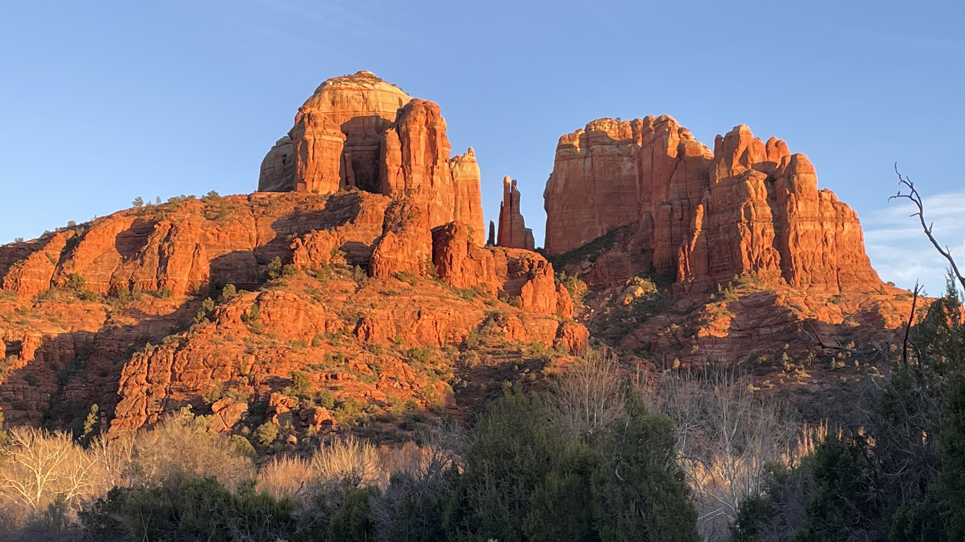
Welcome to GBC
May 28th, 2023
From the mountains to the prairies …
God Bless America!

Slide 2
O say, does that star-spangled banner yet wave …
O’er the land of the free,
and the home of the brave.

Slide 3
Ecclesiastes
God’s Timeless Wisdom for Today’s Headline Questions
(Preview of new Adult SS series)

Slide 4
The Background
Title - Ecclesiastes = preacher (Greek)
Author - son, King, wise (I Kgs 3:5-14)
Style - Wisdom Literature = skills for LIVING
Proverbs - living skillfully
Ecclesiastes - learning skillfully
Song of Solomon - loving skillfully

Slide 5
History of Interpretation
It has been called “a baffling book”
“alien among the other OT books”
“the most problematic of the whole Hebrew Bible”
“embarrassment to the Old Testament”

Slide 6
History of Interpretation
Difficulties – 3:18-20; 8:14; 9:2; 11:7,8
Jewish view – 1:1,12 “was” (banished)
Church Leaders – Jerome, Luther (skeptical)
Modern commentators - Agnostic
Approach as a genuine Book

Slide 7
The Book
Preface (1:2,3) – Statement of vanity
Body – Interwoven ideas and themes
vanity (38x) – temporary hypothesis while he is still “experimenting”
under the sun (29x) – navigating life without God

Slide 8
eat, drink, work (5x) – not hedonism, but simple existence (Eccl 2:24)
God (40x) – key clarifying insights (Eccl 3:10-14)
➢ before this passage “God” used 3x
➢ after this passage “God” used 33x

Slide 9
Ecclesiastes 3
(10) God uses life events as an exercise
(11) God gives men a longing for eternity
(12) There is joy & good in the process
(13) Good food and hard work are a gift
(14) God moves men from sight to faith, from why to Who (7:14; 8:17)

Slide 10
The BOOK of Ecclesiastes
Preface (1:2,3)
Body (12 chapters)
Conclusion (12:13,14) – Biblical ORTHODOXY

Slide 11
Eccl 12:13,14 Hear the conclusion of the whole matter: Fear God and keep His commandments, for this is mankind’s all. For God will bring every work into judgment, including every secret thing, whether good or evil.
Holy Spirit’s convicting work – Jn 16:8

Slide 12
The Bottomline
There is an appearance of Vanity
– Life does not make complete SENSE
Do embrace Eating, Working, Rejoicing – Life is meant to be ENJOYED
In it all, Fear God, Keep His Commands
– Live right, or ELSE

Slide 13
What Solomon came to Believe
Trusting God’s WISDOM makes life sensible
Trusting God’s GOODNESS makes life enjoyable
Trusting God’s JUSTICE makes life accountable

Slide 14
Hear the conclusion of the whole matter: Fear God and keep His commandments. This is the whole duty of man.

Slide 15
God’s Timeless Wisdom for Today’s Headline Questions
(New Adult SS series - 9:30 AM)
Living Beyond “If Only …”
Ecclesiastes 1 & 2

Slide 16
Welcome to GBC
May 28th, 2023
From the mountains to the prairies …
God Bless America!

